Slide 1
Operators
Course Leader:
Jishmi Jos Choondal

Slide 2
Objectives
At the end of this lecture, student will be able to
Explain operators in C
Use different types of operators

Slide 3
Contents
Operators
Types of operators
Operator precedence and associativity

Slide 4
Operators and Operands
Expressions consist of variables, operators and operands
a = b + 5
Operator: Symbol representing the operation
= and +
Operand: The data items (variables and constant) on which the operation is performed
a, b and 5
In case of + operator, operands are b and 5
In case of = operator, operands are a and the value of expression b+5

Slide 5
Operators – Types
Operators are classified based on number of operands as
Unary operators
Binary operators
Ternary operators

Slide 6
Assignment Operator
Assignment Operator =
a = 1;
1 is assigned to the variable a
Do not confuse with equality Operator ==

Slide 7
Arithmetic Operators
+ (addition)
a + 5
- (subtraction)
10 - b
* (multiplication)
a * c
/ (division) – Integer division
a / 5 Example: 10/5 = 2 and 35/2 = 17
% (modulo) - Remainder
a % 2 Example: 35%2 = 1

Slide 8
Compound Assignment Operators
Any statement of the form
variable = variable operator expression;
Can be written as
variable operator = expression;
+= ,-=, *=, /=, %=
a = a + 1;
can be written as
a += 1;

Slide 9
Increment and Decrement Operators
Unary operators for increment and decrement
++
a++; /*post increment - Increment value of a after this expression is evaluated*/
++a; /* pre increment - Increment value of a first and then evaluate the expression */
--
a--; /* post decrement - Decrement value of a after this expression is evaluated*/
--a; /* pre decrement - Decrement value of a first and then evaluate the expression */

Slide 10
Increment and Decrement Operators
Let a=5 and b=10
a++; //a becomes 6
b--; //b becomes 9
Example
int a,b,x=10,y=10;
a = x++; b = ++y;
printf("Value of a : %d",a);
printf("Value of b : %d",b);
Applicable only to variables
n++ //legal
(i+j)++ //illegal

Slide 11
Operators for Comparison
Relational Operators
< Less than
> Greater than
!= Not equal to
== Is it equal to? (Do not confuse with assignment operator =)
<= Less than or equal to
>= Greater than or equal to
Return
0 if false
any other number if true (generally 1 is returned on true)

Slide 12
Logical Operators
Used to take decisions
&& logical AND
if ((a<b) && (a<c)) {}
|| logical OR
if ((a<b) || (a<c)) {}
! logical NOT (unary operator)
if(! ((a<b) && (a<c))) {}
Return values
0 if false
1 if true (generally)

Slide 13
Question
How can we get the bits in memory?

Slide 14
Bitwise Operators
All data items are stored in computer’s memory as a sequence of bits(0s and 1s)
& Bitwise AND The bits in the result are set to 1 if the corresponding bits in the two operands are both 1 E.g., a&b;
| Bitwise OR The bits in the result are set to 1 if at least one of the corresponding bits in the two operands is 1 E.g., a|b;
Suppose a and b are 8-bit Integers
a has value 11010011
b has value 10101100
a&b ?
a|b ?

Slide 15
Bitwise Operators contd.
! Complement All 0 bits are set to 1 and all 1 bits are set to 0 E.g., c = !a;
^ Bitwise XOR The bits in the result are set to 1 if exactly one of the corresponding bits in the two operands is 1
E.g., c = a^b;
<< Left shift Shifts the bits of the first operand left by the number of bits specified by the second operand; fill from the right with 0 bits
E.g., a<<2;
>> Right Shift Shifts the bits of the first operand right by the number of bits specified by the second operand; the method of filling from the left is machine dependent
E.g., a>>2;

Slide 16
Conditional Operators
Ternary operator ?:
It has the general form
exp1 ? exp2 : exp3
exp1 is evaluated. If it is true, then exp2 is evaluated and becomes the value of the expression. If exp1 is false, then exp3 is evaluated, and that is the value
It takes 3 operands
Conditional expression
Conditional operators with the operands

Slide 17
Conditional Operators - Example
main(){
int num;
printf("Enter the Number : ");
scanf("%d",&num);
(num%2==0)?printf("Even"):printf("Odd");
}

Slide 18
sizeof() Operator
sizeof() operators returns the size (number of bytes) of the operand occupies
Must precede its operand
Operand may be a constant, a variable or a data type
Syntax
sizeof(operand);
Example
x=sizeof(int);
y=sizeof(x);

Slide 19
Operators on Floating Point Data Type
Operators that can be used on float and double data types
All Arithmetic operators except %(modulo) operator
All Comparison operators
Compound Assignment operators
sizeof() operator

Slide 20
Operator Precedence and Associativity
Consider
a = 1+2*3/4;
What is the value of a?

Slide 21
Operator Precedence and Associativity
To avoid confusion while reading, always use brackets
The computer always gives one answer only as it understands expressions based on precedence and associativity
Precedence
Which operator to evaluate first
Associativity
Which operand to evaluate first

Slide 22
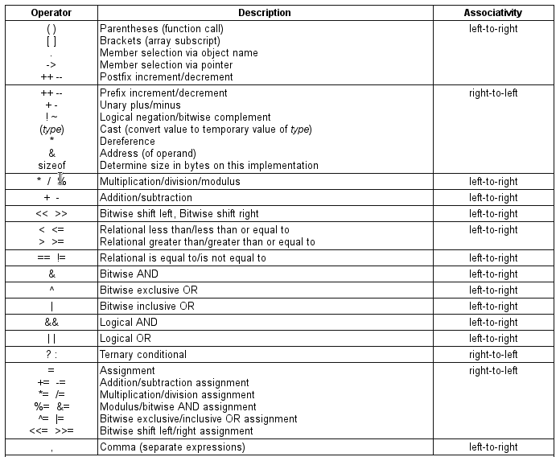
Operator Precedence and Associativity
C Operator Precedence Table (DiFranco 2011)

Slide 23
Example
Consider
a = 1+2*(3/4);
Treated equal to a = 1+(2*(3/4) );
3/4
2*0
1+0
1
a = 1
Refer to the operator precedence chart when writing expressions containing many operators
If you are uncertain about the order of evaluation in a complex expression, use parenthesis to group expressions

Slide 24
Summary
Expressions consist of
operators, the symbols that represent an operation
operands, the data items on which the operation is applied
There are many types of operators
Arithmetic
Comparison
Logical
Bitwise
Conditional, etc.,
Expressions are evaluated based on precedence and associativity of operators

Slide 25
References
DiFranco, D. (2011) C Operator Precedence Table, available at http://www.difranco.net/compsci/C_Operator_Precedence_Table.htm (accessed 28 July 2014).
Further Reading
Kernighan, B. W. and Richie, D. (1992) The C Programming Language. 2nd ed., New Delhi:PHI.

