Slide 1
Condition and Branching
Course Leader:
Jishmi Jos Choondal

Slide 2
Objectives
At the end of this lecture, student will be able to
explain branched program execution
Identify flow chart elements and connectors that are associated with branched control flow
Identify the constructs in algorithms that are associated with branched control flow
Apply branched control flow to solve a problem
Express branched control flow in C programming language

Slide 3
Contents
if, if-else and Nested if statements
switch-case statement

Slide 4

Conditions?
Why do we need them?

Slide 5
Types of Control Structures
All programs could be written in terms of following control structures
Selection structure/decision making statements
if statement (single selection)
if…else statement (double selection)
switch statement (multiple selection)
Repetition structure/loop statements
while statement
do…while statement
for statement

Slide 6
If Statement
We naturally take steps based on conditions
if I get CET seat then I pay Rs. X else if I am in Management quota then I pay Rs. Y
Programs are also written to use such conditions and branch to a block for execution
Logical condition is tested which results in either true or false

Slide 7
if Statement
In C programming language, this is done with if statement
Single selection statement
It selects or ignores a single action
Algorithm
if (<condition>) then
begin
<statements>
end

Slide 8
if Statement - Example
if (a%2==0){
printf(“Number is even”);
}
Is a % 2 = 0?
Y
Write ‘Number is even’
N

Slide 9
An Alternative Choice
What happens if there is an alternative?
if –else statement
double-selection statement
selects between two different actions
if (<condition>) then
begin
<statements>
end
else
begin
<statements>
end

Slide 10
if-else Statement – Example1
if (a>10){
printf(“a is greater than 10”);
}
else{
printf(“a is less than or equal to 10”);
}
Is a > 10?
Write ‘a greater than 10’
Y
N
Write ‘a less than/equal to 10’

Slide 11
if-else Statement – Example2
A
Absolute difference between 2 numbers
Start
temp = b - a
Read integers a, b
B
Is a > b ?
Y
temp = a - b
Print “absolute difference is”, temp
N
B
A
Stop

Slide 12
if-else Statement – Example2 contd.
Absolute difference between 2 numbers
Algorithm absoluteDifference (a, b : Integer)
var temp: Integer;
begin
if ( a > b ) then
begin
temp := a - b;
end
else
begin
temp := b - a;
end
writeln (‘The absolute difference is ’, temp);
end

Slide 13
Multiple Choices – else if
What happens if there are multiple alternatives?
else if ladder
if (a>10){
printf(“a is greater than 10”);
}
else if (a==10){
printf(“a is equal to 10”);
}
else{
printf(“a is less than 10”);
}
Multiple ‘else if’ conditions can be appended to an if statement

Slide 14
else if Ladder - Flow Chart
Is a > 10?
Y
Write ‘a greater than 10’
N
Is a = 10?
Y
Write ‘a equals 10’
N
Write ‘a less than 10’

Slide 15
Multiple Choices – nested if
Nested if statement
if (a>b){
if(a>c){
printf(“a is greater than b and c”);
}
else{
printf(“c is greater than a and b”);
}
}
else{
printf(“hi..”);
}

Slide 16
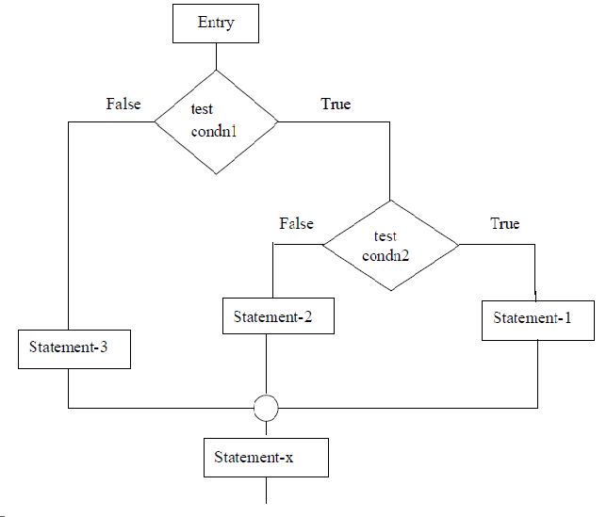
Nested if - Flowchart

Slide 17
Many Choices
What happens if there are too many alternatives?
switch-case statement
Multiple-selection statement
it selects among many different actions
Consists of a series of case labels, and an optional default case
Can be in any order

Slide 18
switch-case Statement
switch (a){
case 1: printf(“a is 1”);
break;
case 2: printf(“a is 2”);
break;
case 3: printf(“a is 3”);
break;
…..
default: printf(“a is not matching \n”);
}
Notice break?
It stops execution and makes the control flow to move to end of block
What is default?
Break statement is optional for default
Works only on enum, int and char values

Slide 19
goto Statement
Unconditional control statement
Transfer the control from one point to another point in the program
A branching statement that requires a label (valid identifier)
Syntax
goto label;

Slide 20
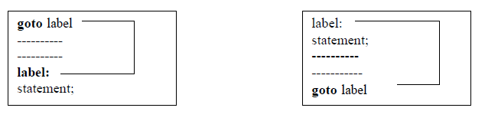
goto Statement contd.
Label can be placed anywhere in the program

Slide 21
Summary
Conditional branching alters the control flow based on a condition
Control structures that branch based on a condition are
If Statements: If, If-Else and Nested If
Switch-Case Statement
All such control structures operate on logical or comparison operators that give true or false values
Goto statement is an unconditional branch statement

Slide 22
Further Reading
Dromey, R. (1982) How To Solve it By Computer. Noida: Pearson Education Inc.
Kernighan, B. W. and Richie, D. (1992) The C Programming Language. 2nd ed., New Delhi:PHI.

