Slide 1
Iteration
Course Leader:
Jishmi Jos Choondal

Slide 2
Objectives
At the end of this lecture, student will be able to
Identify the constructs in algorithms that are associated with for, while and do-while control flow construct
Express for, while and do-while control flow constructs in C programming language

Slide 3
Contents
for Looping Construct
while Looping Construct
do-while Looping Constructs

Slide 4

A Question
Can you write logic to calculate average of n numbers?

Slide 5
Loop Control Statements
There are always problems whose solution requires doing same steps for a given number of steps
Looping is also called a repetitive or an iterative control mechanism
For any looping mechanism, following steps are included
Initialization
Decision
Updating

Slide 6
Types of Loop Control Statements
C provides 3 types of loop control structures
for statement
while statement
do-while statement

Slide 7
for Statement
for (expression1; expression2; expression3)
{
//statements
}
Initialisation of loop variable
Condition that must be true to continue loop
Increment/decrememt Operation to do at end of loop
Note that no semi colon after the for statement

Slide 8
for Statement contd.
for(j=0;j<25;j++); //loop without no body
The three expressions in the for statement are optional
One may omit expression1 if the control variable is initialized elsewhere in the program
for(;j<25;j++)
If expression2 is omitted, C assumes that the condition is true, thus creating an infinite loop
for(j=0;;j++)
expression3 may be omitted if the increment is calculated by statements in the body of the for statement or if no increment is needed
for(j=0;j<25;)

Slide 9
for Statement - Examples
Vary the control variable from 1 to 100 in increments of 1
for ( i = 1; i <= 100; i++ )
Vary the control variable from 100 to 1 in increments of -1 (decrements of 1)
for ( i = 100; i >= 1; i-- )
Vary the control variable from 7 to 77 in steps of 7
for ( i = 7; i <= 77; i += 7 )
Multiple initialisation and multiple updates
for ( i = 0, j = 0; i <= 10; i ++, j++ )

Slide 10
for Statement - Algorithms
for <identifier> in <initial value> to <final value>, step <increment> do
begin
…
end
Examples
for i in 0 to n, step 1 do
begin
…
end

Slide 11
while and do-while Statements
To loop based on conditions, while and do-while control flow statements are used
While loops are used to loop only when the condition is true
Do-While loops are used to loop at least once and then only when the condition is true

Slide 12
while Statement
In C programming language, while statement can be programmed as follows:
printf(“Please enter the number of numbers(n): ”);
scanf(“%d”,&n);
i = 0;
while (i < n){
printf(“%d ”, i );
i++;
} //note that no semi colon

Slide 13
do-while Statement
Tests the loop-continuation condition after the loop body is performed
The loop body will be executed at least once
Format
do {
statement
} while ( condition );
//note the semi colon after the while
statement
do
statement
while(condition );
Correct, but confusing

Slide 14
do-while - Example
In C programming language, do-while statement can be programmed as follows:
printf(“Please enter the number of numbers(n): ” );
scanf(“%d”,&n);
i = 0;
do{
printf(“%d ”, i);
i++;
}while (i < n);

Slide 15
Algorithm for while and do-while
while Statement
do-while statement
while <condition>
begin
…
end
Example
while (a[i] != n)
begin
…
end
do
…
while <condition>
Example
do
…
while (a[i] != n)

Slide 16
for, while and do-while
for statement
for (expression1; exprssion2; expression3)
statement
while statement
expression1;
while(exprssion2){
statement
expression3;
}
do-while statement
expression1;
do{
Statement
expression3;
} while(exprssion2);

Slide 17
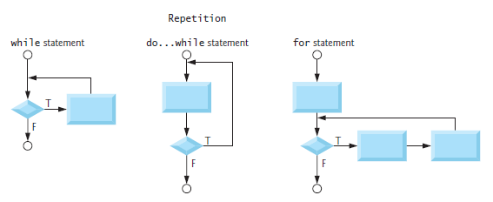
for, while and do-while - Flowcharts

Slide 18
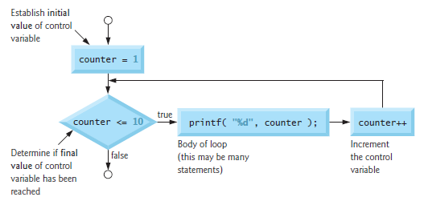
for – Flow chart - Example

Slide 19
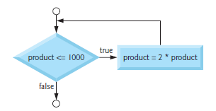
while - Flow Chart- Example
product= 2;
while ( product <= 100 ) {
product = 2 * product;
} /* end while */
What is the final value of product?

Slide 20
Jumps in Loops
C permits a jump from one statement to another within a loop as well as the jump out of a loop
Jumping out of a Loop
An early exit from a loop can be accomplished by using the break statement or the goto statement
When the break statement is encountered inside a loop, the loop is immediately exited and the program continues with the statement immediately following the loop
break will exit only a single loop

Slide 21
Jumps in Loops contd.
Skipping a part of a Loop
continue;
skip the following statements and continue with the next iteration
Example
while (i<=10){
if(i==8){
continue;
}
printf(“%d”,i);
}

Slide 22
Break and Continue
int main( void ){
int x;
for ( x = 1; x <= 10; x++ ) {
if ( x == 5 )
break;
printf( "%d ", x );
}
printf( "\nBroke out of loop at x == %d\n", x );
return 0;
}
int main( void ){
int x;
for ( x = 1; x <= 10; x++ ) {
if ( x == 5 )
continue; printf( "%d ", x );
}
printf( "\nUsed continue to skip printing the value 5\n" );
return 0;
}

Slide 23
Summary
Looping constructs alter control flow to repeat a set of instructions
A loop repeats a block of statements for a predefined number of times
Loop control structures in C are
for
while
do-while
All such control structures operate on logical or comparison operators that give true or false values

Slide 24
Further Reading
Dromey, R. (1982) How To Solve it By Computer. Noida: Pearson Education Inc.
Kernighan, B. W. and Richie, D. (1992) The C Programming Language. 2nd ed., New Delhi:PHI.

