Slide 1
Arrays
Course Leader:
Jishmi Jos Choondal

Slide 2
Objectives
At the end of this lecture, student will be able to
Express logic using one-dimensional array variables
Express one-dimensional arrays and multi-dimensional arrays in C programming language

Slide 3
Contents
Derived Data Structures – Arrays
Two dimensional arrays
Multidimensional arrays

Slide 4
Derived Data Type
Derived Data Type
Heterogeneous (Structures)
Homogeneous
(Arrays)

Slide 5
Arrays
Collection of elements of same data type
All these elements are stored in consecutive memory locations
Values can repeat – It is not a set
The collection is represented by one name
Each individual data in the array is referenced by a subscript or index (positive integer constant or expression) enclosed in a pair of square brackets []

Slide 6
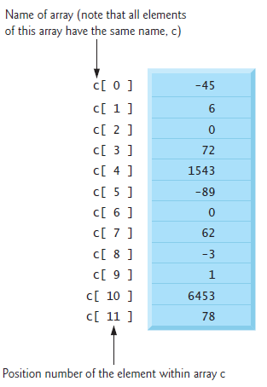
Arrays
Array contains 12 elements
The first element in every array is the zeroth element
first element of array c is referred to as c[0]
second element of array c is referred to as c[1]
In general, the ith element of array c is referred to as c[i – 1]

Slide 7
Defining Arrays
Arrays occupy space in memory
Programmer specify the type of each element and the number of elements required by each array
Syntax
<data type> <identifier> [<constant size>];
Example
int numArray[20]; /*tell the computer to reserve 20 spaces. Elements are from numArray[0] to numArray[19]*/
or
#define N 20
int numArray[N];

Slide 8
Array Initialisation
Individual elements of the array can be initialised
Initial values must be constants, never be variables or function calls
Example
int numArray[4]= {10,20,30,40};
/*4 is size. numArray[0]=10,… numArray[3]=40*/
or
int numArray[4];
numArray[0]=10;
numArray[1]=20;

Slide 9
Array Initialisation contd.
The array definition
int n[5] = { 32, 27, 64, 18, 95, 14 };
causes a syntax error because there are six initializers and only five array elements
If the array size is omitted from a definition with an initializer list, the number of elements in the array will be the number of elements in the initializer list
For example,
int n[] = { 1, 2, 3, 4, 5 };
would create a five-element array

Slide 10
Address of the Array Elements
Array name is the same as the address of the array’s first element
int array[5]; /* define an array of size 5 */
printf( " array = %p \n &array[0] = %p \n &array = %p\n",
array, &array[ 0 ], &array );
Output : array = 0012FF78
&array[0] = 0012FF78
&array = 0012FF78
%p conversion specifier
a special conversion specifier for printing addresses
Normally outputs addresses as hexadecimal numbers

Slide 11
Algorithms
Arrays
<identifier>: array [<initial value> .. <final value>] of <Primitive data type>;
<identifier>[<index value>]
Examples
numArray: array [0 .. n] of Integer;
numArray[10] := 20;

Slide 12
Algorithm - Reading an Array
Algorithm sigmaN (numArray: Array [0 .. N] of Integer):Integer
var i, temp: Integer; {temp is the return value}
begin
for i in 0 to N, step 1 do
begin
writeln (‘Please enter the number at index ’, i, ‘:’);
readln (numArray[i]);
end
end

Slide 13
Algorithm – Sum of N numbers
Algorithm sigmaN (numArray: Array [0 .. N] of Integer):Integer
var i, temp: Integer; {temp is the return value}
Begin
temp := 0;
for i in 0 to n, step 1 do
begin
temp := temp + numArray[i];
end
stop

Slide 14
Flow Charts
A
Summation of N numbers
temp = temp + numArray [i]
Start
Read N elements in to numArray, an array of N Integers
i := i + 1
Integer i :=0, temp := 0
C
B
Is i > N?
Y
Print “Sum of N numbers is”, temp
C
B
N
Stop
A

Slide 15
Two-Dimensional Arrays
The elements of a two-dimensional array are arranged in rows and columns
In general, an array with m rows and n columns is called an m-by-n array

Slide 16
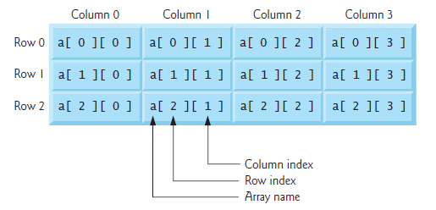
Two-Dimensional Arrays
The array contains three rows and four columns, so it’s said to be a 3-by-4 array

Slide 17
Accessing Two-Dimensional Array Elements
Array declaration
<data type> <identifier> [<row size>] [<column size>];
int matrix[2][3]; //array name is matrix with 2 rows and 3 columns
An element in 2-dimensional array is accessed by using two subscripts, i.e., row index and column index of the array
Example: int val = a[2][3];
// take 4th element from the 3rd row of the array

Slide 18
Initializing Two-Dimensional Arrays
Multidimensional arrays may be initialized by specifying bracketed values for each row
An array with 3 rows and each row has 4 columns
int a[3][4] = { {0, 1, 2, 3} , {4, 5, 6, 7} , {8, 9, 10, 11}};
is equivalent to
int a[3][4] = {0,1,2,3,4,5,6,7,8,9,10,11};

Slide 19
Initializing Two-Dimensional Arrays contd.
If there are not enough initializers for a given row, the remaining elements of that row are initialized to 0
int b[2][2] = { { 1 }, { 3, 4 } };
would initialize
b[0][0] to 1
b[0][1] to 0
b[1][0] to 3
b[1][1] to 4

Slide 20
Multi-dimensional Arrays
General form of a multidimensional array declaration:
type name[size1][size2]...[sizeN];
For example, the following declaration creates a three dimensional 5 . 10 . 4 integer array:
int threedim[5][10][4];

Slide 21
Multidimensional Arrays contd.
Array declarations read right-to-left
int a[10][3][2];
“an array of ten arrays of three arrays of two ints”
In memory
3
3
3
...
2
2
2
2
2
2
2
2
2
10

Slide 22
Summary
Array is a collection of elements of same data type
All these elements are stored in consecutive memory locations
Array name is the same as the address of the array’s first element
The elements of a two-dimensional array are arranged in rows and columns

Slide 23
Further Reading
Dromey, R. (1982) How To Solve it By Computer. Noida: Pearson Education Inc.
Kernighan, B. W. and Richie, D. (1992) The C Programming Language. 2nd ed., New Delhi:PHI.

