Slide 1
Functions
Course Leader:
Jishmi Jos Choondal

Slide 2
Objectives
At the end of this lecture, student will be able to
Use modular programming using functions and multiple files
Identify flow chart elements and connectors that are associated with functions
Identify the constructs in algorithms that are associated with functions
Apply functions to solve a problem
Express functions in C programming language

Slide 3
Contents
Functions
Standard library functions
Header files

Slide 4
Question
Simple projects in C programming language have thousands of lines of code. How do programmers manage writing and maintaining such code?

Slide 5
Solution
Divide and conquer
Break large computing tasks into smaller ones
Construct a program from smaller pieces of code
Each piece can be maintained independently
Enable people to build on what others have done instead of starting from scratch

Slide 6
Modules in C
Functions
Modules in C
A set of instructions to carry out a particular task
Advantages
Reduce program development time
Reusability
Manageability - Debugging is easier
Avoid repeating code in a program

Slide 7
Types of C functions
Library function/Built-in functions
C standard library has many functions
E.g., printf(), scanf(),sqrt(), etc.,
User defined function/ Programmer defined function
Functions written by the user

Slide 8
Programming in C
When programming in C, you will be using
C standard library functions
Functions you create yourself
Functions other people have created and made available to you

Slide 9
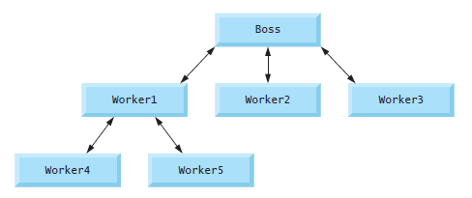
Functions
Function declaration
Function call
Function definition
Consider the hierarchical
form of management

Slide 10
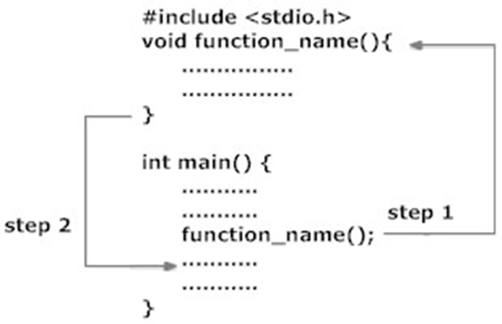
User Defined Function

Slide 11
Function Prototype
Helps compiler know that such a function exists
Function prototype tells the compiler
the type of data returned by the function
the number of parameters the function expects to receive
the types of the parameters
the order in which these parameters are expected
Example
int product(int); //Takes 1 integer and returns an integer
int product(int a) ; //compiler ignores the names

Slide 12
Function Definition
Writing an actual code for the function which performs a specific task
A function cannot be defined inside another function
Function definition format
<return value type> function-name(<parameter list> ){ statements }
Example
int product(int n){
int result;
result=n *10;
return result;
}

Slide 13
Function Definition contd.
Return-value-type: data type of the result
void - function returns nothing
Default - int
Returning control
If nothing returned
return;
or, until end of function block
If something returned
return expression;

Slide 14
Function Calls
Invoking functions
Function call includes
function name
arguments (data)
Function returns results
Example: value=product(x);
The compiler uses function prototype to validate function calls
A function call that does not match the function prototype is a syntax error
Need not worry about how operations are performed
Procedural abstraction

Slide 15
Sample Program
int sum(int,int); //function declaration
int main(int argc, char** argv) {
int a,b,c;
printf("Enter the numbers:");
scanf("%d%d",&a,&b);
c=sum(a,b); //function call, a and b are arguments
printf("\nSum is %d",c);
return (EXIT_SUCCESS);
}
int sum(int x,int y) { //function definition, x and y are parameters
int z=x+y;
return z;
}

Slide 16
Category of Functions - Demo
Functions can be categorized into
No arguments, no return value
Arguments , no return value
No arguments, return value
Arguments, return value

Slide 17
Headers
Each standard library has a corresponding header
It contains
the function prototypes for all the functions in that library
definitions of various data types and constants needed by those functions
You can create custom headers
Programmer-defined headers should also use the .h filename extension
A programmer-defined header can be included by using the #include preprocessor directive

Slide 18
Some Standard Library Headers
Header | Explanation
<assert.h> | Contains macros and information for adding diagnostics that aid program debugging
<float.h> | Contains the floating-point size limits of the system
<limits.h> | Contains the integral size limits of the system
<math.h> | Contains function prototypes for math library functions
<stdio.h> | Contains function prototypes for the standard input/output library functions, and information used by them
<stdlib.h> | Contains function prototypes for conversions of numbers to text and text to numbers, memory allocation, random numbers, and other utility functions
<string.h> | Contains function prototypes for string-processing functions
<time.h> | Contains function prototypes and types for manipulating the time and date

Slide 19
Math Library functions
Allow you to perform certain common mathematical calculations
Include the math header by using the preprocessor directive #include <math.h>
Example, a programmer desiring to calculate and print the square root of 900.0 might write
printf( "%.2f", sqrt( 900.0));
When this statement executes, the math library function sqrt is called
The number 900.0 is the argument of the sqrt function
The preceding statement would print 30.00

Slide 20
Flow Charts and Algorithms
Predefined Process
Examples
Use function call
For each function, define separate algorithm
Examples
add(a,b);
Algorithm add (a,b:Integer):Integer
var c:Integer; {The result}
Begin
c := a+b;
End
power(10,num)

Slide 21
Summary
Functions are used to increase reusability and maintainability of C code
Functions focus on solving one aspect
Functions take arguments and copy values to local parameters
All variables declared within a function are local to that function
Functions can be declared if use of function appears before the function definition

Slide 22
Further Reading
Kernighan, B. W. and Richie, D. (1992) The C Programming Language. 2nd ed., New Delhi:PHI.

