Slide 1
Recursion
Course Leader:
Jishmi Jos Choondal

Slide 2
Objectives
At the end of this lecture, student will be able to
apply the concept of recursion
identify recursion in a C programming language
use macro programming constructs in the C programming language

Slide 3
Contents
Recursion
C preprocessor

Slide 4
Recursion
C functions can be used recursively
A function may call itself either directly or indirectly
When a function calls itself recursively, each invocation gets a fresh set of all the automatic variables, independent of the previous step
f1
f1
f2
…
fn

Slide 5
Factorial: In Mathematics
1 if N = 0
N! =
N*(N-1)! if N > 0
Example using Definition
4! = 4 * 3!
= 4 * 3 * 2!
= 4 * 3 * 2 * 1!
= 4 * 3 * 2 * 1 * 0!
= 4 * 3 * 2 * 1 * 1

Slide 6
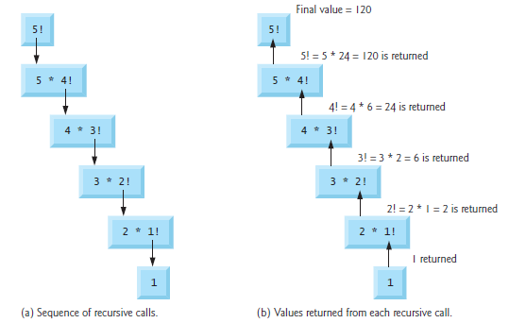
Recursion - Example

Slide 7
Recursive Function
Determine the base case(s)
the one for which you know the answer
There must be a terminating condition
Determine the general case(s)
the one where the problem is expressed as a smaller version of itself

Slide 8
Factorial Using Recursion
Algorithm fact(x :Integer):Integer
var xFactorial :Integer; {The factorial}
begin
{assert x=>0}
If (x <= 1) then
begin
xFactorial := 1;
end
else {if it is greater than 1}
begin
xFactorial := x * fact ( x-1 );
end
end

Slide 9
Equivalence with Iteration
All recursive functions have iterative equivalents
Example:
Algorithm fact(x :integer):Integer
Var iLoop, xFactorial :Integer; {The factorial}
begin
{assert x=>0}
xFactorial := 1;
for iLoop in 1 to n, step 1 do
begin
xFactorial := xFactorial * iLoop;
end
end

Slide 10
Recursion vs. Iteration
Both Recursion and Iteration is
Based on a control structure
Iteration uses a repetition structure
recursion uses a selection structure
Involve repetition
Iteration explicitly uses a repetition structure
recursion achieves repetition through repeated function calls
Involve a termination test
Iteration terminates when the loop-continuation condition fails
Recursion terminates when a base case is recognized

Slide 11
Recursion vs. Iteration contd.
Both iteration and recursion can occur infinitely
An infinite loop occurs with iteration if the loop-continuation test never becomes false
infinite recursion occurs if the recursion step does not reduce the problem each time in a manner that converges on the base case

Slide 12
Why Avoid Recursion?
What happens when the value of n increases?
How many variables will be there in memory?

Slide 13
Merits and Demerits of Recursion
Merits
Reduce unnecessary calling of function
Easier to write and understand than the non-recursive equivalent
Demerits
Take more time compared to iterative methods
A stack of the values being processed must be maintained
Consume additional memory
Recursive solution is always logical and it is very difficult to trace

Slide 14
C Preprocessor
C provides certain language facilities by means of a preprocessor
A macroprocessor program that processes the source program before it is compiled
Source Program -> C Preprocessor -> Compiler -> Object Prorgam
Before the source code passes through the compiler, it is examined by the preprocessor for any preprocessor directives

Slide 15
Preprocessor Directives
Preprocessor directives are placed in the source program before the main line
Statements which begin with # symbol
#include
#define
Three types
Macro substitution directives
File inclusion directives
Conditional compilation directives

Slide 16
Macro Substitution
To replace a token by an arbitrary sequence of characters
A definition has the form
# define name replacement_text
Possible to define macro with arguments
E.g., define a macro called max
#define max(A,B) ((A)>(B)? (A) : (B))
The line
X=max(p+q, r+s); will be replaced by the line
X=((p+q)>(r+s) ? (p+q) : (r+s));

Slide 17
File Inclusion
To include the contents of the file during compilation
Avoids rewriting those functions or macro definitions
#include “filename”
Searching of the file typically begins where the source program was found
#include <filename>
Searching follows an implementation-defined rule to find the rule

Slide 18
Summary
Functions can call themselves - recursion
Recursive programs need memory and hence are discouraged
All recursive programs have iterative equivalents
Preprocessor directives are placed in the source program before the main line

Slide 19
Further Reading
Kernighan, B. W. and Richie, D. (1992) The C Programming Language. 2nd ed., New Delhi:PHI.

