Slide 1
Files
Course Leader:
Jishmi Jos Choondal

Slide 2
Objectives
At the end of this lecture, student will be able to
Use standard file operations
Explain user defined data types

Slide 3
Contents
File I/O in C
Bit fields
User defined Data types

Slide 4
Files
Many real-life problems involve large volumes of data and in such situations, the console oriented I/O operations pose two major problems
It becomes cumbersome and time consuming to handle large volumes of data through terminals
The entire data is lost when either the program is terminated or the computer is turned-off
Concept of files to store data
A more flexible approach where data can be stored on the disk and read whenever necessary, without destroying the data

Slide 5
Data Hierarchy
To build electronic devices that can assume two stable states—0 and 1
Bit
Short for “binary digit”
a digit that can assume one of two values
Byte
A pattern of 1s and 0s
Characters(digits, letters and special symbols) are composed of bits
Field
A group of characters that conveys meaning

Slide 6
Data Hierarchy contd.
A record (i.e., a struct in C)
Composed of several fields
A file
A a group of related records
Record key
To facilitate the retrieval of specific records from a file
Database
A group of related files

Slide 7
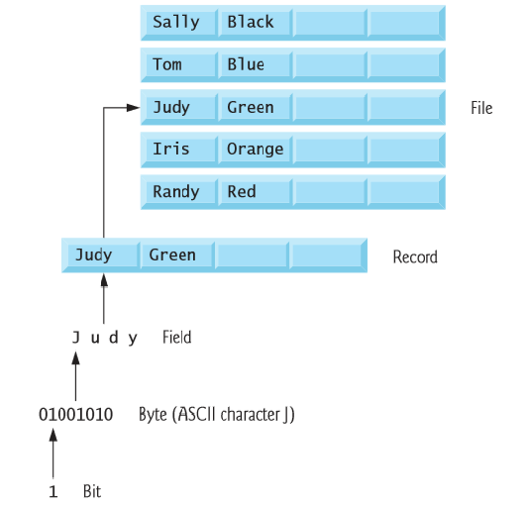
Data Hierarchy contd.

Slide 8

Files and Streams
C views each file simply as a sequential stream of bytes
Each file ends either with an end-of-file marker
When a file is opened, a stream is associated with the file
Three files and their associated streams are automatically opened when program execution begins
standard input, standard output, standard error
Streams provide communication channels between files and programs

Slide 9
Types of Files
Sequential File
Records are typically stored in order by the record key field
Random access file
individual records are normally fixed in length and may be accessed directly (and thus quickly) without searching through other records

Slide 10
File I/O functions
Prototype | Description
FILE | Data type (a structure) to store file information permanently
FILE *fopen(const char *path, const char *mode ) | Opens a file and returns FILE pointer. Path is the path to the file. Mode can be combinations of “r”, “w” or “a”. Other possibilities include “+”.
int fclose(file *FP) | Closes a file that was already opened in the program
int fscanf(FILE *stream, const char *format,…) | Similar to scanf for file I/O
int fprintf(FILE *stream, const char *format,…) | Similar to printf for file I/O

Slide 11
Opening and Closing a File
int main(int argc, char** argv) {
FILE *fp;
fp = fopen("data1.txt", "w");
if (fp == NULL) {
printf("File does not exist, please check!\n");
}
fclose(fp);
return (EXIT_SUCCESS);
}

Slide 12
File Opening Modes
File Mode Description
r Open a text file for reading
w Create a text file for writing, if it exists, it is overwritten
a Open a text file and append text to the end of the file
r+ Open a text file both in reading and writing mode
rb Open a binary file for reading
wb Create a binary file for writing, if it exists, it is overwritten
ab Open a binary file and append data to the end of the file

Slide 13
Input/Output Operations on Files
C provides several different functions for reading/writing
getc() – read a character from file
putc() – write a character to file
fprintf() – write set of data values to file
fscanf() – read set of data values from file
getw() – read integer from file
putw() – write integer to file

Slide 14
getc() and putc()
int main(int argc, char** argv) {
FILE *fp, char ch;
fp=fopen("datum.txt","w");
printf("\nEnter data");
while((ch=getchar())!=EOF)
putc(ch,fp);
fclose(fp);
fp=fopen("datum.txt","r");
if(fp==NULL)
printf("\nFile does not exist");
else{
while((ch=getc(fp))!=EOF)
printf("%c",ch);
}
fclose(fp);
return (EXIT_SUCCESS);
}

Slide 15
fprintf() and fscanf()
fp=fopen("reads.txt","r");
if(fp==NULL)
printf("\nFile does not exist");
else{
printf("\nDetails are");
do{
fscanf(fp,"%d%s",&days,names);
printf("%d %s",days,names);
}while(!feof(fp));
}
fclose(fp);
return (EXIT_SUCCESS); }
int main(int argc, char** argv) {
FILE *fp;
int day,days;
char name[10],names[10];
fp=fopen("reads.txt","w");
printf("\nEnter data");
scanf("%d%s",&day,name); fprintf(fp,"%d%s",day,name);
fclose(fp);

Slide 16
Writing to a Text File
void main() {
int num; FILE *fptr;
fptr = fopen("C:\\program.txt","w");
if(fptr == NULL) {
printf("Error!");
}
printf("Enter num: ");
scanf("%d",&num);
fprintf(fptr,"%d",num);
fclose(fptr);
}

Slide 17
Reading from a Text File
void main() {
int num;
FILE *fptr;
fptr = fopen("C:\\program.txt",“r");
if(fptr == NULL) {
printf("Error!");
}
fscanf(fptr,"%d", &num);
printf("Value of n=%d", num);
fclose(fptr);
}

Slide 18
Errors that occur during I/O
Typical errors that occur
trying to read beyond end-of-file
trying to use a file that has not been opened
perform operation on file not permitted by ‘fopen’ mode
open file with invalid filename
write to write-protected file

Slide 19
Bit Fields
Member of a structure whose width(in bits) has been specified
Enable better memory utilization
Only for int or unsigned
Declaring bit fields - Example
struct myMacHeader{
unsigned int dest: 48; /* 48 is width in bits*/
unsigned int src: 48;;
unsigned int seq: 16;
unsigned char * data;
};

Slide 20
Bit Fields
Unnamed bit field
Field used as padding (empty area) in the structure
Nothing may be stored in the bits
struct myStruct{
unsigned a : 13;
unsigned : 8; /*reserved, not used*/
unsigned b : 7;
}

Slide 21
User defined Data Type
C allows user to define an identifier that would represent an existing data type
typedef
The general form is
typedef type identifier;
Example
typedef int units;
typedef float marks;

Slide 22
Enumerated Data Type
User defined data type
Short for Enumeration
Keyword enum
A set of integer enumeration constants represented by identifiers
Enumeration constants - like symbolic constants whose values automatically set
Values start at 0 and are incremented by 1
Values can be set explicitly with “=“
Need unique constant names

Slide 23
ENUM
Declare variables as normal
Enumeration variables can only assume their enumeration constant values not int values
enum DAYS {SUN, MON, TUE, WED, THU, FRI, SAT};
Starts at 0, increments by 1
enum DAYS {SUN= 1, MON, TUE, WED, THU, FRI, SAT};
Starts at 1, increments by 1

Slide 24
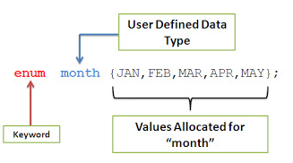
ENUM - Example

Slide 25
Summary
Files can be used to store data
C standard library provides functions to handle files
Bitfields help specify member width in bits and can be used only on int and unsigned int members
User defined Data types are used to define an identifier that would represent an existing data type
Enumerated data type helps create more readable code by assigning integer constants to enumerated values

Slide 26
Further Reading
Kernighan, B. W. and Richie, D. (1992) The C Programming Language. 2nd ed., New Delhi:PHI.

