Slide 1

Paper ID – MMCITRE2021055 Diagnosis of Intracranial Tumor via Selective CNN Data Modelling Technique
Author Name :- Vinayak Singh, Harshvardhan GM, Mahendra Kumar Gourisaria, Siddharth Swarup Rautaray and Manjusha Pandey

Slide 2
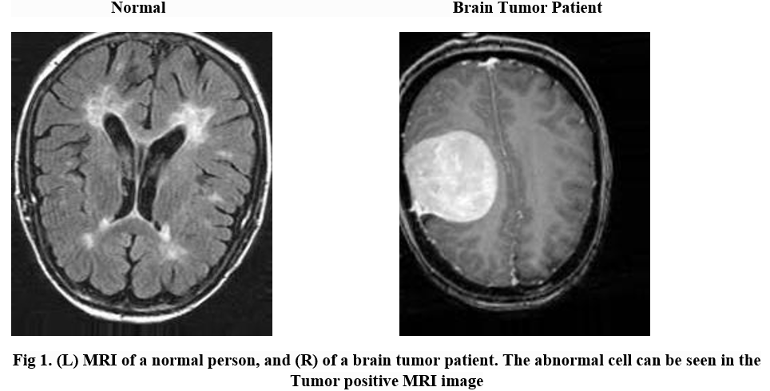
Problem Statement
Detection of Brain Tumor via selective CNN data modelling technique and classifying into tumorous and non- tumorous categories.

Slide 3
Abstract
A brain tumor is a condition in which there is a development of abnormal cells in our brain.
Brain tumor diagnosis needs high accuracy or else a minor error in diagnosis can cause a huge blunder.
Experimental evaluations of the best architecture show that a maximum objective function value of 1.84, a validation accuracy score of 0.8275 is achieved & an AUC of 0.737 in the ROC curve

Slide 4
Introduction
A major increase in mortality among children and adults is due to the brain tumor. A brain tumor is a condition in which there is a development of abnormal cells in our brain.
Tumor can be classified into two categories :- Benign and Malignant.
In the U.S., 29000 peoples were diagnosed out of which nearly 13000 were suffering from primary malignant brain tumors each year which was stated by NBTF. One-quarter of all cancer death in children is caused by the brain tumor.
MRI is a medical image processing that assists the medical diagnoser to diagnose the tumor.
In this paper, we discuss performance metrics achieved by different architectures configurations in which convolution neural networks (CNN) & artificial neural networks (ANN) are used in training the model.

Slide 5
Author Names & Year | Techniques | Accuracy
1.) Seetha et al. (2018) | CNN architectures, Gradient descent | 97.5%
2.)Ghasemi et al. (2020) | GAN, CNN architectures | 93.01% and 95.6%
3.) Pashaei et al. (2018) | Extreme learning machines, CNN architectures | 81%
4.) Afshar et al. (2019) | CapsNet | 90.89%
5.) Mohsel et al. (2018) | FCM,DWT,SMO,LDA and K-NN | 96.97
Related Work
Disadvantages -: Small dataset, Poor execution and Unbiased models.

Slide 6
Methods and Data
Methods use for classifying whether a person is suffering from a tumor or not.
Techniques Used :- Image Augmentation , ANN and CNN
Dataset :- The MRI images for Brain Tumor Detection of patients were collected from Kaggle by Navoneel Chakrabarty.
No. of images -: 253 images
No. of images after Image Augmentation :- 2225 images
 | Brain Tumor Patient | Normal
Training | 1037 | 781
Testing | 234 | 137
Total | 1307 | 918

Slide 7
Methods and Data
15 different CNN and ANN architectures with regularization were introduced for training of our model.
We had various parameters such as the number of artificial layers and convolutional layers, regularization parameters like L1, L2, Batch normalization and Dropout, image input sizes, kernel sizes, pooling matrix sizes, and analogize all the architectures on a basis of maximum accuracy achieved during training and least cross-entropy loss encountered during training.
 | Minimum | Maximum
Maximum Validation Accuracy | 0.7224 | 0.8672
Least Validation Cross Entropy Loss | 0.3281 | 0.5651
Training Time | 106 | 220

Slide 8
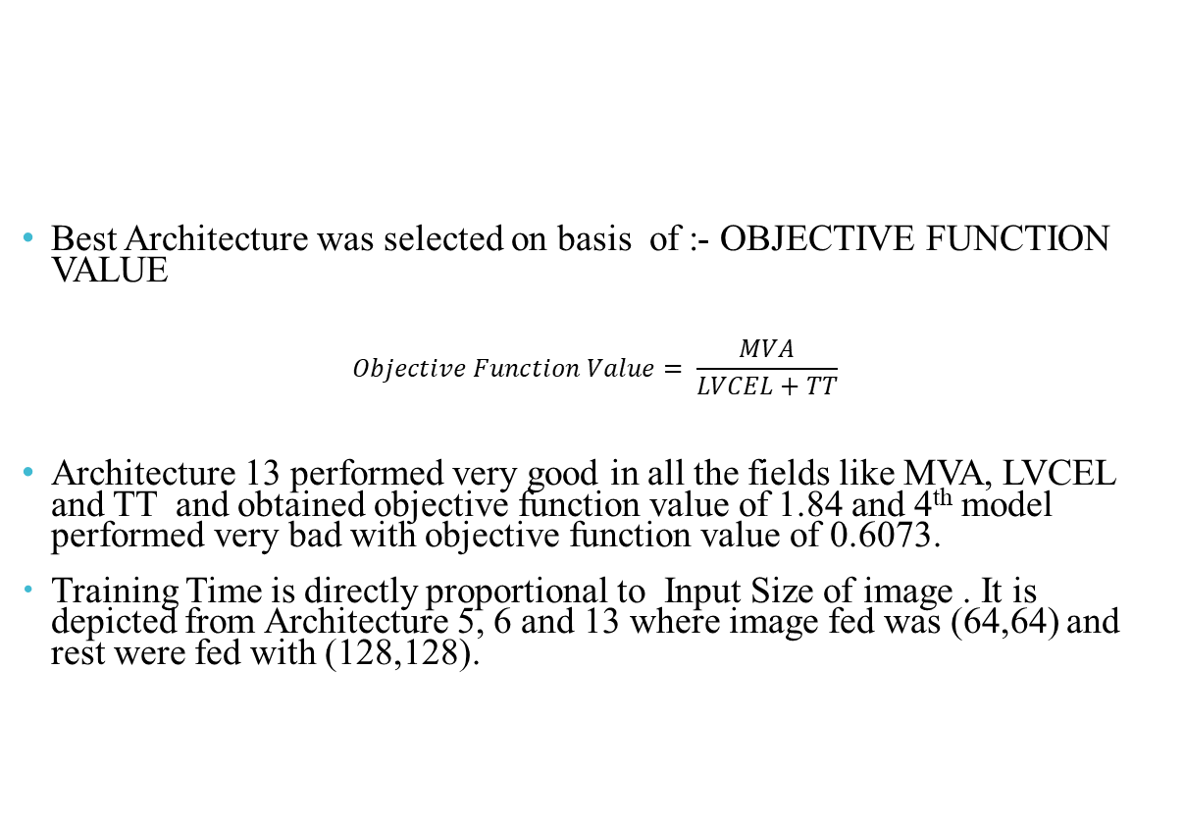
Results
Best Architecture was selected on basis of :- OBJECTIVE FUNCTION VALUE
$$Objective Function Value= \frac{MVA}{LVCEL+TT}$$
Architecture 13 performed very good in all the fields like MVA, LVCEL and TT and obtained objective function value of 1.84 and 4th model performed very bad with objective function value of 0.6073.
Training Time is directly proportional to Input Size of image . It is depicted from Architecture 5, 6 and 13 where image fed was (64,64) and rest were fed with (128,128).

Slide 9
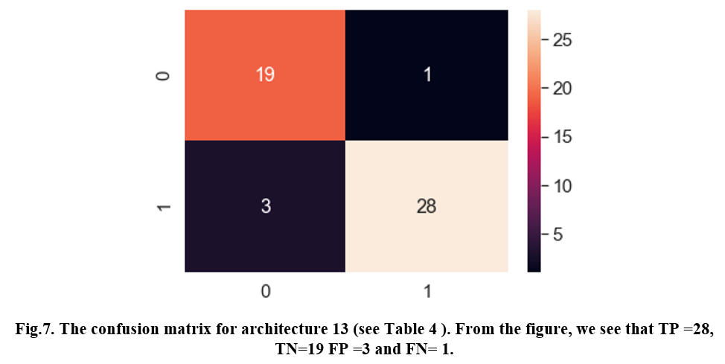
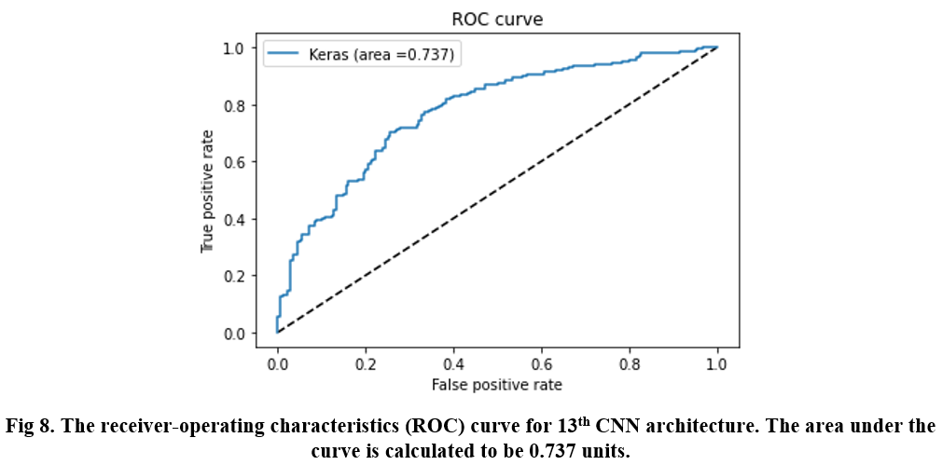
Results
For evaluation metrics, we use the confusion matrix and calculate the precision, recall, and F1 score.
As there were but 371 images for testing which were augmented but we considered only 51 images for evaluation of confusion matrix and calculation for accuracy and stability of our model.
From Confusion matrix, TP = 28,
TN = 19, FP = 3 and FN = 1
Precision = 0.90322, Recall = 0.9655
and F1- Score = 0.93331
The area under ROC curve was found to be 0.737 units.

Slide 10
Conclusion & Future Work
We make an effort to find out the best approach for Brain Tumor Detection Using MRI images .
Based on objective function value we selected the ideal model which is easy to train, detecting tumor faster as compared to other architectures, and training time was less with more accuracy and stability.
We recommend that the simpler architectures perform best and are more stable and reliable than the complex ones.
So, many techniques can be implemented in future for finding more good models by implementing transfer learning , different parameters for training of models.

Slide 11
References
Seetha, J., & Raja, S. S.: Brain tumor classification using convolutional neural networks. Biomedical & Pharmacology Journal 11(3), 145 (2018).
Ghassemi, N., Shoeibi, A., Rouhani, M.: A deep neural network with generative adversarial networks pre-training for brain tumor classification based on MR images. Biomedical Signal Processing and Control 57(1), 101678 (2020).
Pashaei, A., Sajedi, H., Jazayeri, N.: Brain tumor classification via convolutional neural network and extreme learning machines. In: 8th International conference on computer and knowledge engineering (ICCKE), pp. 314-319. IEEE, (2018, October).
Afshar, P., Plataniotis, K. N., Mohammadi, A.: Capsule networks for brain tumor classification based on MRI images and coarse tumor boundaries. In ICASSP 2019-2019 IEEE International Conference on Acoustics, Speech and Signal Processing (ICASSP), pp. 1368-1372. IEEE (2019, May).
Mohsen, H., El-Dahshan, E. S. A., El-Horbaty, E. S. M., Salem, A. B. M.: Classification using deep learning neural networks for brain tumors. Future Computing and Informatics Journal 3(1), 68-71 (2018).

Slide 12
Any Questions??
Thank You !!

