Slide 1
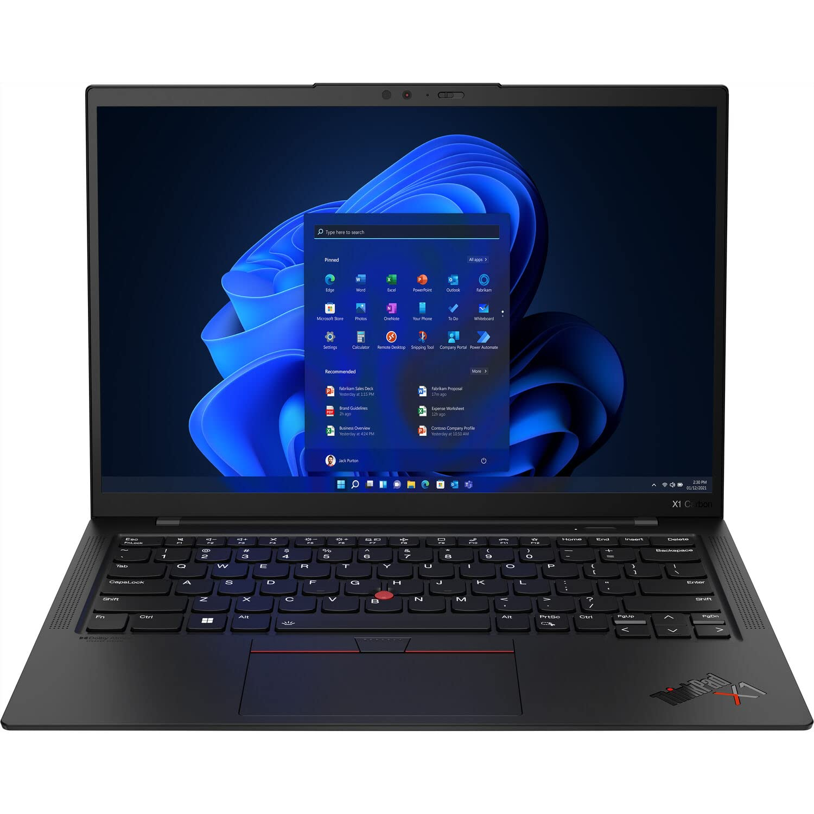
Product: ThinkPad X1 Carbon

