Slide 1
Fake News Blocker
AI-Based Fake News Classification System
By – Vinayak, Sai, Hardik
Exploration in AI

Slide 2

Introduction
Fake news spreads rapidly on social media
Difficult to manually verify authenticity
Aim: Build an ML system to detect Fake vs Real news
Deployed using Flask on localhost

Slide 3

Problem Statement
Provides instant results to the user
Fake news causes misinformation
Need an automated solution for text classification
Project detects fake news using ML and NLP

Slide 4
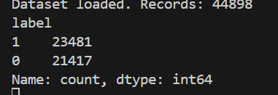
Dataset Description
Dataset includes Fake.csv and True.csv
Fake = 1, Real = 0
Combined total ≈ 45,000 articles
Text column used for classification

Slide 5

Data Preprocessing
Lowercasing text
1
Removing punctuation & symbols
2
Cleaning noise
3
Preparing text for TF-IDF
4

Slide 6
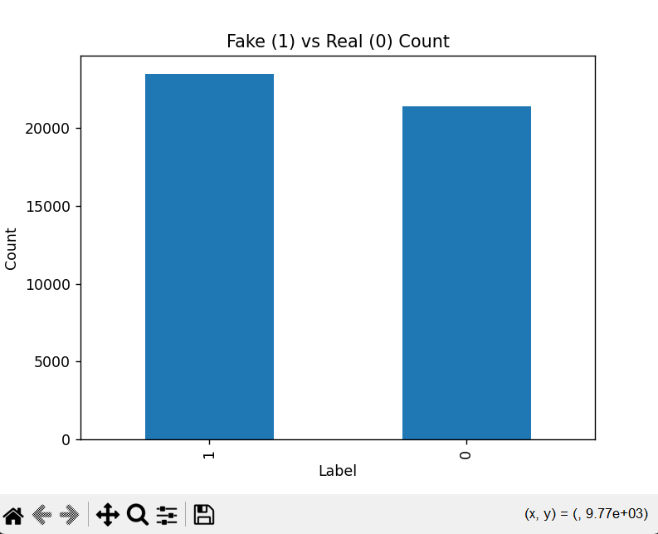
Data Visualization
Plotted Fake vs Real distribution
Helps understand class balance
Useful before model training

Slide 7
Feature Extraction (TF-IDF)
Converts text to numerical vectors
Highlights important words
5000 features used
Works well with Logistic Regression

Slide 8

Model Used
Logistic Regression classifier
Fast & accurate for binary classification
Good with sparse text features
Ideal for TF-IDF vectors

Slide 9
Model Accuracy
Achieved accuracy: ≈ 98.9%
Very strong generalization
Minimal misclassifications

Slide 10
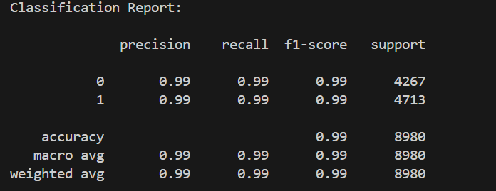
Classification Report
High precision, recall, and F1-score
Balanced performance across classes
Indicates strong model reliability

Slide 11
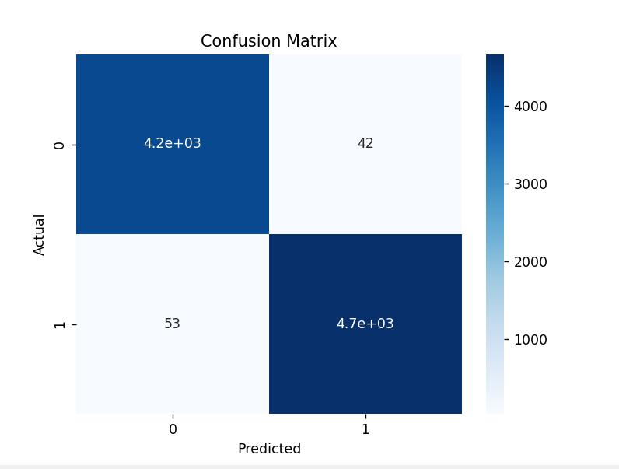
Confusion Matrix
Shows correct vs incorrect predictions
High true positives and true negatives
Very few classification errors

Slide 12
Saving the Model
Saved model using pickle
Saved vectorizer for deployment
Files generated:
fake_news_model.pkl
vectorizer.pkl

Slide 13
Testing Script
test_fake_news.py validates predictions
Useful for manual testing
Confirms model performance

Slide 14
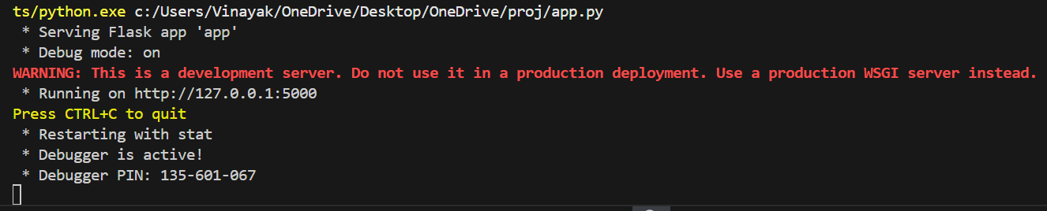
Flask Deployment
Deployed on localhost using Flask
Runs on: http://127.0.0.1:5000
Simple UI for predictions

Slide 15
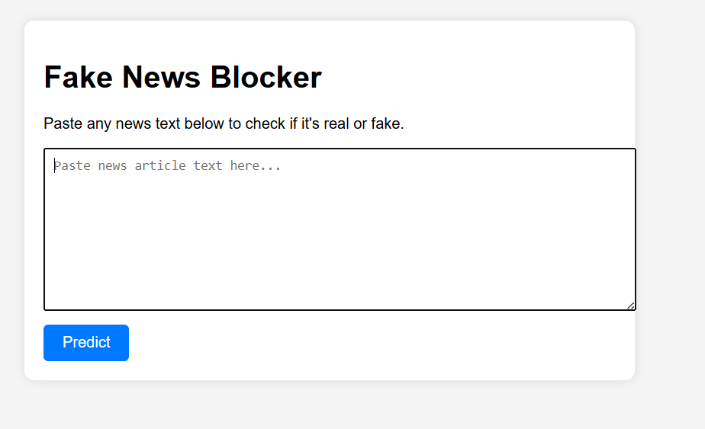
Website UI
Clean interface
Text input + Predict button
User-friendly layout

Slide 16
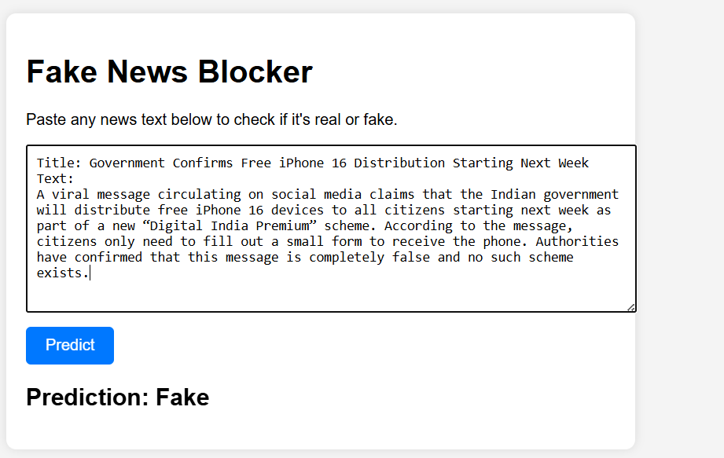
Prediction Output
Final classification displayed clearly
Fake → Alert
Real → Safe

Slide 17
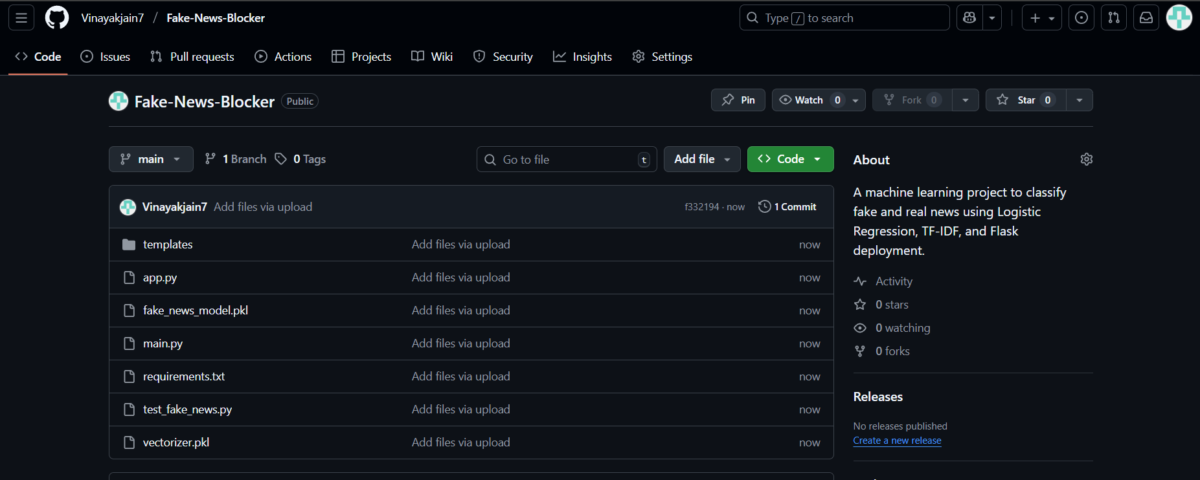
GitHub Repository
Contains all required project files
Organized folder structure
Easy to replicate the project

Slide 18
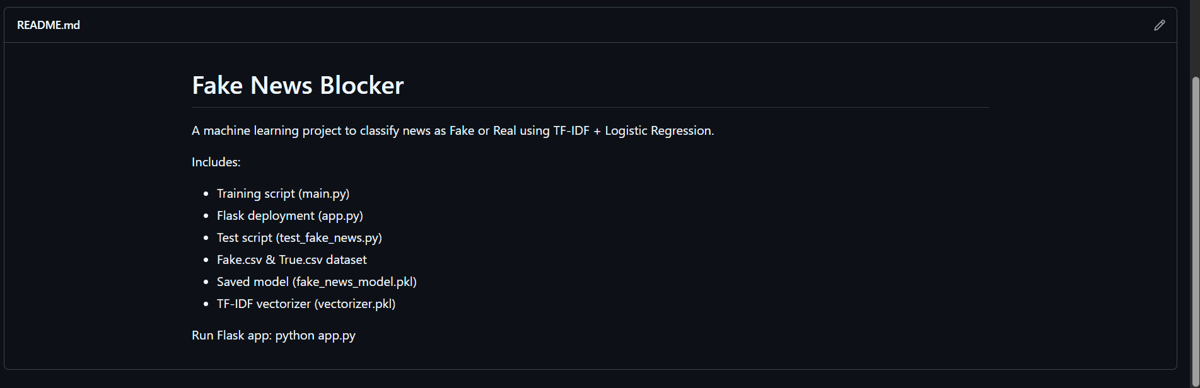

Slide 19
Conclusion
Successfully built fake news detection system
High model accuracy
Smooth Flask deployment
Useful for identifying misinformation

Slide 20

Future Scope
Use BERT or LLM models
Deploy online
Real-time detection system
Multi-language support

Slide 21

Thank You

