Slide 1
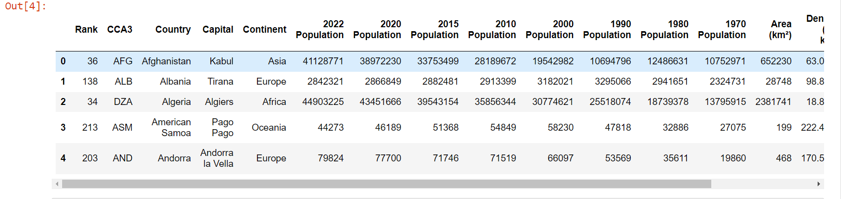
Dataset :
Shape Of Dataset : (234 x 17)

Slide 2
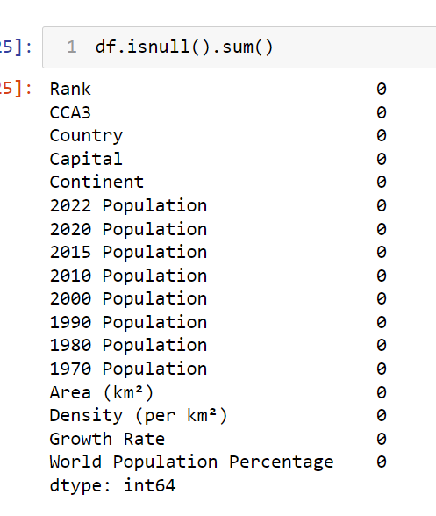
Missing Values :
No column have Missing Values present

Slide 3
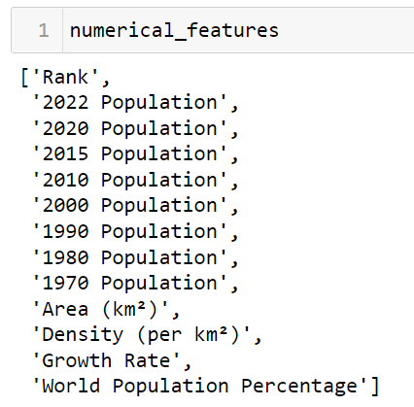
Numerical Features :
There are 13 numerical features out of total . All these features are continues features , no feature is discrete

Slide 4
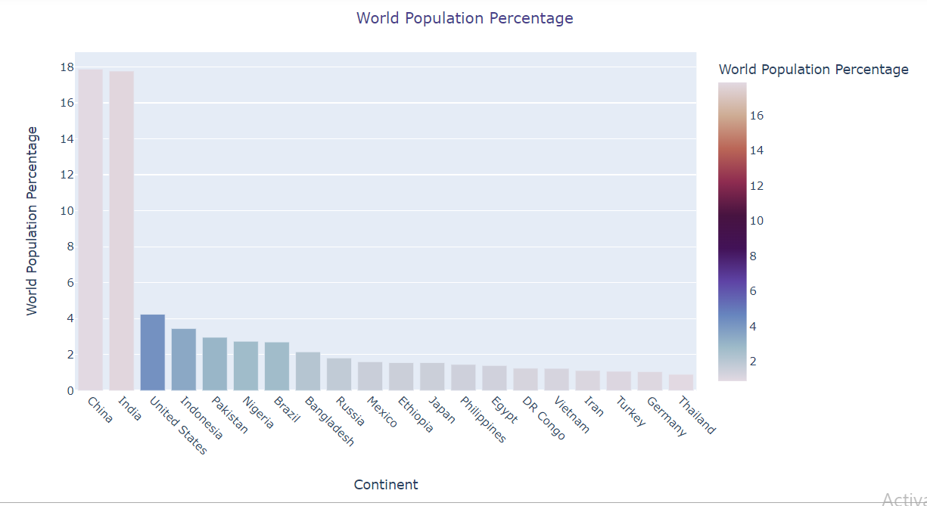
World Population Percentage :
The graphs shows World population percentage of countries below :
1.China = 17.88 %
2. India = 17.77 %
3. United states = 4.24 %
4. Indonesia = 3.45 %
5. Pakistan = 2.96 %

Slide 5
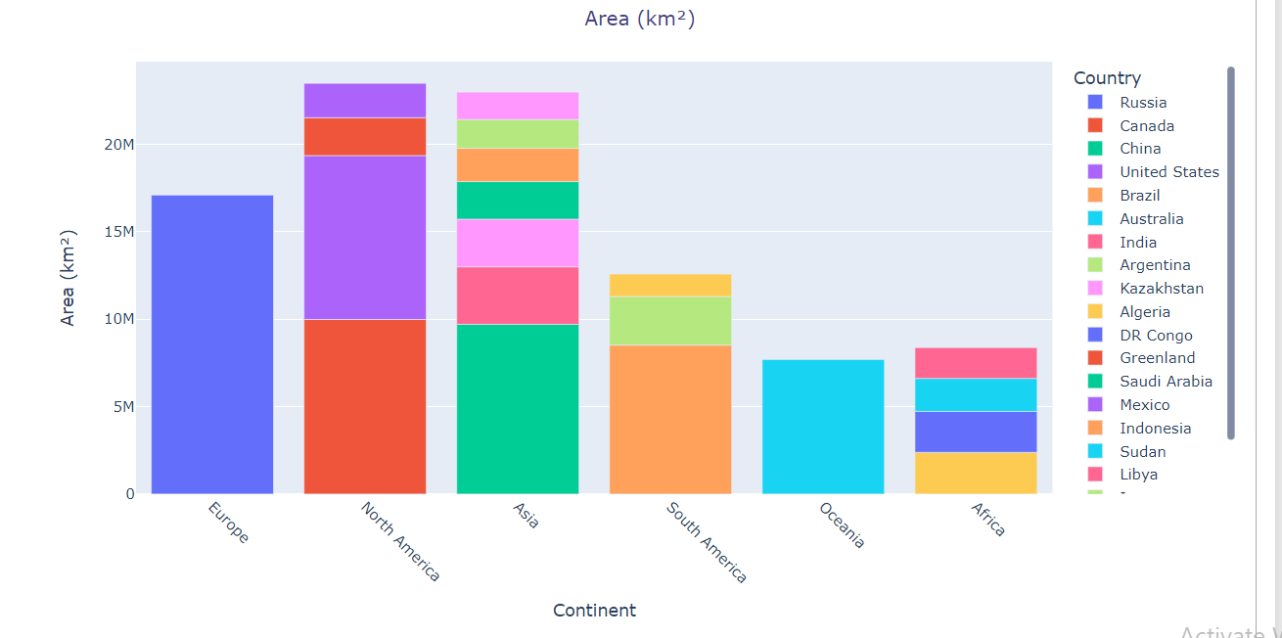
Area in km^2 :
Below 5 countries have maximum area :
Russia = 17.0982M km^2
Canada = 9.98M km^2
China = 9.7M km^2
United States = 9.37M km^2
Brazil = 8.5M km^2

Slide 6
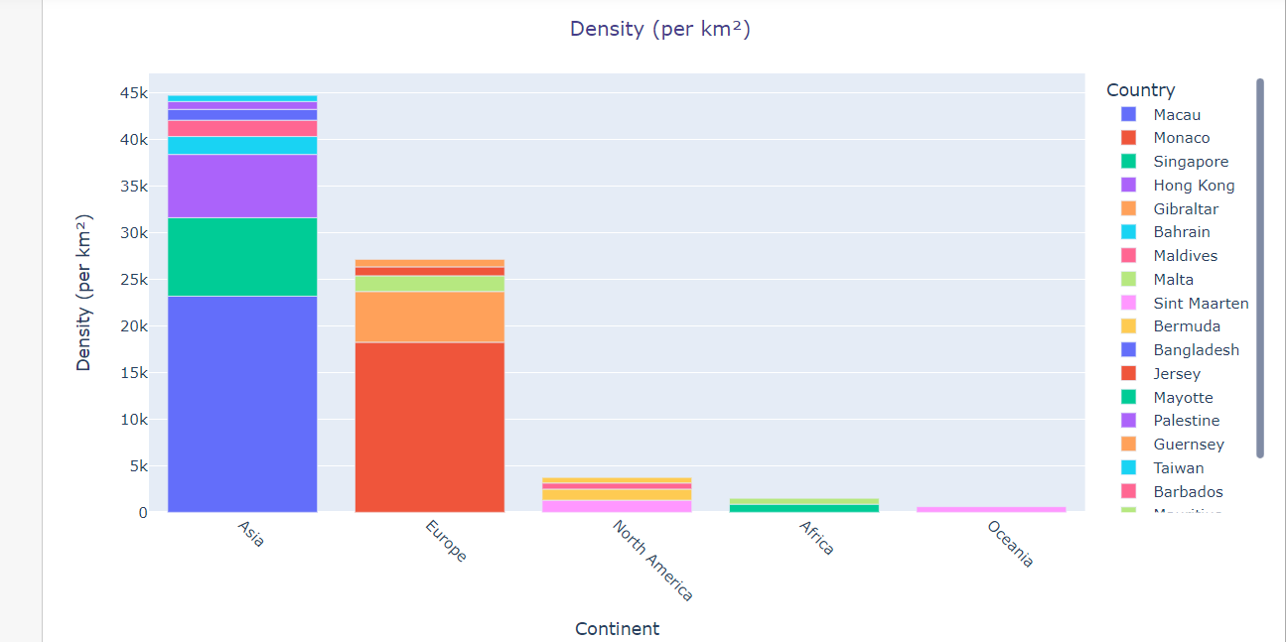
Density (per km^2) :
Below 5 countries have maximum Density :
1.Macua = 27.17K per km^2
2. Monaco = 18.23K per km^2
3. Singapore = 8.416K
4. Hong Kong = 6.7k per km^2
5. Gibraltar = 5.44K perm km^2

Slide 7
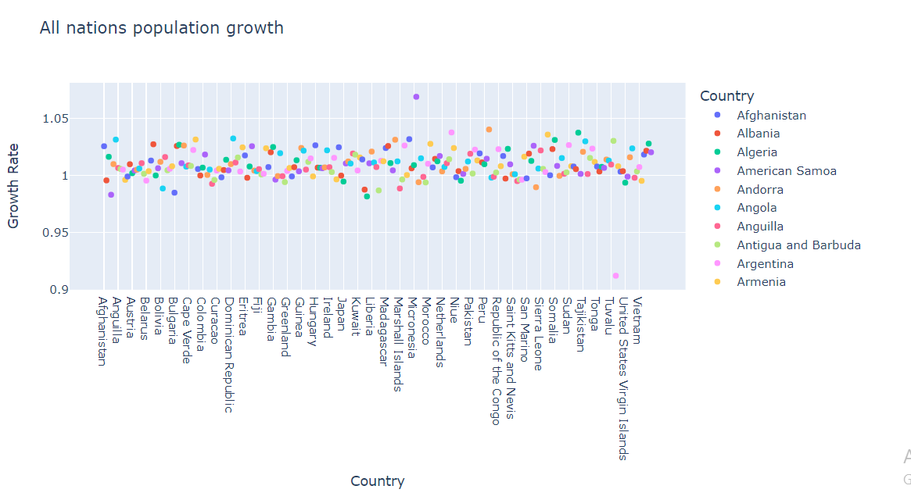
Growth rate :
This graphs shows growth rate of countries :

Slide 8
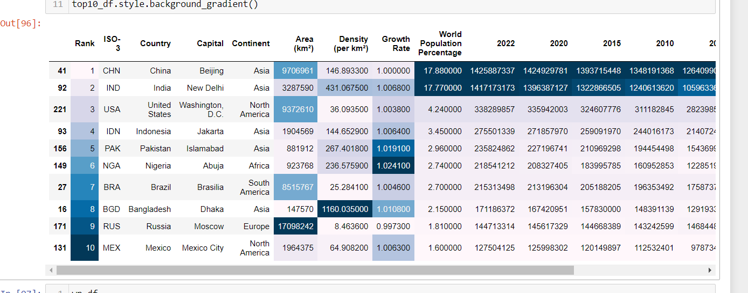
Top 10 records :
We can see data analysis of top 10 records

Slide 9
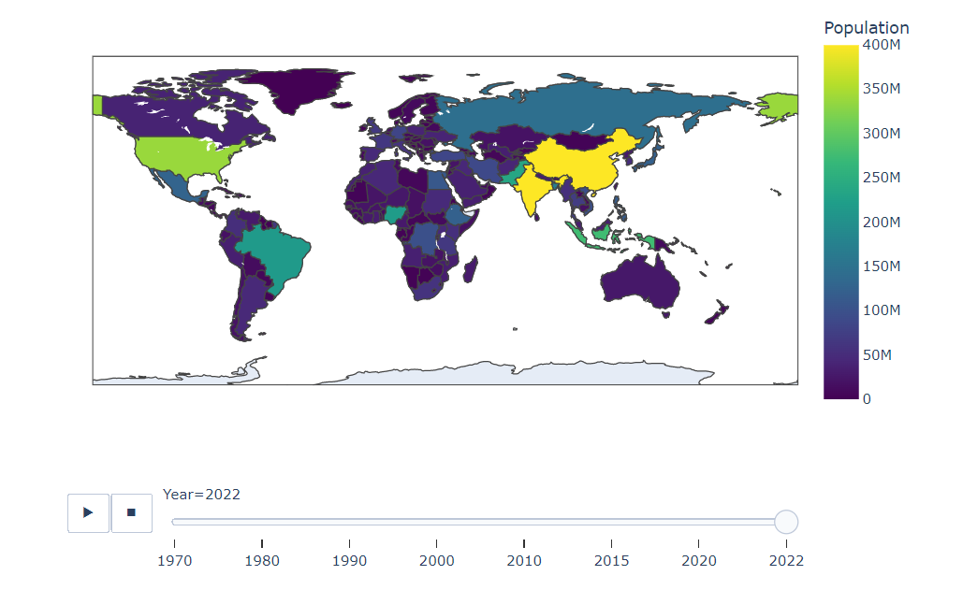
Animation of world Population with years :

