Slide 1
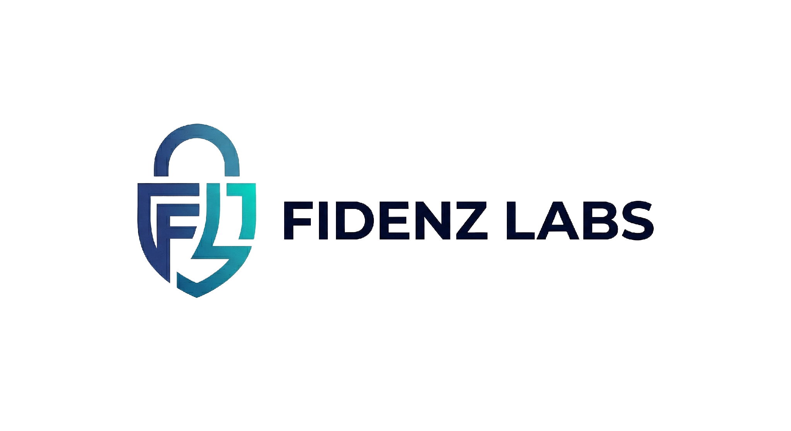
2026 INNOVATION CUP FOR AI AGENTS · CHALLENGE 4
FidenzLabs Co-Scientist
An autonomous in-silico AI co-scientist for area-selective atomic layer deposition

Slide 2



Who are we?
Vinayak S
Pavan Kumar L
Fidenz AI Co Scientist

Slide 3
OVERVIEW
What this deck covers
01
02
03
The problem
The approach
The science
Challenge 4 goal, AS-ALD mechanism, and why 3D-NAND needs it
A four-layer agentic funnel and the two graded deliverables
Amorphous surface builder, site-matched selection, testing protocol
04
05
06
The screening funnel
Results & rigor
References
Batch candidate screening → recommendation → paper
Example campaign, reproducibility, and requirement mapping
Literature and methods behind the system
1

Slide 4
THE PROBLEM
Challenge 4 — the goal
“Passivate SiN (nitride) to deposit SiOₓ on SiOₓ (oxide) with 90% selectivity at 10 nm of oxide thickness.”
The in-silico AI co-scientist shall include:
1 Amorphous surface builder
2 Agentic selection logic
▪ Better reflects real experimental surfaces
▪ SiOₓ models over-count reactive sites vs experiment
▪ SiNₓ –NH₂/–NH sites have irregular spacing
▪ Chooses inhibitor / precursor candidates
▪ Grounded in literature; steerable via a criteria file
▪ Surfaces = SiN, SiO₂; film = SiOₓ, SiNₓ, or high-k oxides
Selectivity metric: S = (Thk_GS − Thk_NGS) / (Thk_GS + Thk_NGS) evaluated where the growth-surface film reaches 10 nm.
2

Slide 5
THE PROBLEM
Why area-selective ALD — and why it is hard
▪ AS-ALD. Deposit film only where wanted: grow on the growth surface (GS), block the non-growth surface (NGS) with a molecular inhibitor.
▪ The mechanism. The inhibitor chemisorbed on the NGS and survives the purge; the precursor nucleates on the GS. The nucleation delay on the NGS is the selectivity.
▪ 3D-NAND driver. Selectively growing oxide-on-oxide isolates charge-trap nitride on adjacent cells, reducing cross-talk — with fewer patterning and etch steps.
▪ The core difficulty. Computed selectivity is dominated by the assumed amorphous-surface model. Crystalline slabs get the sign of screening decisions wrong.
The selectivity picture
SiOₓ film grows
inhibitor
Growth surface (SiO₂)
Non-growth surface (SiN)
Film builds on the growth surface; the inhibitor delays nucleation on the non-growth surface.
Amorphous ≠ crystalline
▪ Amorphous surfaces expose terminal AND bridge sites
▪ ~35% fewer terminal sites than crystalline models
▪ Getting the surface right is where the challenge is won
3

Slide 6
THE APPROACH
A four-layer agentic co-scientist funnel
LAYER 1
Deep Research Engine
Deep
A literature-mining swarm builds a typed knowledge graph of surfaces, sites, inhibitors, precursors, mechanisms, and prior selectivity results.
LAYER 2
Human-in-the-loop commitment
Human-in-the-loop
The researcher reviews ranked intervention hypotheses and commits one inhibitor/precursor scheme — the expensive branch point.
LAYER 3
In-silico validation & screening with AI Agentic candidate selection
In-silico
Surface builder + fidelity gate, AI agentic candidate selection, tiered reactivity engine, screening funnel, and a bounded reflection loop.
LAYER 4
Autonomous manuscript
Autonomous
A section-writer swarm stitches a reproducible LaTeX paper — every number and figure pulled from the run artifacts, nothing invented.
4

Slide 7
THE APPROACH
The two graded deliverables
Deliverable 1 — Amorphous surface builder
Deliverable 2 — Agentic selection logic
▪ Protocol. Crystalline-derived slab → element-keyed passivation → geometric bridge anneal (–O– siloxane, –NH– imide).
▪ Explicit target site density per site type, not just “looks amorphous.”
▪ Fidelity gate. Rejects any slab whose per-site densities fall outside the measured acceptance bands before any compute is spent.
▪ Ensembles. N independent slabs per surface → selectivity reported as a distribution, not a fragile point estimate.
▪ Retrieve candidate inhibitors/precursors from the knowledge graph.
▪ Site-match. Score how completely an inhibitor passivates the sites the precursor needs on the NGS — while staying inert on the GS.
▪ Rank on differential adsorption, volatility, removability, sterics, and site match, via a human-editable criteria file.
▪ Propose novel candidates with a generative agent; they can never be “supported” on priors alone — they must clear the real-surface search.
5

Slide 8
THE SCIENCE
Layer 1 — Deep Research Engine
▪ Swarm mining. Parallel agents mine open scholarly sources by DOI and normalize everything to a single citation schema.
▪ Typed knowledge graph. Site-resolved nodes: Surface (material, phase, site type, density), Inhibitor, Precursor, Mechanism (ΔEr, Ea, byproduct), Selectivity Result.
▪ Seeded anchors. A curated set of real-DOI anchor citations guarantees no run is left without domain-grounded literature; mined papers merge on top.
▪ One graph, three consumers. It feeds hypothesis generation, the selection agent's candidate library and priors, and the manuscript bibliography.
Knowledge-graph node types
Surface
Site type
Inhibitor
Precursor
Mechanism
Byproduct
Selectivity Result
Citation
6

Slide 9
THE SCIENCE
Layer 2 — Human-in-the-loop commitment
▪ The right place for a human. “Which inhibitor/precursor scheme do we commit compute to?” is the expensive branch point — a human gate before the validation spend is the correct antidote to trial-and-error.
▪ Review & commit. The researcher sees the top ranked hypotheses and selects, edits, merges, or redirects.
▪ Structured output. The decision is saved as a structured specification (growth / non-growth surface, inhibitor, precursor, target film, thickness, selectivity threshold, provenance).
▪ Flows downstream. That one record seeds the surface builder, the selection agent, the scoring model, and the manuscript.
Committed specification
Growth surface
a-SiO₂
Non-growth surface
a-SiN
Inhibitor
committed candidate
Precursor
e.g. BDEAS
Target film
SiOₓ
Target thickness
10 nm
Target selectivity
≥ 90%
7

Slide 10
THE SCIENCE
Amorphous surface builder + fidelity gate
Seed bulk
Cleave + vacuum
Passivate sites
Bridge anneal
Fidelity gate
Ensemble of N
The gate is the load-bearing rigor element — pathological surfaces are thrown out before any expensive reactivity call. Two builder modes feed the same gate: fast procedural slabs, or an opt-in real MLIP melt-quench MD network (LLM auto-tuned).
Surface
Site
Acceptance band (nm⁻²)
Crystalline ref.
a-SiO₂
–OH silanol
~4.5 – 7.5
9.57
a-SiO₂
–O– siloxane bridge
~2.0 – 6.0
—
a-SiN
–NH₂ amine
~2.5 – 5.5
5.97
a-SiN
–NH– imide bridge
~2.0 – 5.5
—
8

Slide 11
THE SCIENCE
Site-matched selection — not strongest-binder
▪ The key insight. A good inhibitor must passivate the specific sites the precursor attacks on the NGS — ranking on raw binding strength selects the wrong pair.
▪ Terminal vs bridge. Some inhibitors passivate terminal sites easily but not bridge sites; whether that is enough depends on which sites the precursor uses.
▪ Directional chemistry. Head-group chemistry is directional — some families prefer oxide (–OH), others nitride (–NH₂/–NH).
▪ Honest ranking. The committed molecule is not auto-promoted; every candidate competes, and unevidenced ones are flagged and ranked below evidenced ones.
Ranking axes
Differential adsorption (chemisorb NGS / physisorb GS)
Site-match to the precursor's preferred sites
Volatility — disable from vapor
Removability after growth
Steric blocking footprint of the tail group
Literature grounding in the knowledge graph
9

Slide 12
THE SCREENING FUNNEL
From a single test to a closed-loop batch screening campaign
Pool
10–50 candidates: library + mined + AI-proposed novel molecules
Tier-0 prior rank
All N ranked by the heuristic — honest, no committed pin
MLIP batch screen
Shortlist scored on shared, seed-identical gated slabs
Full-fidelity top-k
Best few re-run at full ensemble fidelity
Recommendation
Agent names winner, runners-up, risks; a failed campaign spawns a new AI-designed generation
10

Slide 13
THE SCREENING FUNNEL
What makes the campaign trustworthy
Apples-to-apples
Honest competition
Every candidate is scored on the SAME seed-identical gated slab ensembles differences are chemistry, not surface luck. Slabs are built once per campaign, not per molecule.
No candidate is auto-promoted. The committed hypothesis molecule is always screened, and the recommendation states plainly whether it won or lost and to whom.
Evidence discipline
Agent can't cheat physics
Extrapolated, missing, or AI-proposed priors are flagged and cannot be reported as “supported” on priors alone; a calibration delta is carried on every energetics value.
The recommendation agent may narrate risk and context, but a guard forces the winner to be the top candidate by computed selectivity it can never override the numbers.
11

Slide 14
THE SCIENCE
The in-silico testing protocol
1
Build & gate surfaces
The selectivity driver
Ensemble of N growth + N non-growth slabs; each passed through the fidelity gate, failures discarded.
Differential blocking
θ_block(NGS) − θ_block(GS)
— not raw Langmuir coverage, which saturates at process temperature and falsely washes out selectivity.
2
Site-resolved reactivity screen
Per-site reaction energy ΔEr (and barrier Ea where available) for the inhibitor on each surface.
3
Effective blocking coverage
Blocking = Σ (site fraction × reactivity), counting only chemisorbed, purge-surviving inhibitor.
4
Precursor barrier (optional)
Higher-tier barrier check on clean vs inhibited surface, reported explicitly as a lower bound.
Every intermediate is logged, so each number in the paper traces to a computation.
5
Selectivity & verdict
Differential blocking → nucleation delay → S(N); report S at 10 nm as mean ± std with a calibration flag.
12

Slide 15
THE SCIENCE
Tiered compute — runs on a laptop or a GPU
Tier 0
Tier 1
Tier 2
Anywhere · no GPU
GPU or CPU
Optional
▪ Fidelity gate + site-resolved blocking
▪ Literature / semi-empirical energy priors
▪ Full selectivity + verdict, fully reproducible
▪ Real 3D molecules on gated slabs
▪ Foundation-MLIP (MACE / CHGNet) adsorption search
▪ Reaction-energy endpoints · opt-in MLIP melt-quench slabs
▪ Semi-empirical (xTB) cross-check on top-k
▪ Flags large model-vs-reference disagreement
▪ Calibration validity flag on the result
Discipline throughout: foundation-model barriers are treated as lower bounds, and every energetics value carries a predicted-vs-reference delta — never hidden.
13

Slide 16
THE APPROACH
Layer 4 — the co-scientist authors its own paper
▪ Section-writer swarm. One agent per section (abstract, intro, methods, results, discussion, limitations, conclusion) fans out in parallel.
▪ No invented numbers. Every quantitative statement is grounded in the run artifacts; missing values are written as “not recorded,” never guessed.
▪ Real bibliography. Citations come from the literature mined in Layer 1 — actual DOIs, not model-generated references.
▪ Campaign-aware. With the screening funnel, the paper presents the whole campaign (comparison table + ranked figure) then the winner deep-dive.
▪ Deterministic fallback. Offline mode writes the full paper without a key, so the manuscript is always reproducible.
Generated manuscript sections
Abstract
Introduction
System architecture
Methods: surfaces
Methods: selection
Methods: protocol
Results + screening table
Discussion
Limitations
Reproducibility
14

Slide 17
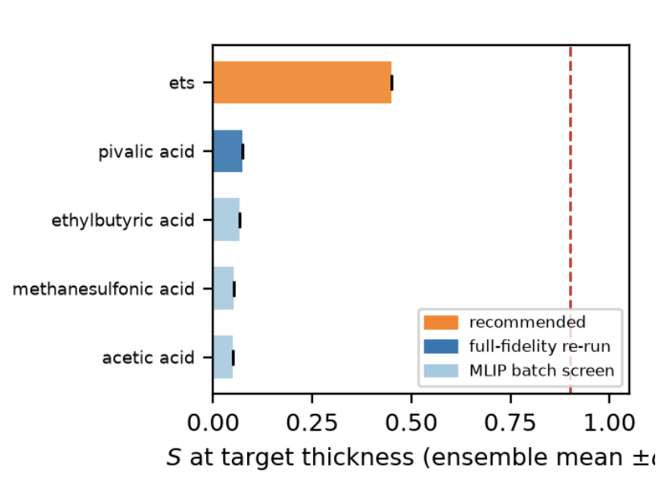
RESULTS & RIGOR
Example screening campaign (illustrative run)
A 12-candidate pool was screened on shared slabs; the best two were re-run at full fidelity and the recommendation agent selected the winner. Numbers are a pipeline demonstration, not a quantitative claim.
Computed selectivity, ranked
Candidate
Stage
S
Verdict
acetic acid ★
full
0.923
supported
pivalic acid
batch
0.923
supported
methanesulfonic acid
full
0.923
supported
ets
batch
0.656
rejected
aniline (committed)
batch
0.229
rejected
Recommendation: winner beats the committed molecule; the outcome is stated honestly.
15

Slide 18
RESULTS & RIGOR
Reproducibility & provenance
▪ Everything is pinned. Random seeds, compute tier, model/device/dtype, slab source and supercell, temperature, dose time, ensemble size, package versions — all logged.
▪ Artifacts per run. Structured JSON for the plan, per-candidate results, surface fidelity, the screening campaign, and the recommendation.
▪ Knowledge-graph linkage. Results link back into the graph so every claim resolves to a logged computation and every prior to a source.
▪ Containerized. A Docker image + locked environment reproduce the funnel end-to-end; a judge can re-run and recover the numbers.
Key run artifacts
official_hypothesis.json
screening_results.json
recommendation.json
asald_results.json
surface_fidelity.json
validation_results.json
manuscript.tex / .pdf
16

Slide 19
RESULTS & RIGOR
How the system meets Challenge 4
Challenge requirement
How the co-scientist delivers it
Amorphous surface builder that better reflects experimental surfaces
Site-density target + fidelity gate against measured bands; ensembles of slabs; no over-counted sites
Agentic inhibitor / precursor selection
ReAct selection agent + generative proposer, site-matched and steerable via a criteria file
90% selectivity at 10 nm oxide
Site-resolved blocking → nucleation delay → S(N) reported at 10 nm as mean ± std
In-silico testing with computed results
Five-step protocol emitting a full JSON record; batch campaign over 10–50 candidates
Reproducible, Python, easy to use
Pinned provenance, Docker, CLI + Gradio UI, deterministic offline mode
17

Slide 20
RESULTS & RIGOR
Technology & agentic patterns
Orchestration
Atomistic engine
Data & models
Delivery
▪ LangGraph state machines
▪ Supervisor + Swarm · ReAct designer
▪ Bounded Reflection loop
▪ AI planner · generational proposer · melt-quench tuner
▪ ASE + foundation MLIP (MACE / CHGNet)
▪ rdkit molecules · pymatgen slabs
▪ Real MLIP melt-quench MD amorphization
▪ xTB + D3 (torch-dftd) cross-check
▪ Typed knowledge graph
▪ Pydantic schemas
▪ Scholarly source clients
▪ Provenance store
▪ CLI (3 entry points)
▪ Refresh-proof Gradio UI on Hugging Face
▪ LaTeX manuscript stitcher
▪ Docker + locked env · persistent storage
18

Slide 21
WRAP-UP
Summary
1
An end-to-end co-scientist. Research idea → hypotheses → human commitment → batch in-silico screening → recommendation → reproducible paper.
2
Both graded deliverables are first-class. A fidelity-gated amorphous surface builder and an agentic, site-matched selection loop.
3
The stated risk is the moat. Surface-model fidelity dominates results, so the gate + ensembles + calibration flags are the centerpiece.
4
A real screening funnel. 10–50 candidates on shared slabs, honest competition, and a recommendation agent that can't override the physics.
5
Trustworthy by construction. Every number traces to a logged computation; every prior to a source; the whole run re-runs from pinned provenance.
19

Slide 22
REFERENCES
Domain literature
Literature and methods that ground the system (kept off the content slides by design).
▪ Kim, Kim, Hahm, Kwon, Park, Hong & Han. A computational study for screening high-selectivity inhibitors in area-selective ALD on amorphous surfaces. Applied Surface Science 730 (2026) 166294. doi:10.1016/j.apsusc.2026.166294 — anchor methodology (slab protocol, site densities, ΔEr/Ea, screening).
▪ Parsons & Clark. Area-selective deposition: fundamentals, applications, and future outlook. Chem. Mater. 2020. doi:10.1021/acs.chemmater.0c00722
▪ Mameli & Teplyakov. Selection criteria for small-molecule inhibitors in area-selective ALD. Acc. Chem. Res. 2023. doi:10.1021/acs.accounts.3c00221
▪ Soethoudt et al. Selective surface reactions of dimethylamino-trimethylsilane for area-selective deposition. J. Phys. Chem. C 2020. doi:10.1021/acs.jpcc.9b11270
▪ Merkx et al. Relation between reactive surface sites and precursor choice for AS-ALD using small-molecule inhibitors. J. Phys. Chem. C 2022. doi:10.1021/acs.jpcc.1c10816
▪ Tezsevin et al. Computational investigation of precursor blocking with an aniline SMI. Langmuir 2023. doi:10.1021/acs.langmuir.2c03214
▪ Karasulu, Roozeboom & Mameli. High-throughput area-selective spatial ALD of SiO₂ with interleaved small-molecule inhibitors. Adv. Mater. 2023. doi:10.1002/adma.202301204
▪ Roh et al. Surface reactions in ALD of silicon oxide using BDEAS and ozone. Appl. Surf. Sci. 2022. doi:10.1016/j.apsusc.2021.151231
20

Slide 23
REFERENCES
Domain literature
▪ Zhuravlev. The surface chemistry of amorphous silica. Colloids Surf. A 2000. doi:10.1016/s0927-7757(00)00556-2
▪ Ewing et al. Accurate amorphous silica surface models from first-principles thermodynamics of surface dehydroxylation. Langmuir 2014. doi:10.1021/la500422p
▪ MAD-SURF: fine-tuning MACE-MPA-0 for molecular adsorption on surfaces. arXiv:2601.18852 — Tier-1 engine basis.
▪ Fine-tuning foundation MLIPs with frozen transfer learning. arXiv:2502.15582 — foundation MLIPs underestimate reaction barriers (the lower-bound rule).
▪ Werbrouck et al. LLM Agents for Knowledge Discovery in Atomic Layer Processing. arXiv:2509.26201 — agent/swarm exploration and persistence.
▪ Ghafarollahi & Buehler. Sparks Matter: ideation → planning → experimentation → reporting. arXiv:2508.02956
▪ Gottweis et al. Towards an AI Co-Scientist. arXiv:2502.18864 — co-scientist framing.
▪ Lu et al. The AI Scientist. arXiv:2408.06292 (Nature, 2026) — autonomous LaTeX authoring + figure QA + automated review.
▪ PaperOrchestra: multi-agent LaTeX manuscript assembly. arXiv:2604.05018
▪ Seal et al. Supervisor / Swarm / ReAct / Reflection agentic architecture. arXiv:2510.27130 — the Layer-3 loop pattern.
21

Slide 24
Thank You

