Slide 1
Design & Analysis of Algorithms
Joy Mukherjee

Slide 2
Books
Introduction to Algorithms by Coreman et al. (CLRS book)
Algorithm Design by Kleinberg & Tardos

Slide 3
Syllabus
Design of Algorithms
Divide and Conquer
Dynamic Programming
Greedy Method
Branch and Bound
Backtracking
Analysis of Algorithms
Asymptotic Analysis (Big Oh, Big Omega, Big Theta Notations)
Recurrence Relations
Amortization
Graph Algorithms
Theory of NP-completeness

Slide 4
Graph Algorithms
Traversal: Breadth-First Search, Depth-First Search and their applications
Minimum Spanning Tree: Prim, Kruskal
Shortest Path: Dijkstra, Bellman-Ford, Floyd Warshall
Maximum Flow Minimum Cut: Ford-Fulkerson
Matching in a Bipartite Graph: Hopcroft

Slide 5
Graph
G = (V, E)
V: Set of vertices
E: Set of edges
1
2
1
2
0
0
3
5
3
5
4
4

Slide 6
Representation of Graph
Adjacency Matrix: Given a graph G=(V, E), we create a matrix M of size |V| X |V|, where M[i][j] is 1 if there is an edge between vertex i and vertex j; otherwise it is 0.
O(|V|²).
For undirected graph (no edge has a direction), M is a symmetric matrix.
Adjacency List: Array of Linked Lists, where the Array size is |V|, the linked list corresponding to a vertex v has all its neighbors. O(|V| + |E|)
1
2
0
1
2
3
4
5
1
4
2
0
3
5
5
1
2
5
3
4
2
4

Slide 7
Undirected & Directed Graphs
Indegree of a Vertex: Number of incoming neighbors
Outdegree of a Vertex: Number of outgoing neighbors
Degree of a Vertex: Number of neighbors of the vertex
1
2
1
2
0
0
3
5
3
5
4
4

Slide 8
Weighted Graph
G = (V, E, F)
V: Set of vertices
E: Set of edges
F: E -> R₀+
5
2
50
1
1
2
3
30
40
0
0
3
5
3
5
4
4

Slide 9
Walk, Trail, Path
Walk: Sequence of vertices in the graph where adjacent vertices must have an edge between them. Example: 1 2 5 4 3 2 5 is a walk
Trail: A walk with no repeated edge. Example: 1 2 5 4 3 2 4 is a trail.
Path: A trail/walk with no repeated vertex. Example: 1 2 5 4 3 is a path.
1
2
0
3
5
4

Slide 10
Connected Graph
An undirected graph is called a connected graph if there is a path between every pair of vertices.
1
2
6
7
0
3
5
8
4

Slide 11
Strongly Connected Graph
A directed graph is called a strongly connected graph if there is a path between every pair of vertices.
Strongly Connected Components: In a directed graph, a SCC is defined as a maximal strongly connected subgraph.
If a directed graph is not Strongly Connected, then it can be decomposed into SCCs.
1
2
0
3
5
Not a SCG
4

Slide 12
Graph Traversal Algorithms
Given a vertex s (source vertex) in a graph G=(V, E), how do we systematically explore the other vertices V – {s} in G?
Breadth-First Search
Depth-First Search

Slide 13
Breadth First Traversal/Search (BFS)
Input: G=(V, E)
Choose a vertex s, and explore its neighbors first, subsequently exploring the neighbors of the neighbors.
For an undirected unweighted graph G, BFS gives shortest path from s to all other reachable vertices of the graph G.
s
If there is a directed edge from a node to its ancestor in the BFS tree, then cycle is detected.
s1
s2
s3
s11
s12
s31

Slide 14
Breadth First Traversal/Search (BFS)
1
2
0 | 1 2 4 | 3 5
Implementation: Linear Queue
0
3
5
4
0

Slide 15
Data Structure
For each node x, we maintain three variables
Distance of x from the source s: dist
Parent of x: parent
Is x already visited during BFS: visited
Linear Queue

Slide 16
BFS Algorithm
BFS(G, s)
For all vertex x in V – {s} dist[x] = inf parent[x] = NULL
Dist[s] = 0
Initialize the Queue Q
enqueue(Q, s)
While( Q is not empty) {
u = dequeue(Q)
Visited[u] = 1
For each v in Adj[u]
If(visited[v] == 0)
dist[v] = dist[u] + 1
parent[v] = u
Visited[v] = 1
enqueue(Q, v)
}

Slide 17
Breadth First Traversal/Search (BFS)
1
2
0 | 1 2 4 | 3 5
Implementation: Linear Queue
Q
0
3
5
V
1 | 1 | 1 | 1 | 1 | 1
D
0 | 1 | 1 | 2 | 1 | 2
4
P
N | 0 | 0 | 4 | 0 | 4
BFS gives us a BFS tree rooted at s, the green edges are called tree edges, and the red edges are called non-tree edges.

Slide 18
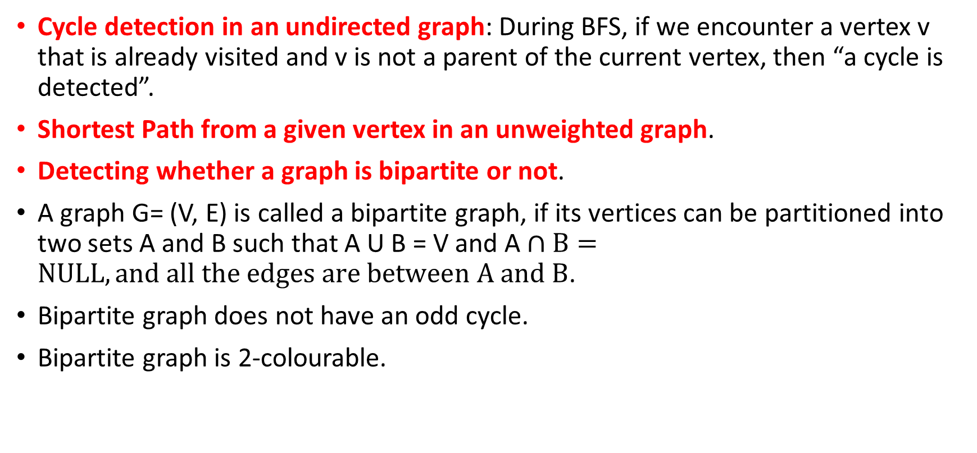
Application: BFS
Cycle detection in an undirected graph: During BFS, if we encounter a vertex v that is already visited and v is not a parent of the current vertex, then “a cycle is detected”.
Shortest Path from a given vertex in an unweighted graph.
Detecting whether a graph is bipartite or not.
A graph G= (V, E) is called a bipartite graph, if its vertices can be partitioned into two sets A and B such that A U B = V and A $∩B=NULL, and all the edges are between A and B$.
Bipartite graph does not have an odd cycle.
Bipartite graph is 2-colourable.

Slide 19
Depth First Traversal/Search (DFS)
Given a graph G = (V, E), and a source vertex s, we explore s first, followed by any one neighbour v of s, and we do it recursively from v unless we encounter a dead end, where we start backtracking to explore the rest of the vertices not yet explored.
s
s1
s2
s3
s11
s12
s31

Slide 20
Depth First Traversal/Search (DFS)
1
2
0 2 1 4 3 5
Implementation: Stack
0
3
5
4

Slide 21
Data Structure
For each node x, we maintain three variables
Parent of x: parent
Is x already visited during BFS: visited
Stack

Slide 22
DFS Algorithm
DFS(G)
For all vertex x in V parent[x] = NULL
visited[x] = 0
time = 0
For each vertex u in V
If(visited[u] == 0)
DFS_VISIT(G, u)
DFS_VISIT(G, u)
visited[u] = 1
disc[u] = time = time+1
For each v in Adj[u]
If(visited[v] == 0)
parent[v] = u
DFS_VISIT(G, v)
finish[u] = time = time + 1

Slide 23
Depth First Traversal/Search (DFS)
2/5
3/4
0 1 2 4 3 5
1
2
Stack
V
1 | 1 | 1 | 1 | 1 | 1
0
9/14
10/13
3
5
1/8
 | 0 | 1 |  | 0 | 3
P
4
6
Discovery time/Finish Time
Discovery time: The node found for the first time
Finish time: The time at which the backtracking happens
11/12
6/7
DFS gives us a DFS forest, the green edges are called tree edges, the red edges are called back edges, the blue edges are called forward edges, and the orange edges are called cross edges.

Slide 24
DFS on Directed Graph
2/5
3/4
Tree Edge (u, v) :
u is parent of v
d[u] < d[v] < f[v] < f[u]
Forward Edge(u, v):
u is not the parent of v
d[u] < d[v] < f[v] < f[u]
Back Edge (u, v): [Cycle]
d[v] < d[u] < f[u] < f[v]
Cross Edge (u, v):
(d[u], f[u]) is non-overlapping
with (d[v], f[v])
2. d[v] < f[v] < d[u] < f[u]
1
2
0
9/14
10/13
3
5
1/8
4
6
11/12
6/7

Slide 25
Depth First Traversal/Search (DFS)
4/5
2/3
1
2
0
9/14
10/13
3
5
1/8
4
6
11/12
6/7

Slide 26
DFS on Undirected Graph
2/13
3/4
Tree Edge (u, v) :
u is parent of v
d[u] < d[v] < f[v] < f[u]
Back Edge (u, v): [Cycle]
d[v] < d[u] < f[u] < f[v]
1
2
0
5/12
6/11
3
5
1/14
4
6
7/8
9/10

Slide 27
Application: DFS
Cycle detection in a graph

