Slide 1

A STUDY TECHNICAL ANALYSIS
OF
BANK NIFTY FROM
JULY 2024 TO APRIL 2025
PRESENTED BY:
VINAY

Slide 2

OBJECTIVE
"With precision and pattern recognition at its core, this study is centered around the following Four objectives to enhance trading outcomes in Bank Nifty."
1
To detect long and medium-term trading opportunities based on trend momentum and pattern recognition.
2
To Interpret trading signals from indicators such as (RSI)Relative strength index, Moving average convergence divergence (MACD) , Bollinger Bands and Moving Averages.
3
To purpose Tactical Trading Strategies tailored for swing trading based on technical set up.
4
To enhance the understanding of technical analysis for effective decision making in volatile market condition.

Slide 3
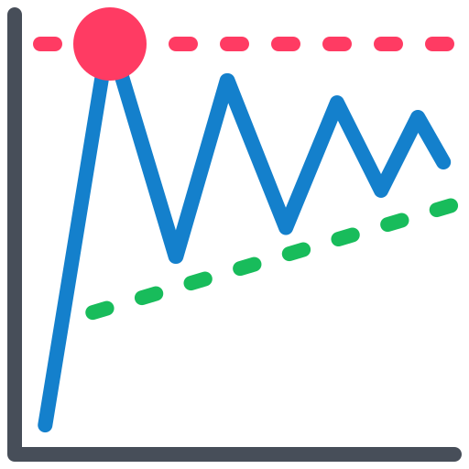






RESEARCH METHODOLOGY
This study employs a quantitative, technical analysis-based methodology
The research adopts an observational, non-experimental approach where historical market data is analyzed
TOP-DOWN APPROACH
RESEARCH DESIGN
SOURCE OF DATA COLLECTION
SAMPLE SIZE AND DESIGN
The research follows an analytical and exploratory design
The study follows non-probability Technique and select bank nifty index as primary sample
Weekly Analysis
To identify long term trend
Daily Analysis
Hourly and 15 min Analysis
To identify trading opportunities
To identify Mid term trend
1
The data is collected from secondary sources
The analytical design allows examination of trends, while the exploratory helps in identify potentially signals or unique confluences of indicators.
2
Sample Size:168 trading days.
Sample Duration: July 2024 to April 2025
Sample Universe : Bank Nifty Index

Slide 4

DATA ANALYSIS TECHNIQUES
1
Chart Patterns were studied to determine potential trend directions and reversal points.
2
Exponential Moving Average (EMA) was utilized in recognizing the overall market trend.
3
Relative Strength Index (RSI) was utilized to identify overbought and oversold zones.
4
MACD (Moving Average Convergence Divergence) was applied to assess the strength of the trend and generate buy/sell signals.
5
Bollinger Bands assisted in measuring market volatility.

Slide 5


MAJOR FINDINGS
Support lies between 47,800 – 47,900, while resistance is seen near 51,800 – 52,000.
The weekly chart formed double bottom pattern indicating possible reversal.
Bank Nifty is currently in a bullish long-term trend, Sustaining over100 and 200 EMA’S.
Bank Nifty holds a neutral to bearish intraday trend, indicating profit book.
Bank Nifty shows a weak bullish bias in the short term, with the 1-hour chart indicating a correction phase.
Ideal entry for buy is on dips near 50,750,if confirmed by RSI <30 bullish MACD crossover and reversal candlestick formation.
LONG TERM TREND
SHORT TERM TREND
Squeezing of Bollinger Bands suggesting volatility is reducing and breakout can happen on either side.
The bullish outlook is supported by RSI > 55 and MACD showing a positive crossover, confirming trend continuation.

Slide 6


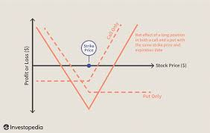

CONCLUSION
WAIT AND WATCH POLICY:
Based on the technical analysis trader should wait for the price action formation at support.
OPTION STRATEGY:
In the short term, considering the current RSI and MACD signals, a straddle strategy can be employed to benefit from a potential breakout in either direction.
Stock Selection Aligned with Bank Nifty:
Track high-weightage stocks like HDFC Bank, ICICI Bank, Axis Bank, Kotak Mahindra Bank, and SBI, for trend confirmation.

Slide 7

“Thanks for your patience”

