Slide 1


Slide 2
Insurance cost prediction
Price prediction determines the insurance price based on some input data such as age, gender, smoking, body mass index (BMI), number of children, and region.

Slide 3
DATA
There are 1338 records in data. There are 8 columns which are
The age of the person
Gender of the person
Body Mass Index of the person
Weight status base on BMI
How many children the person is having
Whether the person smokes or not
The region where the person lives
And the charges of the insurance premium

Slide 4
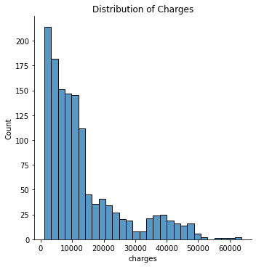
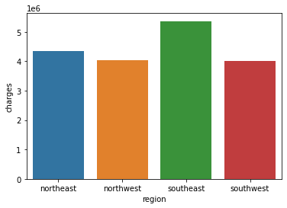
EDA-Exploratory Data Analysis
histogram or density plot for the dependent variable (charges) shows the medical insurance costs most are around 1000-20,000 dollars
The population in southeast region has higher charges

Slide 5
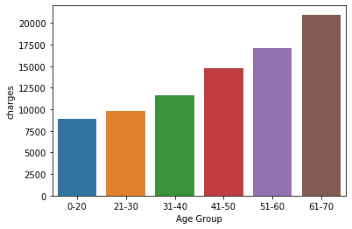
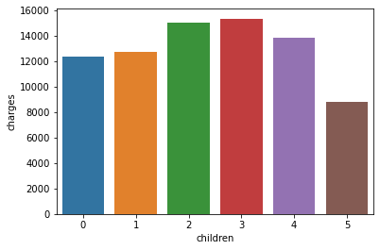
EDA-Exploratory Data Analysis
Older people have more expensive charges
Figure shows the impact of the number of children on charges.

Slide 6
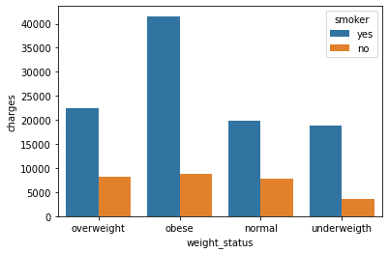
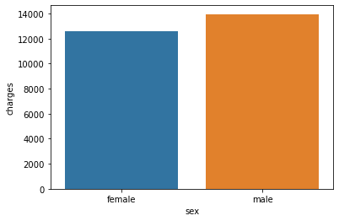
EDA-Exploratory Data Analysis
People who smoke & have a higher BMI(obese), has higher charges
Male population has higher charges

Slide 7

Algorithm used
Decision Tree
Linear Regression
Random Forest

Slide 8
Algorithm Result
Model | Accuracy | R2_score
Linear Regression | 73.25 | 77.29
Decision Tree (hyperparameter) | 86.07 | 86.68
Random Forest | 97.59 | 86.16
By comparing all the models with accuracy,r2_score score we find that Random Forest Algorithm is best model for predict charges

Slide 9
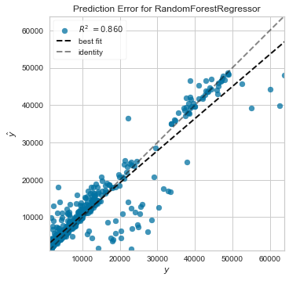
Random Forest Regressor
This graph show Actual and predict value
And show best fit line(Minimum error line)

Slide 10
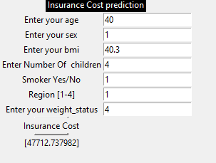
Prediction Demo
Gender -- 1=Male 0=Female
smoker -- 1=yes 0=no
region-- 1= southwest ,2= southeast ,
3= northwest ,4= northeast
Weight_status– 1=underweight,2=normal
3=overiwght,4=obese

Slide 11
Summary
The premium amount of a health insurance policy depends on person to person as many factors affect the premium amount of a health insurance policy
Insurance costs predictions based on certain factors help insurance policy providers to attract consumers and save time in formulating plans for every individual.

Slide 12


