Slide 1
House Grade Classification
Vinay Khurana

Slide 2
House Grade Classification
Property buyers have different requirements. To facilitate this, real estate companies prefer categorizing various houses into different grades based on various parameters. This would help agents in identifying the type of house a customer is looking for. This way, the search for the house can be narrowed down by focusing only on the ‘condition of the house’. The Grade (condition of the house that ranges from A (Best) – E (Worst) ) can also be used by existing owners to list their properties for sale. Grading helps them in arriving at a price of the house.

Slide 3
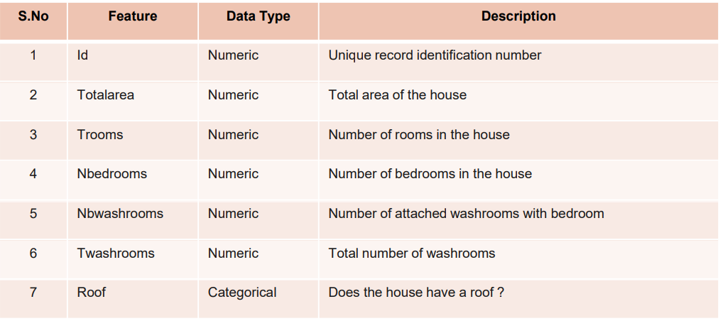
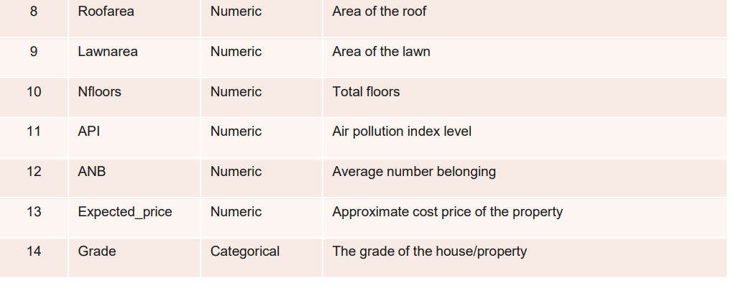
DATA
The structure of the given dataset :
Rows = 3000
Columns = 14.
The datatypes of the 14 features are shown in the picture which has
12 – Numeric columns
2 – Nonnumeric Columns

Slide 4
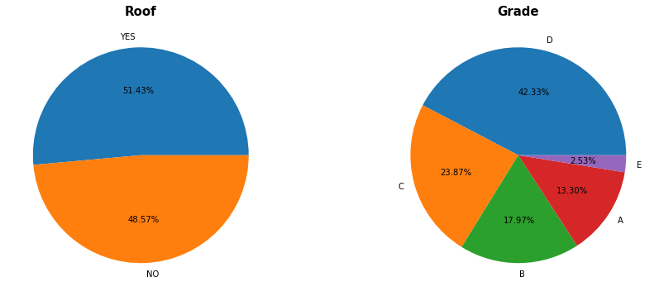
EDA-Exploratory Data Analysis
The Houses with 'Roof' are more than the houses without roof that is 51.43% . The Houses with 'Grade D' are more compared to other grades that is 42.33% and least houses are with 'Grade E' that is 2.53%

Slide 5
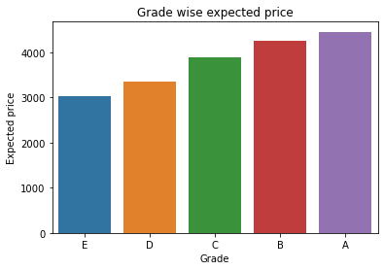
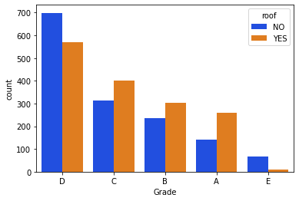
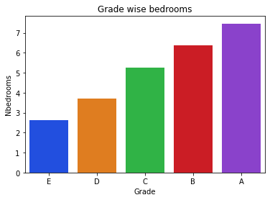
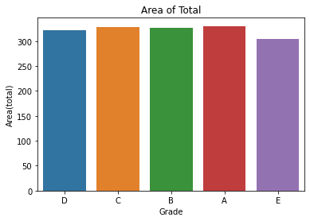
EDA-Exploratory Data Analysis
A grade houses are high priced houses and E grade houses are low in price
A grade houses having more bedrooms compared to other grade houses
In Grade-D,E most of the houses don't have roofs. Whereas, houses in Grade-A,B,C most of the houses have roofs
The Area of Total for the houses with Grade C and Grade A is more

Slide 6
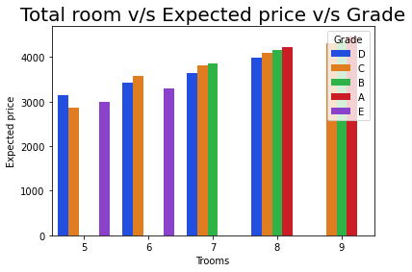
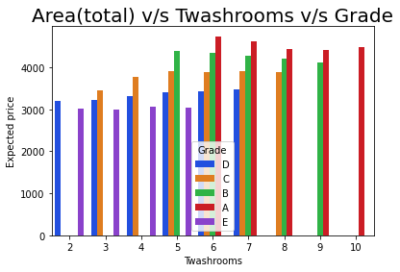
EDA-Exploratory Data Analysis
From the above plot we can see that grades distribution over number of rooms The more number of rooms are available in grade A, B and C grade houses and the expected price is also more
From the above plot we can see that grades distribution over total number of washrooms
The more number of washrooms are available in grade A grade houses and the expected price is also more

Slide 7
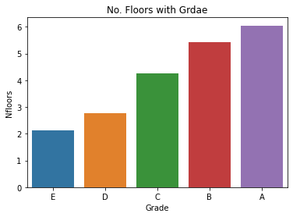
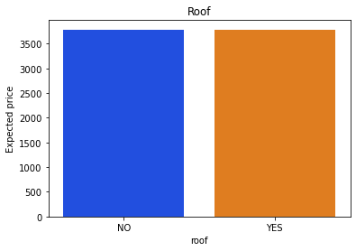
EDA-Exploratory Data Analysis
from the above plot we can say that as number of floor is increasing expected price and grade is also increasing
There is not much difference in the Expected prices for the houses with roof and without roof

Slide 8

Algorithm used
Decision Tree Classifier
Random Forest Classifier
Kneighbors Classifier

Slide 9
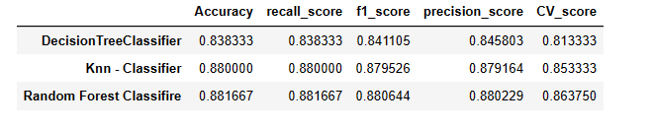
Algorithm Result
From the above Comparison Report we understand that out of all the 3 classification models Random forest Classifiers gives us the best output.

Slide 10
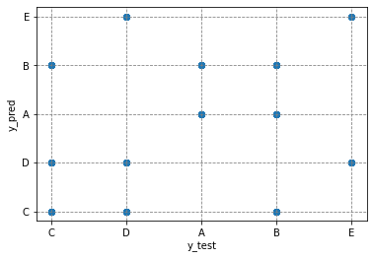
Random Forest Regressor
color='gray', linestyle='dashed'
This graph show Actual and predict Grade

Slide 11
Summery
There are more number of houses with Grade D and less with Grade E.
In Grade D houses there are more houses without roof compared to houses with roof.
The expected prices for the houses with roof and without roof doesn’t have much difference.
In Grade and Expected price graph, Grade A have highest Expected price and Grade D and E have lowest price . Most of the count is of Grade C and D.
For the houses in all Grades as the number of total rooms and Twashrooms increase the expected price also increases and the Expected price for the Grade A houses with total rooms 9 is more.
For the people with less income and small family go with the Grade E houses.
For the people with less income and big Family go with the Grade D and Grade C houses.
For the people with high income and require more luxury go for the houses with Grade A.
For the people with high income and doesn’t require any luxury houses go for Grade D and Grade C houses.
So, On the basis of above conclusion buyer can decide the way
he/she wants to buy the house.

Slide 12
THANK YOU

