Slide 1

HOME SERVICES
MINOR PROJECT
Under Guidance of Presented By
Miss. Kashifa Khan Abhishek Mishra
Asst. Prof. (CSE) Vinayki Khare
Mr. D.S. Rao
HOD (CSE)
Satna

Slide 2
CONTENTS
INTRODUCTION
OBJECTIVE
PROPOSED WORK
GANNT CHART
PROPOSED ARCHITECTURE
PROPOSED ALGORITHAM

Slide 3
INTRODUCTION
Traditionally ,the digital home services have been provided separately by each service provider that have closed service delivery infrastructure for delivering home services.
The key of home services project is in integrating existing and adding new features to the global e-commerce network by providing the easiest solution for multiple home work.

Slide 4
OBJECTIVE
Provide very affordable home service to our city people .
The person who want to provide service they can join this business and provide their service easily .

Slide 5
PROPOSED WORK
Painting Services
Plumber Services
Electrical Services
Carpenter Services
Lawn Care Services

Slide 6
GANTT CHART
08/09/21
Planning
28/09/21
Testing
15/10/21
Project Submission
04/11/21
22/10/21
Designing
Database Connectivity

Slide 7
Proposed Architecture
Find Services
Choose City
Get Services
Provide Services
Fill Name
Contact Number
Book
Choose Services
Search
Photo [A.C.]
Address
Aadhar Number
City
Register
Description
Password
Profession

Slide 8
Proposed Algorithm
Start with xampp server :-
Enter home page here we have navigation bar in which you see the service providers.
Step 1:- Choose city
Step 2:- Choose providers
Step 3:- Then search the service providers

Slide 9
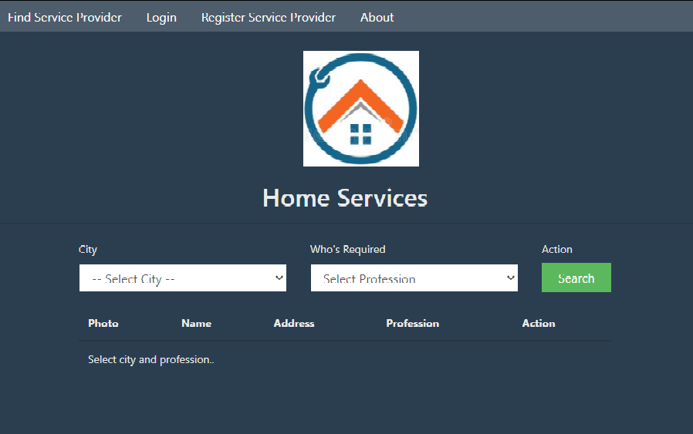
If service providers available then show other wise ‘no service provider available ’show in display..

Slide 10
If You Want To Provide Service Then
Step1:-
Register as service provider.
Step2:-
Fill all the information given below.

Slide 11
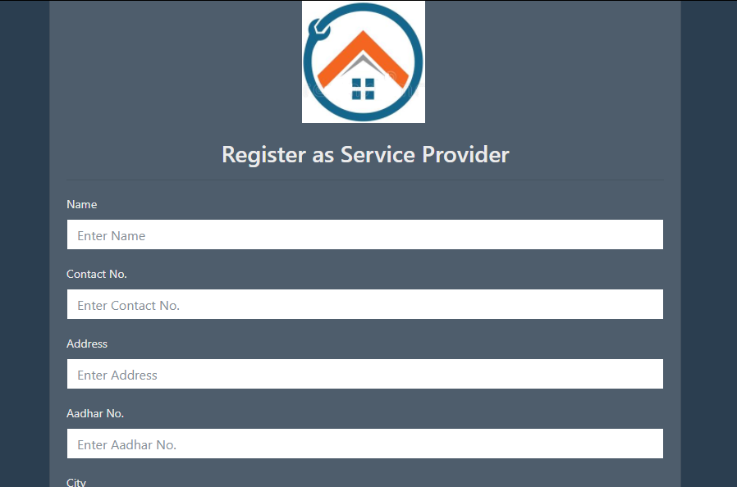
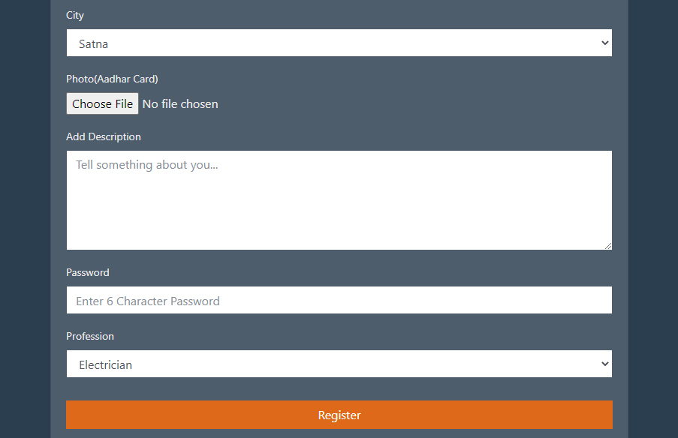

Slide 12
If You Want To Book A Service Provider Then
Step 1 :-
After finding the service provider click on the book button.
Step 2 :-
Fill all the information given below.

Slide 13
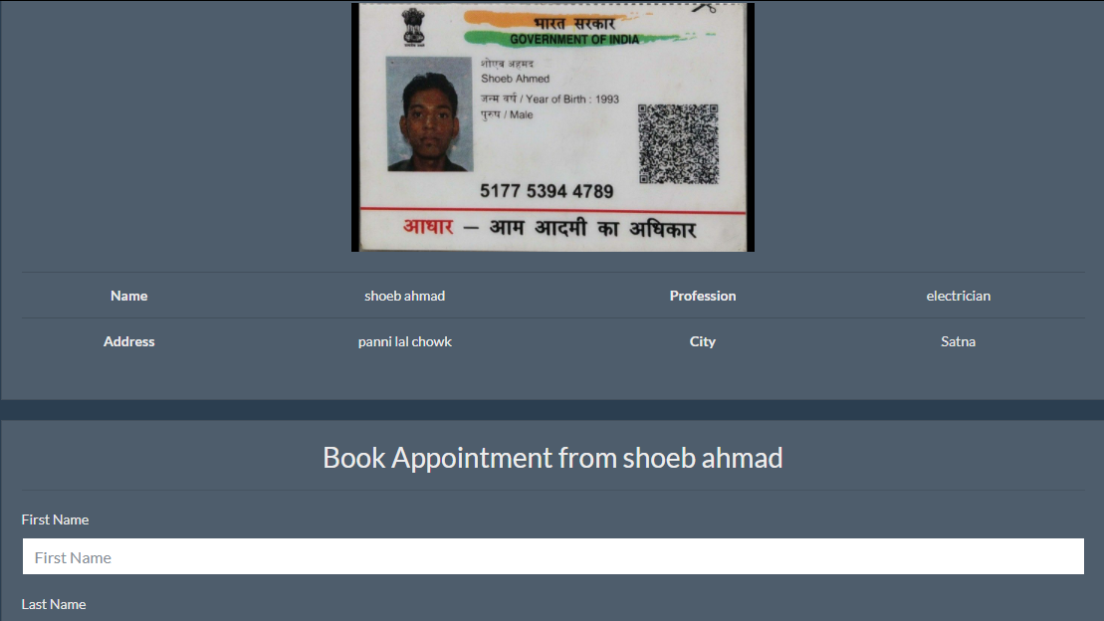
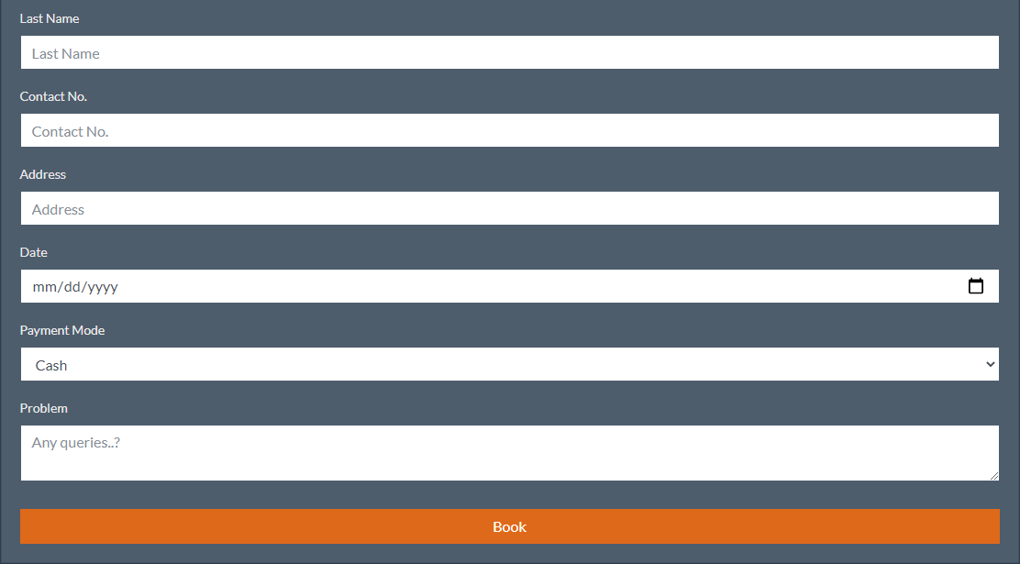

Slide 14
THANK YOU

