Slide 1

Predicting Sales Conversion
Likelihood

Slide 2

Problem Statement :
Companies get a lot of leads every day, but not all of them turn into customers. Right now, sales teams often guess which leads are good, which wastes time and effort.
Project Goal
Build an accurate and explainable ML model to predict lead conversion, helping sales teams focus on high-potential leads and improve efficiency and ROI..

Slide 3





Business Objectives:
Maximize conversions by targeting high-potential leads.
Reduce effort and cost through automated lead scoring.
Support decisions with accurate and interpretable predictions.

Slide 4
AWS ML Pipeline Architecture
Storage: Amazon S3 for raw, processed, and artifact data.
ETL Processing: AWS Glue for extraction, transformation, cataloging, and job scheduling.
Data Warehouse: Amazon Redshift for analytics-ready, structured lead data.
Networking: VPC with security groups and endpoints for secure services connectivity.
ML Platform: SageMaker Studio Lab for model building, explainability, logging.
MLOps & Tracking: MLflow for experiment logging, model registry, and lifecycle management.
Serving & Monitoring: Flask API endpoints, MLflow UI, drift tracking via Evidently,Trigger via Airflow.

Slide 5
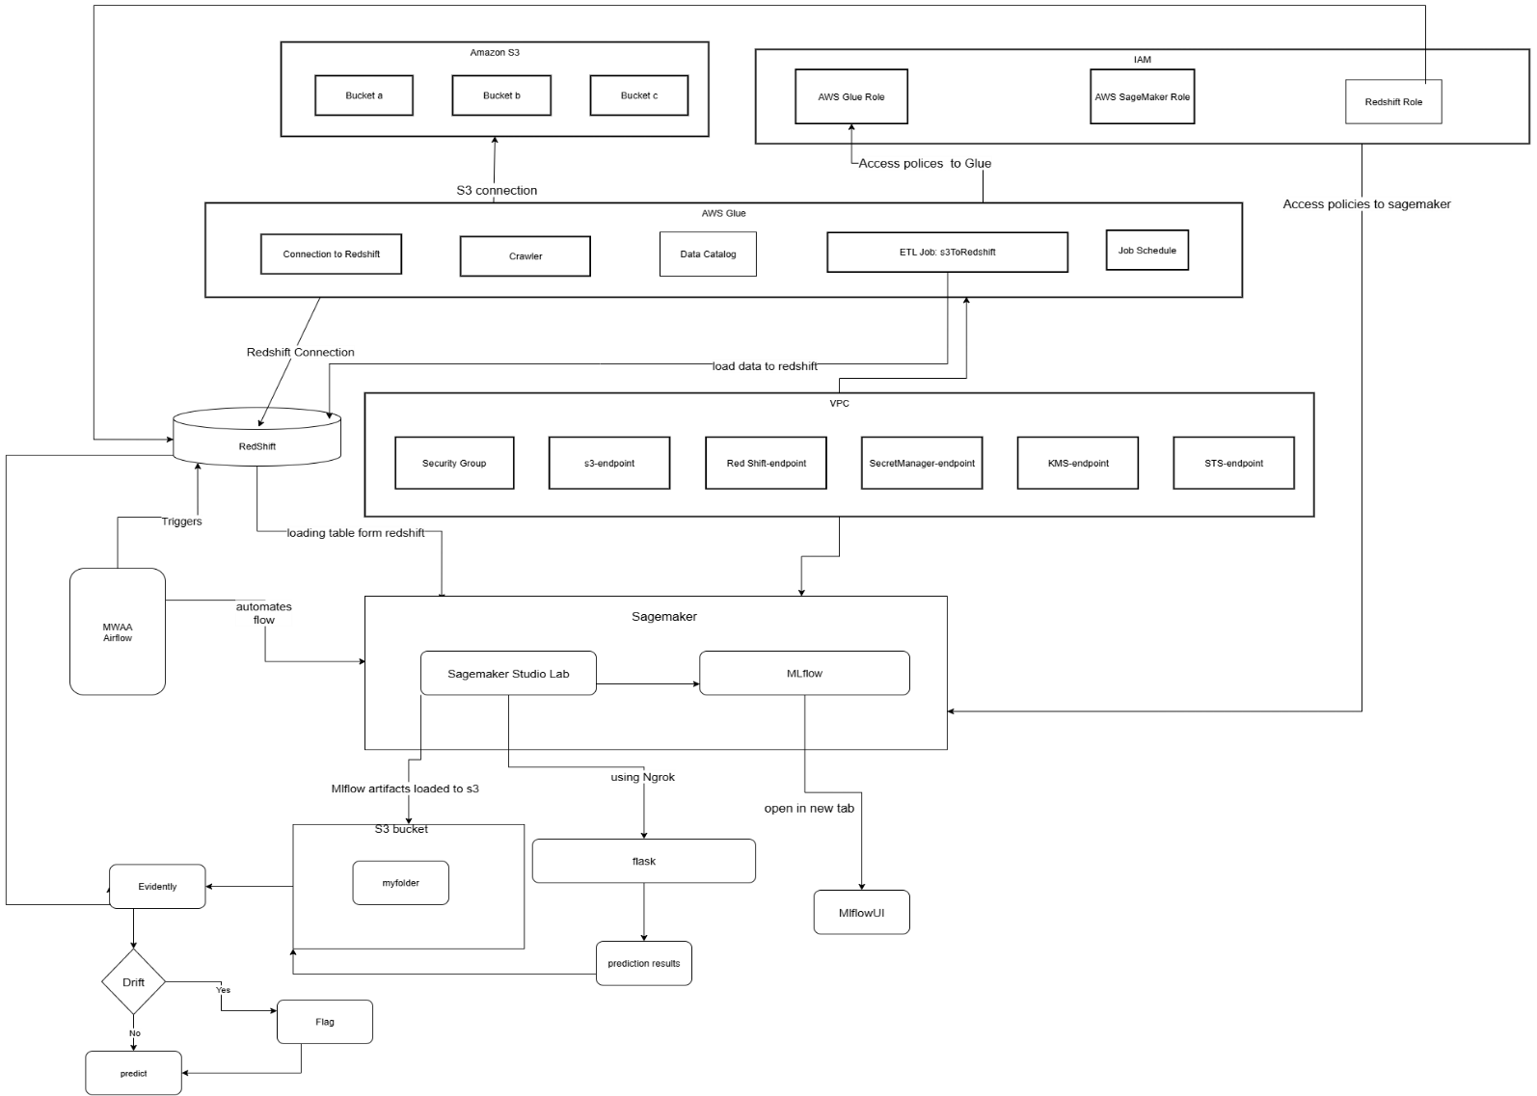
.

Slide 6
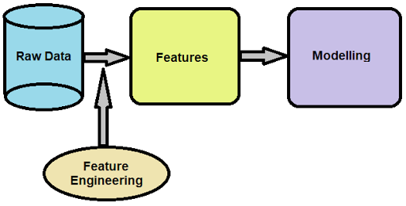
Data Preparation & Feature Engineering
Initial Quality Checks: Inspect, summarize, clean data for consistency.
Standardization: Uniform column formatting, removal of irrelevant IDs, consistent missing value encoding.(eg:MinMax)
Feature Engineering:
Binary Mapping: Yes/No → 1/0
Ordinal Encoding: Ordered categories (Low/Medium/High for activity/profile indices)
One-Hot Encoding: Nominal features for channel/source
Target Variable: “Converted” (Lead outcome).

Slide 7
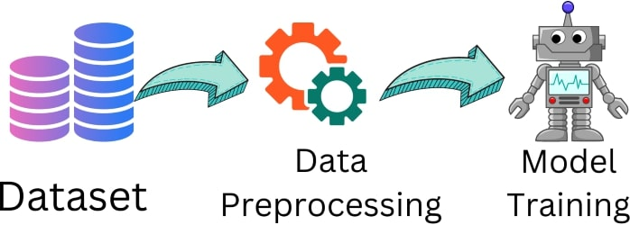
Handling Imbalance, Splitting, and Preprocessing
Duplicate & Outlier Handling: Removal and normalization.
Class Imbalance: Visualized; addressed using SMOTE only on training data.
Train-Test Split: Stratified division to maintain outcome ratios (often 80/20 or 60/20/20 splits).
Preprocessing Pipelines:
Numeric: Impute missing values, scale features.
Nominal: Impute, one-hot encode.
Ordinal: Impute, encode using defined order.

Slide 8
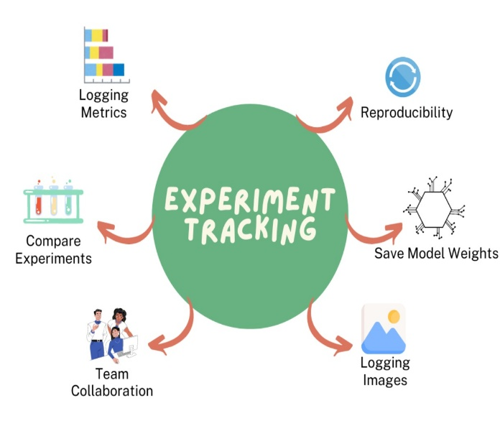
Model Development & Experiment Tracking:
Candidate Models:
Logistic Regression, Decision Tree, Random Forest, XGBoost.
Pipeline:
Preprocessing combined with model via scikit-learn Pipeline.
Hyperparameter tuning:
GridSearchCV, scored on validation ROC AUC.
Experiment Management:
MLflow tracks parameters, metrics, model versions.
SHAP plots explain key feature contributions

Slide 9
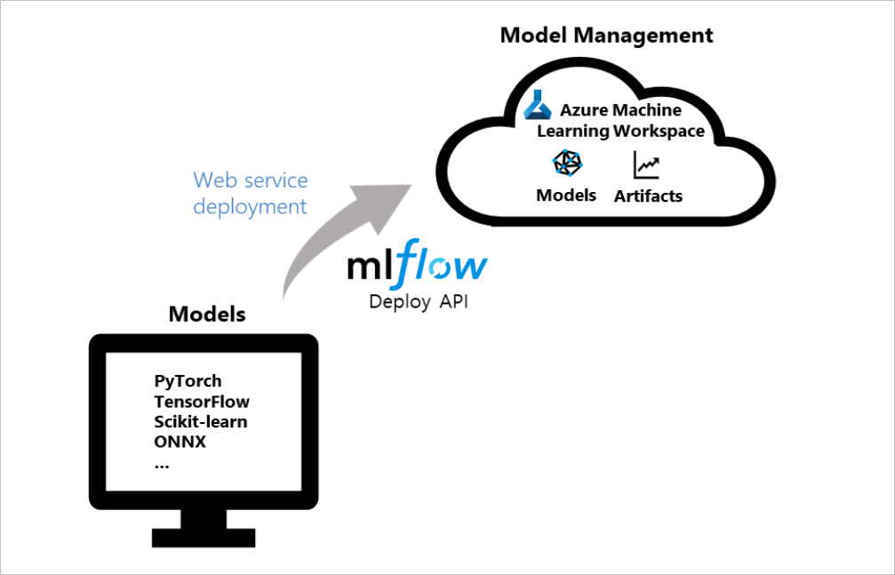
Model Registration & Deployment:
MLflow Model Registry:
Best pipeline auto-registered post-validation.
Promoted to "Production" (alias "champion" optional).
Deployment:
Batch:
Scripts auto-load latest "Production" model from MLflow Registry for offline scoring.
Real-Time:
Flask with Ngrok exposes a REST API for instant predictions.

Slide 10
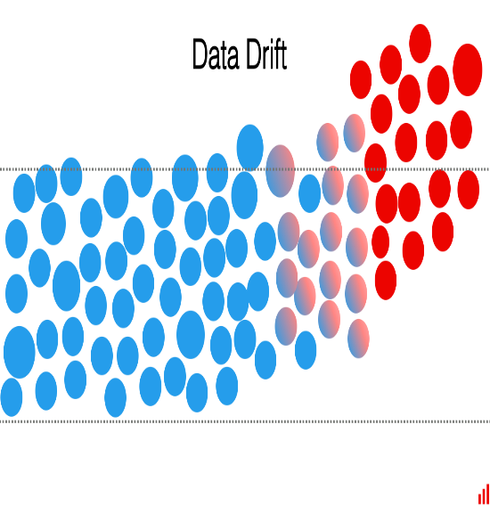
Monitoring, Drift Detection & Governance
Data Drift Detection:
Evidently compares splits (train/val/test), detects dataset shifts.
Drift reports and metrics logged to MLflow for traceability.
Monitoring:
Airflow oversees pipeline/endpoint status.
SageMaker, MLflow, and CloudWatch centralize logs, metrics, run statuses.
Governance:
All models tracked, versioned, and auditable for compliance.

Slide 11
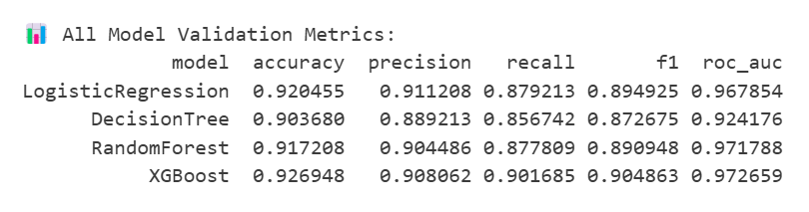
Final Model Performance Benchmarks:
XGBoost outperformed all models, exceeding key performance metrics.

Slide 12






Key Benefits & Future Extensions
Automation:
Reliable, low-touch end-to-end pipeline.
Scalability:
Managed AWS stack grows with workload.
Reproducibility:
Every model, run, and artifact versioned and tracked.
Trust & Compliance:
SHAP, drift monitoring, and full audit trails.
Real-Time Readiness:
Instant lead scoring via flask with Ngrok.
Next steps:
Integrate user feedback, expand monitoring, automate retraining further.

Slide 13

Thank you!

