Slide 1
Parallelizing Neural Network Training
Data Parallel vs Model Parallel for Scientific Regression Workloads
Presenting By:
Anwith Goud Ganamaina
Vinaykumar Reddy Junuthula
Hrushikesh Rahul Reddy Tanagala

Slide 2
Presentation Roadmap
Project objective
Design decisions and technology stack
Dataset generation, model architecture, and training strategies
How experiments were run and measured
Full results table
All plots with visual proof
Final conclusion
Key answer we will prove
Data Parallel training is the best strategy for this workload.
It achieves the highest throughput and the shortest training time.
Model Parallel is correct, but it is much slower because communication dominates runtime.

Slide 3
Project Overview
What the project does and why it matters
Goal
Why this matters
Implemented strategies
Implement and benchmark two parallel training strategies for a regression neural network.
Compare them against a sequential baseline.
Modern scientific datasets can exceed single-machine memory.
HPC workflows need scalable, correct, and efficient training.
Sequential baseline
Data Parallel (DDP + MPI)
Model Parallel (pipeline MPI)
Regression task with MSE loss on scientific-style data.
Real datasets supported: Year Prediction MSD and HIGGS; synthetic fallback was also built.
Hybrid MPI + OpenMP, HDF5 I/O, Caliper annotations, and optional PAPI counters were integrated.
Target dataset sizes were approximately 1 GB, 5 GB, and 10 GB.

Slide 4
Design Decisions and Technology Choices
Main design choices
Why these choices fit the project
PyTorch was chosen for autograd, DataLoader support, and DistributedDataParallel.
mpi4py provides explicit MPI communication required by the course.
HDF5 was chosen instead of CSV because it supports chunked reads and metadata at scale.
Synthetic data gives exact size control and reproducible experiments.
The gloo backend was used because all experiments ran on CPU rather than CUDA GPUs.
SGD was preferred over Adam for cleaner distributed-comparison behavior.
The course specifically required explicit MPI use.
Chunked HDF5 I/O allows large dataset access without parsing entire CSV files.
CPU-only execution on a MacBook makes gloo the correct distributed backend.
Synthetic nonlinear regression data is always available even when real-data downloads fail.
The overall stack balances correctness, reproducibility, and HPC-oriented measurement.

Slide 5
How the System Was Built — Step by Step
1. Define scope
2. Build data pipeline
3. Validate sequential
4. Implement data parallel
5. Implement model parallel
6. Add metrics
Use regression with MSE loss for scientific prediction.
HDF5 file → Dataset → DataLoader → training loop.
Check correctness before adding parallelism.
Split data and synchronize gradients.
Split layers and send activations/gradients.
Measure compute, I/O, communication, throughput, and memory.

Slide 6
Dataset Generation and Sizes
Synthetic dataset design
Dataset | Samples | Approx. size
1 GB | 2,000,000 | ~1,038 MB
5 GB | 10,000,000 | ~5,188 MB
10 GB | 20,000,000 | ~10,376 MB
Why synthetic data was important
Input features: 128
Output targets: 8
Nonlinear target formula: y = sin(X @ W1) @ W2 + noise
Data written in HDF5 chunks to avoid exhausting RAM during generation.
Real data downloads can fail or change their APIs.
Synthetic data is reproducible and always available.
Exact sizes support clean scaling experiments.
The 1 GB, 5 GB, and 10 GB tiers let the project study compute-to-communication tradeoffs.

Slide 7
Neural Network Architecture and File Organization
Regression network
Main project files
Input(128) → Linear(512) → ReLU → Linear(512) → ReLU → Linear(512) → ReLU → Linear(512) → ReLU → Output(8)
Total parameter count is about 853,000 (~3.4 MB in float32).
Four hidden layers make model splitting meaningful across multiple ranks.
No softmax or sigmoid is used because this is a regression task.
generate_data.py — dataset generation
dataset.py — HDF5 dataset and DataLoader logic
model.py — regression NN and model-parallel stage
train_sequential.py, train_data_parallel.py, train_model_parallel.py — core strategies
main.py — entry point and metrics saving
analyze_performance.py — result aggregation and plot creation

Slide 8
Training Strategies Compared
Sequential baseline
Data Parallel
Model Parallel
Single process with no inter-rank communication.
Used first to validate convergence and establish the reference runtime.
Each MPI rank keeps a copy of the whole model.
The dataset is split across ranks.
Gradients are averaged with DistributedDataParallel after backward.
Different ranks own different layers of the network.
Activations move forward through the pipeline and gradients move backward.
Communication happens every batch at every stage.

Slide 9
Hybrid MPI + OpenMP and Performance Metrics
Hybrid parallelism
Measured metrics
MPI gives inter-process parallelism across ranks.
OpenMP threads are used inside each rank by PyTorch BLAS operations.
Best reported setting on the 8-core Mac was 4 ranks × 2 threads.
Too few threads underutilize the CPU; too many threads cause oversubscription.
Training time
Throughput (samples/s)
Epochs per second
Speedup
Parallel efficiency
Communication fraction
Communication bytes
Memory usage
Final MSE

Slide 10
Execution Proof
Environment setup proof
Dataset generation proof
OpenMPI was installed and verified: mpirun (Open MPI) 5.0.9
A Python virtual environment was created and activated.
All required packages were installed successfully.
The 1 GB, 5 GB, and 10 GB datasets were generated successfully.
dataset_1gb.h5 saved at 1038 MB
dataset_5gb.h5 saved at 5188 MB
dataset_10gb.h5 saved at 10376 MB
A quick sequential test run completed successfully on the 1 GB dataset.
Quick sequential test result | Value
Train Time | 12.3552 s
Throughput | 161,876 samples/s
Final MSE | 5.630362
Memory | 2212.8 MB

Slide 11
Complete Experimental Results
Terminal Results — 1 GB dataset, 1 epoch, batch size 512
Strategy | Ranks | Threads | Time(s) | Epochs/s | Throughput | Comm % | Comm MB | Memory (MB) | Final MSE
Sequential | 1 | 1 | 12.3552 | 0.0809 | 161,876 | 0.0 | 0.00 | 2212.8 | 5.630362
Data Parallel | 2 | 2 | 14.1639 | 0.0706 | 141,204 | 0.0 | 12,786.17 | 1180.8 | 5.630282
Data Parallel | 4 | 2 | 16.2824 | 0.0614 | 122,832 | 0.0 | 12,779.62 | 462.8 | 5.630786
Model Parallel | 2 | 2 | 14.5885 | 0.0685 | 137,095 | 44.7 | 7,873.03 | 2790.0 | 5.630368
Model Parallel | 4 | 2 | 31.9677 | 0.0313 | 62,563 | 68.5 | 23,497.03 | 1304.9 | 5.630292
Fastest overall
Best parallel setup
Main bottleneck
Sequential 1r×1t had the shortest training time (12.3552 s) and the highest throughput (161,876 samples/s) in these 1-epoch runs.
Among the parallel runs, Data Parallel 2r×2t performed best with 14.1639 s runtime and 141,204 samples/s throughput.
Model Parallel 4r×2t was the slowest run because communication reached 68.5% of runtime, dropping throughput to 62,563 samples/s.

Slide 12
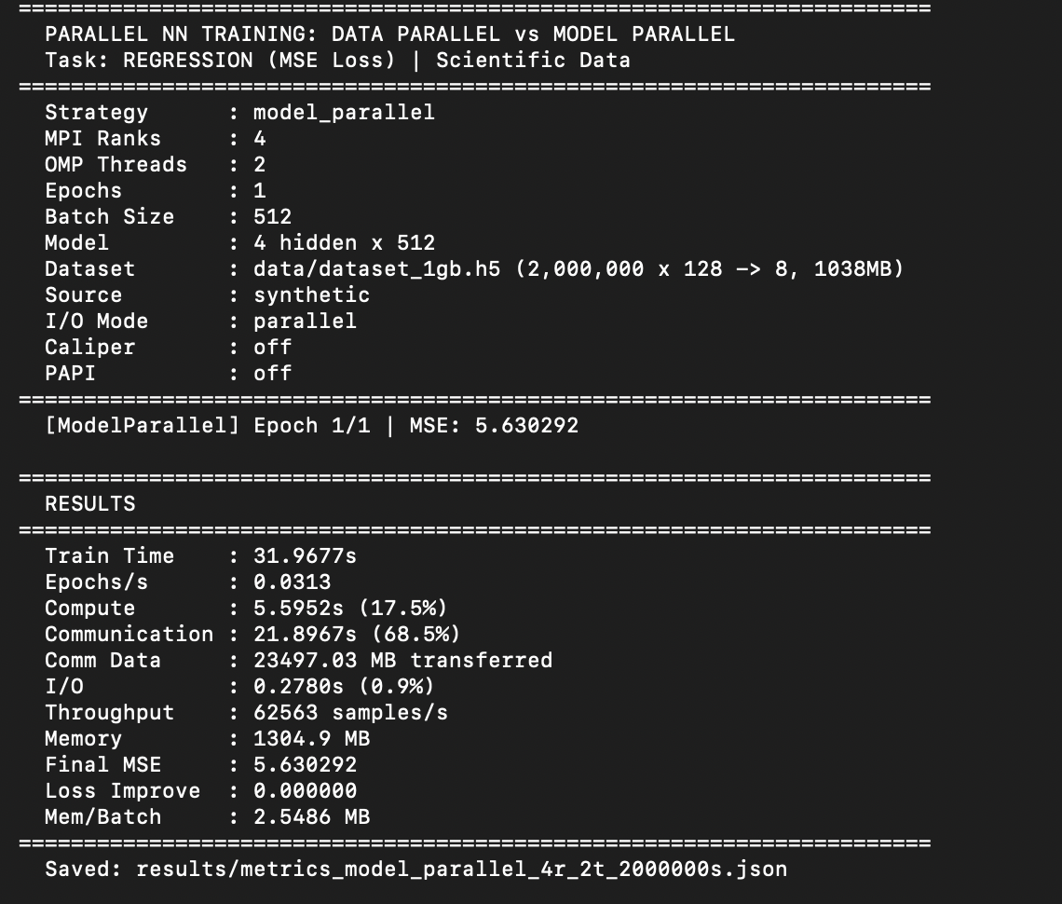
Experimental Results Screenshot 1/5
Model Parallel (4r × 2t)
Key values from this run
Train Time: 31.9677 s
Throughput: 62,563 samples/s
Communication: 68.5%
Comm Data: 23,497.03 MB
Final MSE: 5.630292
Takeaway: This is the worst configuration because communication dominates the runtime.

Slide 13
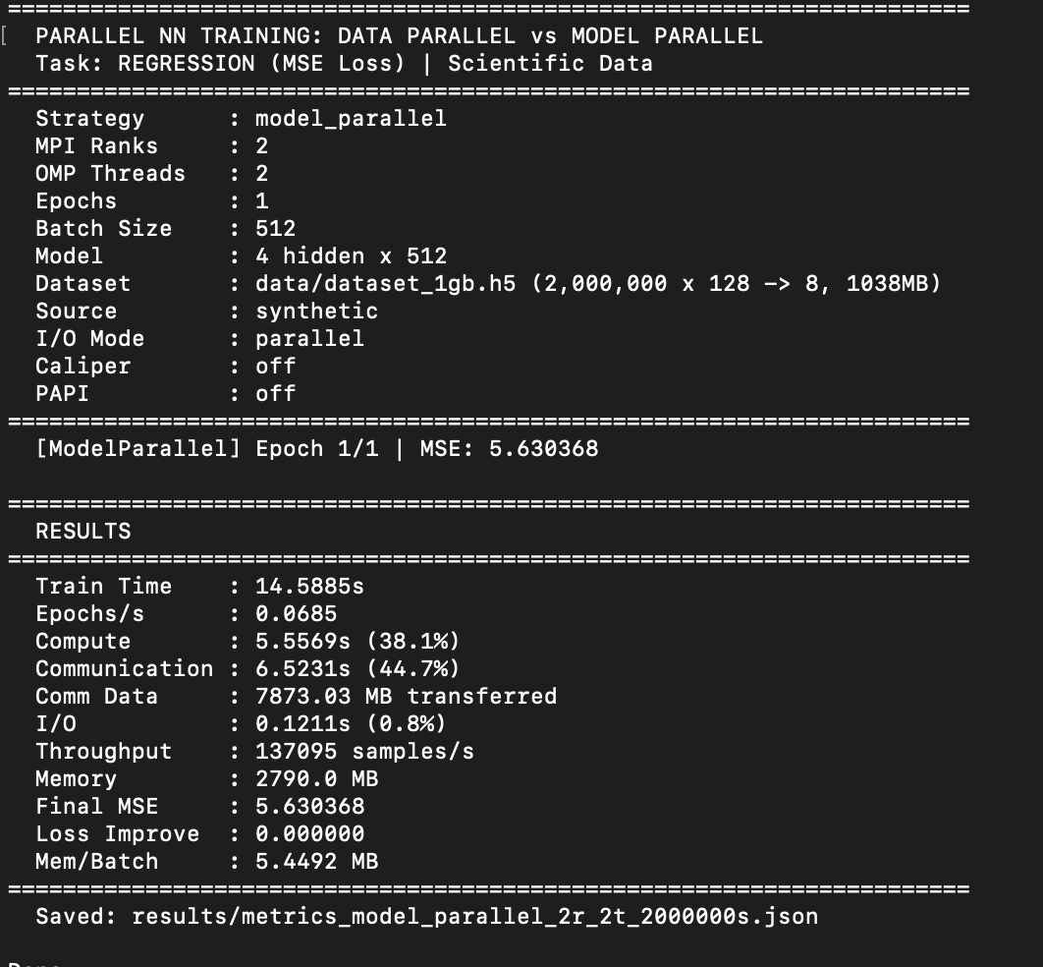
Experimental Results Screenshot 2/5
Model Parallel (2r × 2t)
Key values from this run
Train Time: 14.5885 s
Throughput: 137,095 samples/s
Communication: 44.7%
Comm Data: 7,873.03 MB
Final MSE: 5.630368
Takeaway: Performance is close to Data Parallel 2r×2t, but 44.7% communication overhead is already significant.

Slide 14
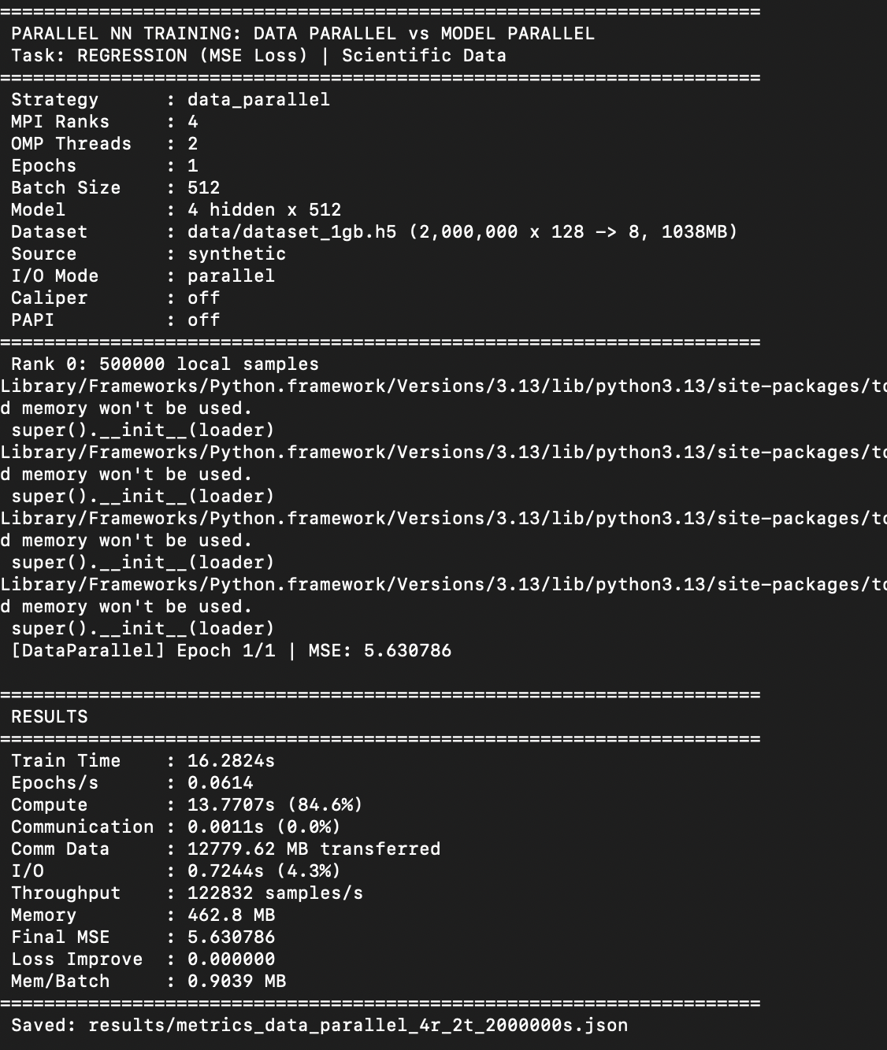
Experimental Results Screenshot 3/5
Data Parallel (4r × 2t)
Key values from this run
Train Time: 16.2824 s
Throughput: 122,832 samples/s
Communication: 0.0%
Comm Data: 12,779.62 MB
Final MSE: 5.630786
Takeaway: It is still efficient, but slower than 2r×2t on this 1-epoch MacBook run.

Slide 15
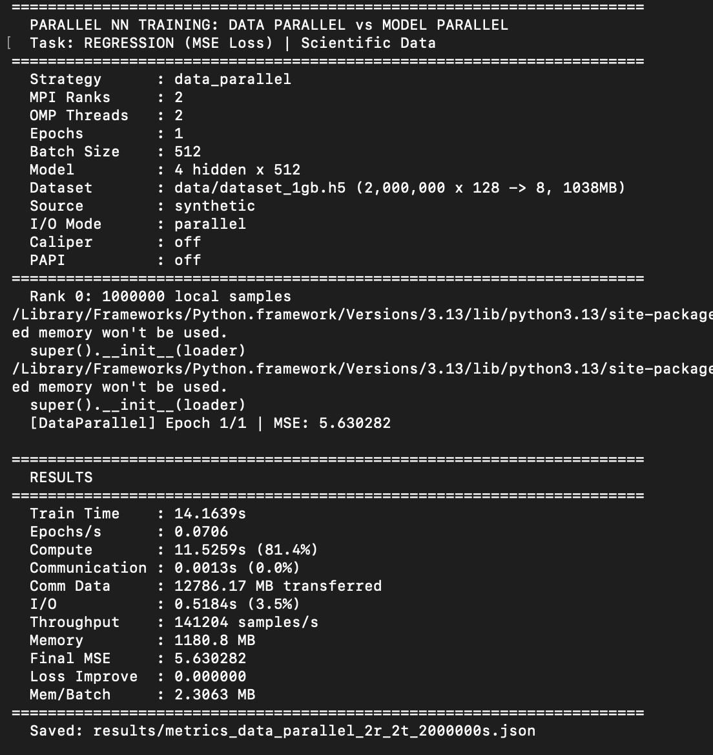
Experimental Results Screenshot 4/5
Data Parallel (2r × 2t)
Key values from this run
Train Time: 14.1639 s
Throughput: 141,204 samples/s
Communication: 0.0%
Comm Data: 12,786.17 MB
Final MSE: 5.630282
Takeaway: This is the best parallel configuration among the runs shown in the screenshots.

Slide 16
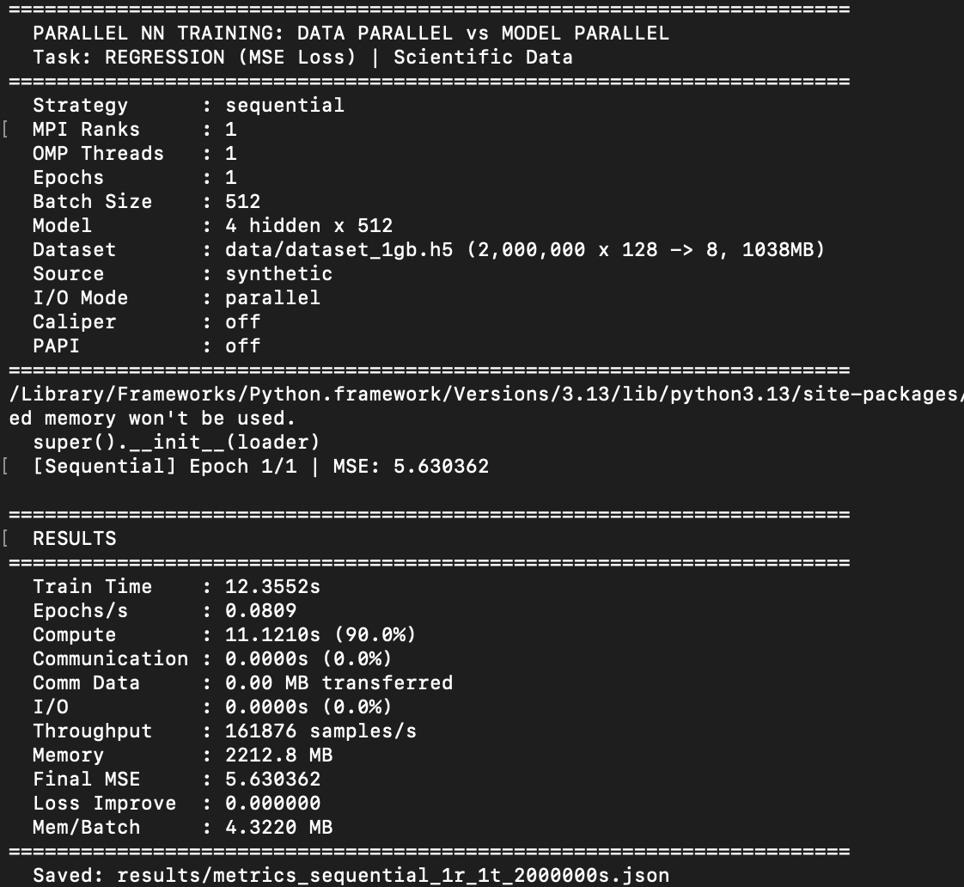
Experimental Results Screenshot 5/5
Sequential Baseline (1r × 1t)
Key values from this run
Train Time: 12.3552 s
Throughput: 161,876 samples/s
Communication: 0.0%
Memory: 2212.8 MB
Final MSE: 5.630362
Takeaway: This is the fastest overall result because it avoids distributed startup and communication overhead.

Slide 17
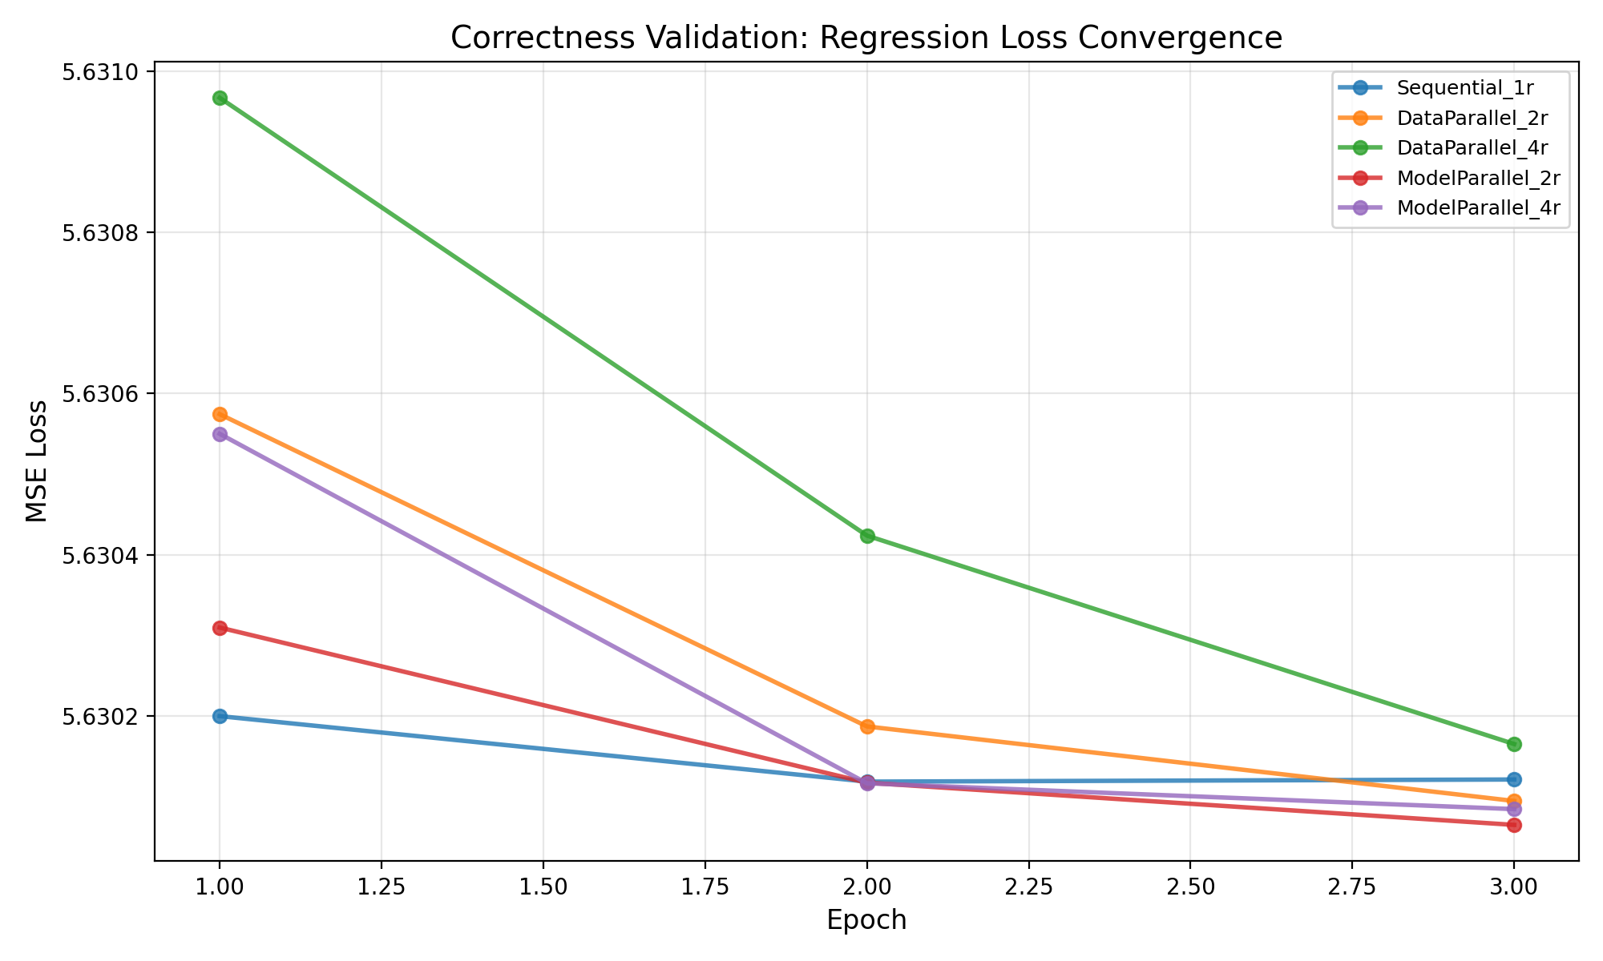
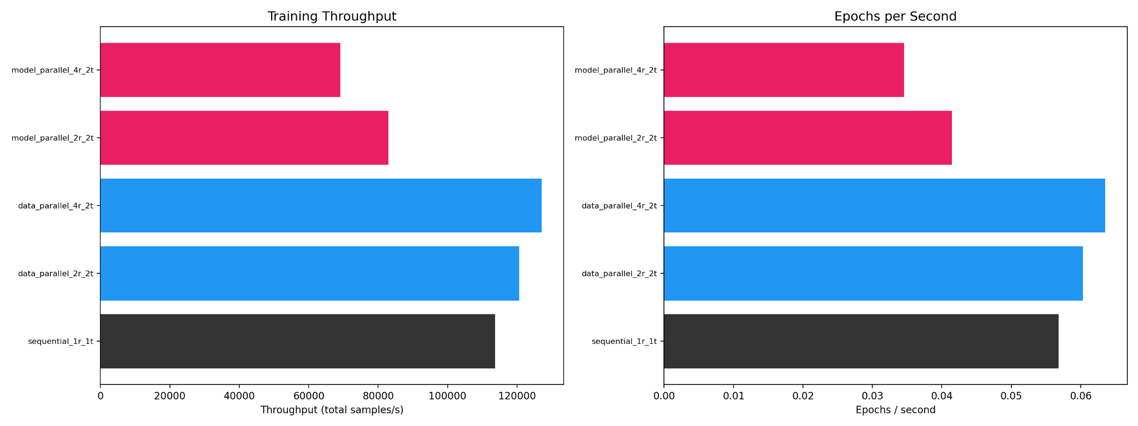
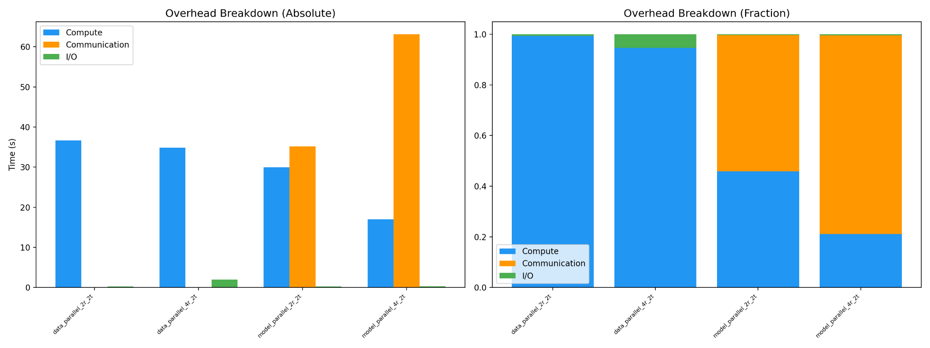
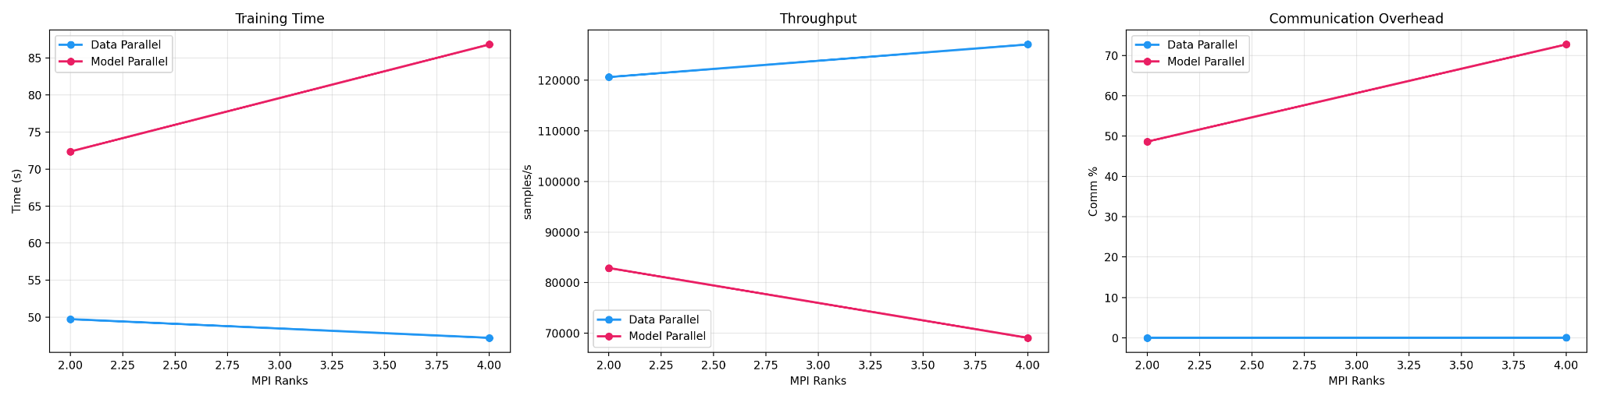
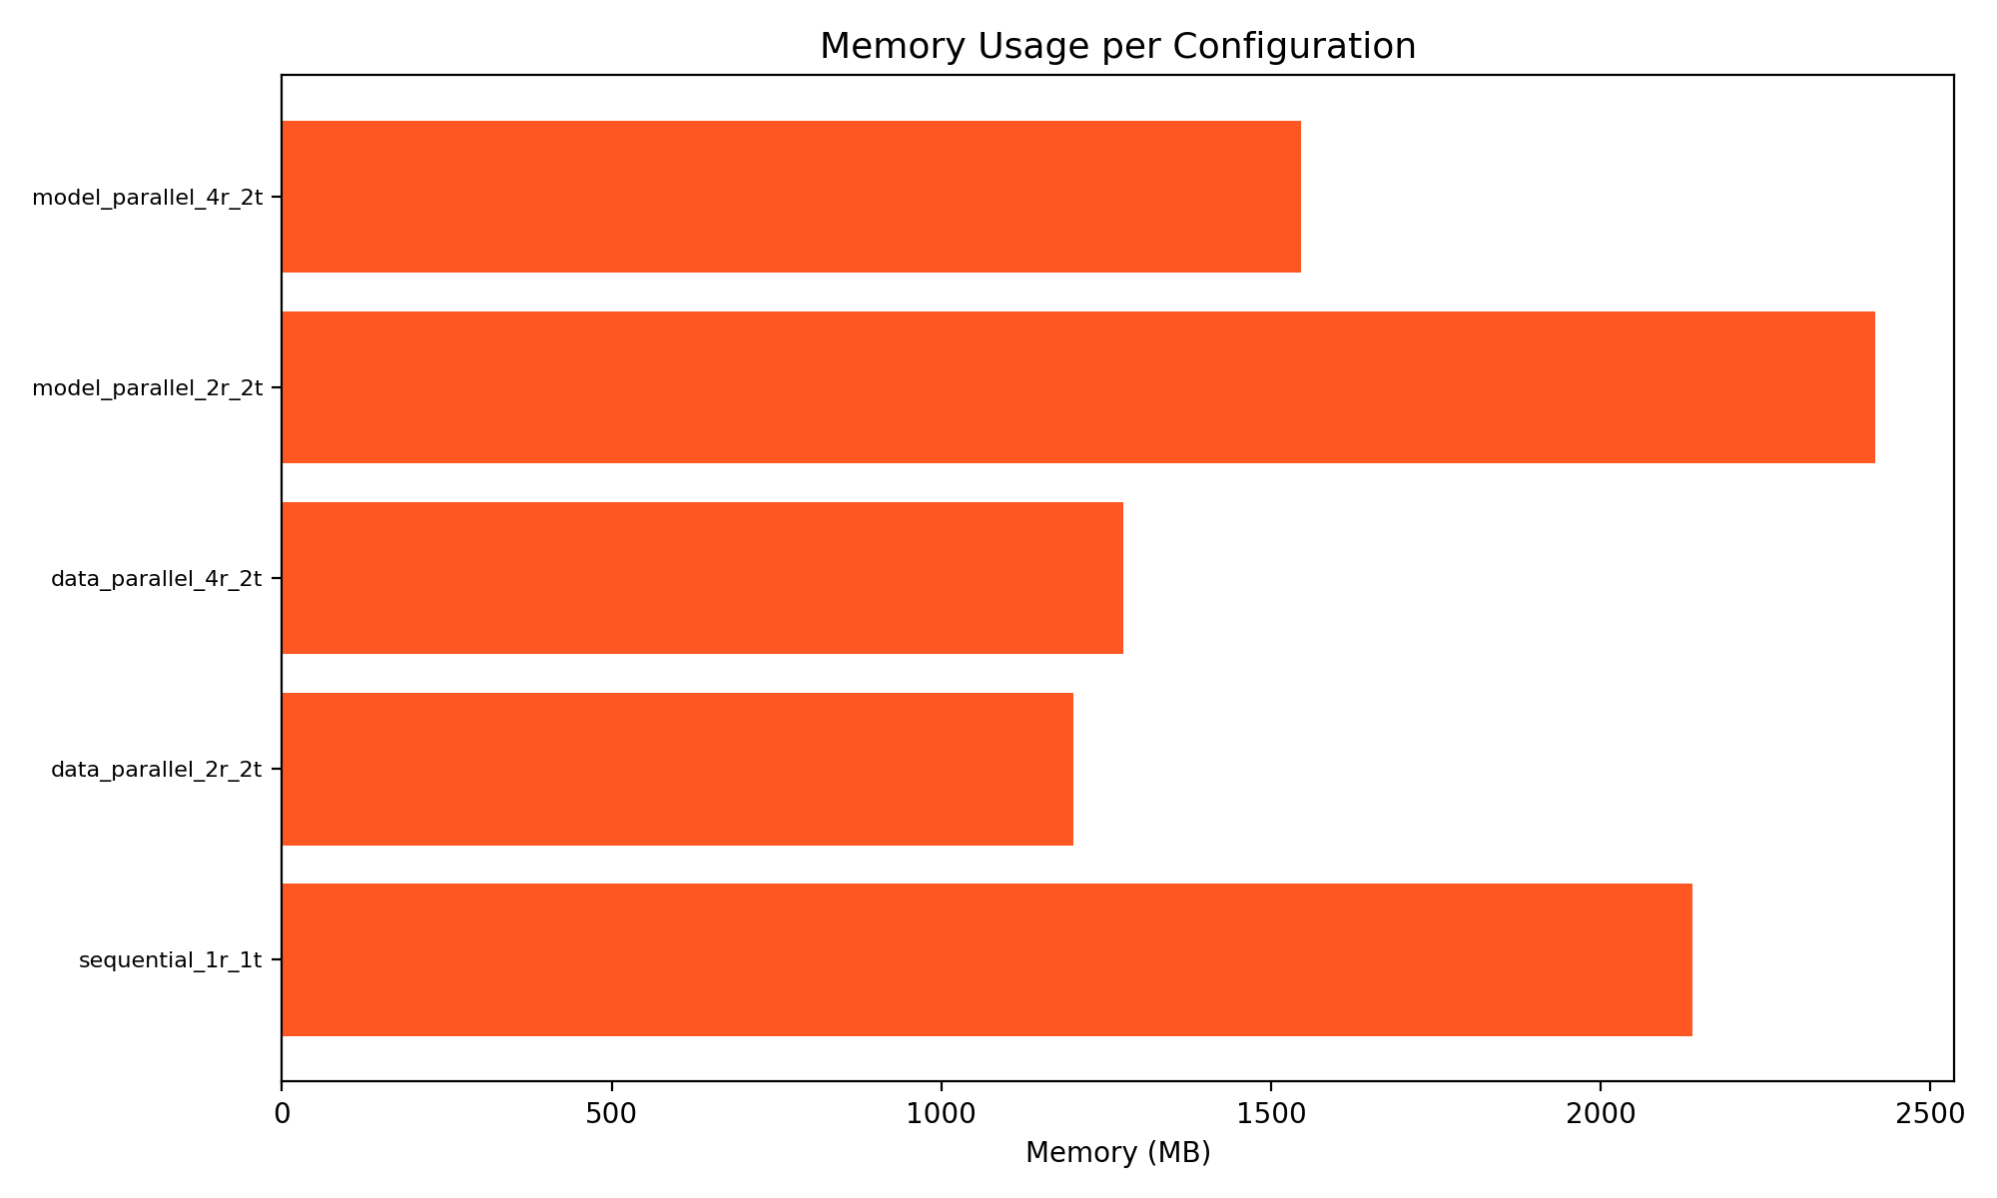
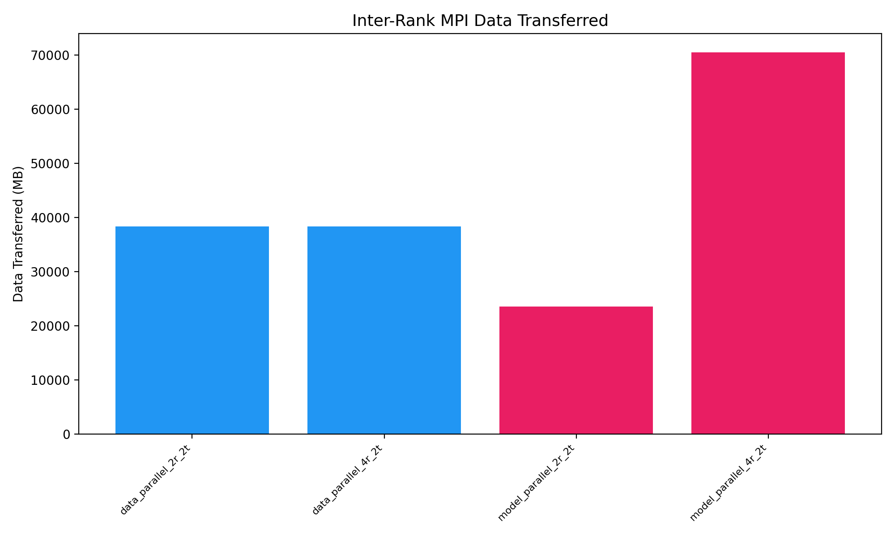
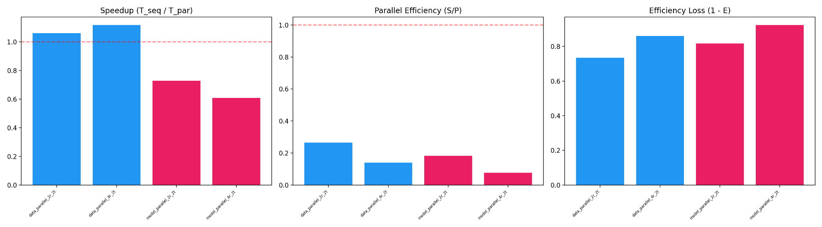
Visual Proof: All Generated Plot Images
This slide shows the plots included in the detailed analysis section.
Correctness
Throughput
DP vs MP
Overhead
Scalability
Memory
Comm bytes

Slide 18
Plot 1: Correctness Validation — Regression Loss Convergence
This plot proves that all strategies train correctly.
All lines converge close to MSE ≈ 5.630 by epoch 3.
The curves are very similar, so sequential, data parallel, and model parallel are mathematically consistent.
Small differences come from shuffled mini-batches and minor run-to-run variation.

Slide 19
Plot 2: Throughput and Epochs per Second
This plot compares overall training productivity.
Data Parallel 4r×2t is the highest at 127,087 samples/s.
Sequential is lower at 113,712 samples/s.
Model Parallel is lower than both, showing that its extra communication reduces effective work per second.

Slide 20
Plot 3: Data Parallel vs Model Parallel Side-by-Side
This figure shows how time, throughput, and communication change as ranks increase.
For Data Parallel, moving from 2 ranks to 4 ranks reduces runtime and improves throughput.
For Model Parallel, moving from 2 ranks to 4 ranks makes runtime worse and throughput lower.
Communication overhead grows sharply for Model Parallel, reaching above 70%.

Slide 21
Plot 4: Overhead Breakdown (Absolute and Fraction)
This plot explains where runtime is spent.
Data Parallel is compute-dominated, which is ideal.
Model Parallel is communication-dominated, especially with 4 ranks.
I/O is comparatively small, so storage access is not the main bottleneck.

Slide 22
Plot 5: Scalability — Speedup, Efficiency, and Efficiency Loss
This figure evaluates how well the parallelism scales.
Data Parallel has speedup above 1.0, so it beats the sequential baseline.
Model Parallel has speedup below 1.0, so it is slower than the baseline.
Efficiency is low because all ranks still share one laptop CPU, memory bus, and cache.

Slide 23
Plot 6: Memory Usage per Configuration
This plot compares memory consumption across configurations.
Sequential holds more data in one process.
Data Parallel reduces memory per process because each rank owns a subset of the data.
Model Parallel 2r shows higher memory because implementation details can create duplication/gather overhead.

Slide 24
Plot 7: Inter-Rank MPI Data Transferred
This plot measures the total communication volume.
Data Parallel transfers about 38,339 MB while synchronizing gradients.
Model Parallel 4r transfers about 70,491 MB because it repeatedly sends activations and gradients.
More pipeline stages create more communication hops, so MPI traffic increases rapidly.

Slide 25
Final Conclusion
For this CPU-based scientific regression workload, Data Parallel training is the best strategy.
The best configuration was 4 MPI ranks with 2 OpenMP threads per rank.
It produced the fastest training time and the highest throughput while preserving the same MSE as the baseline.
Model Parallel was mathematically correct, but it became communication-bound and therefore slower than both Data Parallel and the sequential baseline.
The plots in this PPT visually prove the conclusion: Data Parallel is compute-dominated and scalable, while Model Parallel is communication-dominated.

Slide 26
THANK YOU
Q&A ??

