Slide 1
DSCI-6612-02 Intro to Artificial Intelligence
Implementation of Multiple Tic-Tac-Toe Agents in a Tournament Setting
Professor : Vahid Behzadan
Team Members : Vinaykumar Reddy Moku
Madhavi Kancham

Slide 2

Project Topic
Tic-Tac-Toe:
It is a two-player game played on a 3x3 grid. Players take turns marking empty cells with their designated symbols, usually "X" and "O," aiming to create a row, column, or diagonal of their symbol to win.
Game State Representation, Decision Tree Exploration, Game State Evaluation, Optimal Move Identification are the Primary concepts.

Slide 3
Project Objectives
The objective is to develop an AI agent that plays tic tac toe intelligently, aiming to achieve a winning configuration of three marks in a row, either diagonally, vertically, or horizontally.
AI agents will be develped to analyze the game situation and make the best moves to increase its chances of winning or forcing a draw using algorithms like Minimax or Alpha-Beta Pruning.
To manage player moves, determine what constitutes a winning arrangement, and identify valid moves, functions were built. This involved looking for three matching symbols in the rows, columns, and diagonals.

Slide 4
Approch
The Tic-Tac-Toe game’s agents are created using the following algorithm’s:
Adversarial search Algorithms:
1. Minimax algorithm using traditional approach
2. Minimax algorithm using alpha-beta pruning approach
3. Expectimax algorithm
Reinforcement Learning Algorithm:
1. Q-learning
Technology details :
1. Programming Language - Python3

Slide 5

Deliverables
Algorithm
Development
GitHub
Project
Demonstration
Documentation

Slide 6
Evaluation Methodology
The project evaluation focuses on implementing four AI algorithms correctly.
Each agent must smoothly make its next move without freezing or failing.
Agent’s next move should always try to sabotage the opponent's chances of winning the game.
The game's output should be equal to that of two human brains playing the game.

Slide 7
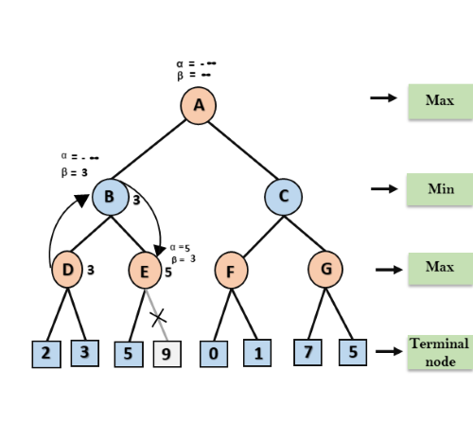
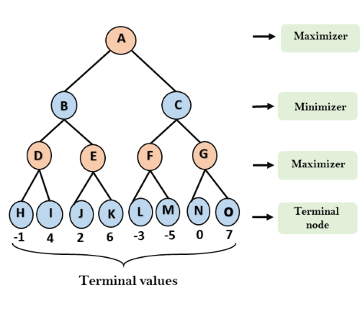
ALGORITHMS
ALPHA-BETA
PRUNING
MINIMAX

Slide 8
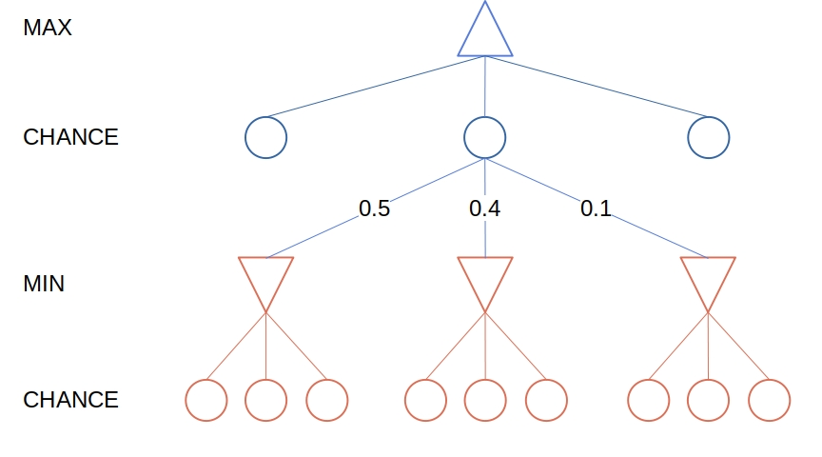
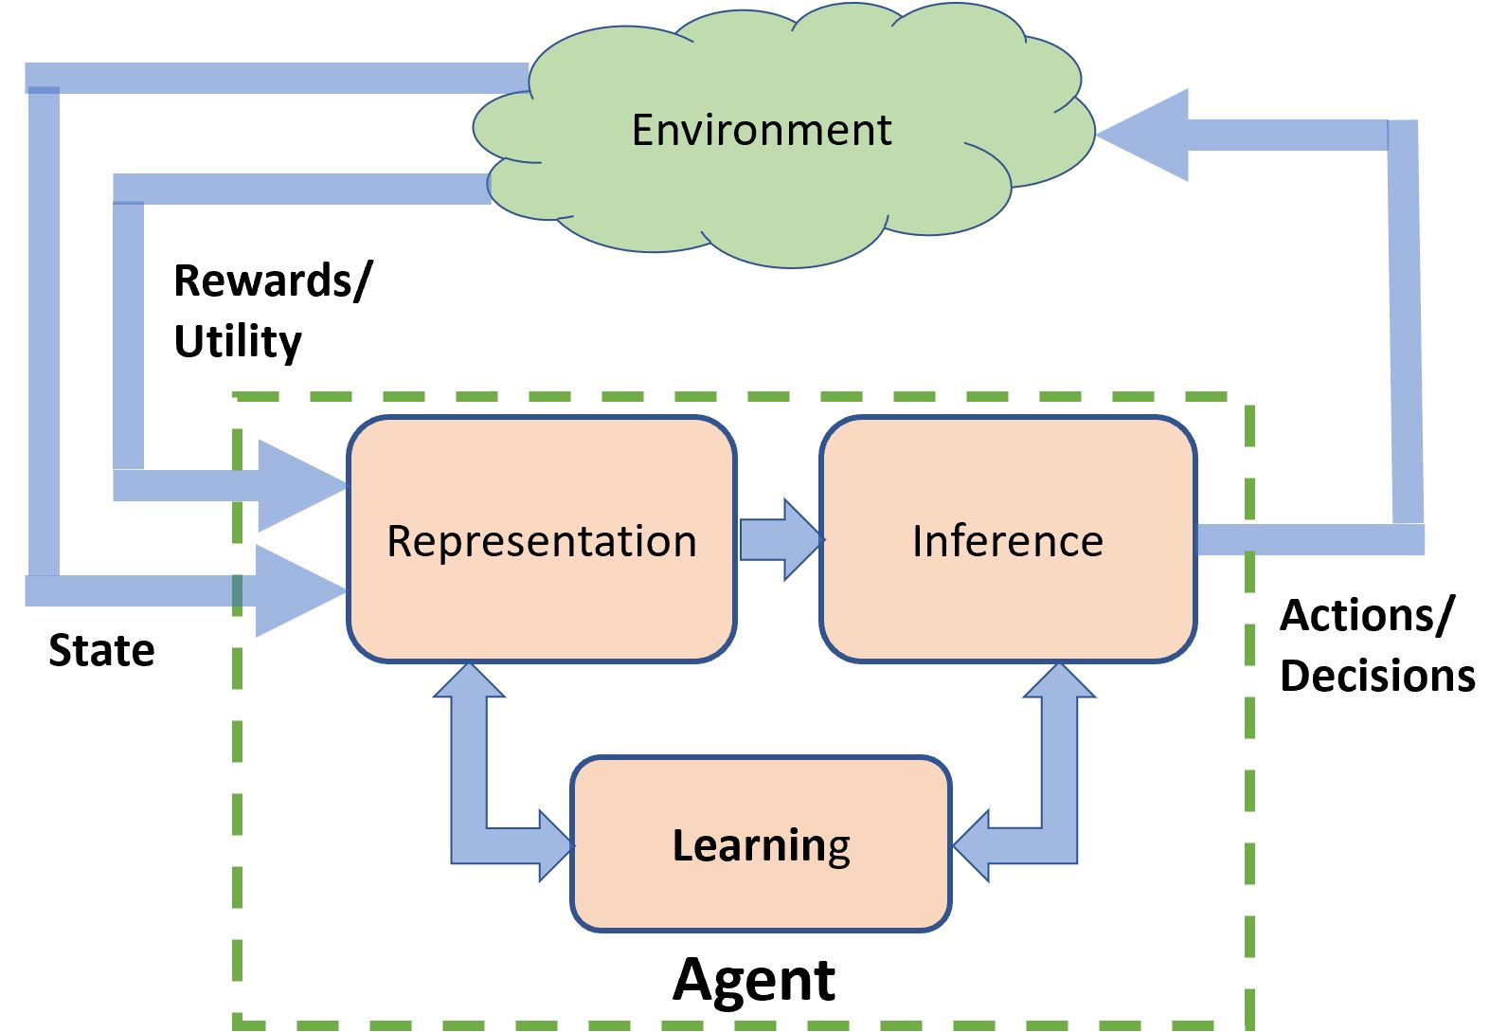
EXPECTIMAX
Q-LEARING

Slide 9
THANK YOU!

