Slide 1
Basic Details of the Team and Problem Statement
PSID: KVH-001
Problem Statement Title : New age women safety app
Team Name: TECH INFINITEX
Team Leader Name: Sravani NVS
Institute Code (AISHE): C-26162
Institute Name: Vasavi College of Engineering(VCE)

Slide 2
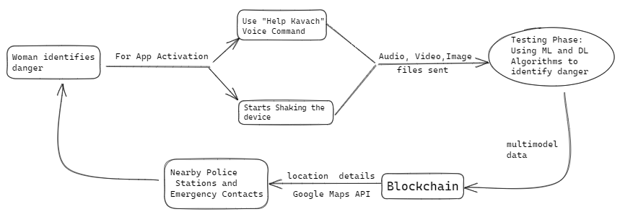
Idea/Approach Details
Our women's safety app can be activated either by shaking the device or using the voice command "Help Kavach".
Once activated, the app records audio and captures video from the front and back camera for safety evaluation.
The captured data undergoes multiple ML and deep learning algorithms to determine if the situation is dangerous or not instantly.
If the situation is deemed suspicious, the location details are sent to the nearest police station and emergency contacts.
Based on past crimes and incidents, our app can determine how safe a particular location is and provide recommendations to the user.
The user's data is secured using blockchain technology to prevent any unauthorized access.
Tech stack:
React-Native
NodeJS
Block Chain
Machine Learning & Deep Learning
Android Media API
MongoDB

Slide 3
Use Cases
Dependencies / Show stoppers
Late-night commuters: Women commuting late at night can use the app to call for help in case of any suspicious activities.
Solo travelers: Women traveling alone can use the app to ensure their safety and call for help if needed.
Women with disabilities: Women with disabilities can use the app to call for help and send location details in case they need assistance or are in danger.
Domestic violence victims: Women who are victims of domestic violence can use the app to discreetly call for help and capture data as evidence.
Workplace safety: Women working in remote or high-risk areas can use the app to call for help and send location details to the police and emergency contacts.
The app's activation feature must work reliably and consistently across all devices, including different models and operating systems.
The app must be able to access the device's camera and microphone to record audio and video.
The machine learning and deep learning algorithms used by the app must be highly accurate in determining the level of danger in a given situation.
The app's blockchain technology must be highly secure and reliable to prevent any unauthorized access to user data.
The app must have a user-friendly interface and be easy to use in high-stress situations.

Slide 4
Team Member Details
Sr. No. | Name of Team Member | Branch (Btech/Mtech/PhD etc): | Stream (ECE, CSE etc): | Year | Position in team (Team Leader, Front end Developer, Back end Developer, Full Stack, Data base management etc.)
1 | Sravani nvs | BE | CSE- AIML | 3rd Year | Team Leader
2 | Guradi Vinay Reddy | BE | CSE-AIML | 3rd Year | Blockchain
3 | Nagasai Vuppala | BE | CSE | 3rd Year | Front-End
4 | Dammalapati Pranav | BE | CSE | 3rd Year | Back-End
5 | Prajwal | BE | CSE-AIML | 3rd Year | ML & DL
6 | Sarath Kumar | BE | CSE | 3rd Year | DBMS
Team Mentor/s Details
Sr. No. | Name of Mentor | Category (Academic/Industry): | Expertise (AI/ML/Blockchain etc): | Domain Experience (in Years )
1
2

