Slide 1
Data Pipeline and Analytics Workflow on AWS

Slide 2
Introduction.
In an era where data is proliferating at an unprecedented rate, the ability to efficiently process and convert vast amounts of raw data into actionable insights is paramount for any business aiming to maintain a competitive edge.
Our project focuses on harnessing the power of cloud computing and automation, utilizing a suite of AWS services, to establish a robust data engineering pipeline.
This pipeline transforms raw data from initial ingestion to insightful visualization, optimizing decision-making processes for our business teams.

Slide 3
Background
Our source data, integral to business analysis and strategic planning, originates from diverse systems in the form of CSV files.
These files are considerable in number and size, necessitating an automated, efficient, and scalable process for extraction, transformation, and loading (ETL).
Traditionally, managing such vast datasets through on-premise infrastructure would be both resource-intensive and cost-prohibitive. Our approach leverages cloud services to not only meet our data processing needs but also streamline operations, reduce overhead costs, and provide high availability and scalability.

Slide 4
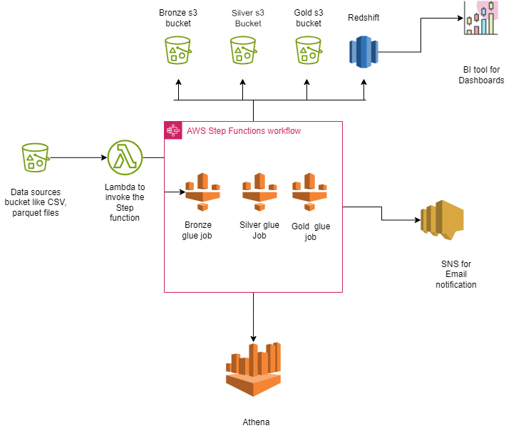
Project Architecture

Slide 5
Project Overview
Strategic journey from raw data to actionable insights, we leverage a robust, three-tiered transformation process within our innovative data engineering pipeline. This methodical approach, metaphorically classified into 'bronze,' 'silver,' and 'gold' stages, is designed to methodically refine the data, enhancing its intrinsic value, accessibility, and precision for our business intelligence initiatives.
Bronze Layer:
Initial ingress of raw CSV data, unaltered for full traceability.
'As-is' data preservation for compliance.
Silver Layer:
Rigorous data processing: cleansing, deduplication, validation, and aggregation.
Focus on bolstering data integrity and consistency.
Gold Layer:
Advanced refinement via enrichment and intricate calculations.
Data synthesis, primed for cutting-edge business analytics tools.

Slide 6
Step 1: Source File Upload to S3
Source: Data sources or systems generate data files named `Orders_YYYYMMDD.csv` where `YYYYMMDD` denotes the date when the file was created.
Upload Process: These files are uploaded daily to an Amazon S3 (Simple Storage Service) bucket by the source systems.
Step 2: Triggering AWS Lambda Function
When a file is uploaded to the S3 source, it triggers an AWS Lambda function. This Lambda then calls an AWS Step Function. The Step Function coordinates the next actions based on the uploaded file.

Slide 7
Step:3
The Step Function consists of three AWS Glue jobs, and upon completion, AWS SNS is used to send emails notifying subscribers about the status of these Glue jobs.
1. Bronze Glue Job: This job processes the raw data obtained from the source. Without applying any transformations, the data is written to parquet files and stored in the Bronze S3 bucket. These files are partitioned using the `batch_id` column. The data can be accessed using AWS Athena, under specific tables in the `bronze` database, and is also available for integration into other data pipelines.
2. Silver Glue Job: In this phase, the data undergoes minor transformations. Changes might include data type conversions, renaming columns, and other such adjustments. Once transformed, the data is loaded into an appropriate location, and it remains accessible via AWS Athena.
3. Gold Glue Job: This is a more intensive transformation layer where major business logic is applied to the data. New columns might be derived from existing ones, for instance, `delivery_time_taken` and `order_total_amount`. After these transformations, the data is loaded into Amazon Redshift for further analysis and querying.

Slide 8
Finally, the SNS Service is used to send out notifications. It publishes emails to subscribers, keeping them informed about the job's status.
Step:4
The loaded data is available in redshift for creating dashboards.

Slide 9
Challenge: Data Ingestion Delays or Failures
Data Ingestion Delays or Failures
Symptoms: Data is not being ingested into the Bronze S3 bucket in a timely manner, causing delays in downstream processes.
Possible Causes:
Source systems are not exporting data properly.
Network connectivity issues.
AWS Lambda invocation issues.
Troubleshooting Steps:
Check CloudWatch logs for Lambda to see if there are any execution errors or timeouts.
Monitor the source system's logs to verify data export operations.
Check the health and metrics of the data source system, looking for outages or disruptions.
Use AWS X-Ray or similar tools to trace data flow from source systems to the Bronze bucket.

Slide 10
Challenge: Glue Job Failures
Symptoms: Glue jobs (Bronze, Silver, or Gold) are failing during execution.
Possible Causes:
Data quality or format issues that weren't expected.
Glue resource limits reached.
Errors in the Glue ETL scripts.
Troubleshooting Steps:
Check the AWS Glue console for error messages associated with the failed jobs.
Review CloudWatch logs for Glue for more detailed error information.
If data quality is suspected, sample the data from the respective S3 bucket and inspect for anomalies.
Monitor Glue job resource metrics (DPU usage, memory, etc.) in CloudWatch to ensure they're within limits. Consider increasing resources if necessary.

Slide 11
Challenge: Query Performance Issues in Athena
Symptoms: Queries in Athena are taking longer than expected, leading to delays in data analysis.
Possible Causes:
Inefficient query design.
Large datasets that are not properly partitioned or indexed.
Non-optimal data formats.
Troubleshooting Steps:
Review the specific Athena queries being executed for inefficiencies or unnecessary operations.
Monitor Athena query execution metrics in CloudWatch to identify bottlenecks.
Ensure that the data in S3 is partitioned effectively, making it easier for Athena to scan only relevant data.

