Slide 1
Skewness and Kurtosis

Slide 2
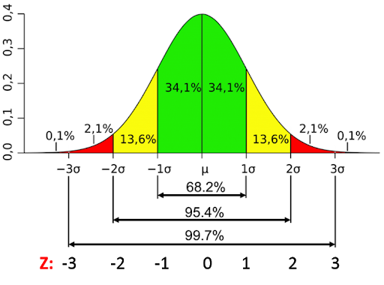

Slide 3
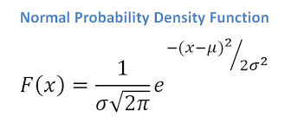

Slide 4
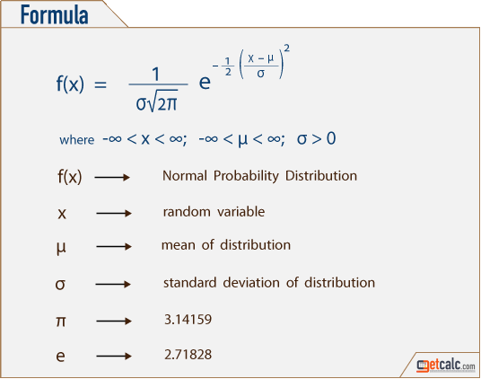

Slide 5
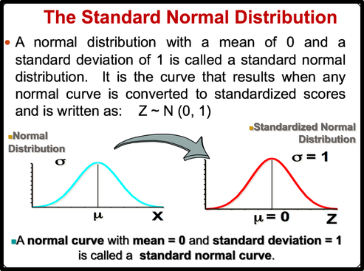
https://statisticstechs.weebly.com/desciptive-statistics/normal-distribution

Slide 6
A normal distribution can be used to describe a variety of quantitative variables
A normal distribution curve is bell-shaped
The mean, median, and mode are equal and are located at the center of the distribution
A normal distribution curve is unimodal ( it has only one mode)
The curve is symmetric about the mean. It means that the right portion of the distribution is equal to the left portion of the distribution

Slide 7
The curve is continuous; that is, there are no gaps or holes
The curve never touches the x axis. Theoretically, no matter how far in either direction the curve extends, it never meets the x axis—but it gets increasingly closer
The total area under a normal distribution curve is equal to 1.00, or 100%
In the normal distribution, about 68% of the data fall within 1 standard deviation of the mean ; about 95% of the data fall within 2 standard deviation of the mean; and about 99.7% of data fall within 3 standard deviation of the mean

Slide 8
What is skewness
Skewness is a measure of asymmetry of a distribution. Another measure that describes the shape of a distribution is kurtosis
In a normal distribution, the mean divides the curve symmetrically into two equal parts at the median and the value of skewness is zero.

Slide 9
What is skewness
When a distribution is asymmetrical the tail of the distribution is skewed to one side-to the right or to the left.
When the value of the skewness is negative, the tail of the distribution is longer towards the left hand side of the curve.
When the value of the skewness is positive, the tail of the distribution is longer towards the right hand side of the curve.

Slide 10
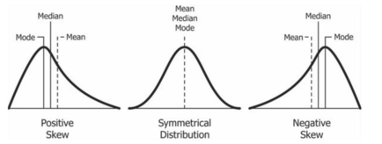

Slide 11
Kurtosis
Kurtosis is one of the two measures that quantify shape of of a distribution. The another measure is skewness.
Kurtosis describes the peakedness of the distribution.
If the distribution is tall and thin it is called a leptokurtic distribution. Values in a leptokurtic distribution are near the mean or at the extremes.

Slide 12
A flat distribution where the values are moderately spread out (i.e., unlike leptokurtic) is called platykurtic distribution.
A distribution whose shape is in between a leptokurtic distribution and a platykurtic distribution is called a mesokurtic distribution. A mesokurtic distribution looks more close to a normal distribution.

Slide 13
How to calculate
The pandas DataFrame has a computing method kurtosis() which computes the kurtosis for a set of values across a specific axis (i.e., a row or a column).
The pandas library function kurtosis() computes the Fisher's Kurtosis which is obtained by subtracting the Pearson's Kurtosis by three.
With Fisher's Kurtosis, definition a normal distribution has a kurtosis of 0.

Slide 14
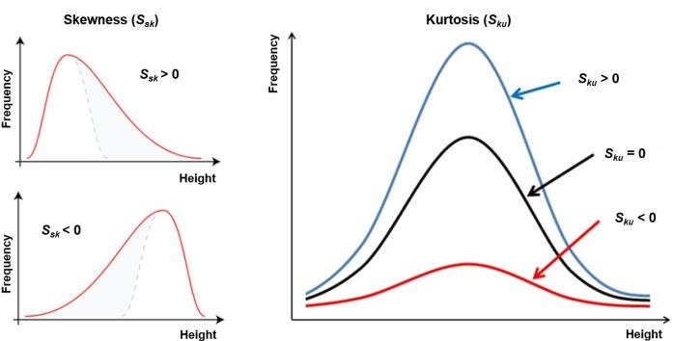

Slide 15
