Slide 1


Dealing with missing data
Dr. Richard Hodgett

Slide 2
Plan for this session
Discuss how data can be missing.
Discuss how you can classify missing data.
Talk about the procedure for dealing with missing data.
Show how to identify missing data.
Discuss deletion methods and then use these in R.
Discuss imputation methods and then use these in R.
Apply what you have learnt to the titanic passengers dataset.

Slide 3



Missing data
Missing data is a common problem and challenge for analysts.
There are many reasons why data could be missing, including:
Respondents forgot to answer questions.
Respondents refused to answer certain questions.
Respondents failed to complete the survey.
A sensor failed.
Someone purposefully turned off recording equipment.
There was a power cut.
The method of data capture was changed.
An internet connection was lost.
A network went down.
A hard drive became corrupt.
A data transfer was cut short.

Slide 4

Missing data
Missing data can usually be classified into:
Missing Completely at Random (MCAR):
If missingness doesn’t depend on the values of the data set.
e.g. a random sample of patients who had their blood pressure measured also had their weight measured.
Missing at Random (MAR):
If missingness does not depend on the unobserved values of the data set but does depend on the observed.
e.g. patients with high blood pressure had their weight measured.
Not Missing at Random (NMAR):
If missingness depends on the unobserved values of the data set.
e.g. overweight patients had their weight measured.
Notes:
Another example:
MCAR: Survey questions asked only to a random sample of original sample.
MAR: Respondents in service occupations less likely to report income.
NMAR: Respondents with high income less likely to report income.
NMAR is difficult to analyse / complex

Slide 5
Missing data
Another example: Survey data on drug use.
Missing Completely at Random (MCAR):
You removed 10% of the respondents data randomly.
Missing at Random (MAR):
People who come from poorer families might be less inclined to answer questions about drug use, and so the level of drug use is related to family income.
Not Missing at Random (NMAR):
Students skipped the question on drug use because they feared that they would be expelled from school.
(most common type)

Slide 6
Missing data
Generally the procedure for dealing with missing data is:
Identify the missing data.
Identify the cause of the missing data.
Either:
Remove the rows containing the missing data
Also called the naïve approach.
Make sure missing data isn’t biased!
Replace missing values with alternative values.
Impute the missing values.
There are a number of approaches.
Deciding between A and B depends on which outcome you think will produce the most reliable and accurate results.

Slide 7
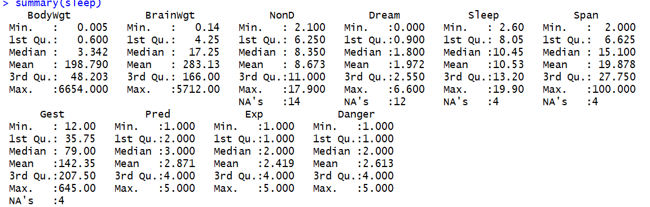
Identify Missing data
Normally missing data is identified using summary in R:
There are also a number of different ways to visualize missing data in R..

Slide 8
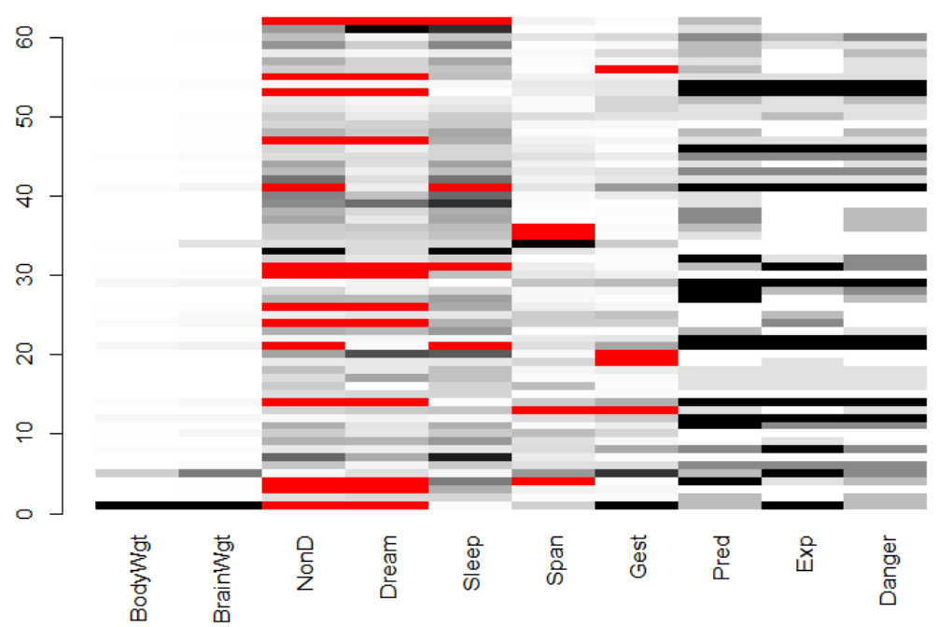
Identify Missing data

Slide 9
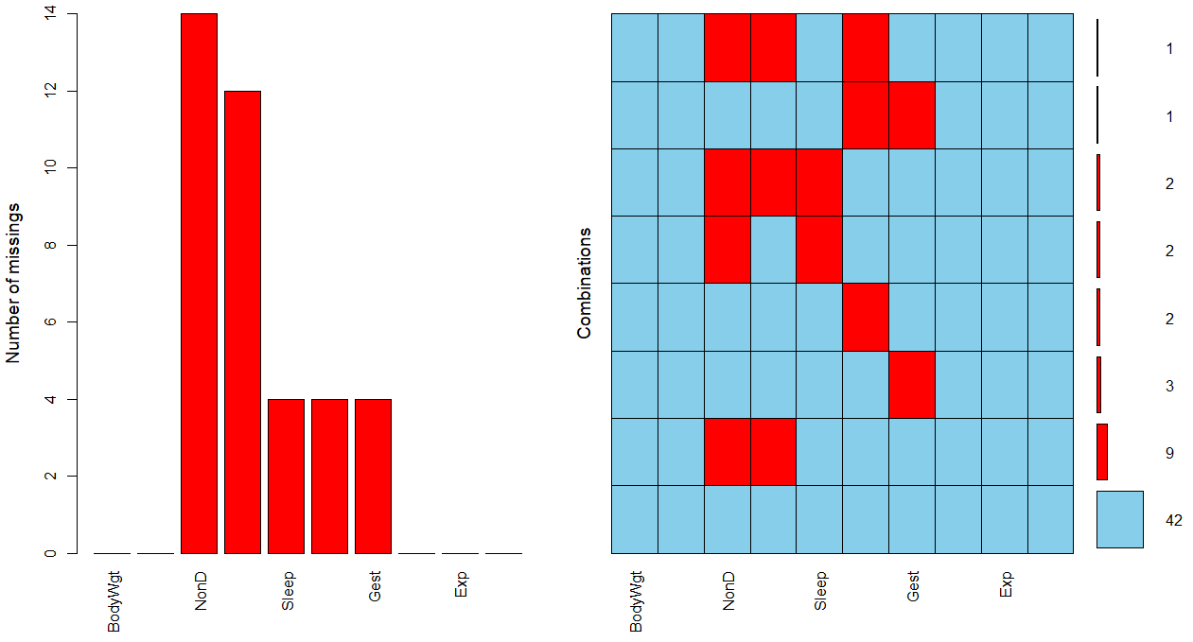
Identify Missing data

Slide 10
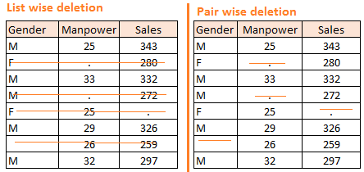
Removing Missing data rows
The two most common methods for removing missing data are:
 | Listwise deletion (complete case analysis) | Pairwise deletion
Description: | Analyse the data rows where there is complete data for every column. | Analyse the data rows where the variables of interest have data present.
Advantages: | Simple Easily compare across analyses. | Uses all possible information.
Limitations: | Could be biased (if the data is not MCAR). Lower n, reduces statistical power. | Separate analyses cannot be compared as the data / sample will be different.
Notes:
Draw 2 types of tables for example?

Slide 11
Remove Missing data rows
In R missing values can be represented by:
NA Not Available (placeholder for a missing value).
NULL Empty value.
Inf Infinity.
It is possible to use is.na(), is.null() and is.infinite() functions in R to identify missing, empty and infinite values in datasets.
The function complete.cases() can be used to identify the data rows in a matrix or data frame that are / aren't complete.
Only NA and NULL are regarded as missing, Inf is treated as valid.

Slide 12
Example Missing dataset
We will be using the following sleep dataset as an example.
It contains the following data on 62 species of mammals:
Various data is missing in the dataset (NA values).
Column | Description
Dream | Length of dreaming sleep
NonD | Non-dreaming sleep
Sleep | Sum of Dream and NonD
BodyWgt | Body weight (kg)
BrainWgt | Brain weight (g)
Span | Life span (yrs)
Gest | Gestation time in days
Pred | Degree to which species were preyed upon (1-low to 5-high scale)
Exp | Degree of their exposure while sleeping (1-low to 5-high scale)
Danger | Overall danger (1-low to 5-high scale)

Slide 13

Session 1
Time to get stuck in and deal with some missing data!
Download: http://www.hodgett.co.uk/MissingData.zip
Follow the code for session 1.

Slide 14
Replacing Missing data
The two most common methods for replacing missing data are:
 | Simple Imputation | Multiple Imputation
Description: | Missing values are replaced with the mean, median or mode value. | Estimates missing data through repeated simulations.
Stochastic: | No | Yes
Advantages: | Simple. | Variability more accurate.
Limitations: | Could be biased (if the data is not MCAR). Underestimates standard errors. Could distort correlations among variables. | Algorithms are more complex. Normally would require complex coding (R library available).

Slide 15
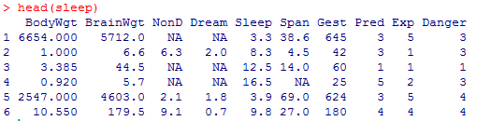
Simple Imputation
Simply replace the missing values with the mean, median or mode:
mean(x)
median(x)
names(sort(-table(x)))[1]
For example, using mean(sleep$x, na.rm=TRUE):
Replace NA values with sleep$x[is.na(sleep$x)] <- value
1.972 (Mean of Dream)
8.672917
(Mean of NonD)
19.87759
(Mean of Span)

Slide 16
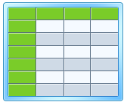
Multiple Imputation
The idea of Multiple Imputation is to replace each missing value with multiple acceptable values that represent a distribution of possibilities.
This results in a number of complete datasets (usually 3-10):
Analyse
Impute
Pool
Dataset with missing values
Dataset with multiple imputation applied
Imputed datasets
Analysis results of datasets

Slide 17
Multiple Imputation
The general procedure for the chained equation approach to multiple imputation (used in mice()) is:
A simple imputation is performed for every missing value.
One of the missing variables are set back to missing.
Regression is performed (linear, logistic, polynomial etc.), the missing variable being the forecast variable and all other variables in the dataset being the predictor variables.
Missing values are replaced with predictions (imputations) from the regression.
Repeat steps 2-4 for each variable that has missing data (one cycle).
Repeat for a number of cycles then retain results as one imputed dataset.

Slide 18
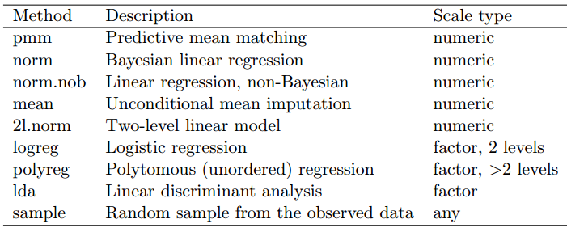
Multiple Imputation
We will focus on using the mice package.
The mice package has many built in imputation techniques including:
Example: mice(data, meth=c('sample','pmm','logreg','norm'))

Slide 19


Session 2 & 3
Session 2
Learn to use simple and multiple imputation methods.
Session 3
Apply what you have learnt to the titanic passengers dataset.
Please ask me any questions you might have.
My email: r.e.hodgett@leeds.ac.uk

