Slide 1
Python frameworks – Numpy, Pandas, Matplotlib and SK-Learn

Slide 2
What is Numpy ?
author: ‎Travis Oliphant
Initial release‎: ‎As Numeric, 1995; as NumPy, 2006
Developer(s)‎: ‎Community project
NumPy is the fundamental package for scientific computing in Python. ...
NumPy arrays facilitate advanced mathematical and other types of operations on large numbers of data. Typically, such operations are executed more efficiently and with less code than is possible using Python's built-in sequences

Slide 3
What is Numpy ?
NumPy’s main object is the homogeneous multidimensional array. It is a table of elements (usually numbers), all of the same type, indexed by a tuple of non-negative integers. In NumPy dimensions are called axes
NumPy, which stands for Numerical Python, is a library consisting of multidimensional array objects and a collection of routines for processing those arrays

Slide 4
SKLearn Overview
sklearn documentation
https://scikit-learn.org/stable/
Simple and efficient tools for predictive data analysis
Accessible to everybody, and reusable in various contexts
Built on NumPy, SciPy, and matplotlib

Slide 5
SKLearn Overview
The scikit-learn project started as scikits. learn, a Google Summer of Code project by David Cournapeau.
Its name stems from the notion that it is a "SciKit" (SciPy Toolkit), a separately-developed and distributed third-party extension to SciPy. The original codebase was later rewritten by other developers

Slide 6
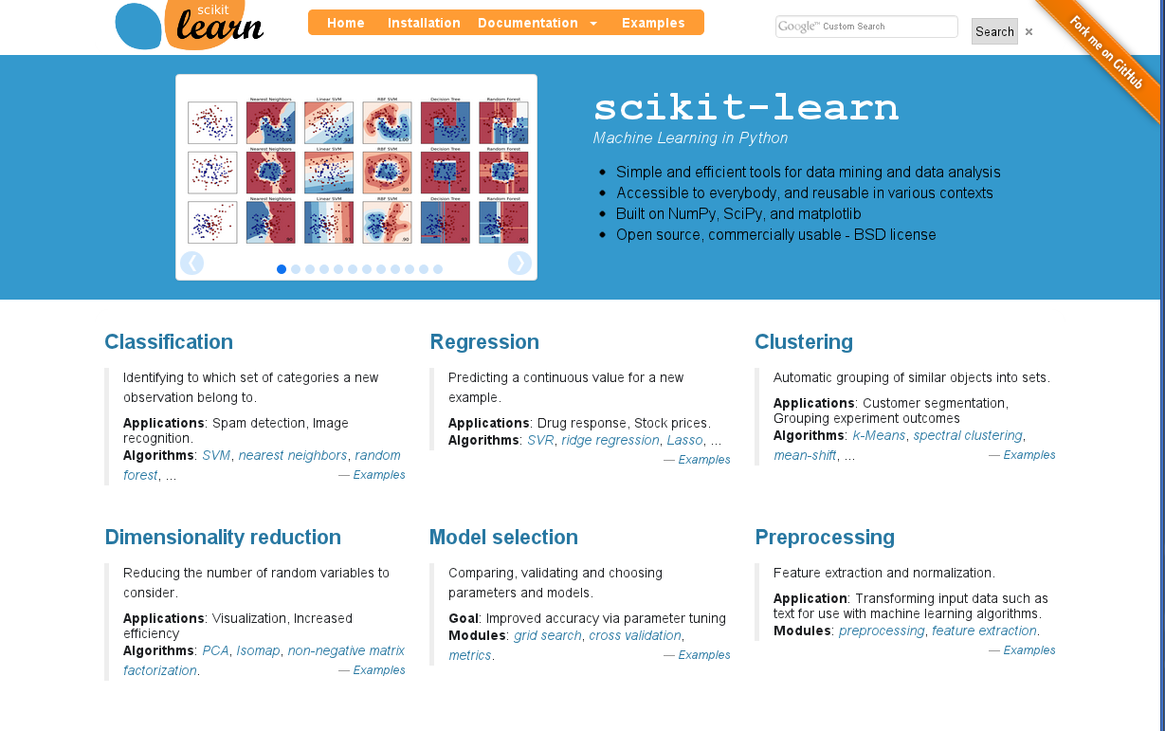

Slide 7
What is pandas ?
pandas is a software library written in Python programming language for data manipulation and analysis.
It offers functions and operations for manipulating numerical tables and time series.
Wes Mckinney 2008

Slide 8
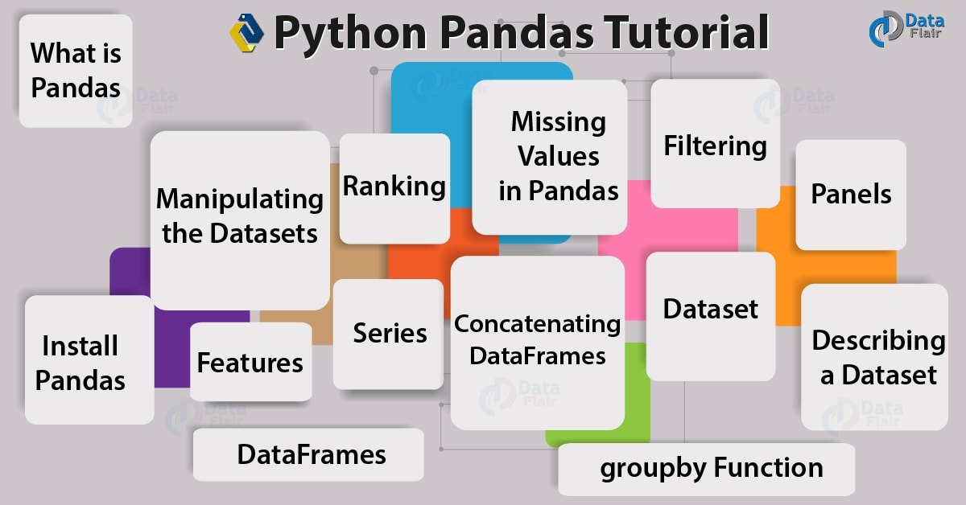

Slide 9
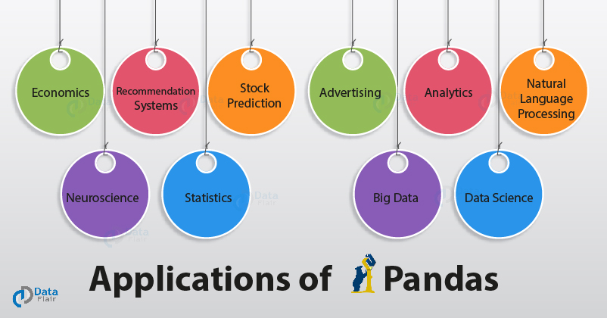

Slide 10
What is Matplotlib ?
Matplotlib: Visualization with Python
Matplotlib is a comprehensive library for creating static, animated, and interactive visualizations in Python.

Slide 11
What is Matplotlib ?
Create
Develop publication quality plots with just a few lines of code
Use interactive plots that can zoom, pan, update...
Customize
Take full control of line styles, font properties, axes
properties..., Export and embed to a number of file formats
and interactive environments
Extend Explore tailored functionality provided by third party packages, Learn more about Matplotlib through the many external learning resources

Slide 12
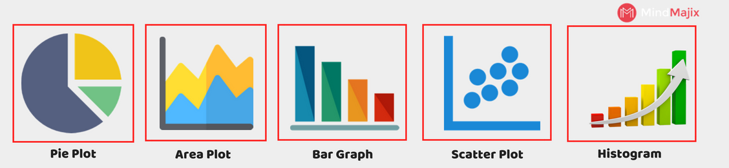

Slide 13
