Slide 1

Vinay
CAPSTONE PROJECT
E-Commerce Sales Analysis
By Vinay
vinaytivarekar1403@gmail.com

Slide 2

INTRODUCTION
Capstone Project: E-commerce Sales Analysis Project :- This project performs an end-to-end data analysis of an e-commerce platform (simulating Amazon sales data). The analysis covers the entire workflow: from raw messy data cleaning, exploratory data analysis, advanced analysis, and insights generation to actionable business recommendations.

Slide 3
GOALS
GOALS & OBJECTIVES
• Analyze sales data to identify trends, top products, and revenue distribution.
• Detect and handle inconsistencies, missing values, and formatting issues in raw data
. • Understand customer behavior and preferences.
• Generate actionable recommendations to improve sales and marketing strategies.
• Create visualizations and reports suitable for business stakeholders.

Slide 4
FILES AND FOLDERS
PROJECT STRUCTURE:
  data/raw_data.csv
  data/cleaned_data.csv
  notebooks/1_data_cleaning.ipynb
  notebooks/2_eda.ipynb
  notebooks/3_analysis.ipynb
  reports/executive_summary.pdf
  reports/technical_report.pdf
  presentations/business_presentation.pptx
  README.md

Slide 5
VISUAL DOCUMENTATION
  The project includes graphs and plots generated by Python scripts to demonstrate insights:
  1. Distribution of numerical features: histograms for price, quantity, discount, tax, and shippingcost.
  2. Categorical distributions: countplots for category, subcategory, region, paymentmethod, and orderstatus.
  3. Correlation heatmap: showing relationships between numerical features
  . 4. Revenue analysis: total revenue by category, region, and top products
  . 5. Monthly sales trend: line plot showing sales over time.
  6. Category vs Region heatmap: highlights top-performing regions and categories.
  7. Discount vs Sales scatterplot: visualizes the effect of discounts on revenue.
  8. Top customers by revenue: identifies high-value customers for targeted marketing.

Slide 6
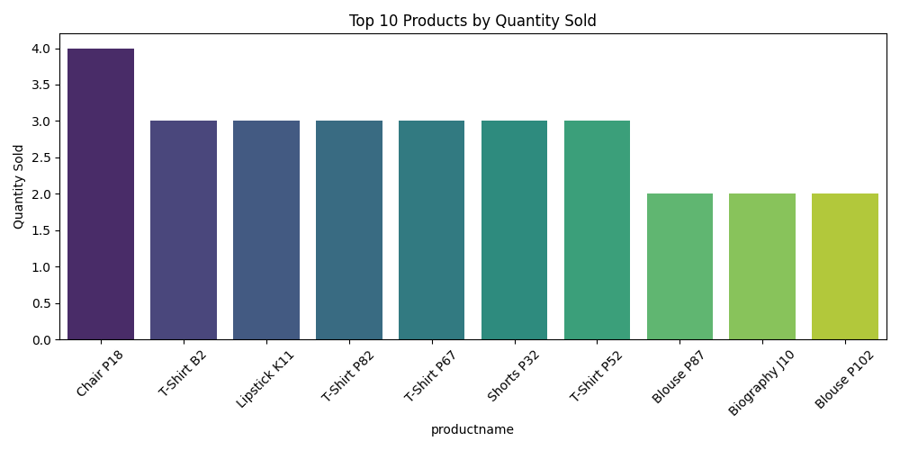
TOP 10 QUANTITIES
BY PRODUCT SOLD
The top-selling products are identified using aggregated quantity.
Barplot of top 10 products by quantity sold.

Slide 7
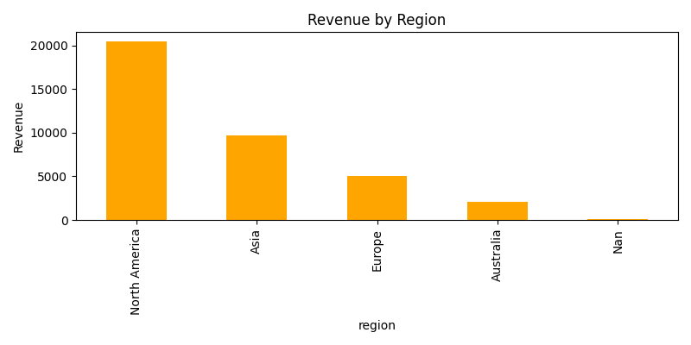
REVENUE BY REIGON
Aggregated total_sales by region to identify high-performing markets.
Bar chart of revenue by region.

Slide 8
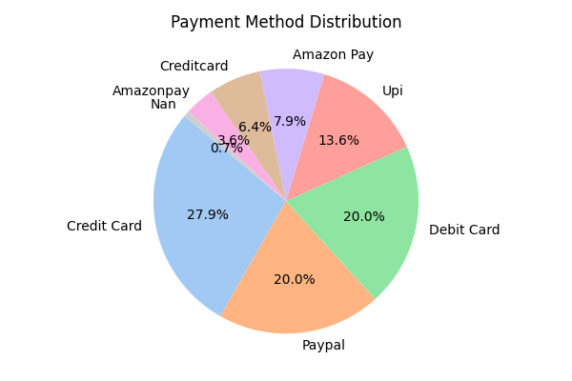
PAYMENT METHOD DISTRIBUTION
Distribution of transactions by paymentmethod.
Useful for financial planning and payment strategy optimization.

Slide 9
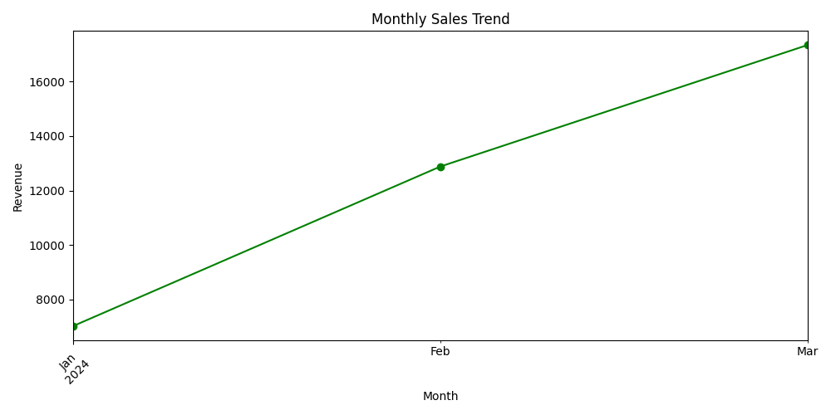
MONTHLY SALES TREND
Aggregated total_sales by month to identify seasonal patterns.
peak sales months for promotions or inventory planning.

Slide 10
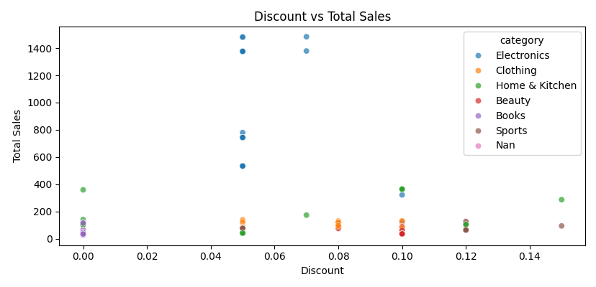
DISCOUNT VS TOTAL SALES
Scatter plot of discount vs total_sales by category.
Evaluates effectiveness of discounts on revenue. Some categories respond more to discounts than others.

Slide 11
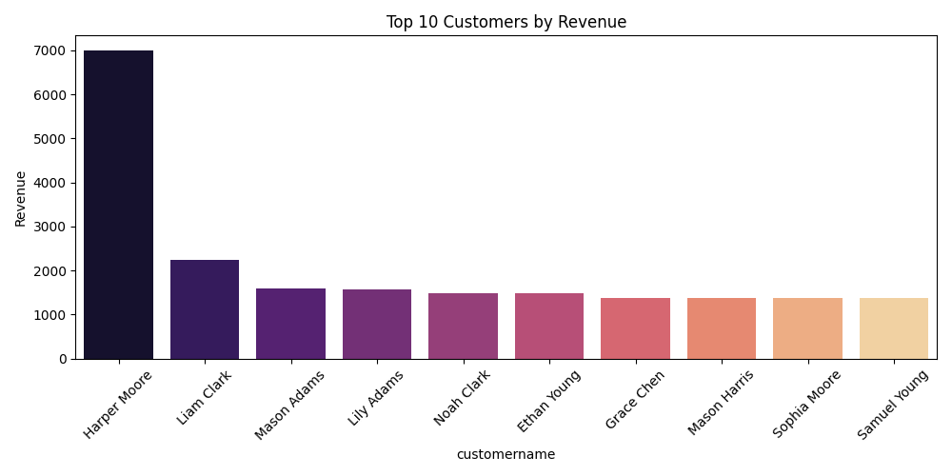
TOP CUSTOMERS BY REVENUE
Aggregated total_sales by customername.
Identify high-value customers for loyalty programs and targeted marketing.

Slide 12
TESTING & VALIDATION
Test Case Method Result
  Missing values Fill nulls with default or median Pass
  Data type validation Convert numeric/text types Pass
  Negative prices Replace with median Pass
  Duplicates Drop duplicate OrderID Pass
  Revenue calculation total_sales formula checked Pass
  Upsell opportunity Filter by quantity and revenue Pass
identification

Slide 13
CONCLUSION
The analysis provides comprehensive insights into product performance, regional sales, customer behavior, and discount effectiveness.
Key business recommendations include targeted upsell promotions, marketing focus on high-revenue regions, and inventory prioritization.
The modular Python code ensures reproducibility and scalability for future datasets.

Slide 14
Capstone Project
THANK YOU
By Vinay Tivarekar
The developers Arena

