Slide 1

Automating Research: Streamlining Workflows and Enhancing Efficiency

Slide 2
The ultimate goal
To establish a unique work-flow based on automation, from organizing the study datasets to presentation of results, which may be easily adapted by and benefit any researchers, students, readers, and collaborators.

Slide 3
Key ideas
Do not re-invent the wheel
Establishing harbors of .do files and .ado files to allow collaborators access and benefit from existing works
FENA website and Github
Easy adaptation and operation
An interactive way of building Stata packages to make Stata programs self-explanatory
Prompt-based Programming Approach
Accessible national datasets
Quickly organize control datasets from public national databases to gather necessary information based on unique needs of studies
NHANES_FENA program

Slide 4
Key ideas
Automated research progress
Automate critical steps in research progress to enhance efficiency and reproductivity (reliability)
Table1_FENA program/survplot_fena program
Visualized result presentation
Present the research findings in visualized way that the readers and end-users can easily understand and make use of it
Online calculators

Slide 5
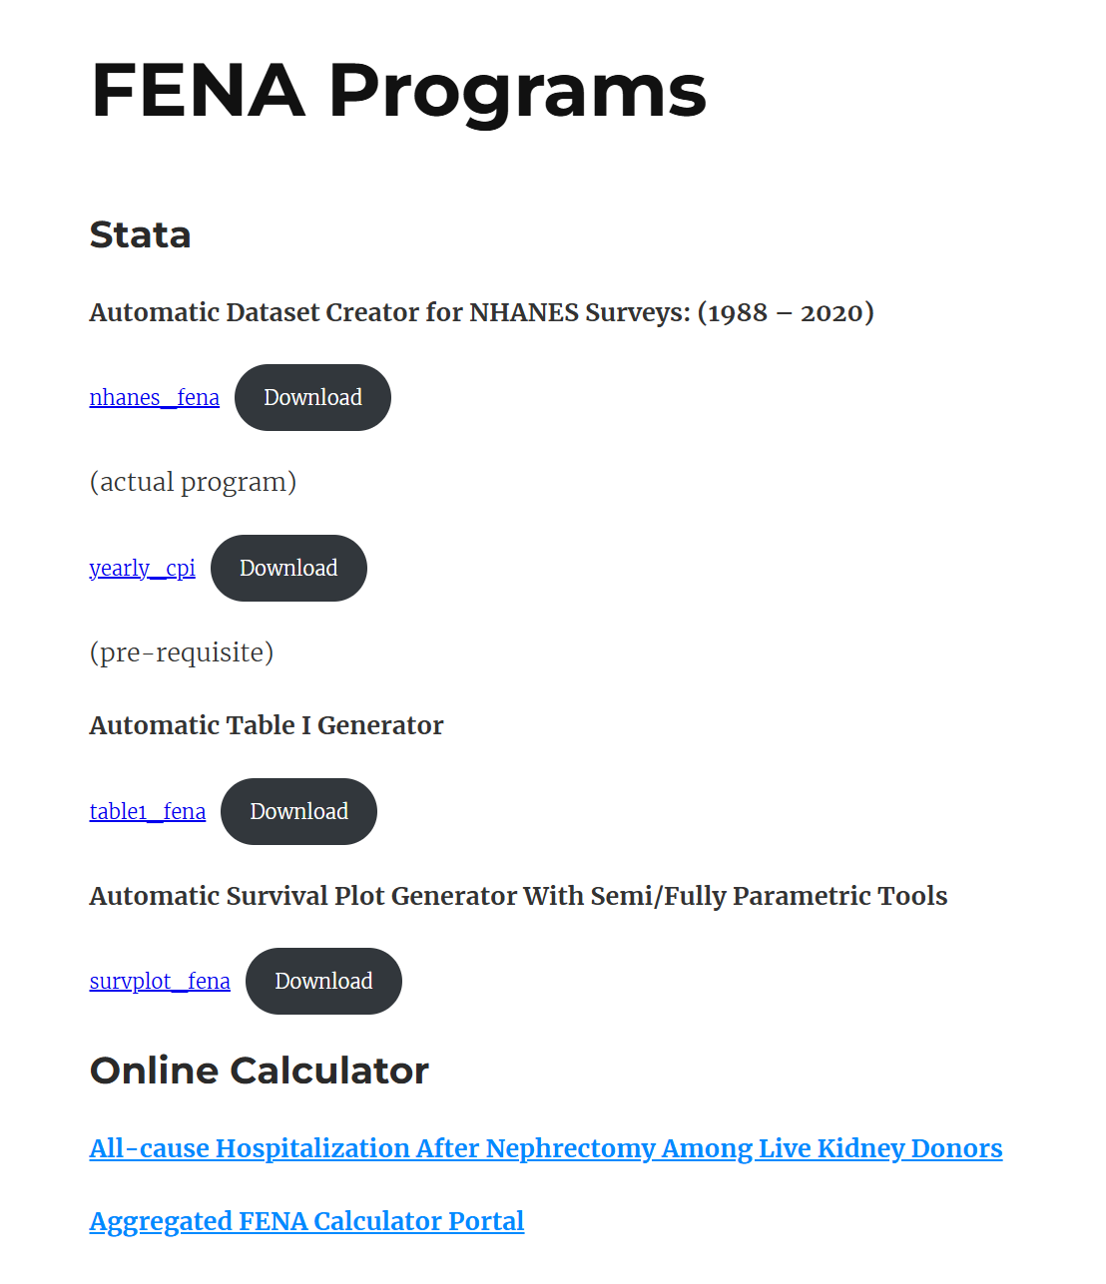
FENA Website
https://projectfena.com/
The unique online harbor that we have created from our work
Catalog of all contributors and products

Slide 6
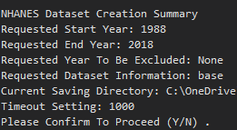
Prompt-based programming
A unique user interactive programming approach that is capable of:
Allowing multiple parameter intake chances
Establishing an instructed program operation style
Checkpoints and modifications without termination
Help collaborators quickly understand and operate the programs even if they have limited knowledge about Stata

Slide 7
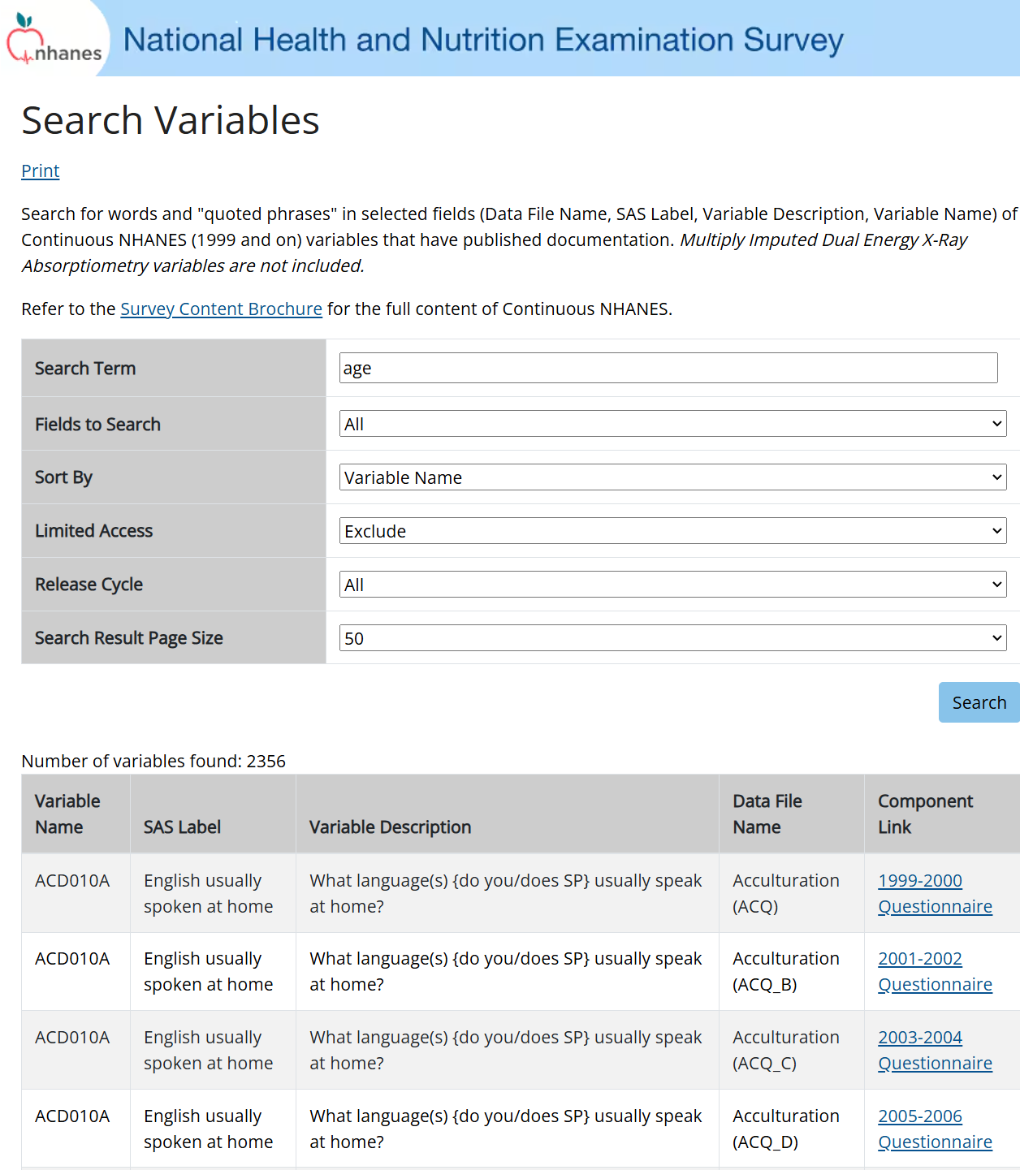
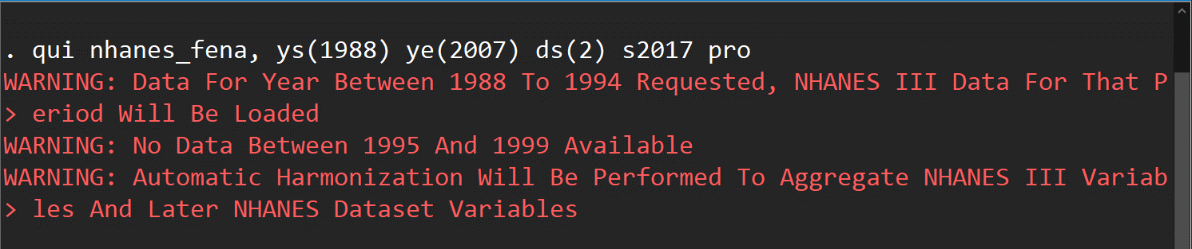
Accessible National Databases
FROM THIS
TO THIS
National databases like NHANES usually contain rich information and large number of participants, which are ideal sources for organizing control populations in researches.
Therefore, we worked on ways to simplify the process of gathering information from NHANES.

Slide 8
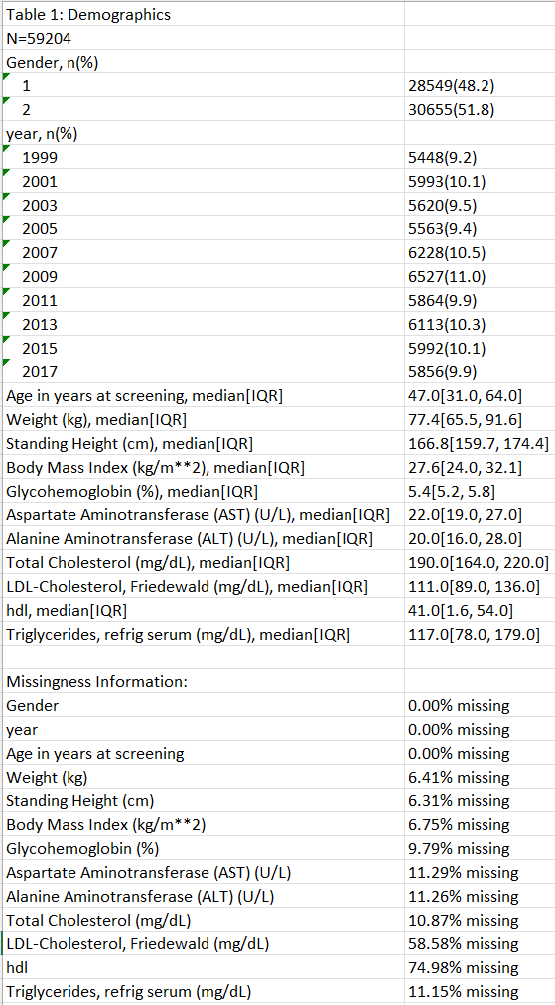
Automated progress
Condensing common research steps like EDA and Table 1 organization into mature packages
Helps to reduce repetitive works in studies and allow fast progresses
Assemble this whole table in just 1 Line of code and store it as an excel

Slide 9
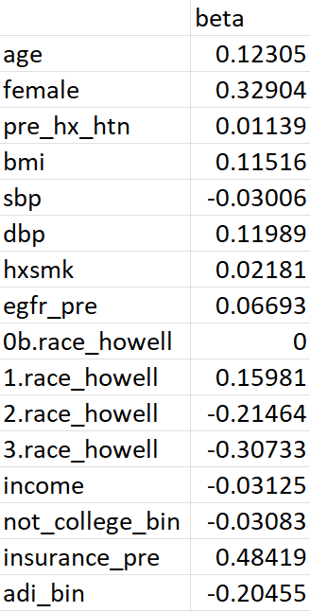
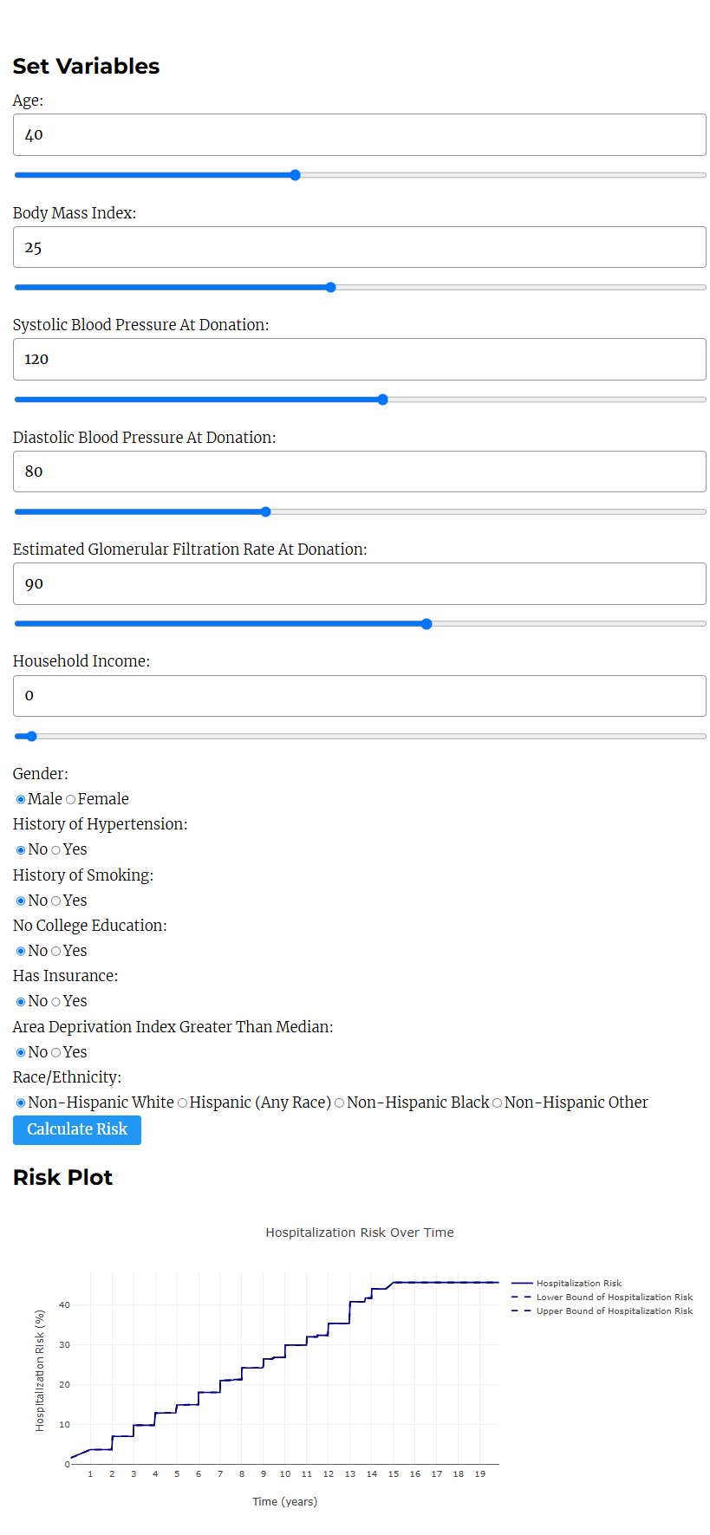
Visualized presentation
Traditional Way
Visual Presentation
https://projectfena.com/index.php/125-2

Slide 10
Future intended work
Expanding the programs and packages into more perspectives to achieve different research progress fast and shortening idea-to-paper process
Enhancing the visual presentation of the online calculators so that every study findings can be translated into practical tools in clinical decision making.
Introducing AI to research progress and clinical works.

