Slide 1

Working Title
By john durso and jacob stephens

Slide 2

Objective and Problem Statement
Given a movie poster, classify the genre it belongs to.
Our goal to achieve the highest performance by experimenting with and comparing several different models

Slide 3
Data
jacob

Slide 4




Horror
Romance
Action
Comedy

Slide 5
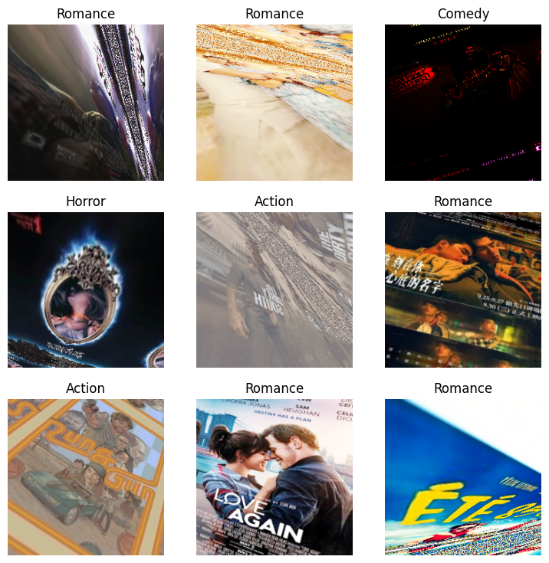
Preprocessing
Resizing to 224x224
Splitting the data into train, validation, and test sets (60/20/20)
Data Augmentation – rotation, zooming, flipping
Pixel normalization from imagenet_stats
Create separate data loaders for train/valid , test

Slide 6
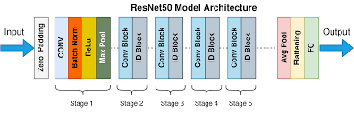
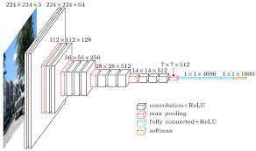
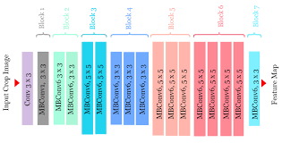
Experiment Set Up - Models
Candidates
VGG-16
Baseline MLP
2 dense layers
ReLu activation
224x224x3→512→4
Resnet50
EfficientNet b0

Slide 7
Experiment Setup - Hyperparameters
Batch sizes of 32, 64, and 100 were evaluated with varying augmentation settings, including rotation, zooming, and flipping.
Patience levels of 5-10 were used for early stopping during model training.
Models were trained with varying numbers of epochs 5-30
Learning rates were tuned with lr_find method

Slide 8
Best Training Results
Resnet50
Accuracy: 0.755,
F1: 0.754,
Validation Loss: 0.696
VGG16
Accuracy: 0.692,
F1: 0.693,
Validation Loss: 0.799
Efficientnet b0
Accuracy: 0.611,
F1: 0.604,
Validation Loss: 0.886
Baseline
Accuracy: 0.442,
Validation Loss: 487.5

Slide 9
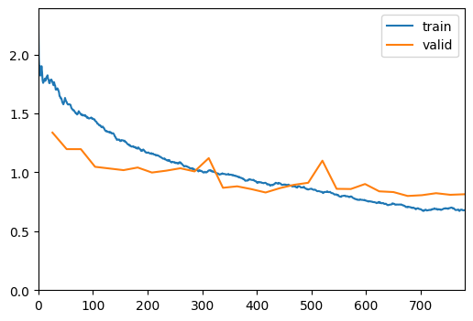
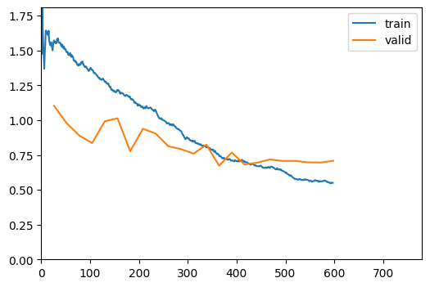
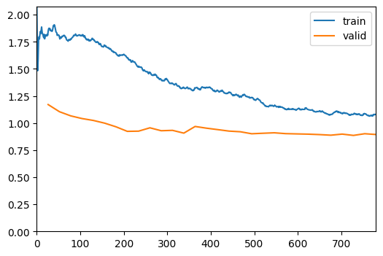
Loss Curves
VGG
Resnet
EfficientNet

Slide 10
Test Results
['Action', 'Comedy', 'Horror', 'Romance']
VGG:
precision recall f1-score support
0 0.76 0.74 0.75 50
1 0.63 0.64 0.64 53
2 0.76 0.71 0.73 58
3 0.63 0.68 0.65 47
accuracy 0.69 208
macro avg 0.69 0.69 0.69 208
weighted avg 0.70 0.69 0.69 208
Resnet:
precision recall f1-score support
0 0.91 0.80 0.85 50
1 0.73 0.70 0.71 53
2 0.80 0.90 0.85 58
3 0.69 0.70 0.69 47
accuracy 0.78 208
macro avg 0.78 0.77 0.78 208
weighted avg 0.78 0.78 0.78 208
Efficientnet:
precision recall f1-score support
0 0.60 0.74 0.66 50
1 0.59 0.38 0.46 53
2 0.76 0.64 0.69 58
3 0.52 0.70 0.60 47
accuracy 0.61 208
macro avg 0.62 0.61 0.60 208
weighted avg 0.62 0.61 0.60 20

Slide 11
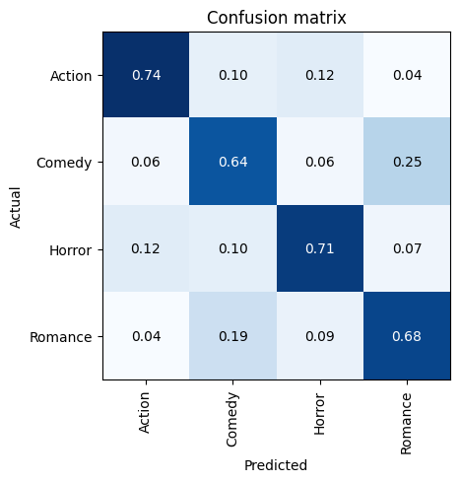
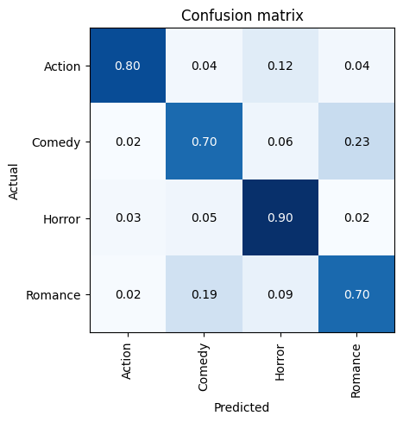
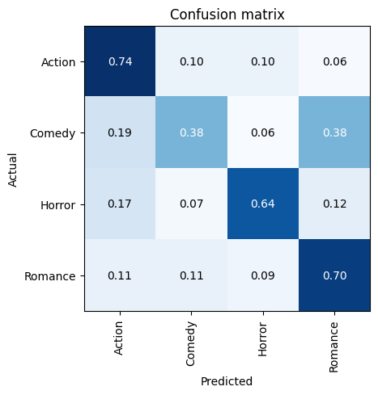
Test Results
VGG
Resnet
Efficientnet

Slide 12
Conclusions and Discussion
Final Thoughts
All models consistently mistake Romance for Comedy and vice versa.
Both VGG and Resnet tended to severely overfit, so inclusion of regularization was paramount.
No statistical stabilization was implemented here so these results are not reflective of overall performance!
Effectively regularizing while maintaining high levels of accuracy was difficult
Further Improvements
Using more data and further tuning
Implementing cross fold validation
Inclusion of user data to build a recommendation system

Slide 13
Dataset Reference
jacob

