Slide 1
Predicting Music Popularity using Machine Learning
John Durso
Diamon Goffe
Nicholas Oswald

Slide 2
Team Members
John Durso: Data preprocessing, feature engineering
Nicholas Oswald: Model training, hyperparameter tuning
Diamon Goffe: Experimentation, results analysis

Slide 3
Specific Aims/ Overview
Problem Statement: The unpredictability of music success poses a significant challenge for stakeholders in the music industry.
Objective: Develop a machine learning model capable of predicting the popularity of music tracks or artists.
Motivation: Growing demand for data-driven insights in the music industry.

Slide 4
Data
Data Source: Kaggle dataset with approximately 30,000 rows, each representing a track.
Format: CSV format, features include metadata and audio characteristics.
Preprocessing: Handling missing values, scaling numerical features, using embeddings for feature encoding.

Slide 5
Data sample
track_id | track_name | track_artist | track_popularity | track_album_id | track_album_name | track_album_release_date | playlist_name | playlist_id | playlist_genre | playlist_subgenre | danceability | energy | key | loudness | mode | speechiness | acousticness | instrumentalness | liveness | valence | tempo | duration_ms
6f807x0ima9a1j3VPbc7VN | I Don't Care (with Justin Bieber) - Loud Luxury Remix | Ed Sheeran | 66 | 2oCs0DGTsRO98Gh5ZSl2Cx | I Don't Care (with Justin Bieber) [Loud Luxury Remix] | ######## | Pop Remix | 37i9dQZF1DXcZDD7cfEKhW | pop | dance pop | 0.748 | 0.916 | 6 | -2.634 | 1 | 0.0583 | 0.102 | 0 | 0.0653 | 0.518 | 122.036 | 194754
0r7CVbZTWZgbTCYdfa2P31 | Memories - Dillon Francis Remix | Maroon 5 | 67 | 63rPSO264uRjW1X5E6cWv6 | Memories (Dillon Francis Remix) | ######## | Pop Remix | 37i9dQZF1DXcZDD7cfEKhW | pop | dance pop | 0.726 | 0.815 | 11 | -4.969 | 1 | 0.0373 | 0.0724 | 0.00421 | 0.357 | 0.693 | 99.972 | 162600
1z1Hg7Vb0AhHDiEmnDE79l | All the Time - Don Diablo Remix | Zara Larsson | 70 | 1HoSmj2eLcsrR0vE9gThr4 | All the Time (Don Diablo Remix) | 7/5/2019 | Pop Remix | 37i9dQZF1DXcZDD7cfEKhW | pop | dance pop | 0.675 | 0.931 | 1 | -3.432 | 0 | 0.0742 | 0.0794 | 2.33E-05 | 0.11 | 0.613 | 124.008 | 176616
75FpbthrwQmzHlBJLuGdC7 | Call You Mine - Keanu Silva Remix | The Chainsmokers | 60 | 1nqYsOef1yKKuGOVchbsk6 | Call You Mine - The Remixes | ######## | Pop Remix | 37i9dQZF1DXcZDD7cfEKhW | pop | dance pop | 0.718 | 0.93 | 7 | -3.778 | 1 | 0.102 | 0.0287 | 9.43E-06 | 0.204 | 0.277 | 121.956 | 169093
1e8PAfcKUYoKkxPhrHqw4x | Someone You Loved - Future Humans Remix | Lewis Capaldi | 69 | 7m7vv9wlQ4i0LFuJiE2zsQ | Someone You Loved (Future Humans Remix) | 3/5/2019 | Pop Remix | 37i9dQZF1DXcZDD7cfEKhW | pop | dance pop | 0.65 | 0.833 | 1 | -4.672 | 1 | 0.0359 | 0.0803 | 0 | 0.0833 | 0.725 | 123.976 | 189052

Slide 6
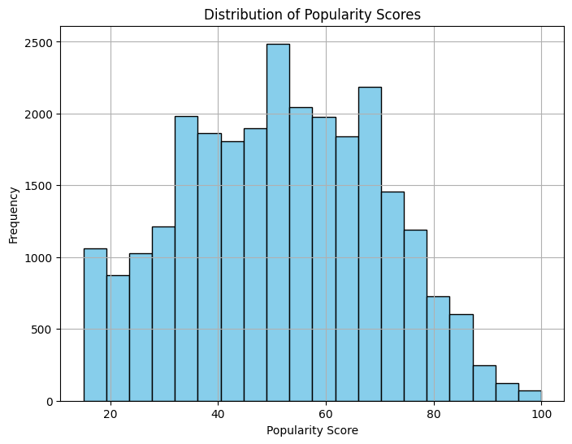
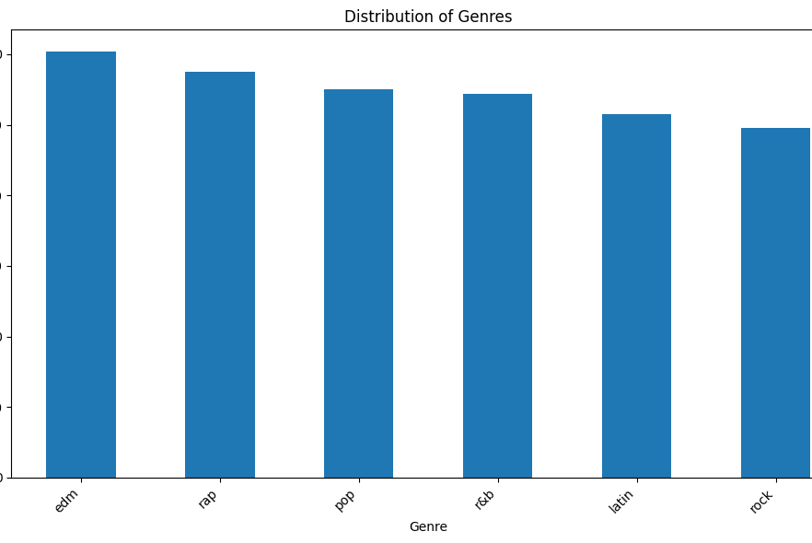
Data Distribution

Slide 7
Features
Metadata Features:
Track ID, name, artist, popularity, album
Playlist name, ID, genre, subgenre
Audio Characteristics:
Danceability, energy, key, loudness, mode, speechiness, acousticness, instrumentalness, liveness, valence, tempo, duration

Slide 8
Methodology
Initial Preprocessing:
Handling null values, train-test split (80-20).
Feature Selection: Recursive Feature Elimination (RFE).
Hyperparameter Tuning: Grid search CV for initial models.
Model Experimentation: Random Forest, Gradient Boosting, SVM, linear models, tree-based models, neural networks.
Tabular Model: Utilizing FastAI with embeddings for better performance.

Slide 9
Initial Results
Performance Metrics:
Random Forest:
MSE: 572.52, R2: 0.067, MAE: 19.40
Gradient Boosting:
MSE: 591.28, R2: 0.036, MAE: 20.09
SVM:
MSE: 612.57, R2: 0.002, MAE: 19.89
Challenges: Difficulty predicting socially curated values, similar results across different models.

Slide 10
Tabular Model Performance
Metrics (Epoch-wise):
Train Loss, Valid Loss, MSE, R2 Score
Loss function: L1LossFlat (MAE)
Promising results indicating considerable improvement.
Best Result:
Training Loss: 2.86
Validation Loss: 7.36
MSE: 112.31
R2: 0.667

Slide 11
Metrics Over Epochs – MLP Architecture
epoch train_loss valid_loss mse r2_score time 0 10.947739 10.533143 184.771774 0.452409 00:16 1 9.089035 9.224443 148.586929 0.559647 00:16 2 6.998212 9.120266 145.200745 0.569682 00:16 3 6.585295 9.313548 158.148453 0.531311 00:16 4 6.108523 8.938370 141.522217 0.580584 00:16 5 6.207332 9.840893 165.634064 0.509126 00:16 6 5.651221 8.803113 137.602936 0.592199 00:16 7 5.413588 9.584910 167.325150 0.504115 00:16 8 5.378374 8.468724 131.435059 0.610478 00:16 9 4.980009 8.320586 130.549164 0.613104 00:16 10 4.698735 8.488416 126.521553 0.625040 00:17 11 4.863050 8.235067 126.221085 0.625931 00:16 12 4.625796 8.401166 136.623764 0.595101 00:16 13 4.560423 8.520554 145.414566 0.569049 00:16 14 4.246871 7.986291 122.761795 0.636182 00:16 15 4.031298 7.978594 121.516869 0.639872 00:16 16 4.310482 7.760572 118.897614 0.647635 00:16 17 3.785820 8.121045 123.804291 0.633093 00:16 18 3.861109 7.711392 117.122223 0.652896 00:16 19 3.810237 7.760774 120.427963 0.643099 00:16 20 3.262500 7.570906 115.787186 0.656853 00:16 21 3.245260 7.589879 115.504417 0.657691 00:16 22 3.472243 7.719013 118.398361 0.649114 00:16 23 3.309793 8.375313 130.790680 0.612388 00:16 24 2.823447 7.437298 114.275291 0.661333 00:16 25 2.856570 7.362502 112.306358 0.667168 00:16
Embedding Layers (x10)(size 1000)
Batch Normalize
Linear Layer – 200 out
ReLu
Batch Normalize
Dropout (0.1)
Linear Layer – 100 out
ReLu
Batch Normalize
Linear Layer – 1 out

Slide 12
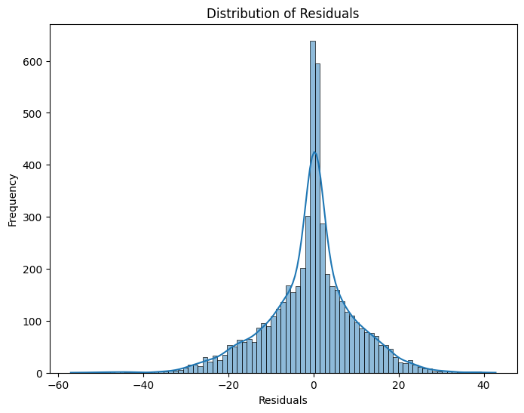
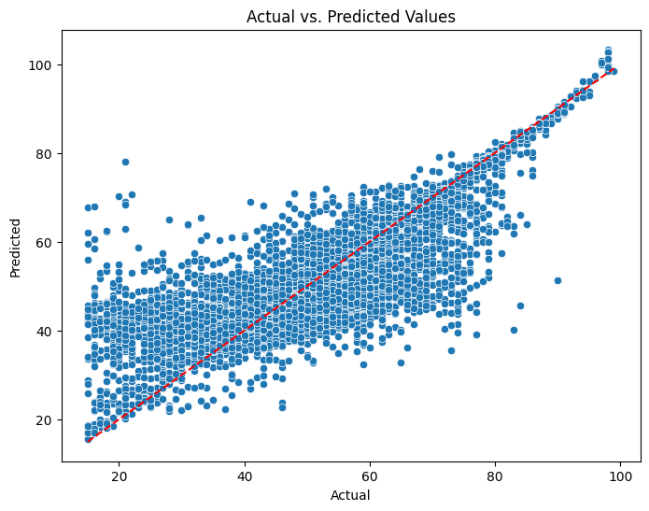
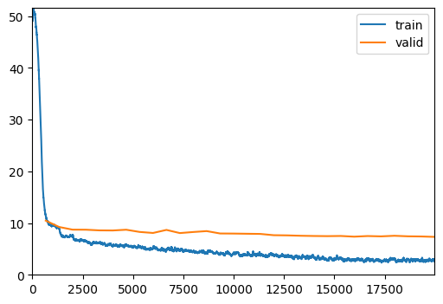
Figures

Slide 13
Reflections and Future Directions
Observations:
Difficulty in predicting socially curated values.
Influence of cultural factors and song characteristics on popularity.
Potential Directions:
Further model tuning and feature engineering.
Consideration of a larger and more date relevant dataset from Spotify's API.
Exploration of specific genres or additional features for better prediction accuracy.

Slide 14
Conclusion
Comprehensive approach to predicting music popularity using machine learning.
Promising results obtained with TabularModel and embeddings.
Future directions for improving prediction accuracy and addressing challenges.

