Slide 1
AI X CITY CLIMATE ACTION HACKATHON 2026
FloodFact AI
Flood warnings people can trust. Rumours that stop spreading.
Concept — Phase 1 Pilot: Mukuru, Nairobi (kwa Reuben · kwa Njenga · Viwandani)
Team: Samuel Mburu Kairu · Vincent Odundo · Alvin Nyota · Amani Maria — Nairobi, Kenya

Slide 2
THE CITY CLIMATE PROBLEM
Every long rain, two disasters hit at once
50%
72 hrs
3 in 5
of Kibera households flooded in a single rainy season
average delay before official alerts reached residents
WhatsApp messages during the 2023 floods were unverified
World Economic Forum
Kenya Red Cross, 2023
iHub Kenya Research
The flood is the first emergency. The wave of unverified WhatsApp rumours that follows — false dam-burst warnings, panicked evacuations, then real alerts ignored because trust is gone — is the second. Nairobi's informal settlements hold 60% of the city's population but receive less than 10% of its climate adaptation resources.
FloodFact AI · Phase 1 Pilot: Mukuru, Nairobi
1

Slide 3
THIS ALREADY HAPPENED
Real incidents, not hypotheticals
Mathare — April 2024
Kibera — May 2023
Flash floods struck at 2 AM with no official alert issued. A viral WhatsApp voice note falsely claiming a nearby dam had burst sent families fleeing into more dangerous streets — two people were injured in the panic.
A KMD regional advisory was issued but never reached households — a 72-hour average delay. So many false WhatsApp warnings had already circulated that residents dismissed the eventual official SMS alerts too.
Kenya Red Cross field report, Apr 2024
Kenya Red Cross 2023; iHub Kenya Research
FloodFact AI · Phase 1 Pilot: Mukuru, Nairobi
2

Slide 4
THE GAP
Early-warning tools and fact-checkers each solve half the problem
Early-warning systems
Fact-checking tools
FloodFact AI
Broadcast alerts from weather/hydrology data.
Verify viral claims after the fact.
Cross-checks the report against real evidence AND classifies rumours — in the same pipeline, in seconds.
Gap: don't touch the disinformation that undermines trust in the alert itself.
Gap: not built for real-time, hyperlocal, life-safety decisions.
Built for exactly this gap.
FloodFact AI · Phase 1 Pilot: Mukuru, Nairobi
3

Slide 5
THE IDEA
Community-centered early warning and verification, in one pipeline
Residents report. AI cross-checks against real evidence. Trusted alerts go back out through the channels people already use.
1
2
3
4
Community Submits
AI Cross-Checks
Classified in Seconds
Alert Delivered
WhatsApp, SMS, the web, or a trained youth ambassador.
Rainfall, flood-risk zones, history, and ground truth — gathered in parallel.
A deterministic, exhaustively tested engine decides — never an LLM guess.
Back out via WhatsApp, SMS, notice points, and youth ambassadors.
FloodFact AI · Phase 1 Pilot: Mukuru, Nairobi
4

Slide 6
TARGET USER & COMMUNITY
Built around the people who live the problem
1
Residents
2
Youth Ambassadors
Submit a report or a suspicious message; get a clear verdict and action, in their language.
Trained community members who validate on the ground, explain results locally, and log ground-truth observations.
3
Ops / Admin Team
4
Partners
Monitor live activity on a mission-control dashboard, review escalations, watch data-source health.
KMD, Kenya Red Cross, UN-Habitat, youth groups, county government — coordinate response using the same evidence trail.
FloodFact AI · Phase 1 Pilot: Mukuru, Nairobi
5

Slide 7
FUNCTIONALITY & METHODOLOGY
What happens inside "AI Cross-Checks"
1
2
3
4
5
6
Understand
Geocode
Gather Evidence
Decide
Explain
Alert
Claude extracts hazard type, location, claims — never infers facts not stated.
A hyperlocal gazetteer + PostGIS resolve the exact pilot sub-area.
Rainfall, flood-risk, history, corroboration, ambassador truth, rumour similarity — in parallel.
A pure, deterministic function scores the evidence. Not Claude.
Claude writes the plain-language, bilingual rationale for the decision already made.
Verdict-specific message dispatched to the right channels.
FloodFact AI · Phase 1 Pilot: Mukuru, Nairobi
6

Slide 8
OUR UNIQUE INNOVATION
The decision is deterministic and tested — not an LLM's guess
Safety rule | What it prevents
Insufficient evidence → always escalate | A confident verdict from too little evidence, in either direction.
Missing data ≠ zero | Treating an unavailable reading as "no risk" instead of "unknown".
Corroboration is weighted, not decisive | A popular or repeated message manufacturing false confidence.
Conflicts are surfaced, not resolved silently | Picking a side when evidence genuinely disagrees.
"No evidence of flooding" ≠ "evidence of no flooding" | Calling a rumour false just because nothing was found yet.
23 unit tests in tests/unit/risk-engine.test.ts encode these rules directly — every one is checked on every commit via CI.
FloodFact AI · Phase 1 Pilot: Mukuru, Nairobi
7

Slide 9
SECURITY & TRUST
Privacy and auditability are structural, not an afterthought
Contact isolation
Row Level Security everywhere
Full audit trail
Real phone numbers live in one table with no default read access — not even for admins. Revealing one is logged.
Every table is RLS-scoped: ambassadors see only their ward; residents get no direct table access at all.
Every classification and alert is traceable to the evidence snapshot and model version that produced it.
FloodFact AI · Phase 1 Pilot: Mukuru, Nairobi
8

Slide 10
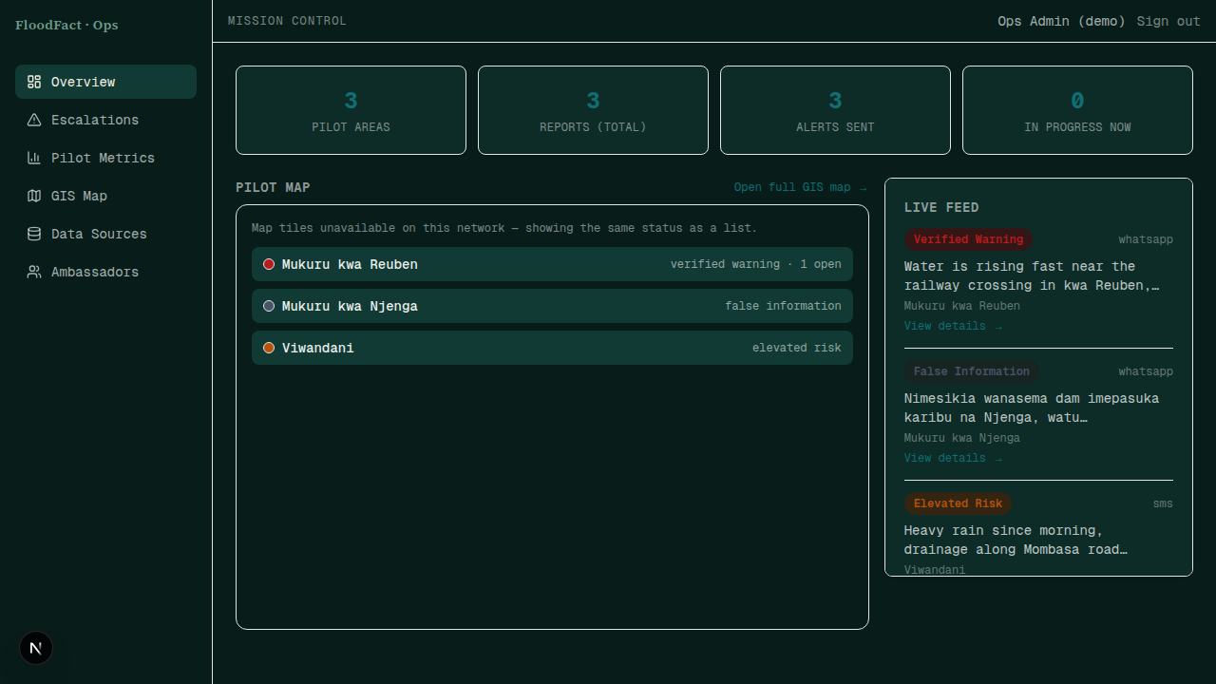
THE PRODUCT — MISSION CONTROL
Admins see every report, live, on a real-time map
Live feed + status view, colored by verdict — Verified Warning, Elevated Risk, False Information.
FloodFact AI · Phase 1 Pilot: Mukuru, Nairobi
9

Slide 11
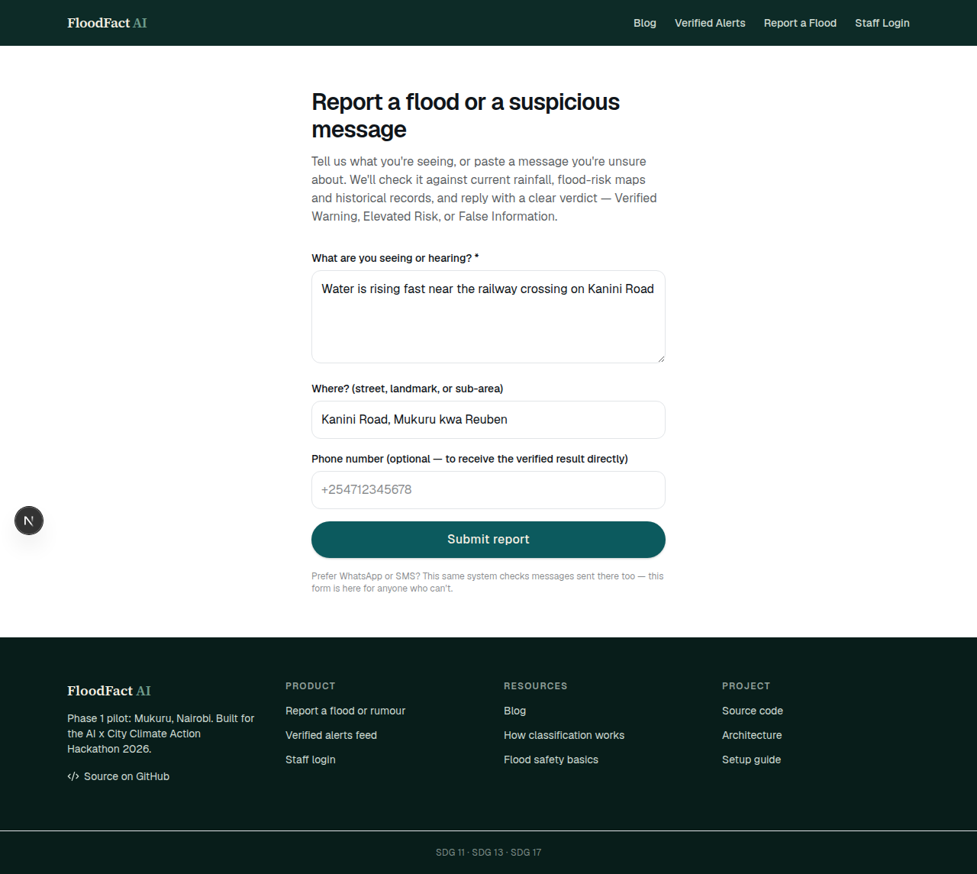
THE PRODUCT — RESIDENT INTAKE
Reporting takes seconds, even without WhatsApp
The same pipeline also runs on real inbound WhatsApp and SMS messages — this form is the fallback channel.
FloodFact AI · Phase 1 Pilot: Mukuru, Nairobi
10

Slide 12
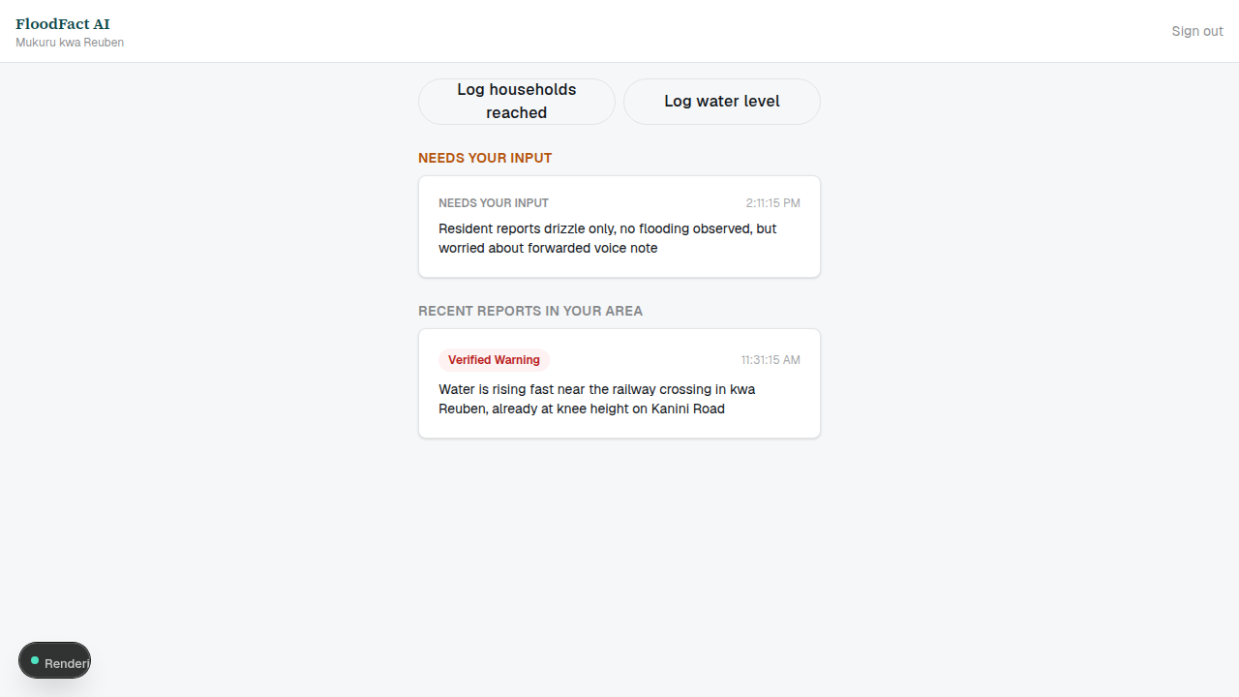
THE PRODUCT — YOUTH AMBASSADOR PWA
Ground truth from the people already trusted locally
Installable, offline-tolerant PWA — built for patchy 2G/3G coverage, not a desktop-first dashboard.
FloodFact AI · Phase 1 Pilot: Mukuru, Nairobi
11

Slide 13
BUILT WITH REAL PARTNERS
Every integration in this build is real — not a mockup
Provider | Used for | Status
Esri ArcGIS | Flood-risk zone geography | Live — WRI Aqueduct flood-risk atlas
Open-Meteo | Rainfall / ERA5 reanalysis | Live — free, keyless
Meta WhatsApp Cloud API | Resident intake + alerts | Live-ready, sandbox fallback
Africa's Talking | SMS intake + alerts | Live — sandbox account verified
Anthropic Claude | Message understanding + rationale (never the decision) | Live — verified
Voyage AI + pgvector | Rumour-pattern semantic matching | Live — verified
Supabase (Postgres/PostGIS/pgvector) | The entire backend | Live
Every provider auto-detects live vs. sandbox mode from its own credentials — no code changes needed to go live.
FloodFact AI · Phase 1 Pilot: Mukuru, Nairobi
12

Slide 14
EXPECTED REAL-WORLD BENEFIT
Phase 1 pilot targets, tied to acceptance criteria
80%
50%
100%
of households receive alerts within 30 minutes
reduction in rumour spread in pilot zones
of youth ambassadors trained in the AI tool
Pilot target
Pilot target
Pilot target
Every one of these is computed live from recorded reports, alerts and ambassador logs (the pilot_metrics database view) — never a hand-typed demo number.
FloodFact AI · Phase 1 Pilot: Mukuru, Nairobi
13

Slide 15
WHY FLOODFACT AI WINS
Unique selling points, at a glance
 | Generic chatbot fact-checker | Alert-broadcast system | FloodFact AI
Evidence-based decision | ✗ LLM opinion | ✗ single source | ✓ 6 sources, deterministic
Handles rumours | partial | ✗ | ✓
Human trust layer | ✗ | ✗ | ✓ youth ambassadors
Explainable verdict | sometimes | ✗ | ✓ evidence-grounded
Real channels people use | ✗ | ✓ | ✓ WhatsApp + SMS + notice points
Safe under uncertainty | ✗ can hallucinate | n/a | ✓ escalates to a human
FloodFact AI · Phase 1 Pilot: Mukuru, Nairobi
14

Slide 16
ROADMAP
Built to scale beyond Mukuru without a rewrite
1
2
3
Phase 1 — Now
Phase 2
Phase 3
Flood + WhatsApp rumour verification. Mukuru: kwa Reuben, kwa Njenga, Viwandani.
Add landslide and fire hazards — new provider adapters and rows, same pipeline.
Expand to SMS, radio, TV, USSD, and national scale across Nairobi's settlements.
FloodFact AI · Phase 1 Pilot: Mukuru, Nairobi
15

Slide 17
SDG ALIGNMENT
Grounded in the goals this hackathon serves
SDG 11 — Sustainable Cities
SDG 13 — Climate Action
SDG 17 — Partnerships
Safer, more resilient informal settlements in Nairobi.
Community-led flood early warning and climate adaptation.
KMD, Kenya Red Cross, UN-Habitat, youth groups, county government.
FloodFact AI · Phase 1 Pilot: Mukuru, Nairobi
16

Slide 18
THANK YOU
Technology performs the evidence check.
People carry the trust.
Full working system, source code, and setup guide: see the Demonstration file and the linked repository.
Team: Samuel Mburu Kairu · Vincent Odundo · Alvin Nyota · Amani Maria — Nairobi, Kenya
FloodFact AI · Phase 1 Pilot: Mukuru, Nairobi
17

