Slide 1
AI X CITY CLIMATE ACTION HACKATHON 2026
FloodFact AI
Live Product Demonstration
Every screen in this file is a real screenshot of the running application, captured with Playwright — not a mockup. Repository: github.com/VinceOdundo/FloodfactAI
Team: Samuel Mburu Kairu · Vincent Odundo · Alvin Nyota · Amani Maria — Nairobi, Kenya

Slide 2
BEFORE YOU START
Two independent layers of realism, both honestly labeled
Whole-app demo mode
Per-provider sandbox mode
One deploy away from real
No Supabase project is configured for this deck. DEMO_MODE drives every screen from the same seed narrative as supabase/seed.sql — the identical query functions that read live Postgres through RLS in production instead read static fixtures.
Independently, each external integration — WhatsApp, SMS, the LLM, embeddings, flood-risk — self-selects live or sandbox based on whether its own credential is present. Sandbox evidence is always stamped quality: "degraded," never "ok."
Add Supabase credentials and fixtures become live rows. Add one provider's API key and that one adapter goes live. Zero code changes either way — see docs/SETUP.md.
FloodFact AI · Phase 1 Pilot: Mukuru, Nairobi
1

Slide 3
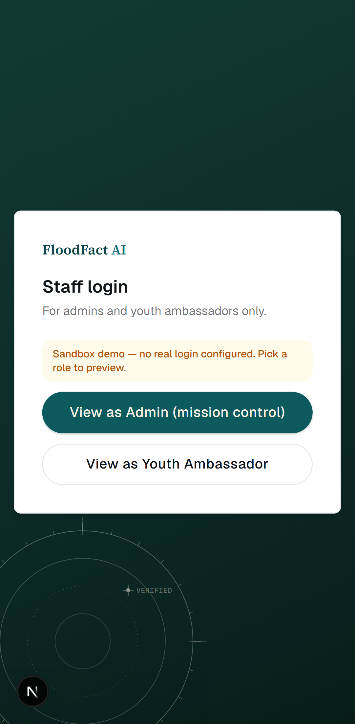
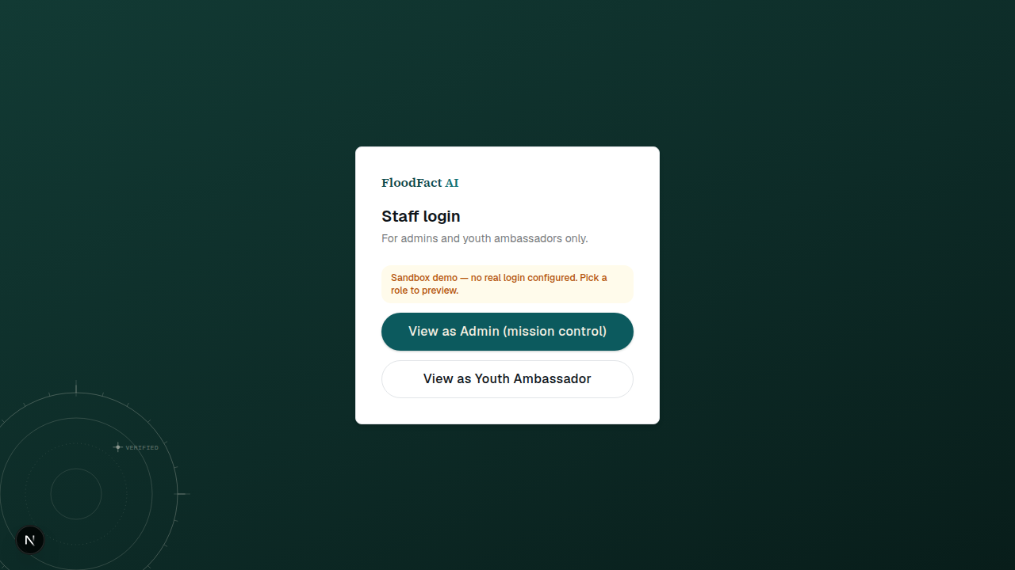
GETTING IN
One login screen swaps in two real roles
Sandbox mode replaces Supabase Auth with a role switcher — Admin or Youth Ambassador — no accounts needed.
FloodFact AI · Phase 1 Pilot: Mukuru, Nairobi
2

Slide 4
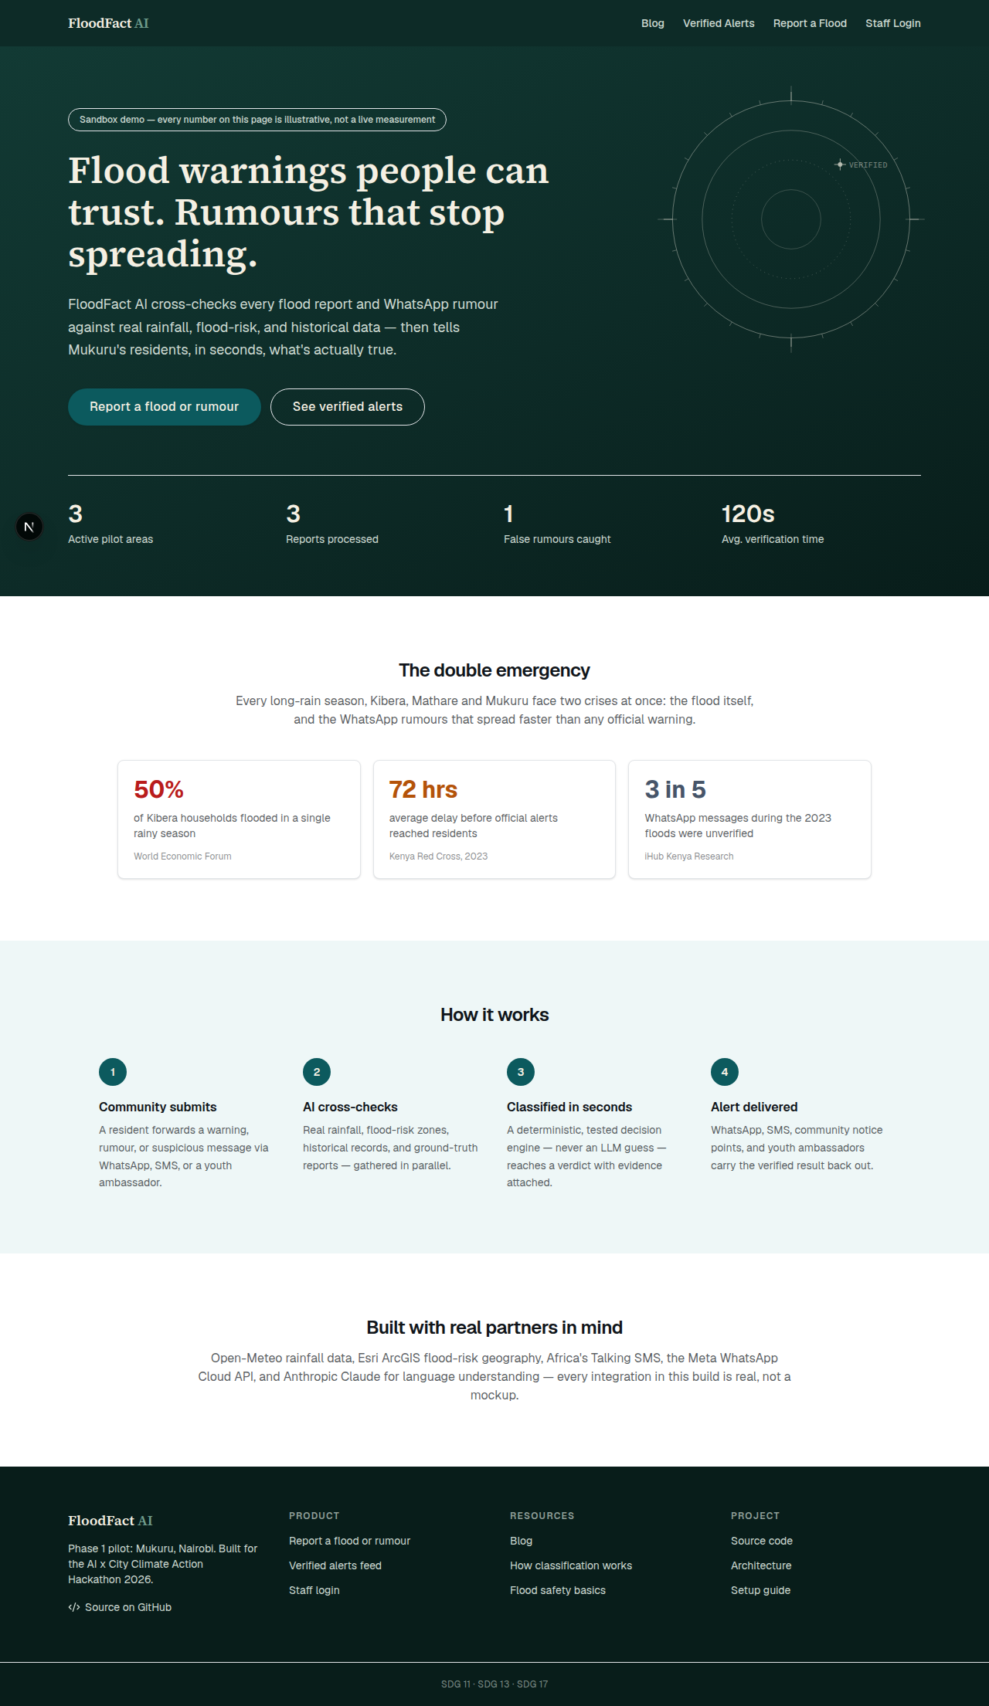
STEP 1 — A RESIDENT ARRIVES
The public site states the deal in one screen
No install, no account — the landing page links straight into reporting and the public alerts feed.
FloodFact AI · Phase 1 Pilot: Mukuru, Nairobi
3

Slide 5
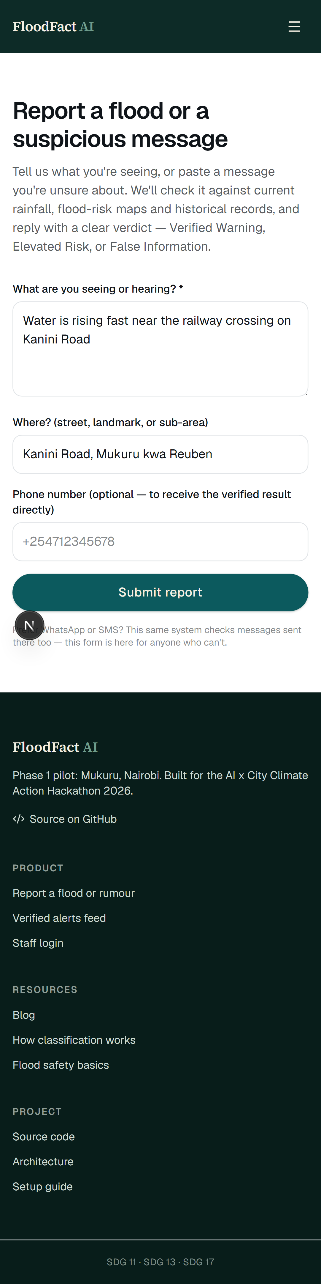
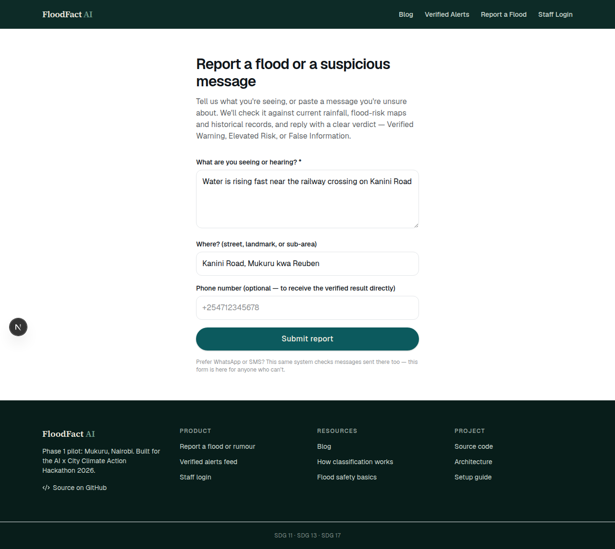
STEP 2 — REPORTING TAKES SECONDS
“Water is rising fast near the railway crossing on Kanini Road”
This same Zod-validated schema also accepts inbound WhatsApp and SMS — the form is the fallback channel.
FloodFact AI · Phase 1 Pilot: Mukuru, Nairobi
4

Slide 6
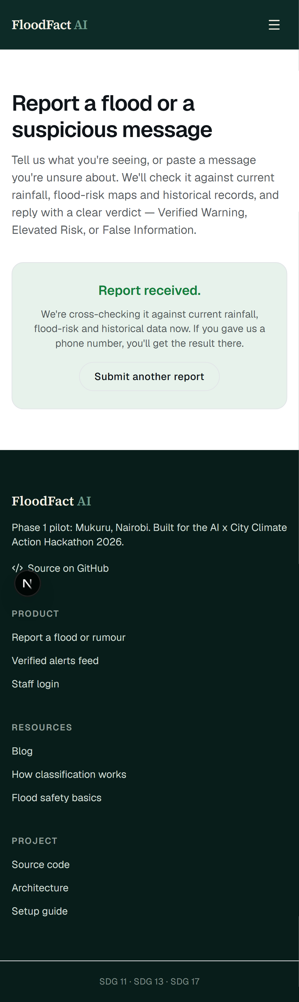
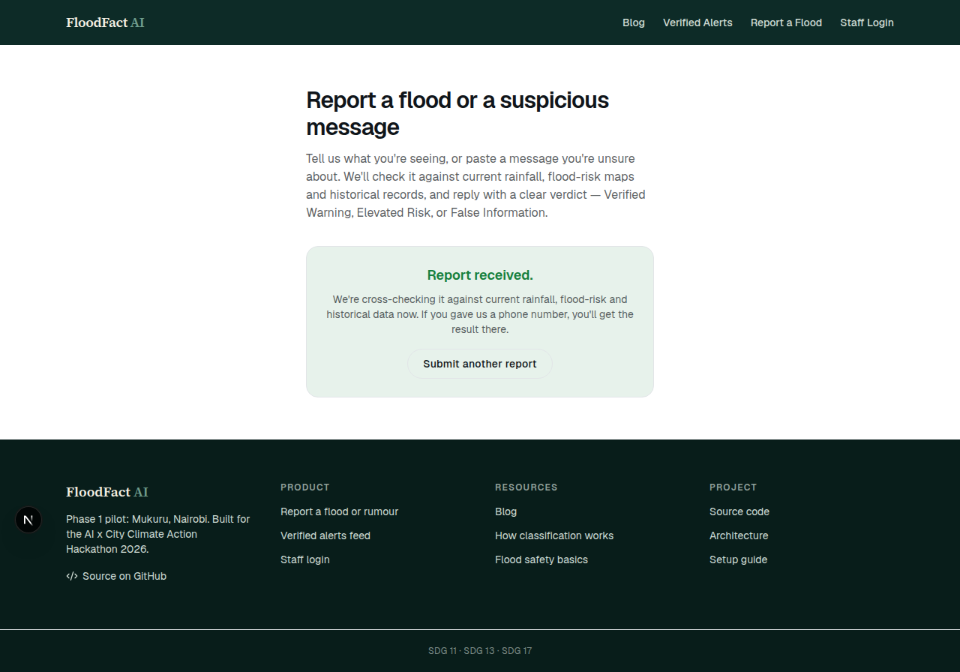
STEP 3 — IMMEDIATE ACKNOWLEDGMENT
The resident is told their report is already moving
Submission triggers the classification pipeline immediately — no queue, no wondering if it arrived.
FloodFact AI · Phase 1 Pilot: Mukuru, Nairobi
5

Slide 7
BEHIND THE SCENES
Every report runs the same six-stage, fully-audited pipeline
This is the real code path — lib/pipeline/classify.ts calling lib/core/risk-engine.ts — not a simplified diagram.
1
2
3
4
5
6
Understand
Geocode
Gather Evidence
Decide
Explain
Alert
Claude extracts hazard type, claimed location, and urgency — logged verbatim to nlu_extractions.
The claimed location is matched against a real Mukuru gazetteer and resolved to a pilot area via PostGIS.
Rainfall, flood-risk zone, historical base rate, corroboration, ambassador ground-truth, and rumor similarity — in parallel.
risk-engine.ts scores the evidence. Pure, deterministic, 23 unit tests. No LLM call in this step.
Claude writes the plain-language, bilingual EN/Swahili rationale for a verdict it did not make.
A channel-specific message goes out over WhatsApp, SMS, the public feed, and the ambassador queue.
FloodFact AI · Phase 1 Pilot: Mukuru, Nairobi
6

Slide 8
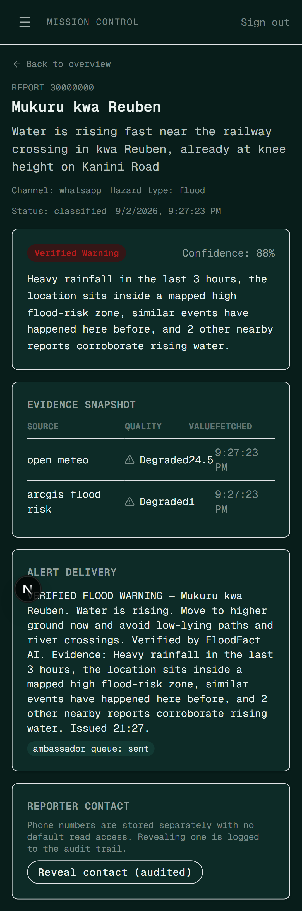
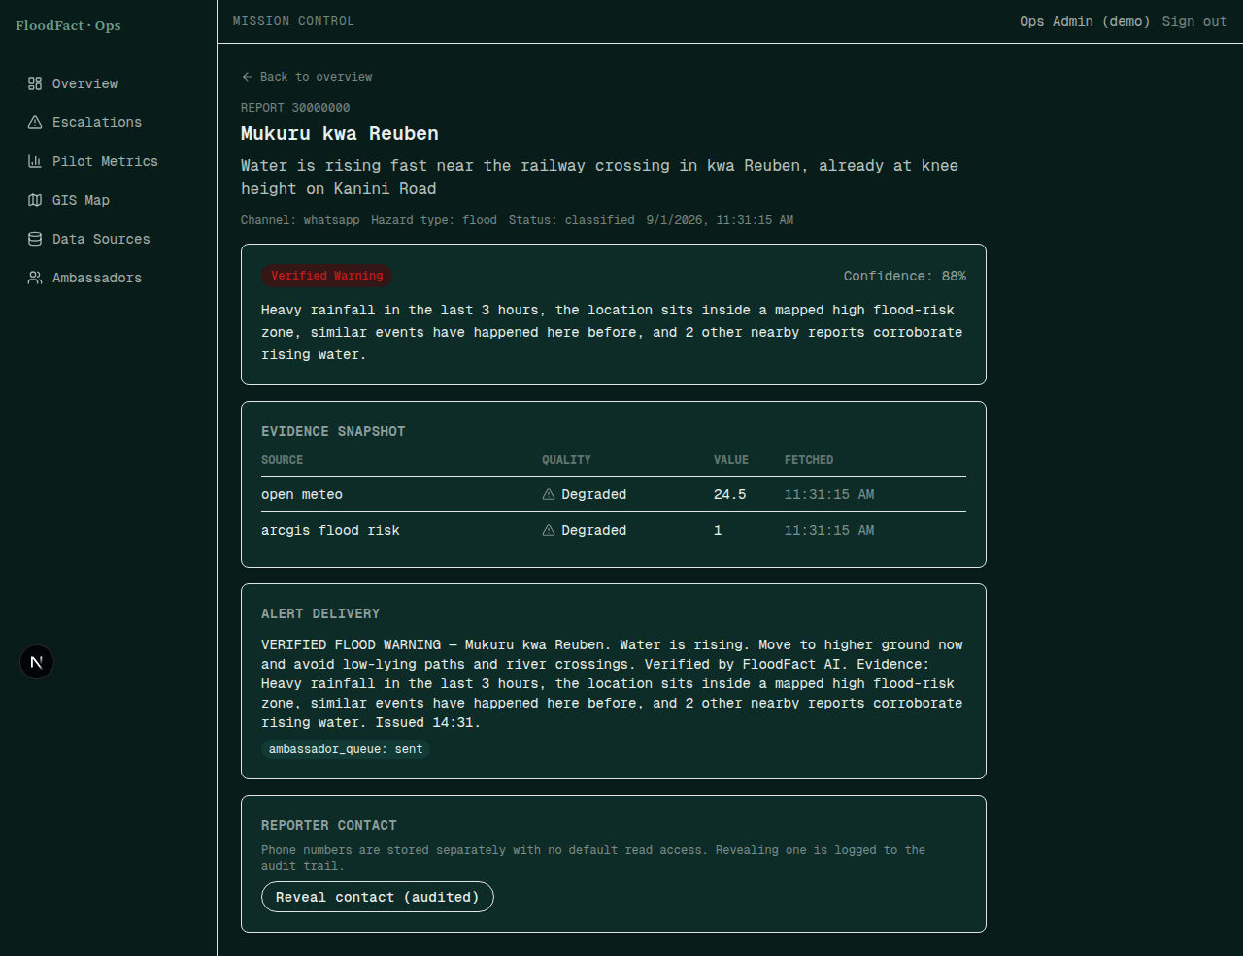
STEP 4 — INSIDE A SINGLE CASE
A verdict that shows its work
Verified Warning, a confidence score, a written rationale, and the evidence_items row behind each one.
FloodFact AI · Phase 1 Pilot: Mukuru, Nairobi
7

Slide 9
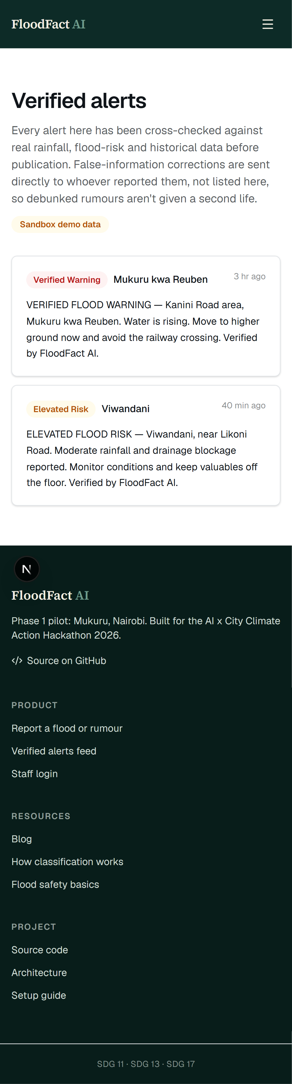
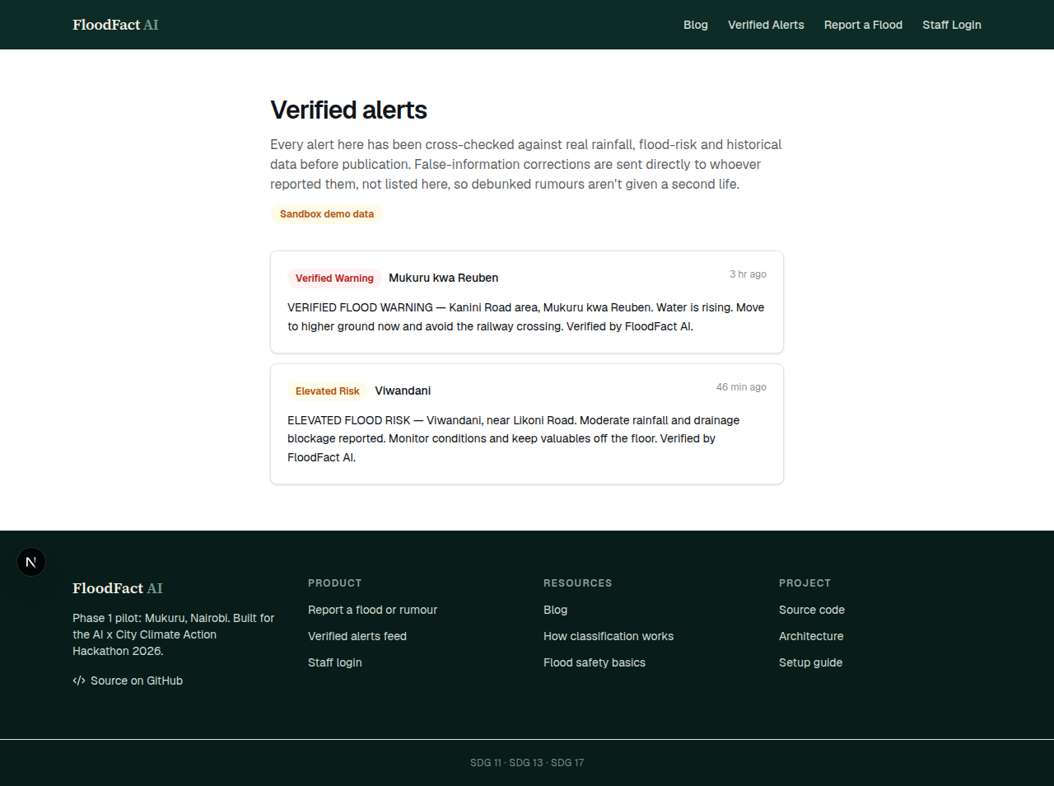
STEP 5 — THE VERDICT REACHES THE PUBLIC
Only verified and elevated-risk classifications appear here
Reads from a dedicated public_alert_feed view — no raw reports, contact details, or open cases exposed.
FloodFact AI · Phase 1 Pilot: Mukuru, Nairobi
8

Slide 10
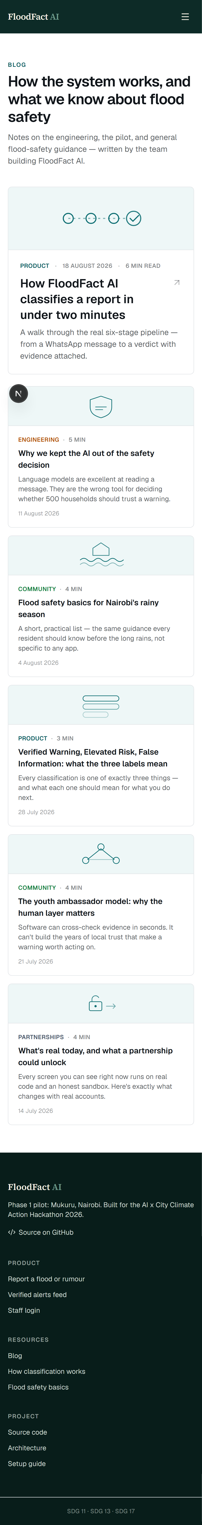
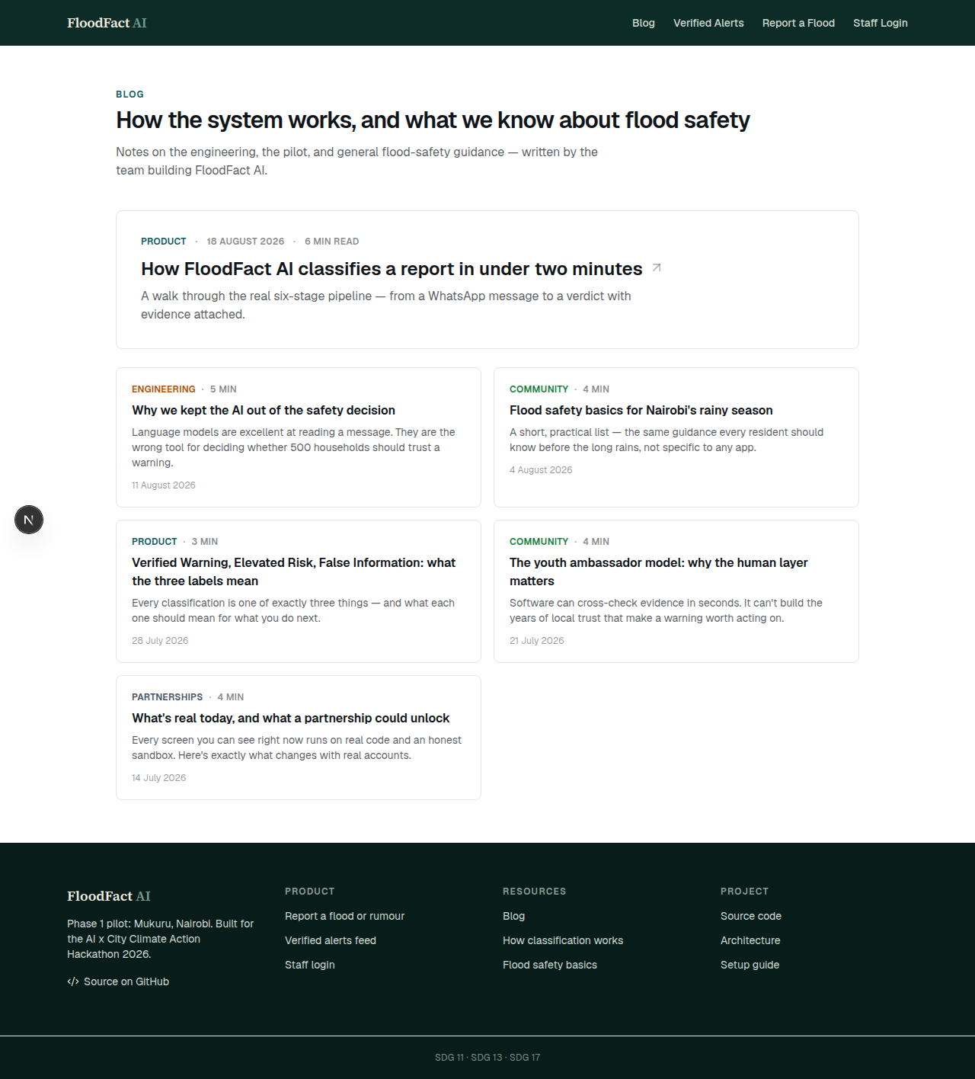
NOT JUST A PRODUCT
A real blog — the engineering rationale, not marketing copy
Six posts on how the pipeline works, why the AI doesn't decide, and general flood-safety guidance — no fabricated pilot results.
FloodFact AI · Phase 1 Pilot: Mukuru, Nairobi
9

Slide 11
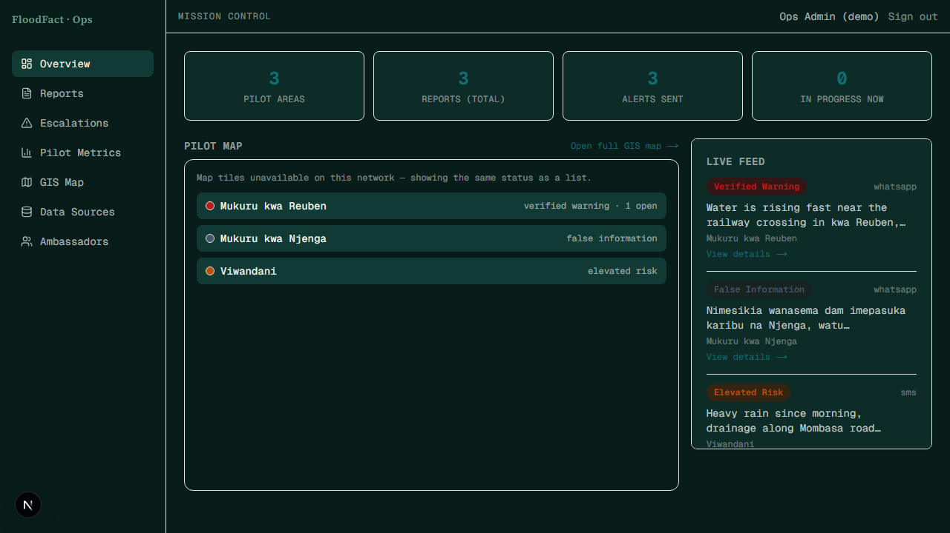
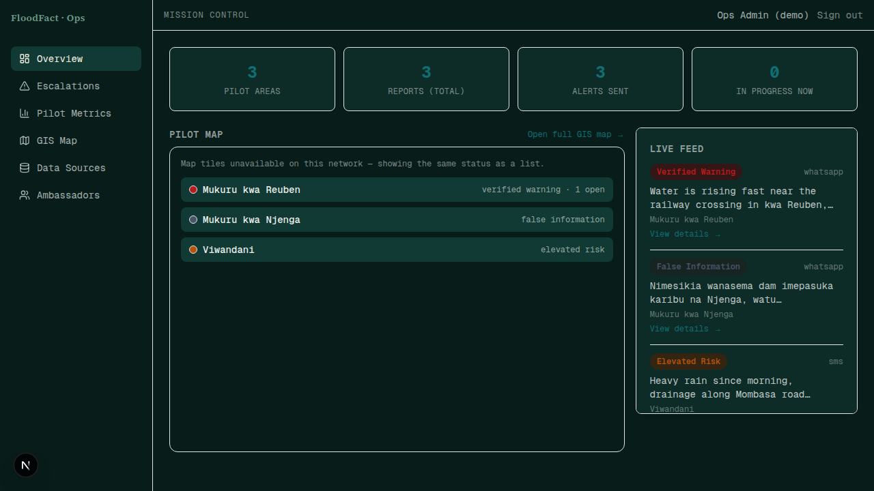
MISSION CONTROL
Every pilot area, one live map
Mukuru's three wards, colored by latest verdict — falls back to a status list if tiles don't load.
FloodFact AI · Phase 1 Pilot: Mukuru, Nairobi
10

Slide 12
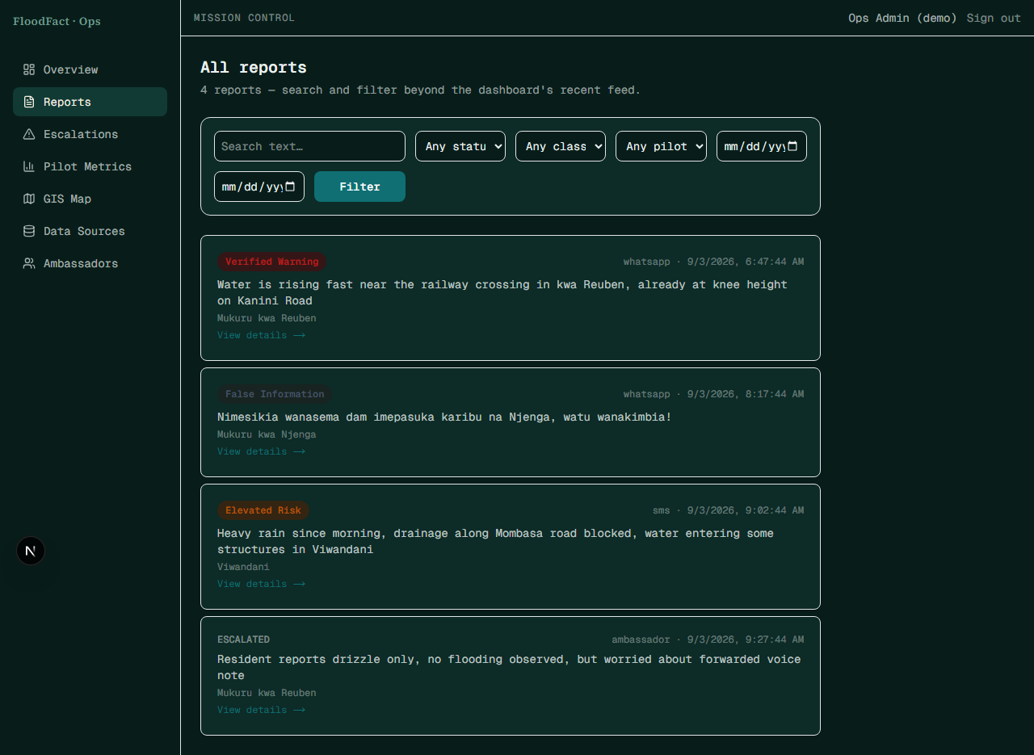
ADMIN — REPORT SEARCH
Every report, searchable — not just the last 15
Filter by status, classification, pilot area, or date, and search report text directly — /admin/reports.
FloodFact AI · Phase 1 Pilot: Mukuru, Nairobi
11

Slide 13
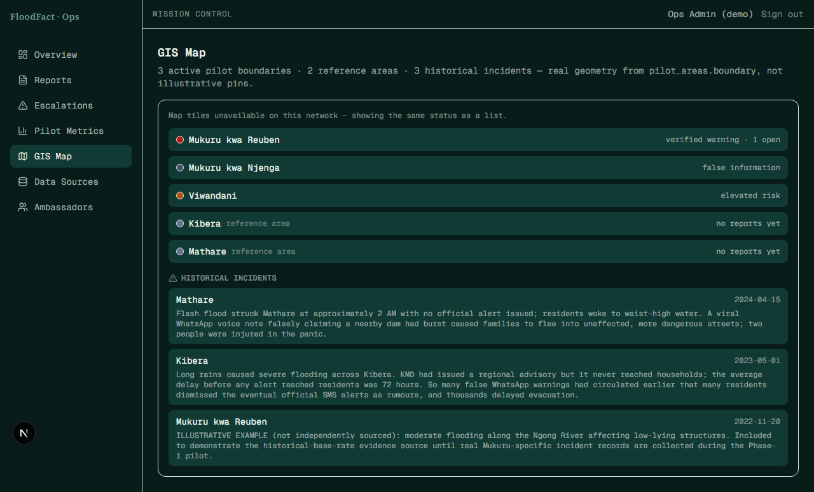
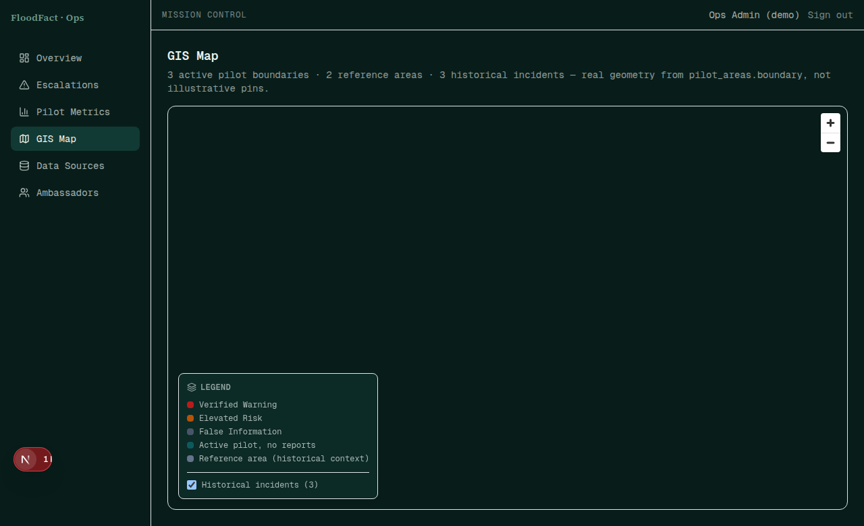
REAL GEOGRAPHY, NOT PINS
Pilot boundaries, reference wards, and historical incidents — one map
Real polygons from pilot_areas.boundary, plus cited historical floods — including an honestly-labeled illustrative one.
FloodFact AI · Phase 1 Pilot: Mukuru, Nairobi
12

Slide 14
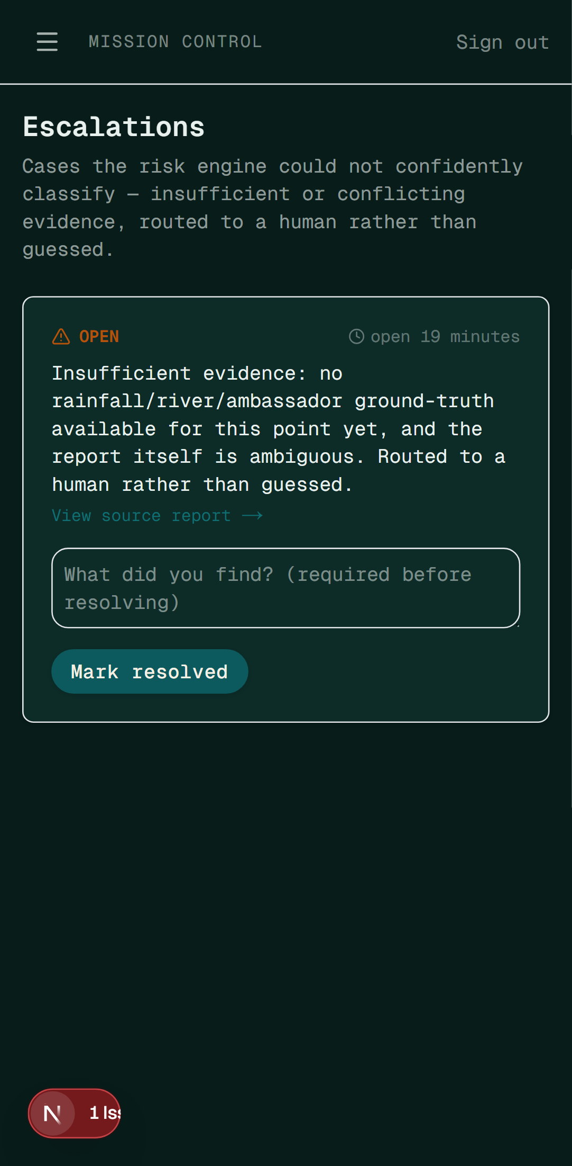
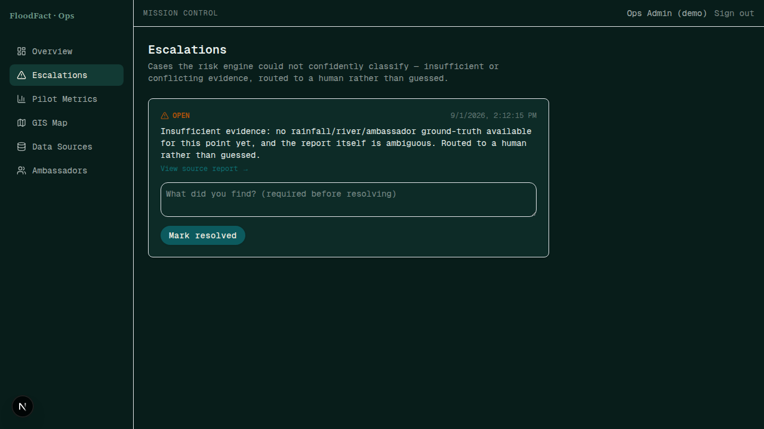
THE SAFETY NET
When evidence is insufficient, a human decides — never an algorithm alone
insufficient_evidence can never silently become "False Information" — it lands here for a human call, with a visible age badge and an hourly SLA-breach sweep so nothing goes stale unnoticed.
FloodFact AI · Phase 1 Pilot: Mukuru, Nairobi
13

Slide 15
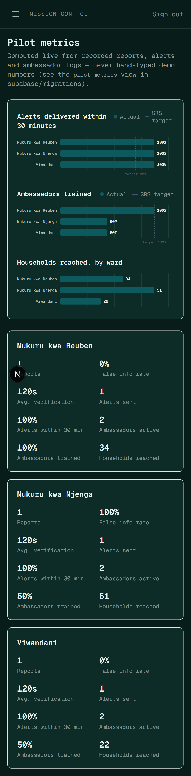
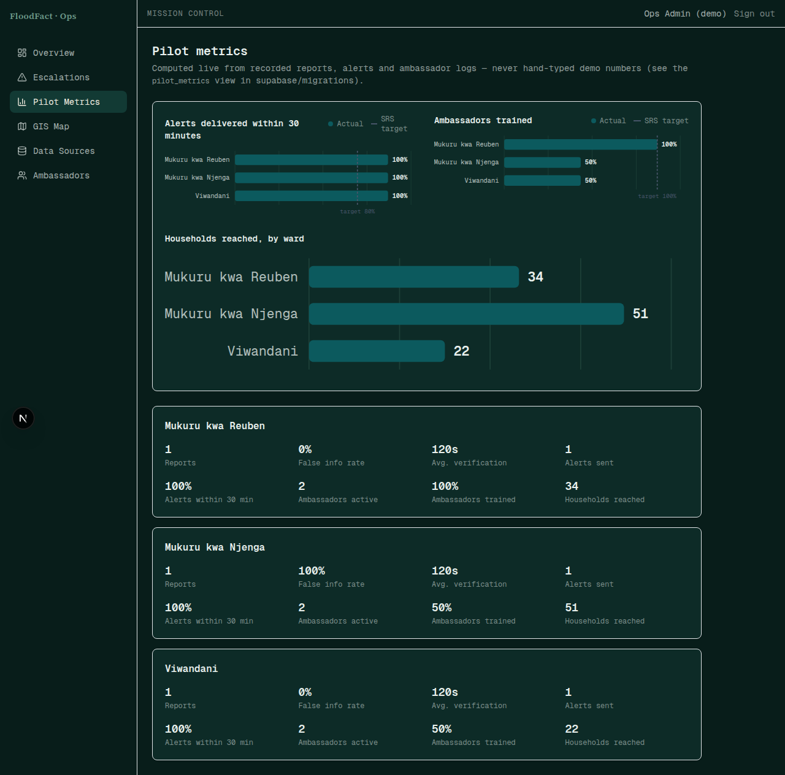
PROOF, NOT PROMISES
Pilot metrics computed from real database rows, not typed into a slide
A live SQL view, not hand-typed numbers — recomputed from reports and ambassador observations.
FloodFact AI · Phase 1 Pilot: Mukuru, Nairobi
14

Slide 16
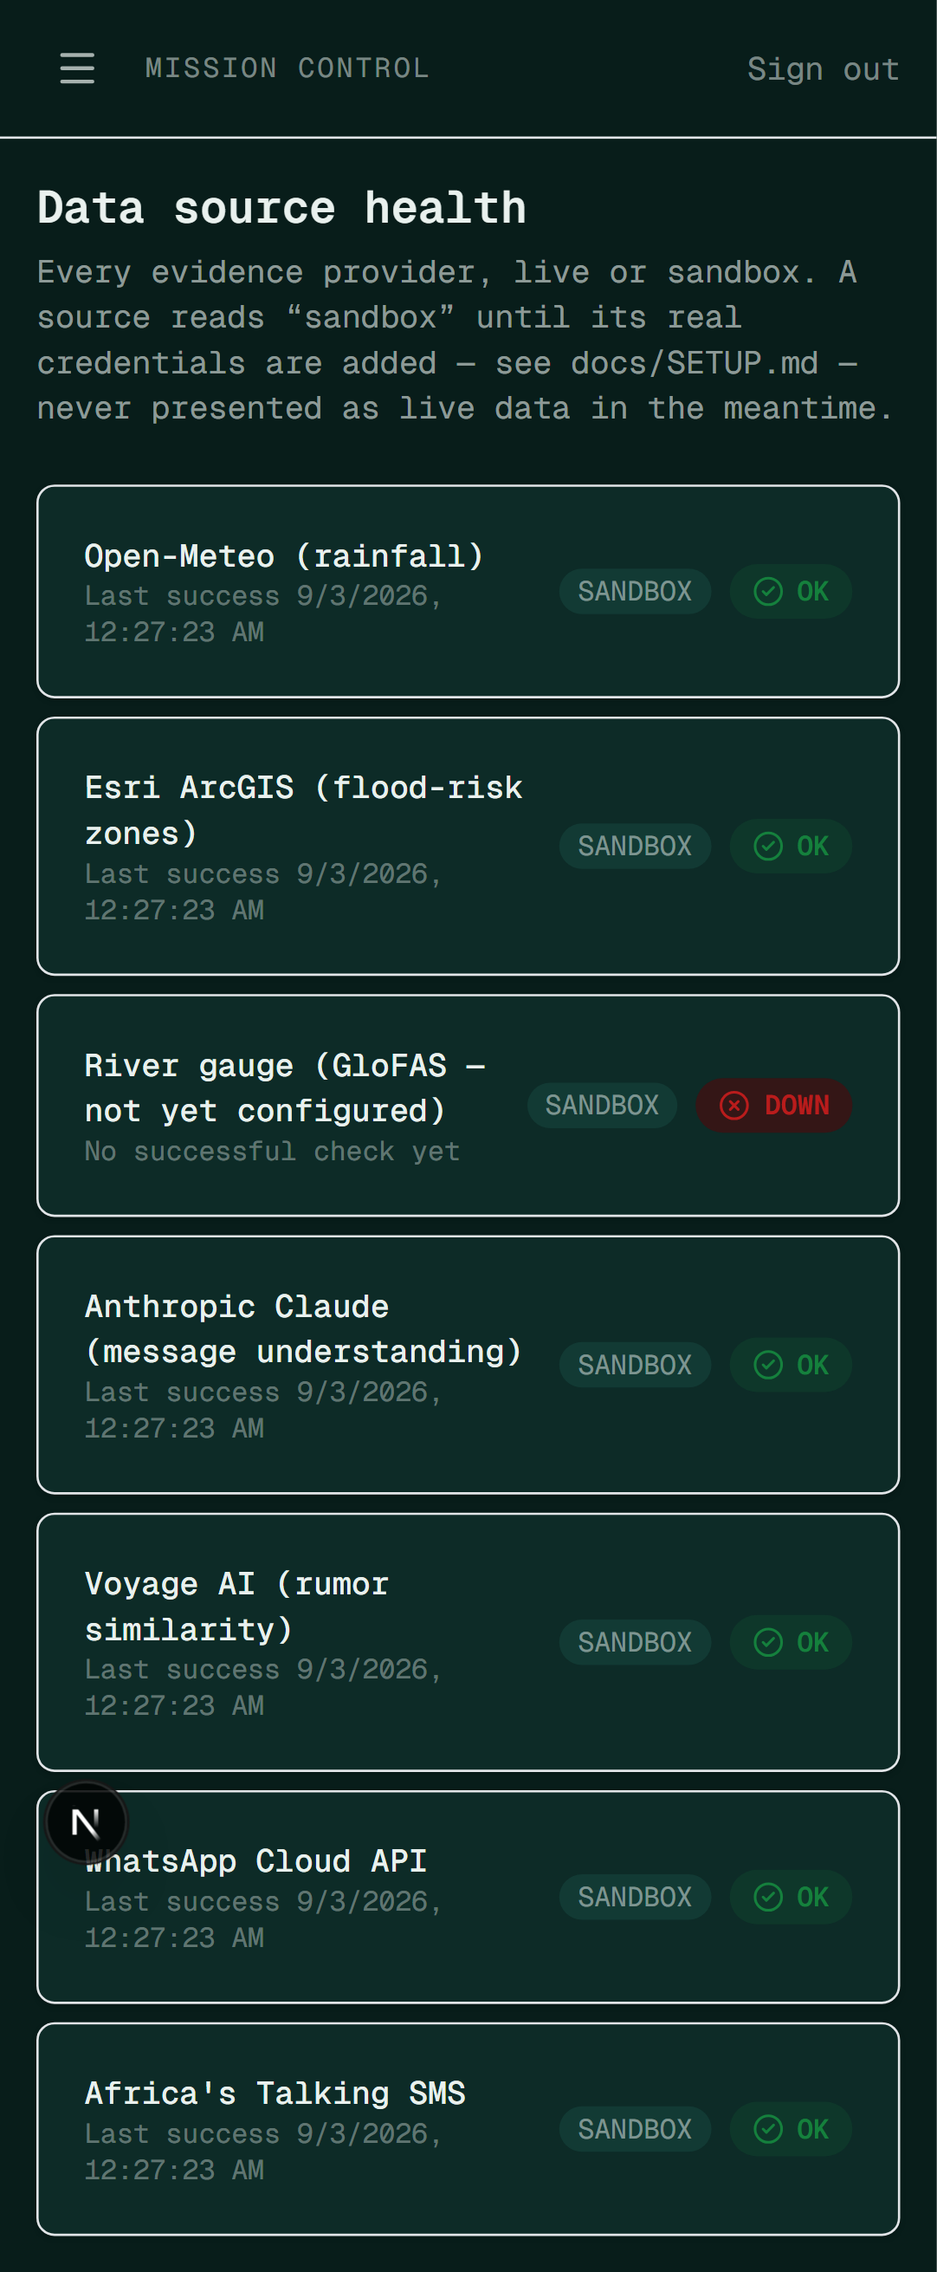
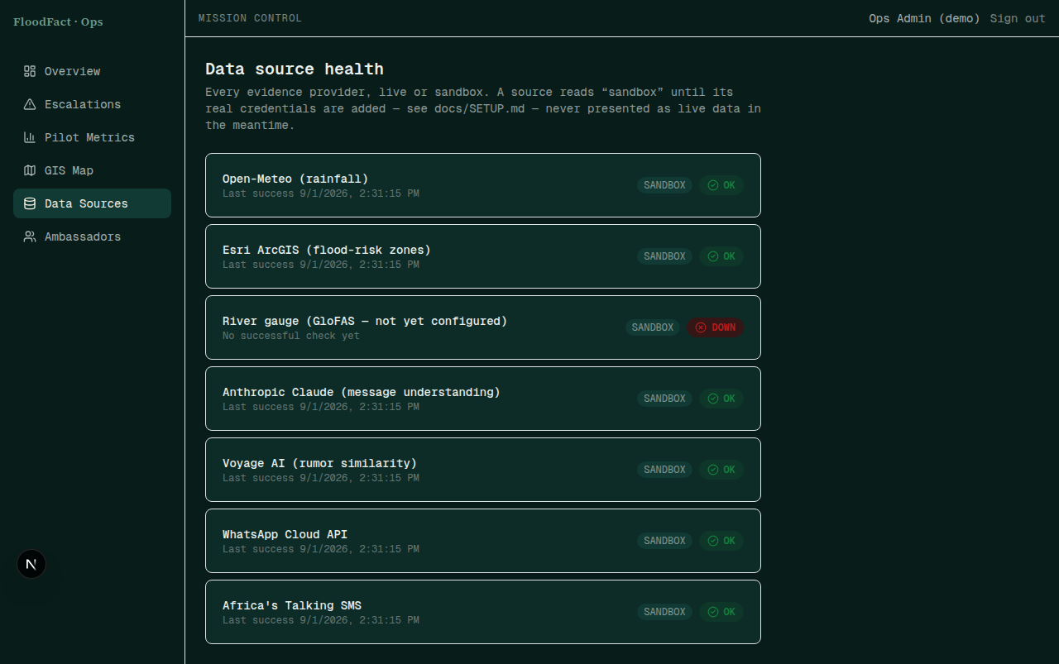
RADICAL TRANSPARENCY
Every data source's health, live or sandbox, in plain sight
Each provider's live/sandbox mode and status, visible to the people operating the system.
FloodFact AI · Phase 1 Pilot: Mukuru, Nairobi
15

Slide 17
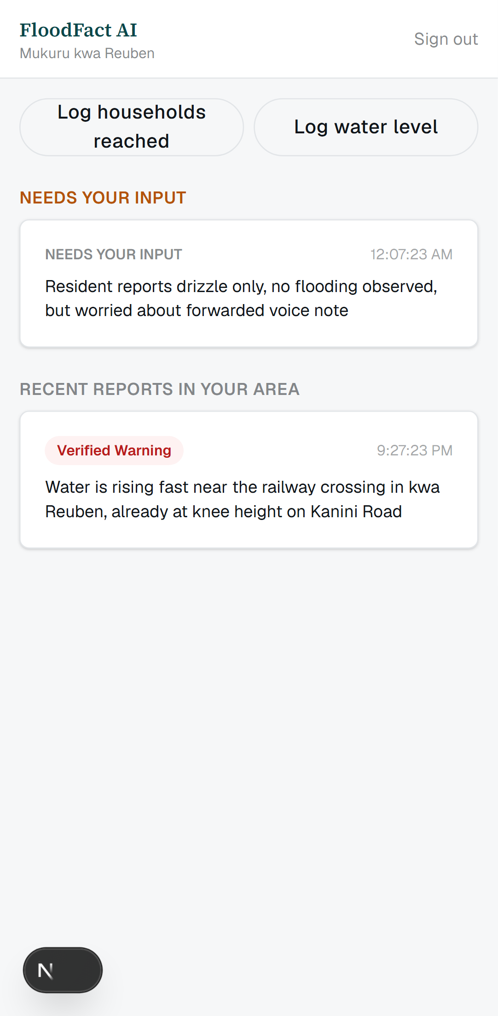
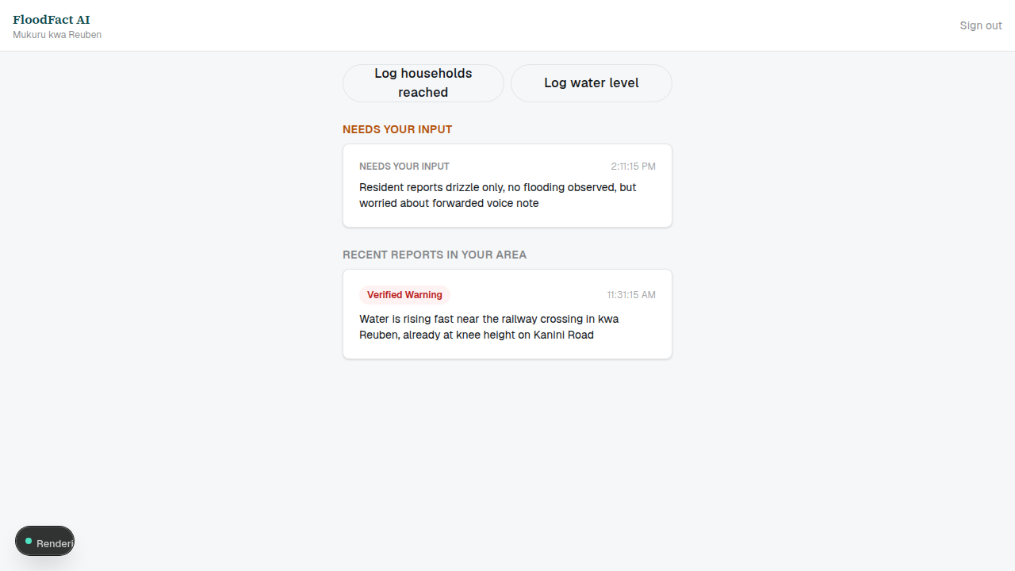
STEP 6 — THE HUMAN TRUST LAYER
Youth ambassadors see only their own ward's queue
Row-level security enforces this at the database — an ambassador's session cannot query another ward.
FloodFact AI · Phase 1 Pilot: Mukuru, Nairobi
16

Slide 18
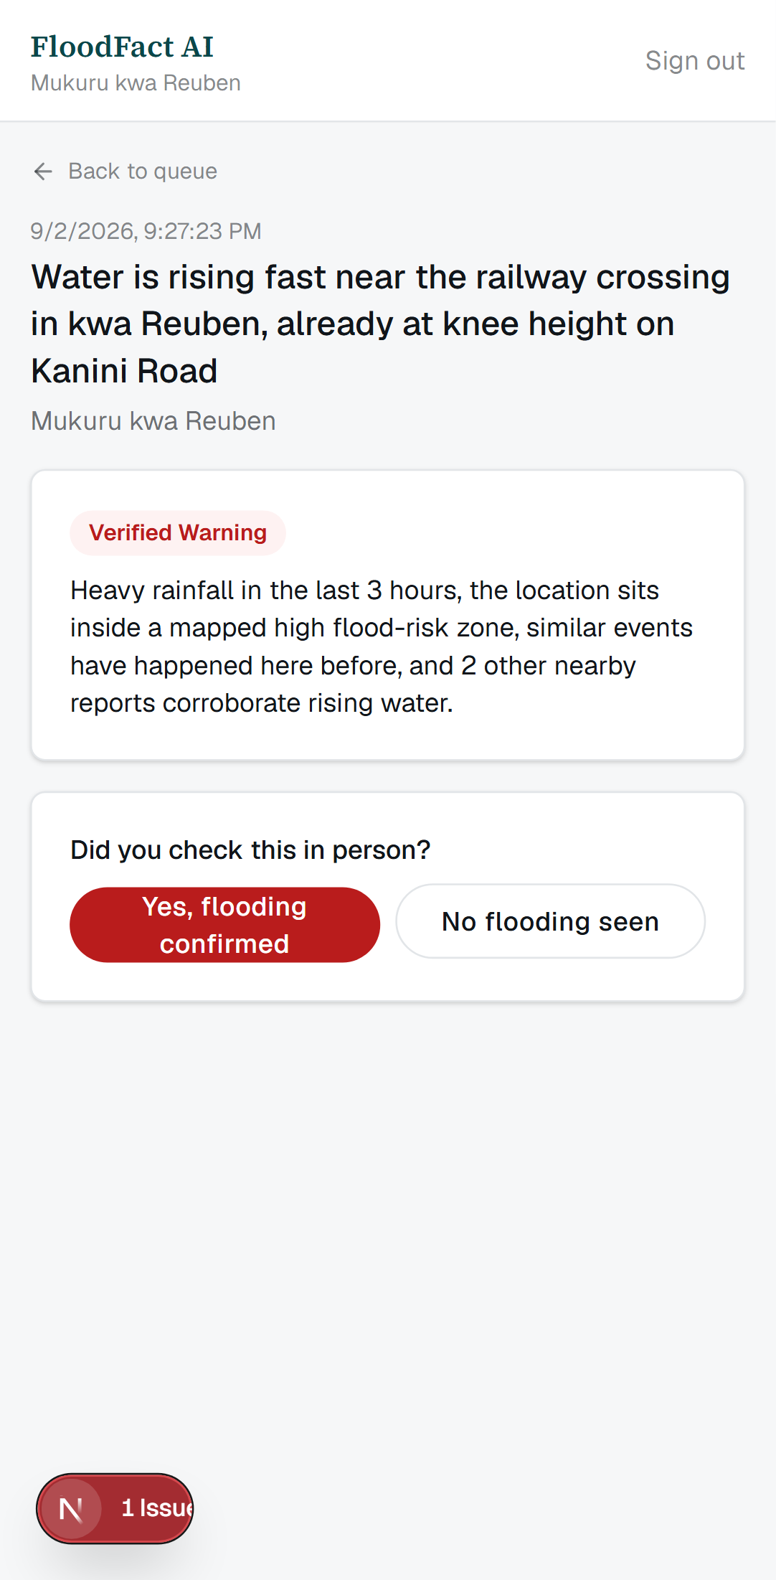
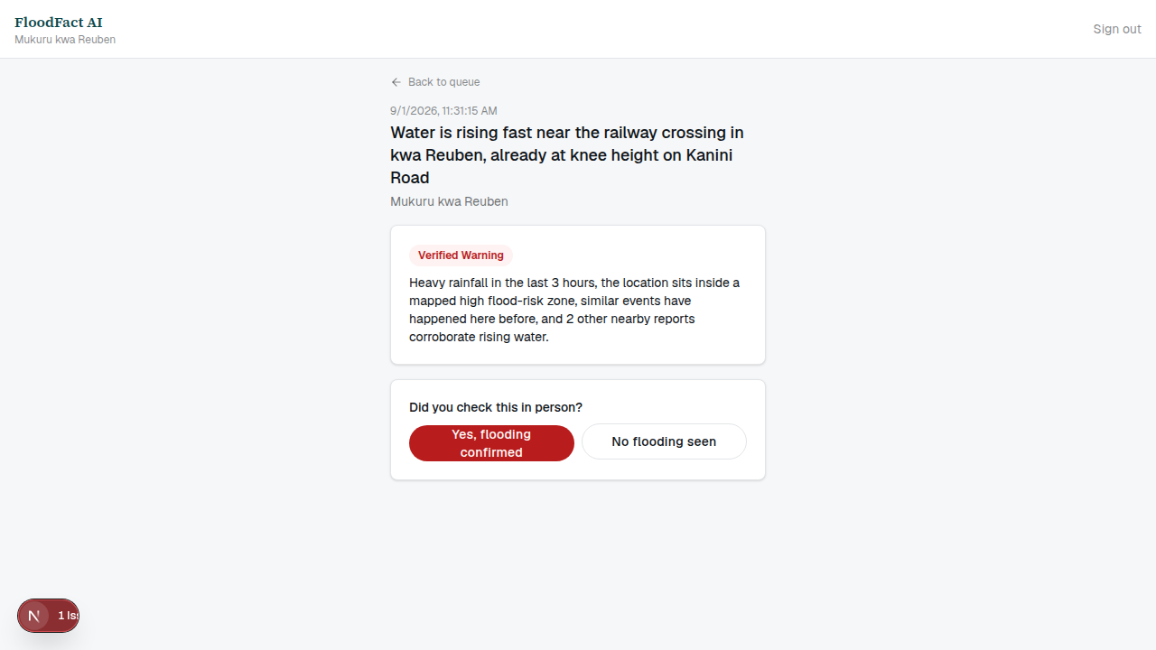
GROUND-TRUTH FROM THE FIELD
A visual confirmation and a water-level reading feed straight back into the evidence store
A visual confirmation and a water reading feed back in as evidence for the next nearby report.
FloodFact AI · Phase 1 Pilot: Mukuru, Nairobi
17

Slide 19
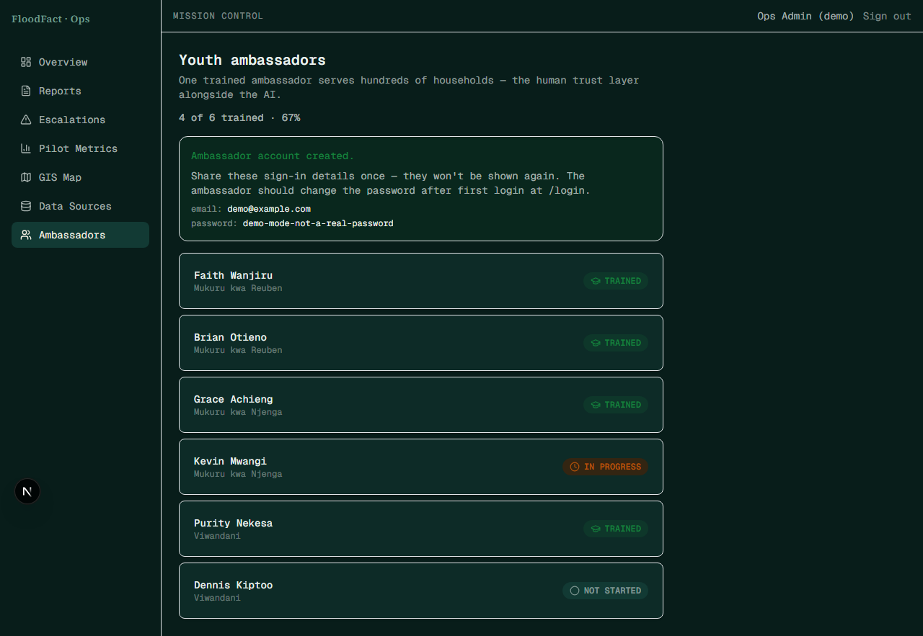
ONBOARDING AMBASSADORS
Adding an ambassador is one form, not a database console
Creates the Auth login, the ambassadors row, and the user_roles row in one action — admin-only.
FloodFact AI · Phase 1 Pilot: Mukuru, Nairobi
18

Slide 20
EXACTLY WHAT'S REAL TODAY
Every integration switches independently — no code changes either way
Integration | Right now (zero paid keys) | Our real pilot deployment, right now
Rainfall & forecast | Open-Meteo — the real public API, already live (keyless) | No key needed — already real
Flood-risk zones | Seeded PostGIS polygon for Mukuru | Live — WRI Aqueduct riverine flood-risk atlas (ArcGIS)
WhatsApp intake/alerts | Deterministic sandbox responder | Not yet — needs a Meta developer app + token
SMS intake/alerts | Deterministic sandbox responder | Live — Africa's Talking sandbox account, real API calls
Claim extraction + rationale | Deterministic template text | Live — Anthropic Claude, verified
Rumor-pattern similarity | Local hash embedding | Live — Voyage AI embeddings, verified
Database, Auth, this deck | Static fixtures — DEMO_MODE, no Supabase project | Live — real Supabase project, 9 migrations, RLS everywhere
Each row switches on its own credential's presence, not a global flag. Exact steps for every row: docs/SETUP.md.
FloodFact AI · Phase 1 Pilot: Mukuru, Nairobi
19

Slide 21
SEE FOR YOURSELF
The whole system is one clone away
Read the code
Run it yourself
Go live
Full source, 6 SQL migrations with RLS, and 43 passing unit tests — 23 of them exhaustively covering the risk engine's safety rules.
npm install && npm run dev boots the entire product — public site, admin console, ambassador PWA — from seed fixtures. No accounts, no keys.
docs/SETUP.md walks through provisioning Supabase, Meta, Africa's Talking, Anthropic, and Voyage, step by step.
FloodFact AI · Phase 1 Pilot: Mukuru, Nairobi
20

Slide 22
THANK YOU
This is not a concept.
It is a working system — already live on 4 of 5 real integrations.
Concept: FloodFact-AI-Concept.pdf · Pilot Plan: FloodFact-AI-Pilot-Plan.pdf · Repository: github.com/VinceOdundo/FloodfactAI
Team: Samuel Mburu Kairu · Vincent Odundo · Alvin Nyota · Amani Maria — Nairobi, Kenya
FloodFact AI · Phase 1 Pilot: Mukuru, Nairobi
21

