Slide 1
Air China 2.5
Explore the Datasets of PM2.5 concentration in China
Wenhan Rao
Xitao Wang
Shuai Yuan

Slide 2
Small Particulate Matter (PM2.5)
Small Particulate Matter with a mean aerodynamic diameter of 2.5 μm (PM2.5) is especially detrimental to health. People with breathing and heart problems, children and the elderly areparticularly sensitive to PM2.5.
PM2.5 has drawn international attention and more and more monitoring stations have been established to collect data on PM2.5 concentration, which is used for broadcasting and scientific studies.

Slide 3
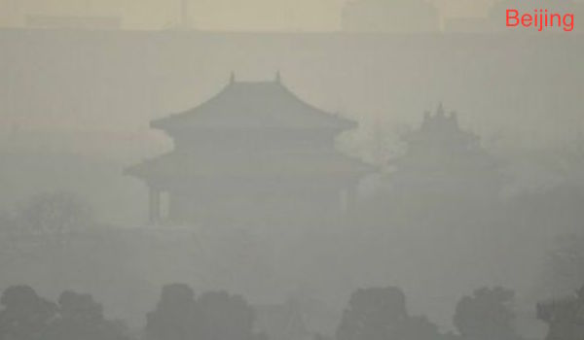
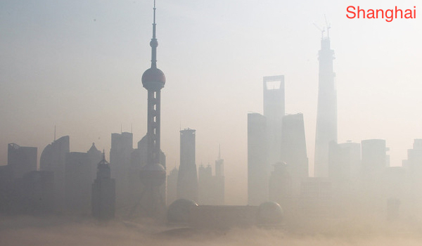
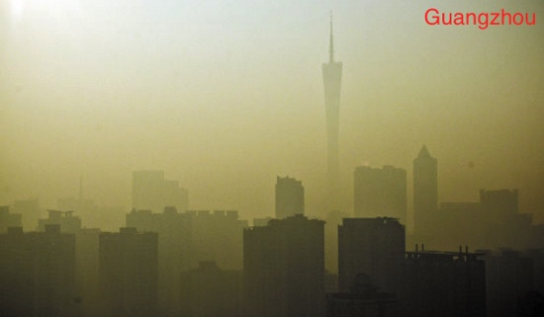
“Toxic Haze” in China Due to PM2.5
China is one of the developing countries that suffers the most severe PM2.5 conditions.
Times reported it as “China’s Eastern Coast Blanketed in Toxic Haze ”.

Slide 4
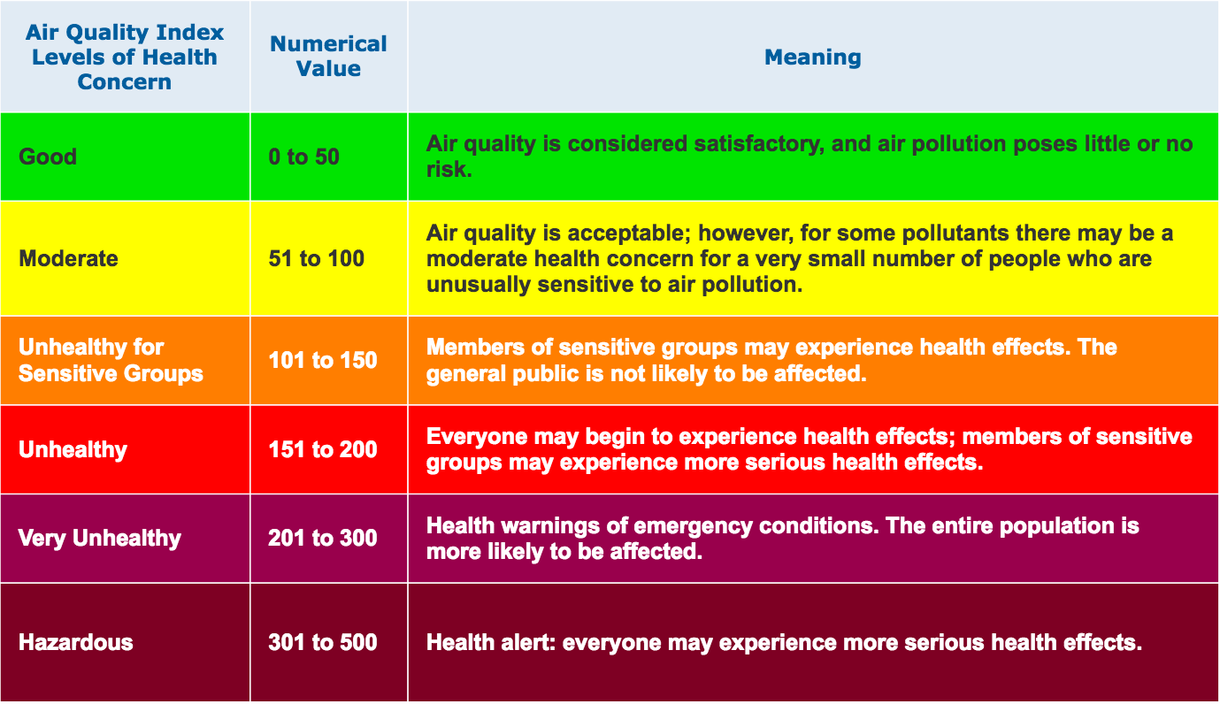
Air Quality Index (AQI)

Slide 5
Goal of Air China 2.5
Allow users to explore two different datasets:
Berkeley Earth: 182 cities over four months in 2014
US embassy: 5 major cities over years
Provide multiple visualizations of the data for different purposes:
Geographic visualization to show air pollution distribution spatially.
Line graph with zooming and panning to explore air pollution over time and compare among a few cities at certain time period.
Small multiples to enable comparison among many cities and ranking by various statistics.

Slide 6
Summary of Features
Berkeley Earth
US Embassy
Tooltip
Zoom in/out
Panning
Ranking/sorting
Filtering
Statistics
Select city
Select time period
Geo-visualization
Line graph
Small multiples

Slide 7
Messages We Learned from Air China 2.5

Slide 8
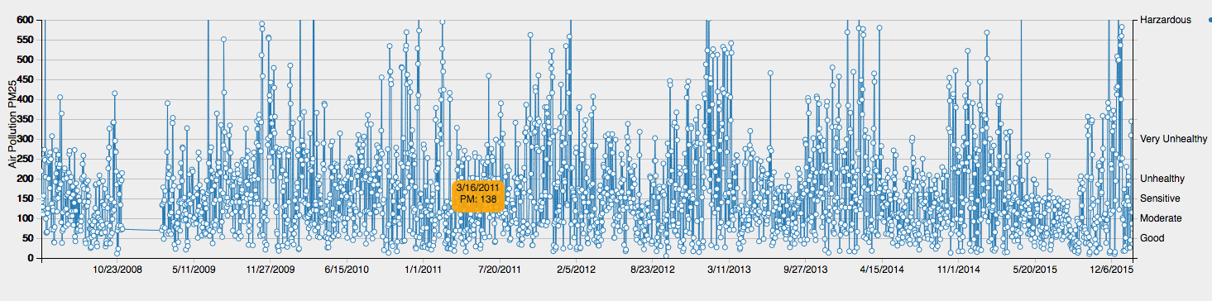
Messages We Learned from Air China 2.5
)

Slide 9
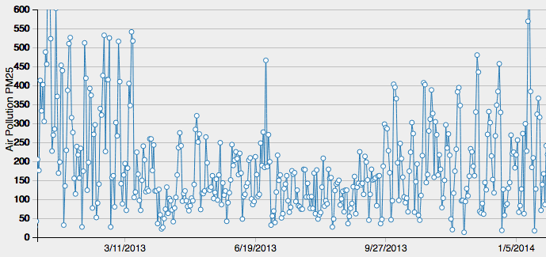
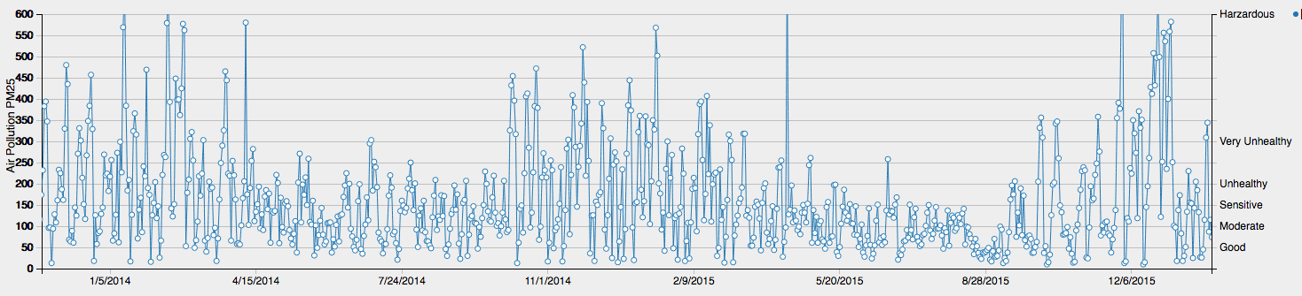
Messages We Learned from Air China 2.5
)

Slide 10
Messages We Learned from Air China 2.5
)
Wind from MP
Wind from MP
Wind from MP
Wind from MP
Rainfall
Rainfall
Rainfall
Wind from Mongolian Plateau: from northwest inner land to southeast coast

Slide 11
Messages We Learned from Air China 2.5
Natural factor: Seasonal
rainfall,
wind from Mongolian Plateau

Slide 12
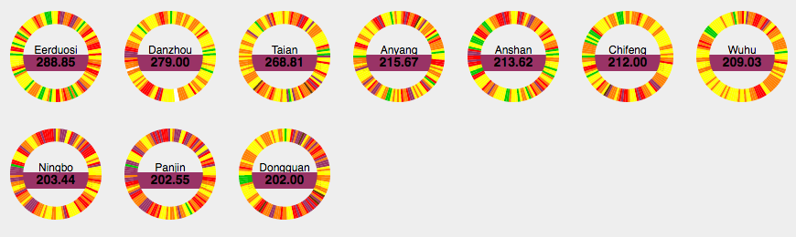
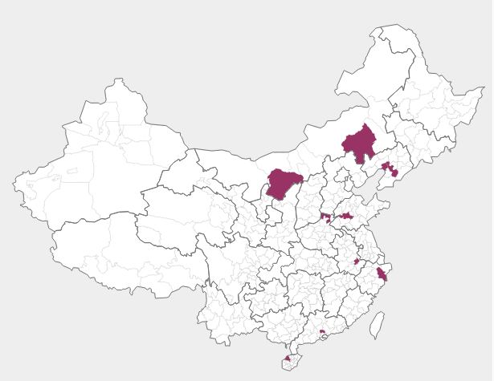
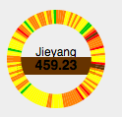
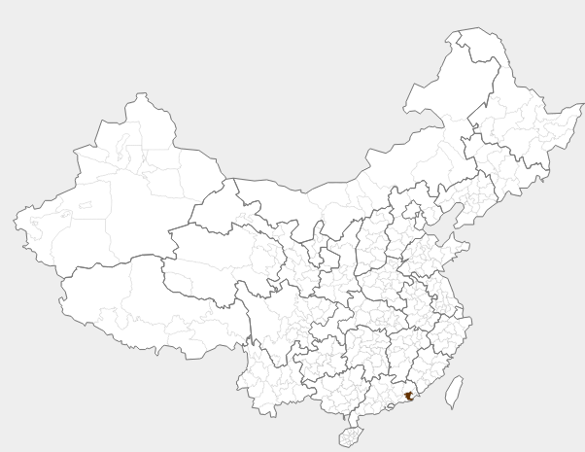
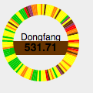
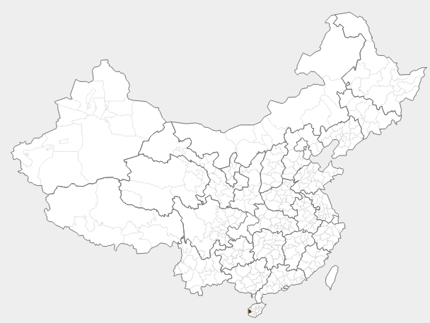
Messages We Learned from Air China 2.5
Geo doesn’t explain it all!
Industrial pollution!
Chifeng: Coal Mining
Jieyang: Textile
Eerduosi: Textile
Anshan: Steel
Dongfang: Oil field

Slide 13
Messages We Learned from Air China 2.5
Natural factor: Seasonal
rainfall,
wind from Mongolian Plateau
Industrial factor:
Coal mining
Steel
Textile
Oil

Slide 14
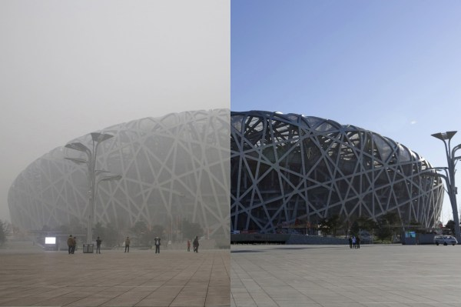
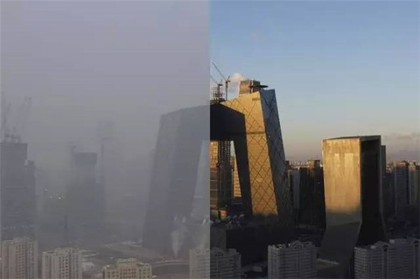
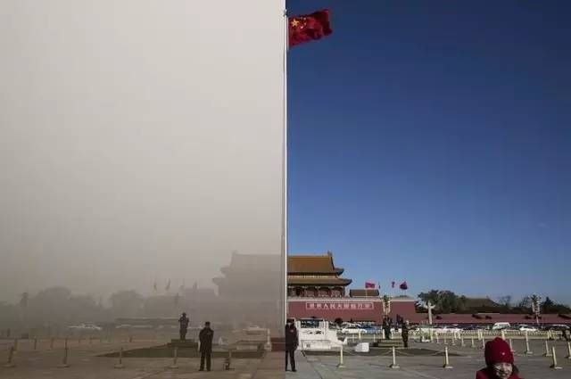
Messages We Learned from Air China 2.5
Beijing Blue!

Slide 15
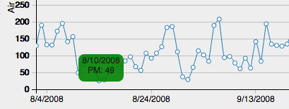
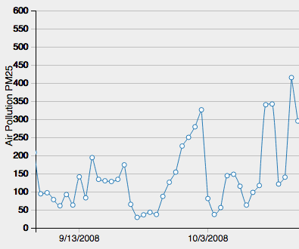
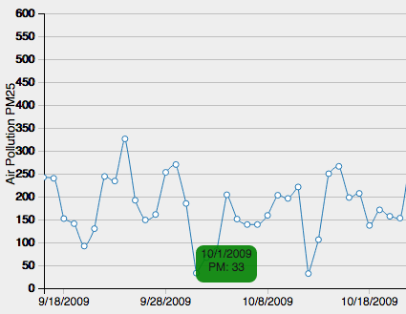
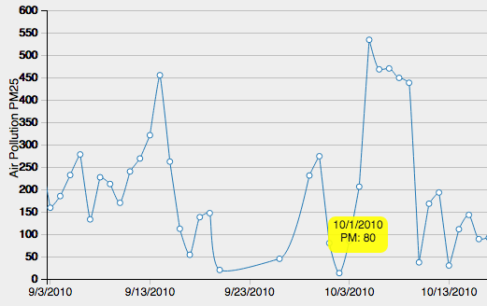
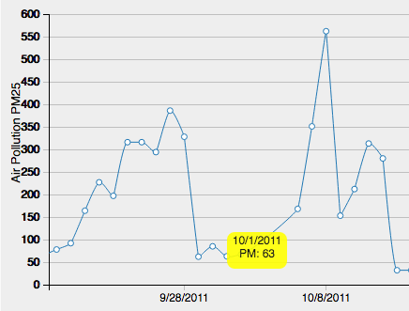
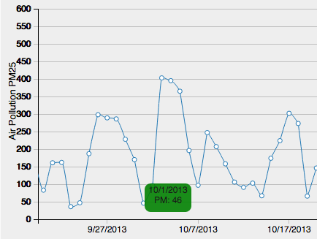
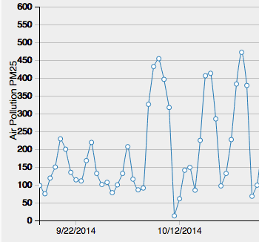
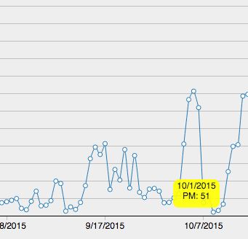
Messages We Learned from Air China 2.5
2008 Olympics
10/01/2008
10/01/2015
Oct, 1st: 2008-2015 National Day Blue!

Slide 16
Messages We Learned from Air China 2.5
Natural factor: Seasonal
rainfall,
wind from Mongolian Plateau
Industrial factor:
Coal mining
Steel
Textile
Oil
Human activity/Government Interference
Artificial rainfall
Temporal pause of polluting industry
Temporal vehicle regulation

Slide 17
What You Learned from Air China 2.5？
Let us know!
Thank you!

