Slide 1
Market Metro
Ontology-guided commerce planning with PayPal Sandbox execution
An agent that learns what to market,
then checks whether the campaign pays.
384 merchants · 19,200 simulated shoppers · settled through day 126
+$3,310.75
+$36,042.88
+532
Modeled PayPal net
Merchant contribution
Retained purchases
After model inference cost
Includes inventory valuation
After the return / settlement window
Same seed and starting economy as strong fixed rules. One observed run at this scale.
Modeled outcomes in an authored economy. Native Sandbox integration is demonstrated separately.
01
Notes:
Opening example, not a production ROI claim. The 384-merchant run completed through day 126 and incurred $0.059695 in token-estimated model cost. Extra retained sales volume was $78,636. The run used twelve fresh provider responses and initiated zero native PayPal payments. There is one seed at this scale, not an unseen-seed confidence interval. We retain the negative merchant result at 96 merchants in the final slide.
Implementation and evidence
/Users/lanz.vencer/Documents/ChatGPT/Paypal AI Hackathon/demo/data/metropolis-live-results.json
/Users/lanz.vencer/Documents/ChatGPT/Paypal AI Hackathon/docs/commerce-metropolis/README.md
Brand asset provenance
/Users/lanz.vencer/Documents/ChatGPT/Paypal AI Hackathon/docs/figures/planner-v23/assets/sources.json
/Users/lanz.vencer/Documents/ChatGPT/Paypal AI Hackathon/docs/presentations/ontology-paypal/vectors/sources.json

Slide 2
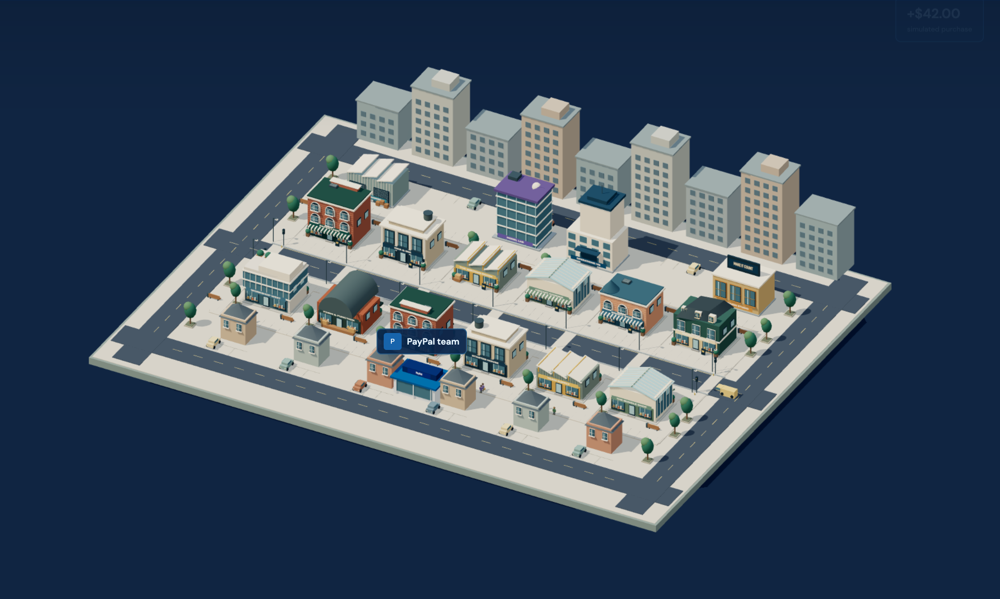
Revised system architecture
Observed commerce → verified data → tested campaigns
Approved campaign
A · Environment
Ontology
B · LLM agent
Link data before decisions
Investigate
Design training
Plan
Checkout
Demand signals
Data + features
Revise campaign
Decisions saved at each step
384 merchants
19,200 simulated shoppers
Order A
Order B
D · Tools + verifier
One payment · two merchant legs
Train
Trial
Verify
events
C · Data plane
Training contract
Local models
3 × 600 shoppers
Publish or hold
Target · cohort · features
Orders · contacts · refunds
Models · checkpoints · receipts
Hold ambiguous inputs
E · PayPal Sandbox
Capture → receipt
selected order / receipt
Proxy trials screen proposals. Final results use the full market. App snapshot shows the representative view.
02
Notes:
This extends the existing A-E architecture in docs/figures/planner-v23. A and C preserve the environment and warehouse. Ontology is a new logical bridge on warehouse exports, not a separate database service. B is one LLM with bounded tools, not a claim of several autonomous LLMs. D executes training, deterministic financial guards and immutable contract binding. The financial verifier uses three 12-merchant/600-shopper proxy markets. Reviews pause economic dates at displayed days 31 and 61. E runs selected native Sandbox orders and returns provider-linked receipts; the large-scale validation itself makes no native payments. The saved screenshot depicts an earlier representative view of the same renderer. The small checkout graph shows cardinality only; its A/B merchant legs are schematic. Agent decisions and tool results are checkpointed. The return line denotes only a checked campaign, not unrestricted LLM execution.
Implementation and evidence
/Users/lanz.vencer/Documents/ChatGPT/Paypal AI Hackathon/docs/figures/planner-v23/README.md
/Users/lanz.vencer/Documents/ChatGPT/Paypal AI Hackathon/scripts/commerce-metropolis/feed-gate.mjs
/Users/lanz.vencer/Documents/ChatGPT/Paypal AI Hackathon/scripts/commerce-metropolis/feed-verifier.mjs
/Users/lanz.vencer/Documents/ChatGPT/Paypal AI Hackathon/scripts/commerce-metropolis/harness/controller.mjs
/Users/lanz.vencer/Documents/ChatGPT/Paypal AI Hackathon/scripts/commerce-metropolis/harness/contracts.mjs
/Users/lanz.vencer/Documents/ChatGPT/Paypal AI Hackathon/scripts/ontology/planner-training.mjs
/Users/lanz.vencer/Documents/ChatGPT/Paypal AI Hackathon/scripts/commerce-growth/autonomy/live.mjs
Brand asset provenance
/Users/lanz.vencer/Documents/ChatGPT/Paypal AI Hackathon/docs/figures/planner-v23/assets/sources.json
/Users/lanz.vencer/Documents/ChatGPT/Paypal AI Hackathon/docs/presentations/ontology-paypal/vectors/sources.json

Slide 3
Where the ontology changes the existing system
Two enforceable boundaries — feed admission and training — with saved reasons for every hold.
EXISTING PLANE
REVISED RESPONSIBILITY
WHAT THE JUDGE SEES
A Market
Same seeded shopper and stock rules
Live market
C Data
Checkout ↔ merchant-order identities
Ontology graph
B Agent
Choose a target, cohort and feature list
Reason + tool call
D Tools / verifier
Check maturity, fit model, test campaign
Fit + trial + publish / hold
E PayPal
Reconcile gross, fee and merchant proceeds
Native receipt lineage
12/12
6/12
12/12
valid feeds certified
with the fixed mapping
unsafe feeds held by both
Held-out authored feed study · 24 cases · zero unsafe feeds certified by either approach. NVIDIA-inspired, project-owned verifier.
03
Notes:
Architecture correspondence uses the labels of the earlier diagram. File map: A scripts/commerce-metropolis/kernel.mjs, environment.mjs and engine.mjs. C scripts/commerce-metropolis/warehouse.mjs and feed-verifier.mjs. Ontology training rules in scripts/ontology/training.mjs and planner-training.mjs. B-D scripts/commerce-metropolis/harness/controller.mjs, tools.mjs, trials.mjs, contracts.mjs, model-check.mjs. Saved app state in scripts/commerce-growth/autonomy/live.mjs. Native payments use the existing server PayPal handlers and receipt warehouse. The feed benchmark is a controlled authored schema-family test, not arbitrary real merchant data. The 2x number is usable valid-feed coverage only. Both methods held all 12 unsafe feeds, so ontology is not credited with unique safety gains there. It is inspired by NVIDIA auto-ontology, not a deployed NVIDIA runtime or a partnership.
Implementation and evidence
/Users/lanz.vencer/Documents/ChatGPT/Paypal AI Hackathon/demo/data/ontology-study.json
/Users/lanz.vencer/Documents/ChatGPT/Paypal AI Hackathon/docs/ontology/README.md
/Users/lanz.vencer/Documents/ChatGPT/Paypal AI Hackathon/scripts/ontology/training.mjs
/Users/lanz.vencer/Documents/ChatGPT/Paypal AI Hackathon/scripts/ontology/planner-training.mjs
/Users/lanz.vencer/Documents/ChatGPT/Paypal AI Hackathon/scripts/commerce-metropolis/warehouse.mjs
Brand asset provenance
/Users/lanz.vencer/Documents/ChatGPT/Paypal AI Hackathon/docs/figures/planner-v23/assets/sources.json
/Users/lanz.vencer/Documents/ChatGPT/Paypal AI Hackathon/docs/presentations/ontology-paypal/vectors/sources.json

Slide 4
PayPal at the center of the commerce loop
Payment execution, verified outcomes and merchant growth
LLM campaign planner
validated outcomes
Fees + merchant value
check economics
selected order
PayPal
test proceeds
Simulated shoppers
Sandbox payments
Merchants
Relevant recommendations
One Sandbox test store
+532
Wallet
Capture
Receipt
+$36,042.88
retained purchases
modeled contribution
+$3,310.75
Ontology + warehouse
modeled PayPal net gain
Native Sandbox receipt
Checkout ↔ order ↔ receipt
linked payment evidence
$96 − $3.56 = $92.44
Blue = Sandbox path · dashed = analysis. Gains are modeled; the $96 receipt is a separate run using test funds.
04
Notes:
PayPal is central through two concrete responsibilities. First, native Sandbox execution proves saved buyer consent, Orders create/capture and exact receipt reconciliation. Second, the simulator models payment fees, processing, refunds, outreach and supplier settlement, and the verifier measures platform and merchant outcomes together. The current scaled study generated zero native payments, so the archived $96 receipt cannot be presented as a new 384-store receipt. Capture ID 2M324038C71499318 belongs to order GARDEN-AUTO-e26323c97cbcb456-SIM-CAPTURE-756-MERCHANT-7, PayPal order 7Y121350Y1983874T, USD 96 gross, 3.56 fee, 92.44 merchant proceeds. These proceeds are not PayPal profit. The diagram shows the validated active path. It does not claim autonomous production access, live revenue, PayPal internal customer data, or completed use of every PayPal product. Modeled fee assumptions differ from native receipt charges. The retained purchases and merchant gain around the diagram are from the 384-store run. The small left return line represents the warehouse feeding validated analysis to the planner.
Implementation and evidence
/Users/lanz.vencer/Documents/ChatGPT/Paypal AI Hackathon/demo/data/judge-reactivation.json
/Users/lanz.vencer/Documents/ChatGPT/Paypal AI Hackathon/demo/data/metropolis-live-results.json
/Users/lanz.vencer/Documents/ChatGPT/Paypal AI Hackathon/scripts/commerce-metropolis/kernel.mjs
/Users/lanz.vencer/Documents/ChatGPT/Paypal AI Hackathon/scripts/commerce-metropolis/balances.mjs
/Users/lanz.vencer/Documents/ChatGPT/Paypal AI Hackathon/scripts/commerce-metropolis/suppliers.mjs
Brand asset provenance
/Users/lanz.vencer/Documents/ChatGPT/Paypal AI Hackathon/docs/figures/planner-v23/assets/sources.json
/Users/lanz.vencer/Documents/ChatGPT/Paypal AI Hackathon/docs/presentations/ontology-paypal/vectors/sources.json

Slide 5
One real review, followed through to the outcome
384-merchant run · fresh model responses · economic time pauses while the review runs
DAY 31 · LLM
LOCAL MODEL FIT
LLM + VERIFIER
CHECKPOINT
Choose evidence
Compare predictions
Revise the campaign
Publish the plan
28-day window
Product-contact target
Eight pre-contact features
Recommendation AUC
0.7503 → 0.7620
Ontology model selected
Intent assistance
Recent-14 demand forecast
7-day stock cover
10 contacts / 100 shoppers
Affordable product preference
Modeled fast settlement
DAY 61
A new recommendation campaign failed the verifier.
The system kept the approved day-31 policy.
DAY 126
+532 retained purchases · +$78,636 retained sales volume
AUC is compared on recommendation contacts. Campaign trials use 600-shopper proxies; final financial results use the full market.
05
Notes:
What the LLM actually chose: investigate payment funnel and intent freshness, select a 28-day intent_context dataset, request boosted training for retained_recommendation with age, search, signal_count, category_affinity, recency, prior_purchases, price_usd and stock. Model d746ce0f65a0 used 2762 pooled rows. Ontology model acb28b01cf5a used 1230 product contacts. Their recommendation-contact AUC values were 0.750325 and 0.762041. The first LLM proposal used adaptive forecast, three cover days and six contacts/100. It failed the proxy verifier. A deterministic component trial with recent14 and seven cover days passed. The LLM used those results to request ten contacts/100 with the same chosen ontology model. The exact contract hash dab9b207c04dc90129b92bc68de26e3fefe38f842021d6931f666b20242f1aad was approved and executed. At day61 the LLM trained another pair with 56-day market_feedback data. The broader candidate had better prediction metrics there. New product-only campaigns did not pass the incumbent checks, so no campaign replacement was published. The workflow includes judgment and deterministic evidence production; we do not credit the LLM with inventing the fixed component trial or executing arbitrary code.
Implementation and evidence
/Users/lanz.vencer/Documents/ChatGPT/Paypal AI Hackathon/demo/data/metropolis-live-results.json
/Users/lanz.vencer/Documents/ChatGPT/Paypal AI Hackathon/scripts/commerce-metropolis/harness/tools.mjs
/Users/lanz.vencer/Documents/ChatGPT/Paypal AI Hackathon/scripts/commerce-metropolis/harness/model-check.mjs
Brand asset provenance
/Users/lanz.vencer/Documents/ChatGPT/Paypal AI Hackathon/docs/figures/planner-v23/assets/sources.json
/Users/lanz.vencer/Documents/ChatGPT/Paypal AI Hackathon/docs/presentations/ontology-paypal/vectors/sources.json

Slide 6
Fixed rules, planner, planner + ontology
Matched 12-merchant / 600-shopper campaign · one seed · fresh LLM decisions in both planner arms
Approach | Modeled PayPal net | Merchant contribution | Retained purchases
Fixed rules | $3,309.83 | $38,928.95 | 627
Planner | $3,391.08 | $39,494.31 | 642
Planner + ontology | $3,424.78 | $39,953.81 | 643
+$33.70
+$459.50
+1
PayPal net vs planner
Merchant contribution vs planner
Retained purchase vs planner
This is one end-to-end comparison. Fresh decisions also changed; it does not isolate the causal effect of ontology alone.
06
Notes:
Direct three-way evidence from ontology-live-campaign.json. Values after model inference cost. Total model estimate across the two LLM arms was $0.077443 for twelve responses. The ontology arm in this older 12-store trial retained the broader 20-field model after the proposed 8-feature model was weaker. Do not confuse it with the newer 384-store run where the eight-feature ontology model was actually deployed. The demonstrated benefit is the complete workflow, including selecting or rejecting training candidates. No claim of a pure ablation or repeated-seed statistical significance. Exact values are fixed 3309.83, planner 3391.075432, planner ontology 3424.777125. Merchant contribution 38928.95,39494.31,39953.81. Purchases627,642,643.
Implementation and evidence
/Users/lanz.vencer/Documents/ChatGPT/Paypal AI Hackathon/demo/data/ontology-live-campaign.json
/Users/lanz.vencer/Documents/ChatGPT/Paypal AI Hackathon/docs/ontology/README.md
Brand asset provenance
/Users/lanz.vencer/Documents/ChatGPT/Paypal AI Hackathon/docs/figures/planner-v23/assets/sources.json
/Users/lanz.vencer/Documents/ChatGPT/Paypal AI Hackathon/docs/presentations/ontology-paypal/vectors/sources.json

Slide 7
Scaling the shared market
Fresh planner + ontology decisions at each size · matched fixed comparator · settled through day 126
Merchants / shoppers | Δ PayPal net | Δ merchant contribution | Δ retained purchases
96 / 4,800 | +$23.63 | −$480.29 | +1
192 / 9,600 | +$1,876.43 | +$18,112.09 | +314
384 / 19,200 | +$3,310.75 | +$36,042.88 | +532
The 384-store run
Judge walkthrough
12 fresh decisions
$0.059695 estimated inference cost
0 unpaid liabilities at settlement
1 Observe the market
2 Inspect ontology associations
3 Follow the plan and verifier
4 Compare results and receipt lineage
One seed per size. The 96-store merchant result is negative. Scaling combines population and policy effects; $96 Sandbox proof is separate.
07
Notes:
The scale ladder is one shared market at each size, not a sum of independent districts. Planner and fixed use identical generated needs, consent, income and starting state. Fees, processing rules and simulator version stay the same within each paired comparison. At 384 stores, fixed vs planner net is 100111.95 vs103422.700305, merchant contribution1254057.38 vs1290100.26, purchases19810vs20342, retainedvolume2816704vs2895340. PayPal modeled net is the change in platform account after modeled retail/supplier fees, processing, outreach, and settled refund/fee obligations, then model-cost deduction. It is not gross sales or actual corporate profit. Merchant contribution includes inventory and pipeline valuation. Cautions: scale proposals are checked on three 600-shopper proxy markets, one seed per size, fresh policy choices differ across sizes, no native payments were made by these scale runs. The successful scale calls cost0.177020 in total, or0.218706 including the interrupted attempt. The project ledger snapshot was7.573648 under the user50dollarcap. The judge routes are studio.html?session=AUTONOMY-d8f8e3695c9118cb&view=market&judge=1, then view=ontology, view=workflow, view=performance. Archived native receipt appears in judge.html#result. The app renderer shows representative shoppers and pages32stores while all384merchants and19200shoppers participate.
Implementation and evidence
/Users/lanz.vencer/Documents/ChatGPT/Paypal AI Hackathon/demo/data/metropolis-live-results.json
/Users/lanz.vencer/Documents/ChatGPT/Paypal AI Hackathon/docs/commerce-metropolis/README.md
/Users/lanz.vencer/Documents/ChatGPT/Paypal AI Hackathon/scripts/commerce-metropolis/balances.mjs
/Users/lanz.vencer/Documents/ChatGPT/Paypal AI Hackathon/scripts/commerce-metropolis/live-data.mjs
Brand asset provenance
/Users/lanz.vencer/Documents/ChatGPT/Paypal AI Hackathon/docs/figures/planner-v23/assets/sources.json
/Users/lanz.vencer/Documents/ChatGPT/Paypal AI Hackathon/docs/presentations/ontology-paypal/vectors/sources.json

