Slide 1
Building a Comprehensive Web ApplicationIntegrating E-commerce and Secure User Authentication
DC328536 ZHONGYUZHANG
date
2025.5
PowerPoint design

Slide 2
01
Introduction to the Project
02
E-commerce Component: Shopping Cart and Checkout System
03
User Authentication Component: Secure Login, Signup, and Logout System
contents
04
User Authentication Component: Secure Login, Signup, and Logout System
05
Project Integration and Structure
06
Key Learnings and Future Enhancements

Slide 3
01
Introduction to the Project

Slide 4
Project Overview
01
02
03
The Challenge of Building a Web Application
Key Technologies and Best Practices
Project Objectives and Outcomes
Developing a web application is a complex task that requires a deep understanding of both front- end and back- end technologies. This project aimed to integrate two crucial components: an e- commerce shopping cart and checkout system, and a secure user authentication system. By tackling these challenges, the project provided a comprehensive learning experience in full- stack web development.
To achieve the project's goals, we utilized a variety of technologies and best practices. PHP was chosen for server- side logic due to its versatility and widespread use in web development. MySQL served as the database management system, providing a reliable and efficient way to store and retrieve data. Bootstrap 4 was employed for responsive front- end styling, ensuring the application looked great on all devices. Ajax was used for dynamic user interface updates, enhancing the overall user experience.
The primary objective of the project was to create a functional and secure integrated system that demonstrated key aspects of full- stack web development. By successfully integrating the e- commerce and user authentication components, the project achieved its goal of providing a comprehensive learning experience in web development.

Slide 5
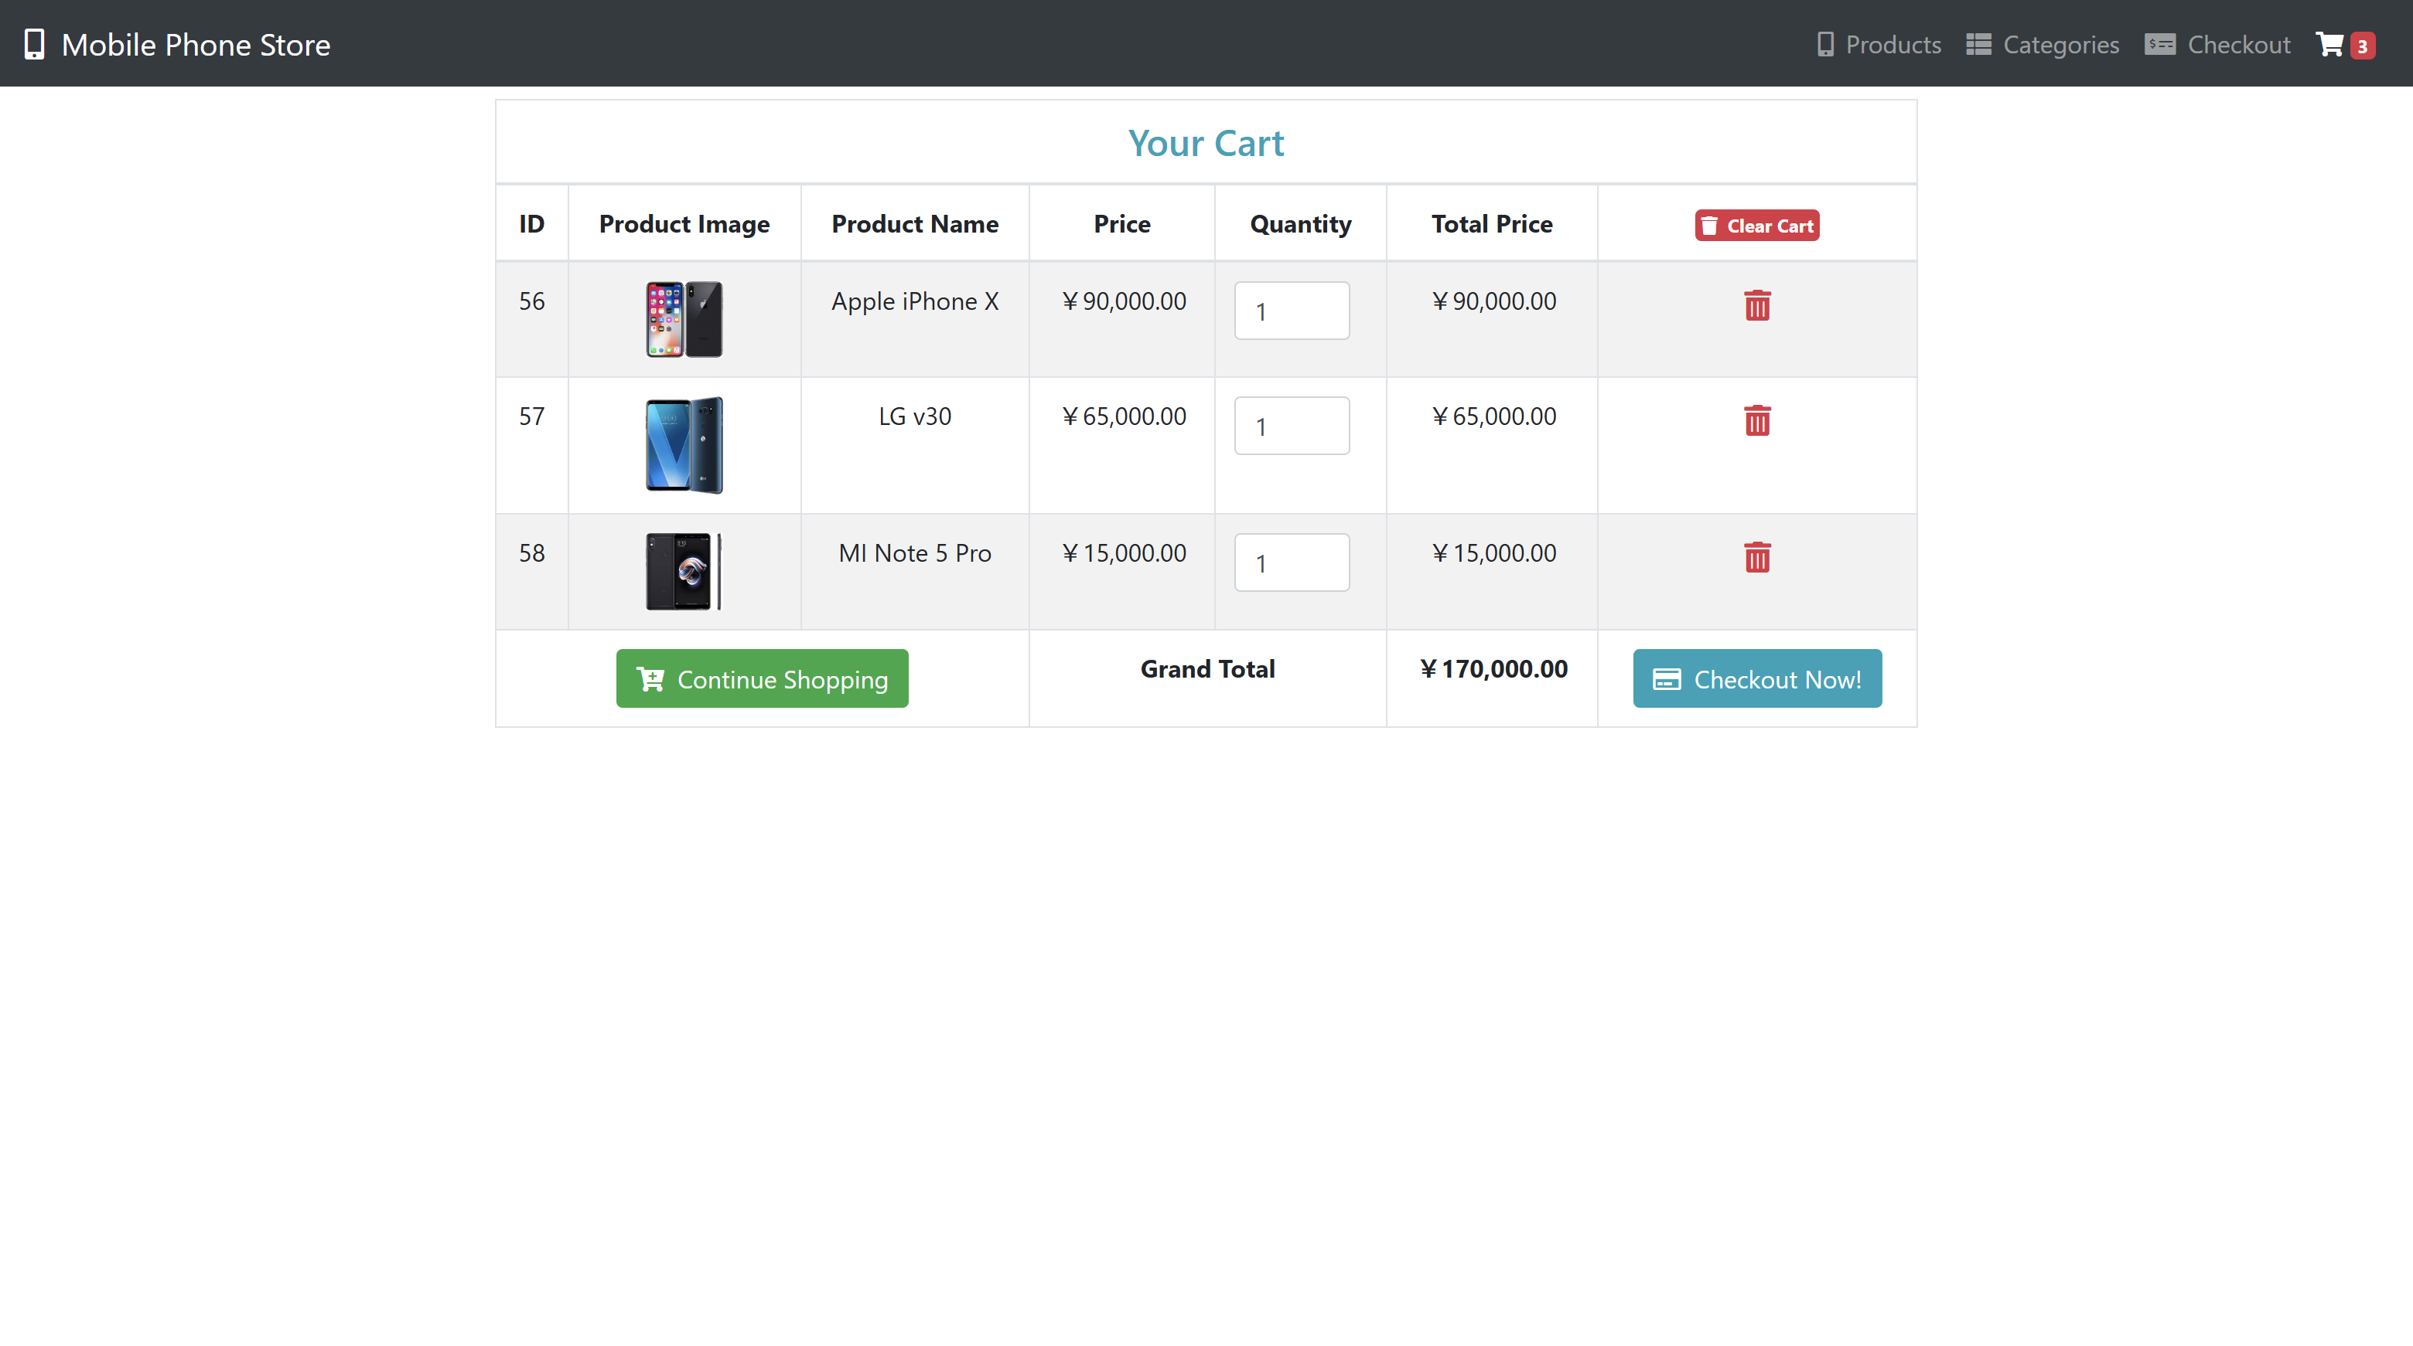
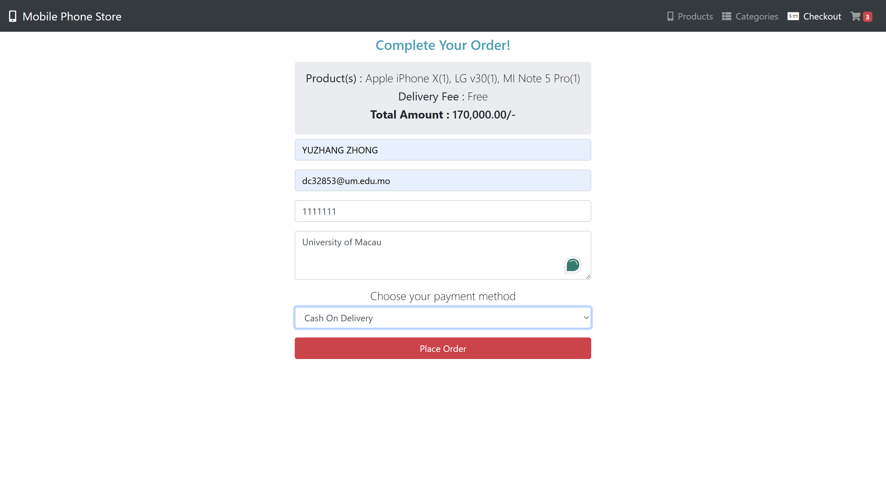
E-commerce Component: Shopping Cart and Checkout System
01.
02.
03.
Product Display and Adding to Cart
Cart Management and Checkout Process
Placing the Order and Order Confirmation
The e- commerce component focuses on providing users with a seamless shopping experience. The product display page fetches product information dynamically from the MySQL database, presenting each item with its image, name, and price in a visually appealing grid layout. The "Add to Cart" functionality allows users to easily add items to their shopping cart with a single click, triggering server- side logic to update the cart contents.
The dedicated cart page provides users with a comprehensive view of all items in their shopping cart. Users can review item details, adjust quantities, and remove items as needed. The system dynamically calculates the total cart price, ensuring accurate and up- to- date information. The checkout form collects necessary customer details, such as shipping and billing information, and securely submits the order using the POST method.
Once the checkout form is submitted, the customer's details and cart items are sent to the server using the POST method. The server- side script processes the order, saving the details to the database and creating a unique order ID. The customer is then presented with a confirmation page, indicating that their order has been successfully placed.

Slide 6

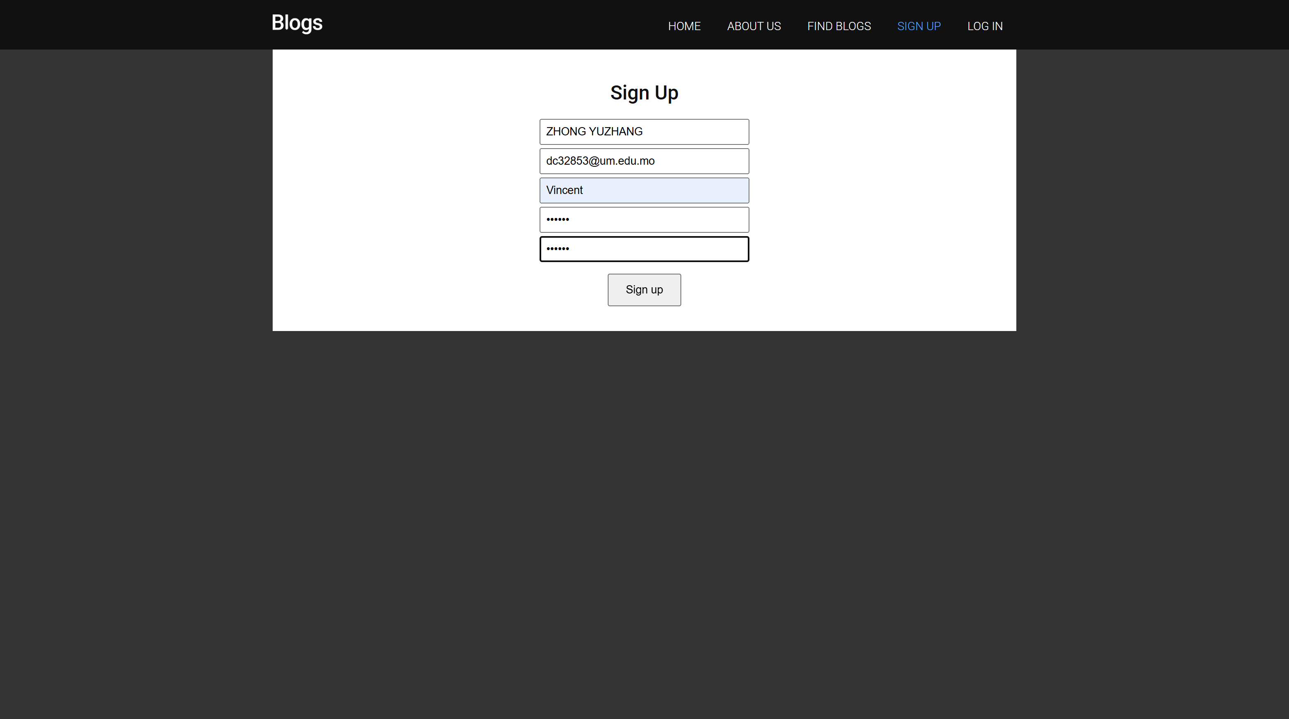
User Authentication Component: Secure Login, Signup, and Logout System
Introduction to User Authentication
Database and Implementation Approaches
User Signup Process
User authentication is a critical component of any web application, especially in the context of e- commerce. By enabling user registration and login, the system allows for personalization, order history tracking, and enhanced security features. This component was developed with a strong emphasis on security and reliability, utilizing PHP (both OOP and procedural) and PDO/MySQLi for database interaction.
The user authentication component utilizes a dedicated users table in the MySQL database, storing essential user information such as username, email, and hashed password. Two implementation styles were demonstrated: an Object- Oriented approach with PDO, offering database flexibility and a structured OOP approach, and a procedural approach with MySQLi, tailored for MySQL databases. This showcased different valid approaches for database interaction and highlighted their respective strengths.
The user signup process involves secure form submission using the POST method. The system performs robust input validation, ensuring that all fields are filled correctly and that the username or email address is not already registered. The password is securely hashed using PHP's password_hash() function with the bcrypt algorithm, providing a strong level of security. The hashed password and user data are then stored in the users table.

Slide 7
User Login Process and Security Measures
Login Form and Password Verification
Prepared Statements for Database Interactions
Session Management and Logout
The user login process allows registered users to access their accounts. The login form securely submits the username or email and password using the POST method. The server- side script retrieves the user's record from the database, comparing the entered password against the stored hash using the password_verify() function. This ensures secure password verification without compromising user data.
To prevent SQL injection vulnerabilities, all database interactions in the project utilize prepared statements. Prepared statements separate the SQL query structure from the user- provided data, ensuring that any malicious input is treated purely as data and cannot be executed as code within the SQL query. This significantly enhances the security of the application and protects against potential attacks.
Upon successful login, the user's session is maintained using PHP's built- in session management. A unique session ID is assigned, and user information, such as the user ID, is stored in the $_SESSION superglobal array. This allows the server to identify the user on subsequent requests. The logout functionality securely ends the user's session by unsetting all session variables and destroying the session data on the server.

Slide 8
02
E-commerce Component: Shopping Cart and Checkout System

Slide 9
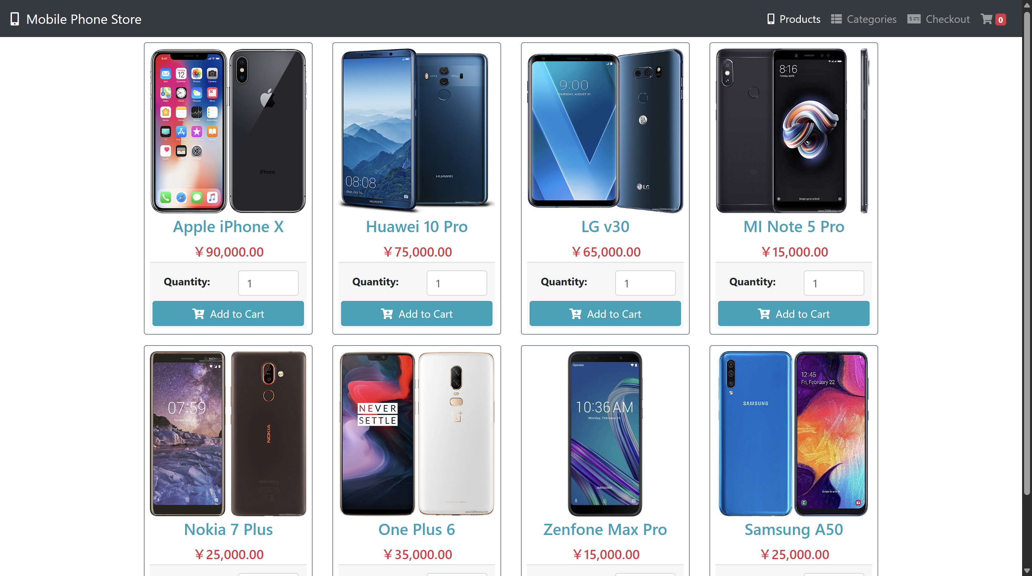
Product Display and Adding to Cart
Dynamic Product Display
"Add to Cart" Functionality
Immediate Feedback and Cart Updates
The product display page fetches product information dynamically from the MySQL database, presenting each item with its image, name, and price in a visually appealing grid layout. This dynamic approach ensures that the product catalog is always up- to- date and provides a seamless browsing experience for users.
The "Add to Cart" functionality allows users to easily add items to their shopping cart with a single click. When a user clicks the "Add to Cart" button, an asynchronous JavaScript request is sent to the server using Ajax. This request contains the details of the product to be added. The server- side PHP script processes the request, updating the cart contents and sending back a response.
Upon receiving the successful response from the server, the front- end JavaScript updates the cart icon in the navigation bar dynamically to reflect the new total number of items. An alert message also appears temporarily to provide the user with immediate visual feedback that the item has been added to their cart. This immediate feedback enhances the user experience and provides a seamless shopping experience.

Slide 10
Cart Management and Checkout Process
Dedicated Cart Page
Removing Items from the Cart
Proceeding to Checkout
The dedicated cart page provides users with a comprehensive view of all items in their shopping cart. For each item, the page displays details such as the product image, name, price, and quantity. A subtotal for each item is shown, and the page dynamically calculates and displays the grand total price for all items in the cart. This allows users to easily review and manage their cart contents.
Users have the option to remove individual items from their cart if they change their mind. When a user clicks the "Remove" button for an item, the system updates the cart contents by removing the item from the cart and recalculating the total price. This provides users with flexibility and control over their shopping experience.
From the cart page, users can proceed to the checkout process. The checkout form collects necessary customer details such as their name, email, shipping address, and payment information (though payment processing integration itself might be a future step). This form allows users to securely submit their order and provides a seamless transition from cart management to order placement.

Slide 11
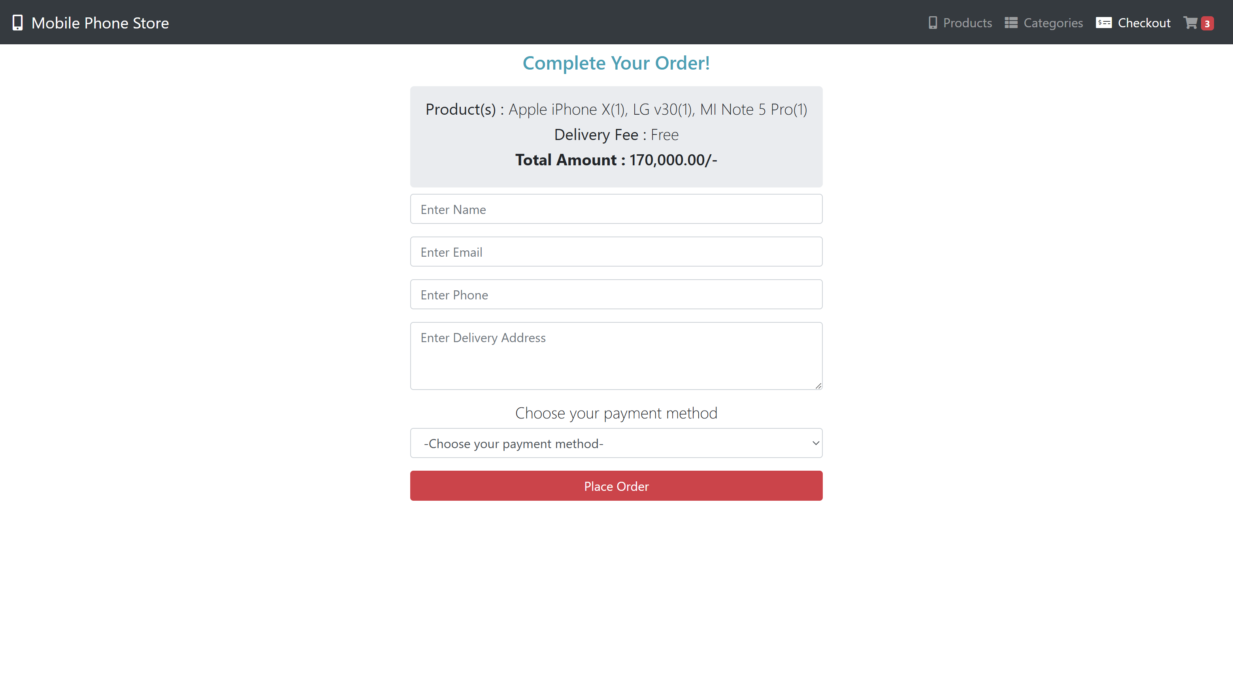
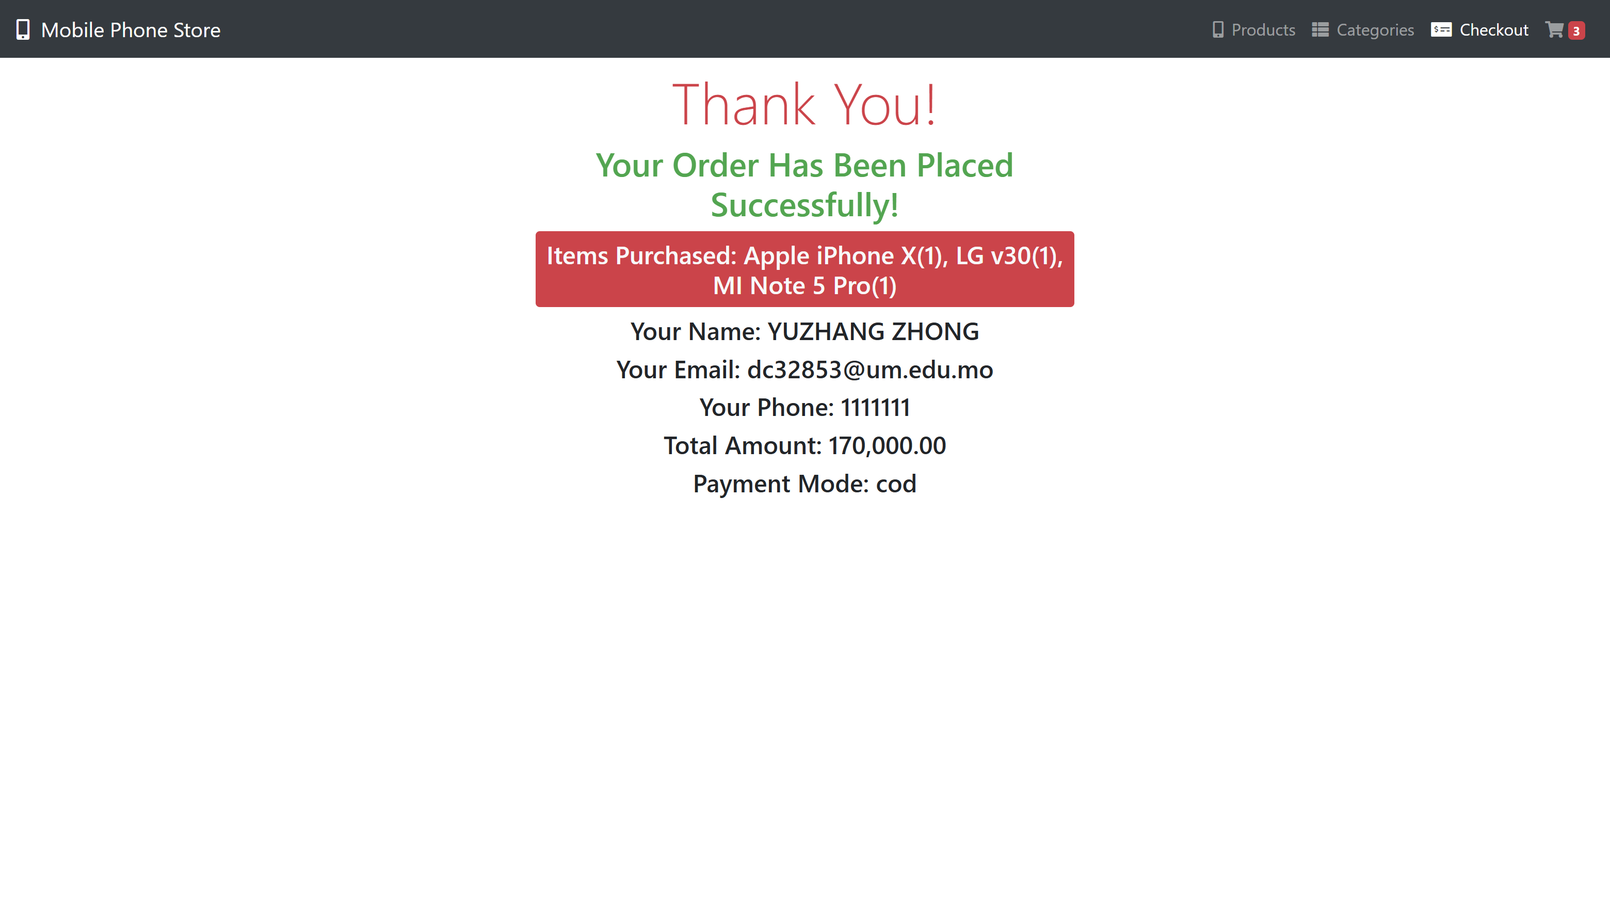
Placing the Order and Order Confirmation
01
02
03
Server-side Order Processing
Order Confirmation Page
Integration with User Authentication
Upon submitting the checkout form and clicking the "Place Order" button, the collected customer details and cart items are sent to the server using the POST method. The server- side PHP script processes the order, saving the details to the database and creating a unique order ID. This ensures that the order is securely stored and can be referenced in the future.
Once the order is successfully placed, the customer is presented with a confirmation page. This page displays a summary of the order, including the order ID, customer details, and the list of items purchased. The confirmation page provides reassurance to the customer that their order has been received and is being processed.
The order placement process is integrated with the user authentication system. If the user is logged in, the system associates the order with their user ID, allowing for personalized order history tracking and enhanced security. This integration ensures that the user's shopping experience is seamless and their order is securely linked to their account.

Slide 12
03
User Authentication Component: Secure Login, Signup, and Logout System

Slide 13
Introduction to User Authentication
User authentication is a critical component of any web application, especially in the context of e- commerce. By enabling user registration and login, the system allows for personalization, order history tracking, and enhanced security features. This component was developed with a strong emphasis on security and reliability, utilizing PHP (both OOP and procedural) and PDO/MySQLi for database interaction.

Slide 14
Database and Implementation Approaches
The user authentication component utilizes a dedicated users table in the MySQL database, storing essential user information such as username, email, and hashed password. Two implementation styles were demonstratedan Object- Oriented approach with PDO, offering database flexibility and a structured OOP approach, and a procedural approach with MySQL, tailored for MySQL databases. This showcased different valid approaches for database interaction and highlighted their respective strengths.

Slide 15
User Signup Process
Secure Form Submission and Input Validation
Password Hashing and Security
Storing Hashed Password and User Data
The cornerstone of security in the signup process is password handling. User passwords are never stored in plain text. Instead, they are securely hashed using PHP's built- in password_hash() function with the highly recommended bcrypt algorithm. This hash, along with a dynamically generated salt and a configurable 'cost' factor, is stored in the database. The cost factor adds computational expense, making brute- force attacks significantly harder.
The user signup process involves secure form submission using the POST method. The system performs robust input validation, ensuring that all fields are filled correctly and that the username or email address is not already registered. This prevents duplicate accounts and ensures a smooth registration process for users.
The hashed password and user data are securely stored in the users table in the database. This ensures that user passwords are protected and cannot be easily compromised. The database schema is designed to efficiently store and retrieve user information, providing a solid foundation for the user authentication system.

Slide 16
04
User Authentication Component: Secure Login, Signup, and Logout System

Slide 17
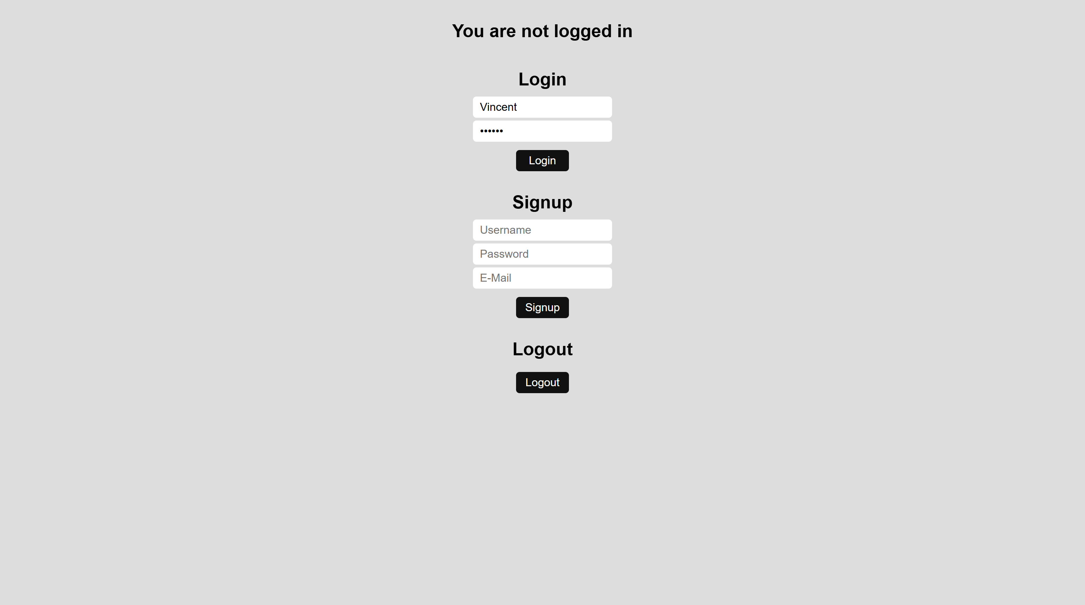
Login Form and Password Verification
Secure Form Submission and User Record Retrieval
Secure Password Verification with
Preventing SQL Injection with Prepared Statements
The user login process involves secure form submission using the POST method. The server- side script retrieves the user's record from the database based on the provided username or email. This ensures that only registered users can access their accounts and prevents unauthorized access.
The server- side script securely verifies the entered password against the stored hash using the password_verify() function. This function takes the user- entered password and the stored hash from the database, hashes the plain- text password using the same algorithm and parameters as the stored hash, and securely compares the two results. If they match, authentication is successful, allowing the user to access their account.
To prevent SQL injection vulnerabilities, all database interactions in the project utilize prepared statements. Prepared statements separate the SQL query structure from the user- provided data, ensuring that any malicious input is treated purely as data and cannot be executed as code within the SQL query. This significantly enhances the security of the application and protects against potential attacks.

Slide 18

Session Management and Logout
Part 01
Part 02
Part 03
Logout Functionality
Session ID Regeneration for Security
Maintaining Login State with PHP Sessions
Once a user successfully logs in, their authenticated state needs to be maintained as they navigate through the website. This is achieved using PHP's built- in session management. A unique session is created for the user, and a session ID is typically stored as a cookie in the user's browser. On the server, information about the logged- in user, such as their user ID, is stored in the $_SESSION superglobal array, associated with that session ID.
To mitigate session fixation attacks, where an attacker might try to hijack a predetermined session ID, the system implements session ID regeneration upon successful login using session_regenerate_id(true). This assigns the user a new session ID and deletes the old one, making it harder for an attacker to exploit a known ID and enhancing the overall security of the application.
The logout functionality provides a secure way for users to end their session. Clicking the "Logout" button triggers a script that unsets all session variables using session_unset() and then destroys the session data on the server using session_destroy(). This effectively logs the user out and requires re- authentication to access protected areas, ensuring the security of the application.

Slide 19
05
Project Integration and Structure

Slide 20
Modular Code Structure
Throughout this project, a modular and organized code structure was followed to enhance maintainability and readability. Files were logically grouped into folders, such as an 'includes' folder for shared scripts and configuration, and a 'classes' folder specifically for the OOP implementation of the authentication system. This separation of concerns between presentation, application logic, and data management is a key principle in web development.

Slide 21
Separation of Concerns
01
The project adhered to the principle of separation of concerns, ensuring that each component of the application has a specific role and responsibility. The presentation layer (HTML/CSS/Bootstrap) focuses on the user interface and user experience, the application logic layer (PHP) handles the business logic and functionality, and the data layer (MySQL) manages the storage and retrieval of data. This separation allows for easier development, maintenance, and scalability of the application.

Slide 22
Integration of Authentication and E-commerce
01
The authentication component seamlessly integrates with the e- commerce component, enhancing the overall functionality of the application. When a logged- in user places an order, the system associates the order with their user ID, allowing for personalized order history tracking and enhanced security. This integration ensures that the user's shopping experience is seamless and their order is securely linked to their account.

Slide 23
06
Key Learnings and Future Enhancements

Slide 24
Hands-on Experience with Web Development Technologies
This project provided invaluable hands- on experience with a range of essential web development technologies, including PHP, MySQLi, PDO, Ajax, and Bootstrap 4. By implementing both Object- Oriented and procedural programming styles for database interaction, the project deepened the understanding of different approaches and their respective strengths.

Slide 25
Deepened Understanding of Web Security
One of the key takeaways from this project is a deepened understanding of web security principles and practices. By implementing prepared statements for database operations, robust password hashing using modern algorithms, and secure session management, the project reinforced the importance of prioritizing security in web development. This knowledge is crucial for building secure and reliable web applications.

Slide 26
Future Enhancements and Scope
01
Looking ahead, there are several exciting ways to expand this application. Implementing a "Remember Me" functionality would provide convenience for users, allowing them to stay logged in even after closing their browser. A secure password reset system would further enhance user security and account management. User profile pages and order history views would provide personalized experiences and allow users to track their past purchases. An administrative panel for managing products, users, and orders would streamline backend operations. Finally, integrating a secure payment gateway would enable online transactions and complete the e- commerce functionality of the application.

Slide 27
THANK YOU!
汇报人:
AiPPT
日 期：
2025.5
PowerPoint design

