Slide 1
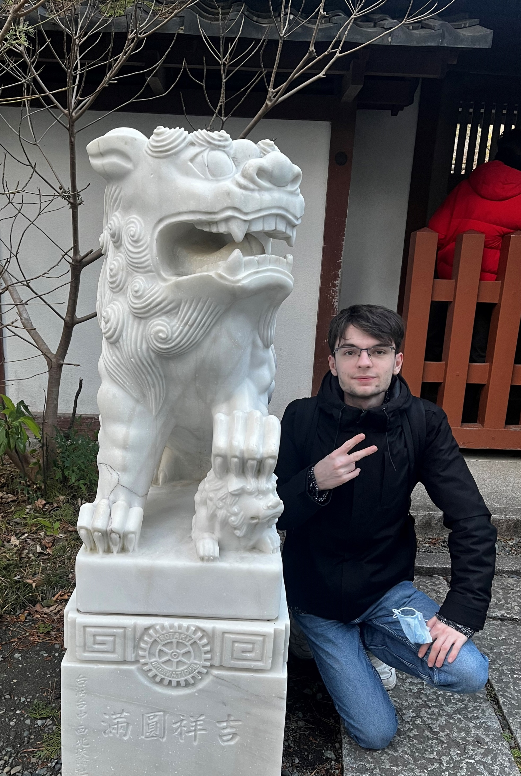
Academic Background
& Research Projects
Apprentice Research Engineer @ CEA
Physics & Microelectronic Systems @ CPE Lyon
Vincent Cauquil

Slide 2




Academic Background
Preparatory Classes
Apprentice Research Engineer @CEA
& Engineering Diploma @CPE
CPGE MPSI PSI
Physics & Microelectronic Systems
Intensive Maths & Physics training. Analytical rigor
Electronics & IC Design, Digital & Computing, Physics & Signal, Research Initiation
Research Intern
Cryogenic electronic and design of a high-density interconnects PCB
2023
2023
June
2025
Sept 2025
Sept 2026

Slide 3

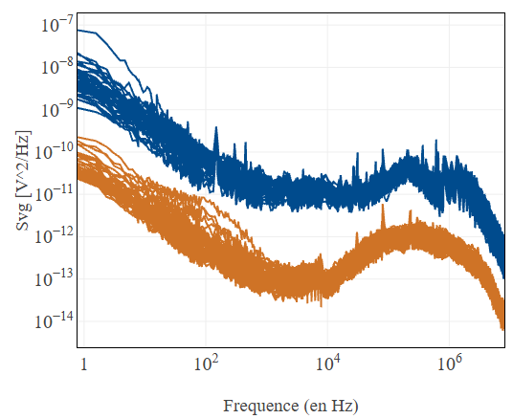
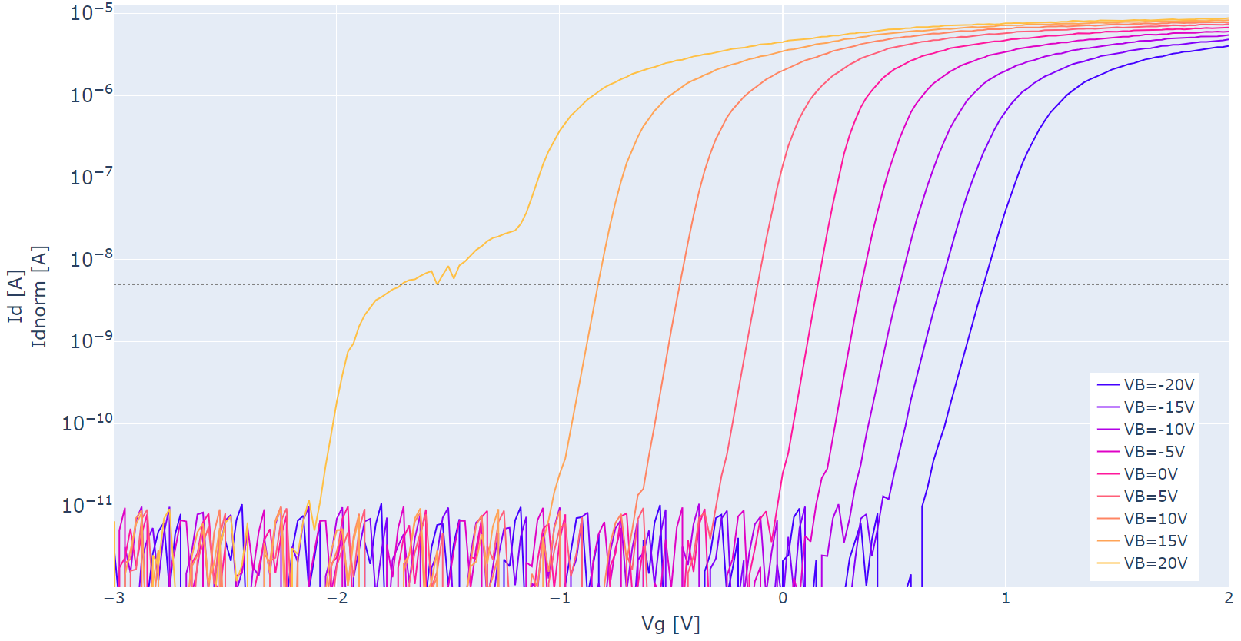
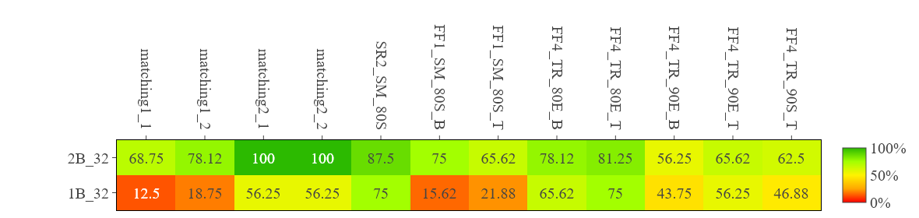
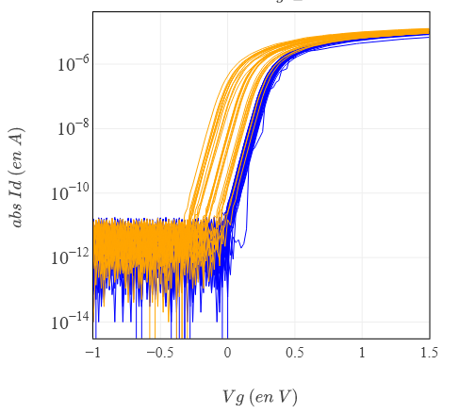
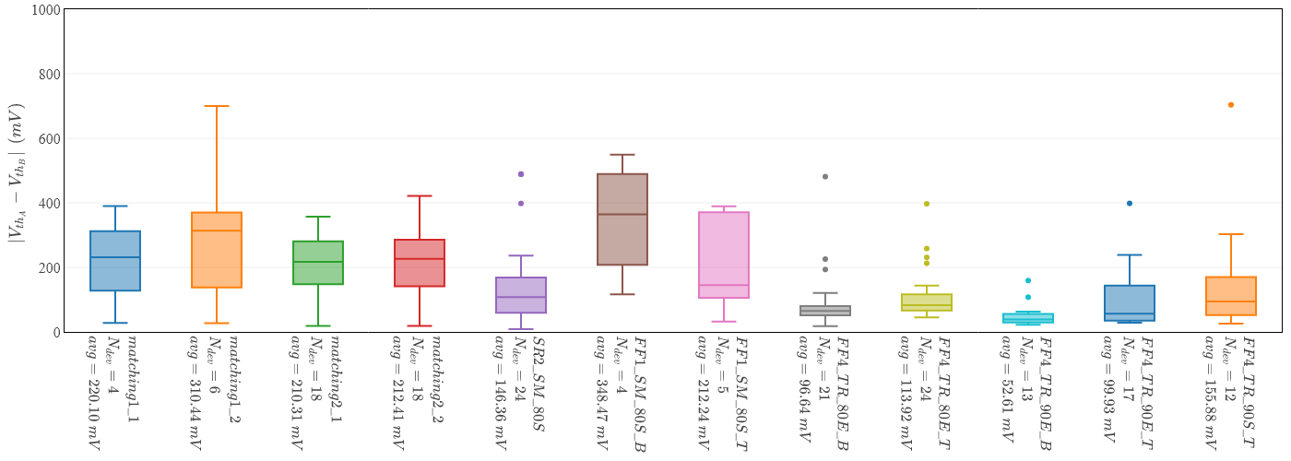
Lab Experience @CEA
Noise analysis
Substrat effect study
FDSOI Characterization : Before any device is dipped into cryogenic equipment, rigorous characterization is essential to optimize lab throughput.
+20V
-20V
VB
Transistor Structure Variation Yield
Dicing Yield optimization by testing multiple process techniques
Before
After
220.1
310.4
210.3
212.4
146.4
348.5
212.2
96.64
113.9
52.61
99.93
155.9

Slide 4
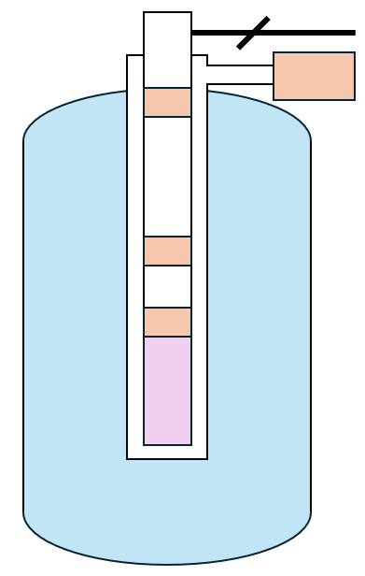
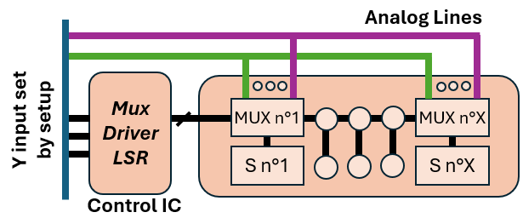
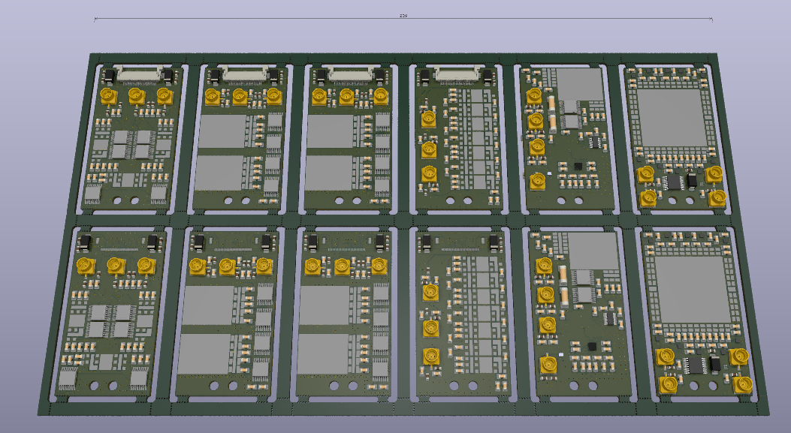
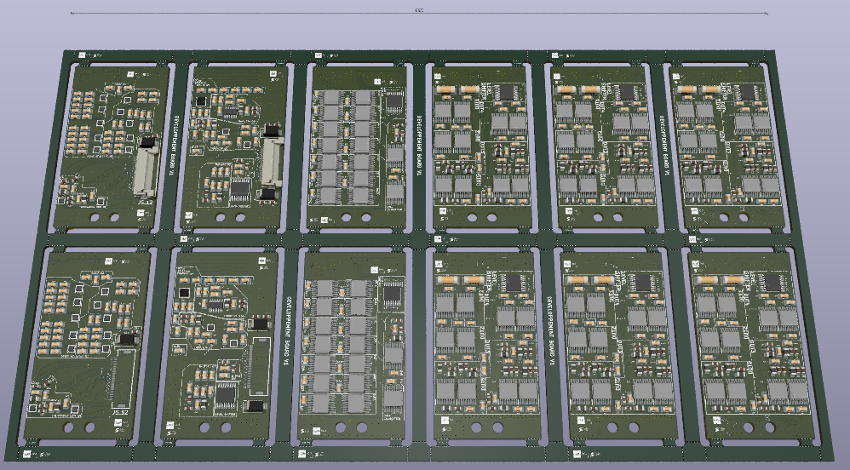
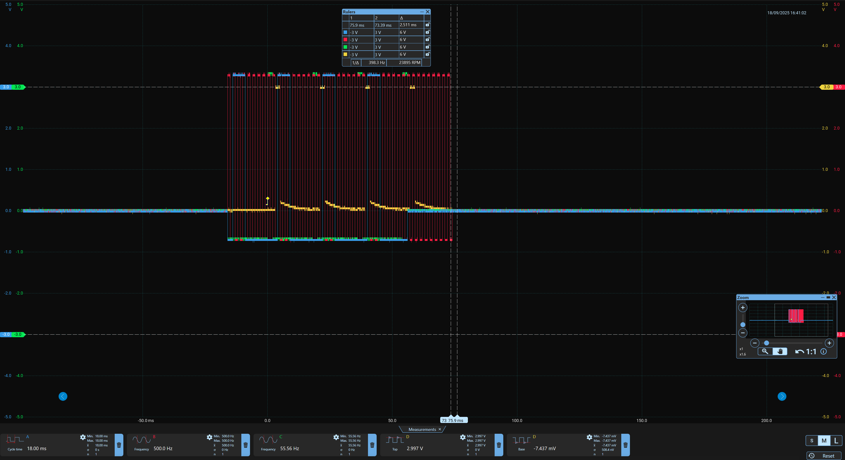
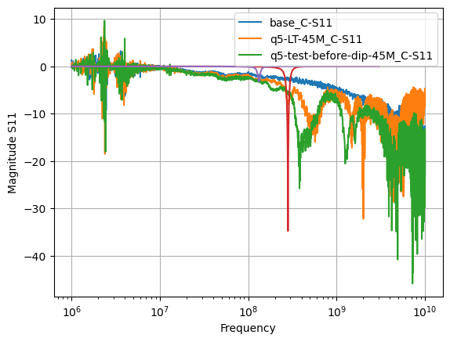
Lab Experience @CEAxISCT
<< 55 mm
QChips
« Typical setup »
Proposed architectured based on [1]
[1] Multiplexed quantum transport using commercial off-the-shelf CMOS at sub-kelvin temperatures, B. Paquelet Wuetz et al., npj Quantum Information 6, 43 (2020).

Slide 5
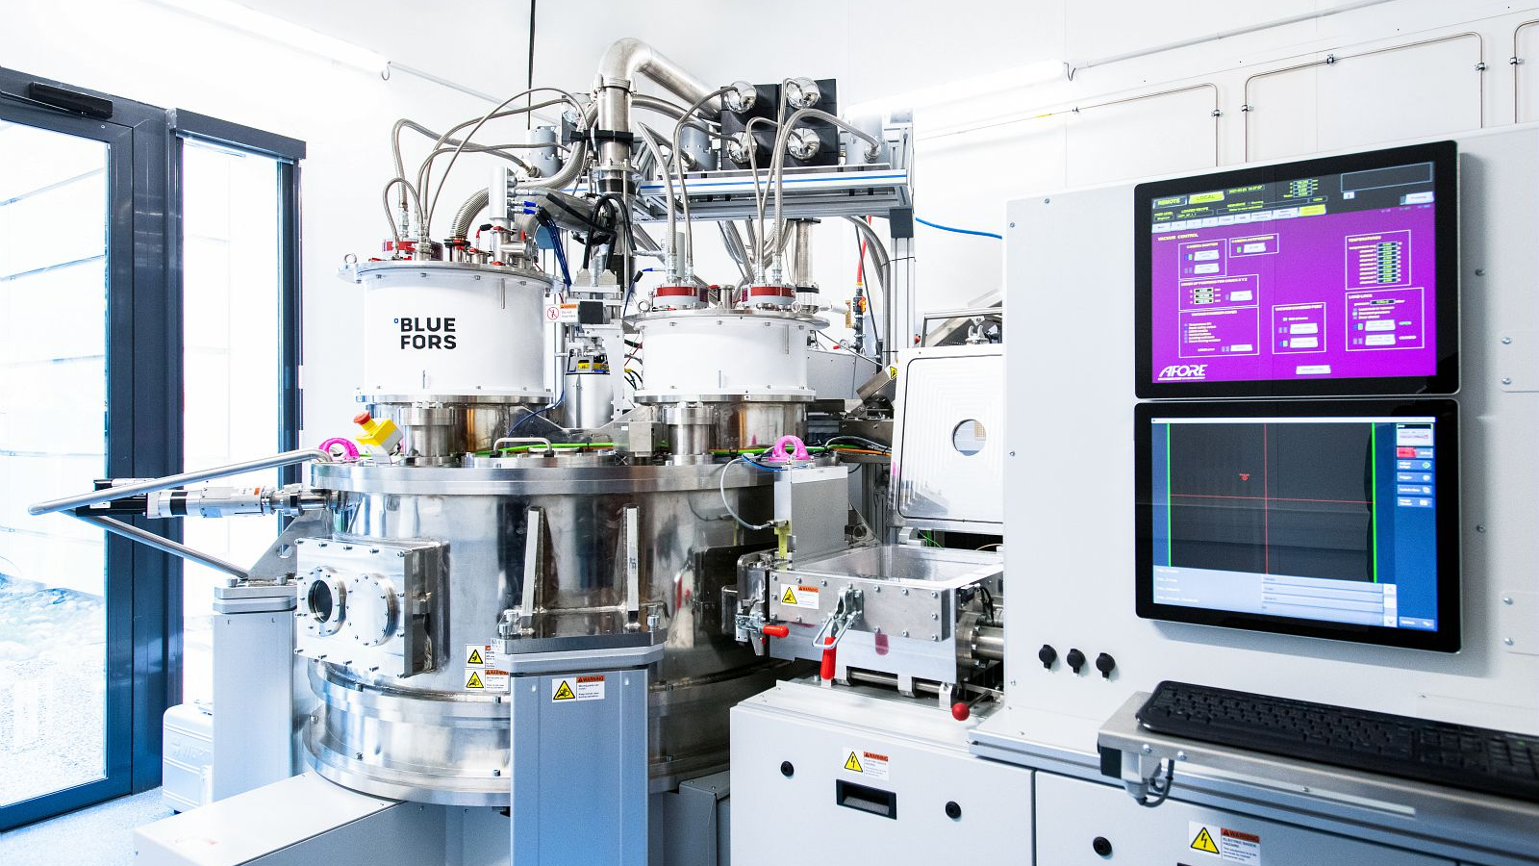
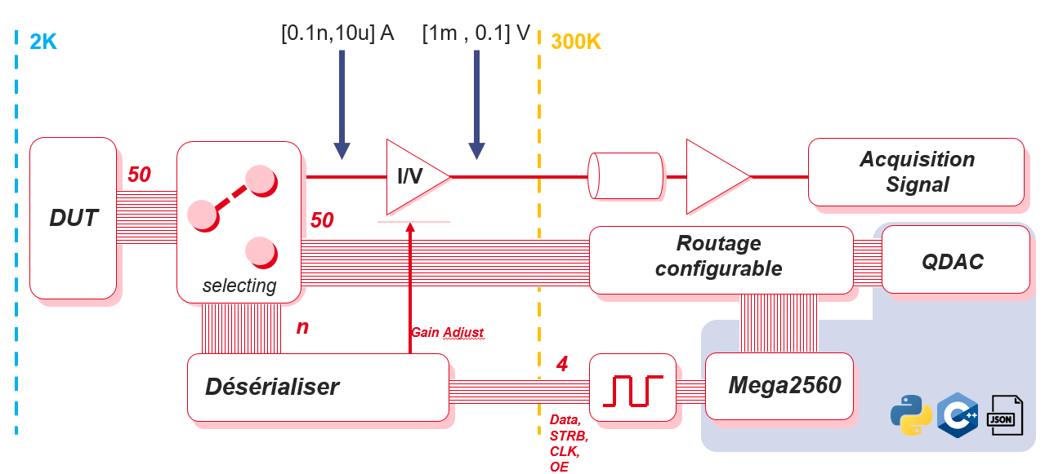
Master Thesis @CEA
Master Thesis: Multiplexing and Amplification board (50 I/Os) for CryoProber to enhance Qubits/Quantum Dots Measurement.
Technical Constraints:
Strict thermal budget management (4 Kelvin stage).
Low-noise Cryogenic I/V converter design.
Signal integrity within a dilution refrigerator
Proposed architecture
Selecting/Logic Circuit/ Software concept has been validated at 298 K & 4 K
Ongoing testing for better Selectors (BW/Footprint/Con,off/Ron)
& Designing Amplification test board

Slide 6
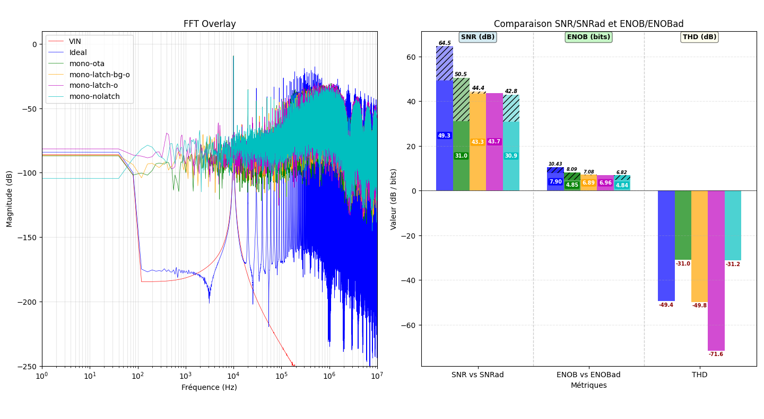
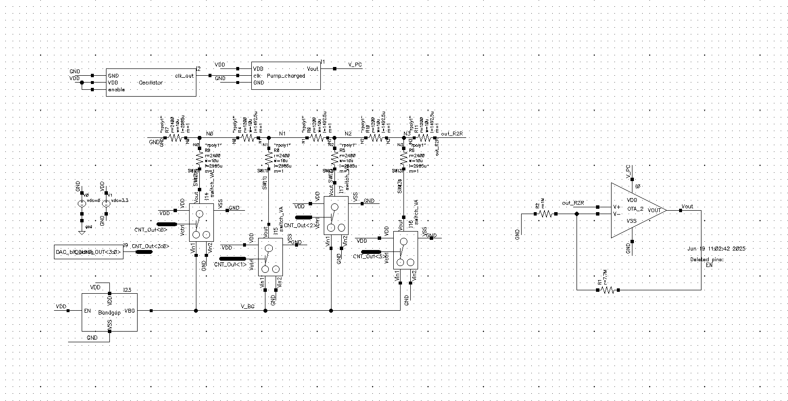
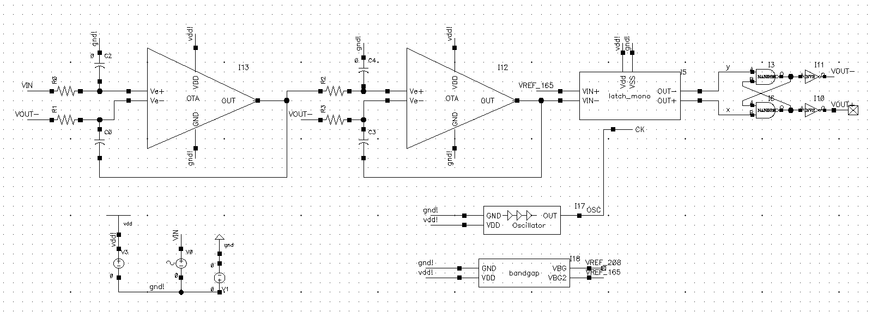
CMOS Designs experiences
ΣΔ ADC – Final Year project in grps of 4
Designed multiple types of CMOS structures ranging from basic current mirrors, Miller OTAs, and charge pumps to more complex structures like R2R DAC and ΣΔ ADC.
Idéale
Full
OTA
OTA – BG
SA
R2R DAC
2nd year project
Grps of 3

Slide 7
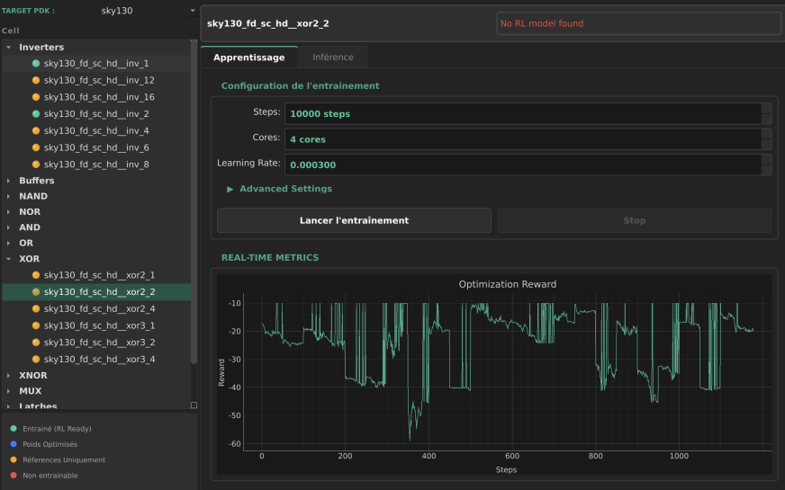
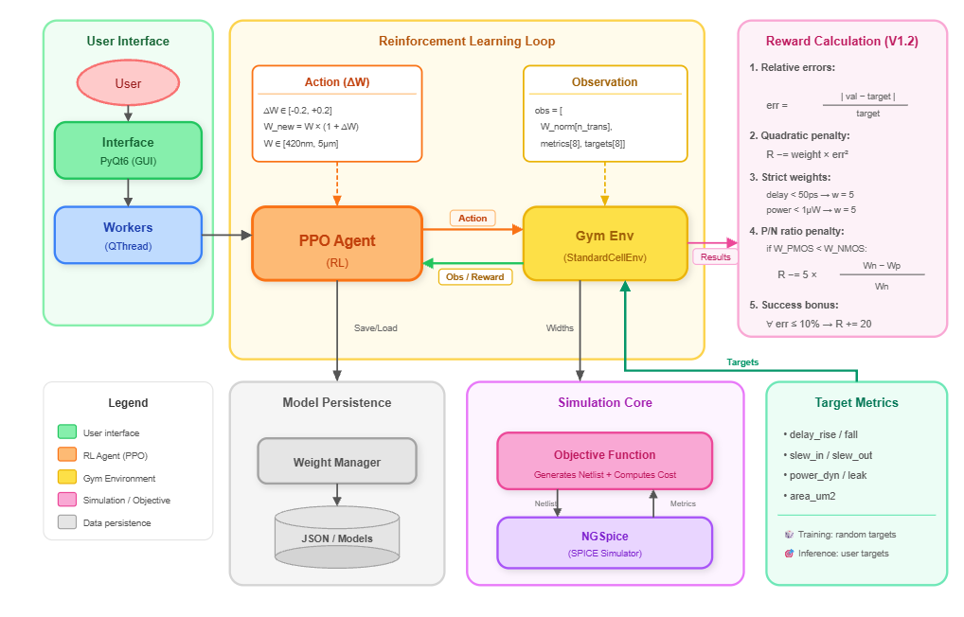
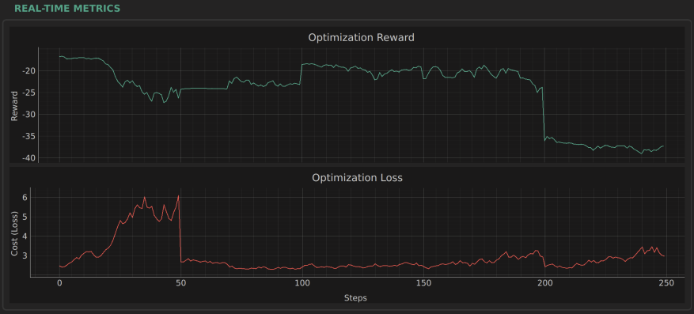
EDA & IA on sky130 pdk

Slide 8
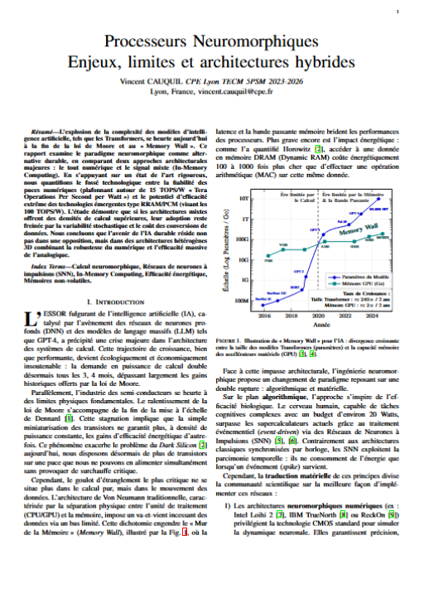
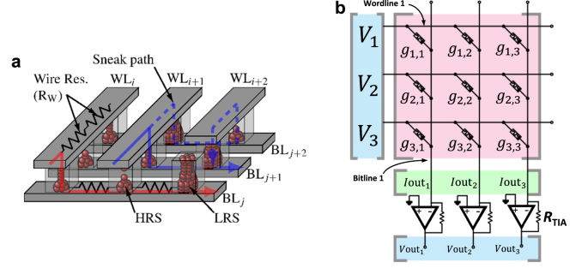
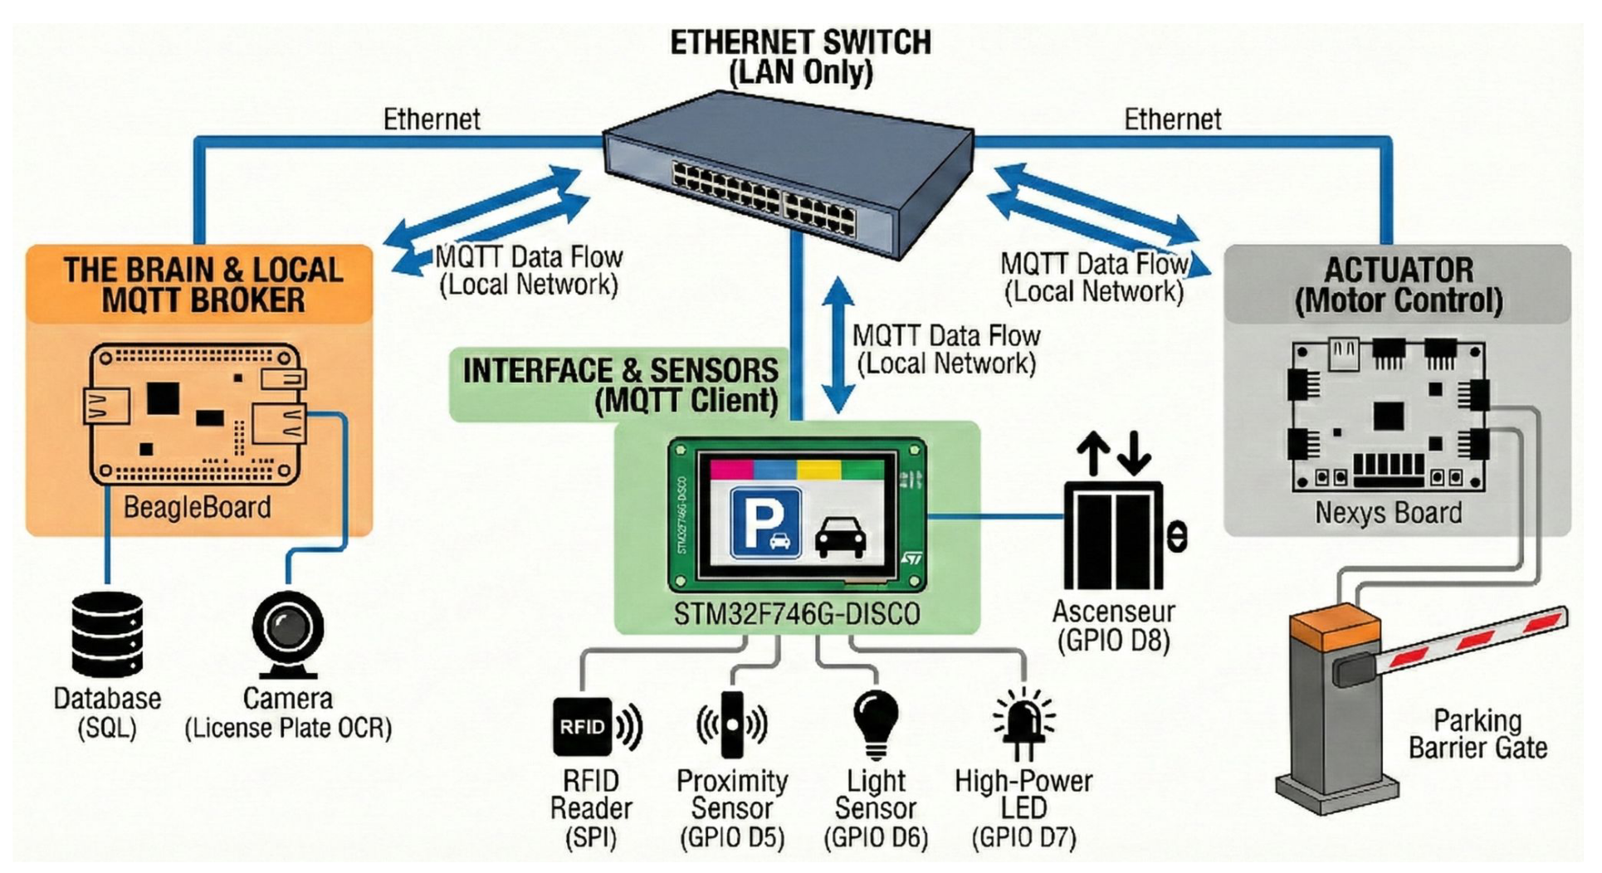
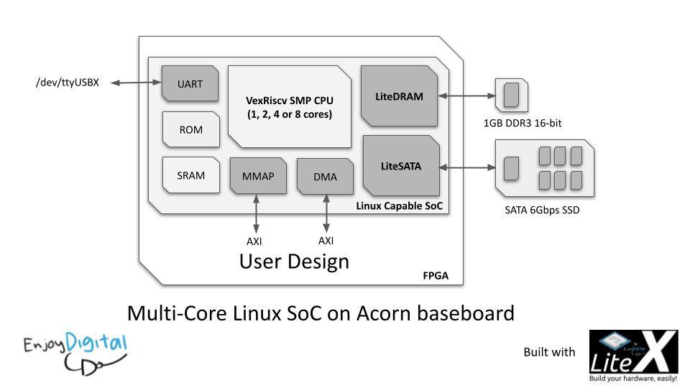
Interest Computing Architecture
System Architecture & SoC Design
Academic Exercise
Writing (in French..) a Scientific review in an IEEE Format
Decided to write on Neuromorphic Processors
Beyond physics, I have a strong interest in how computing systems are architected.
Smart Parking Project: Designed a full autonomous system.
RISC-V Implementation: Deployed a VexRiscv core on FPGA using LiteX.
Full Stack: From AXI bus interconnects to Embedded Linux drivers.

Slide 9
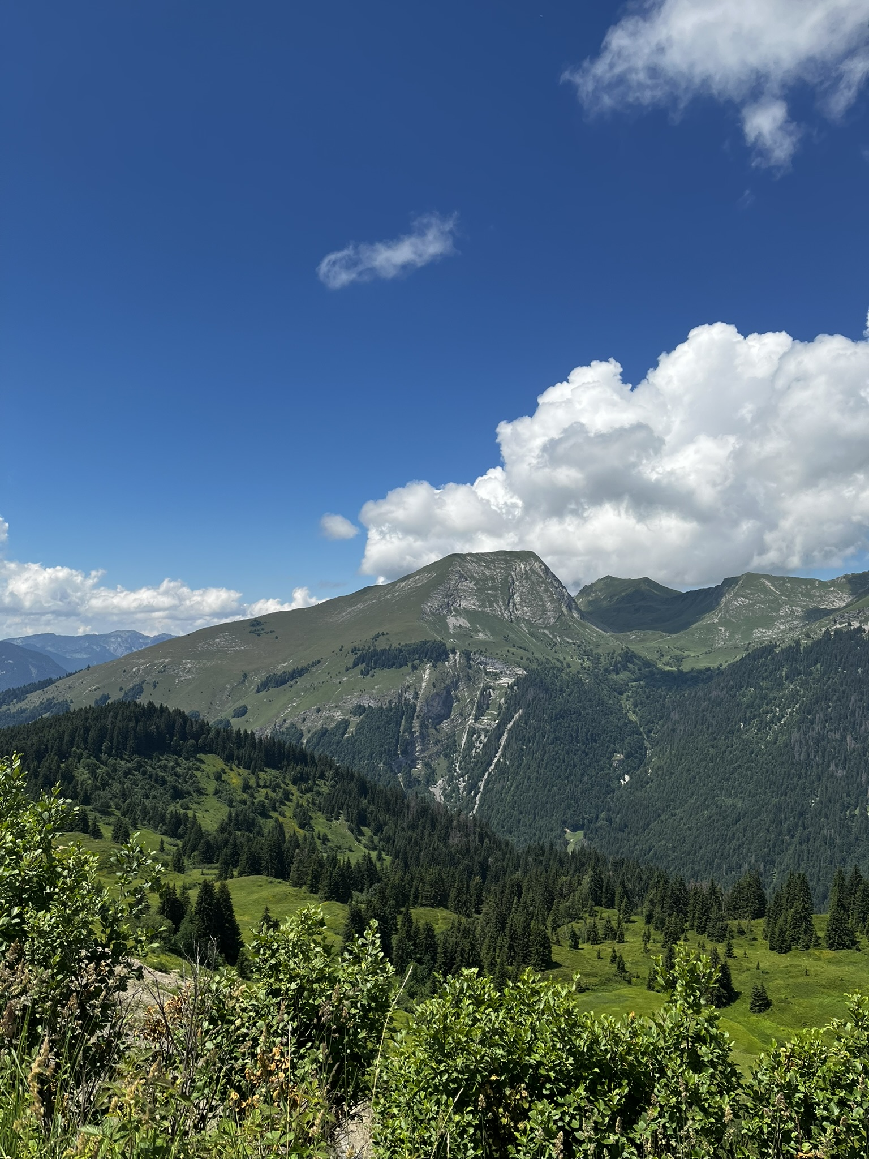


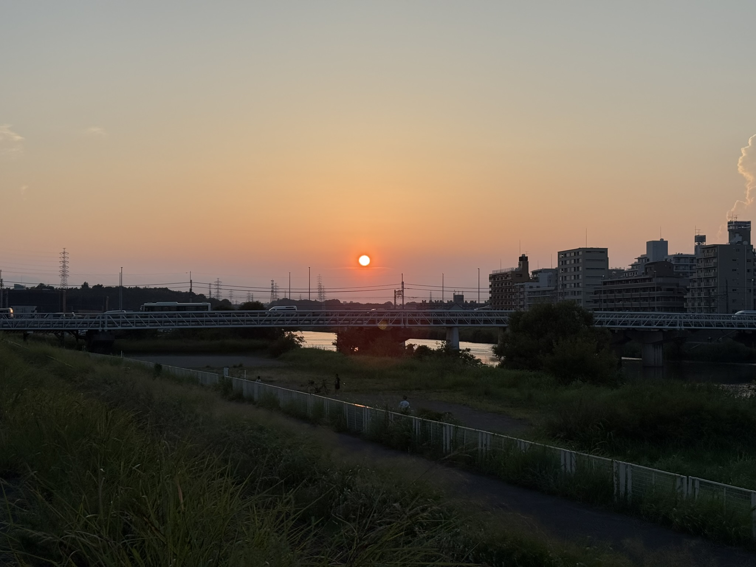





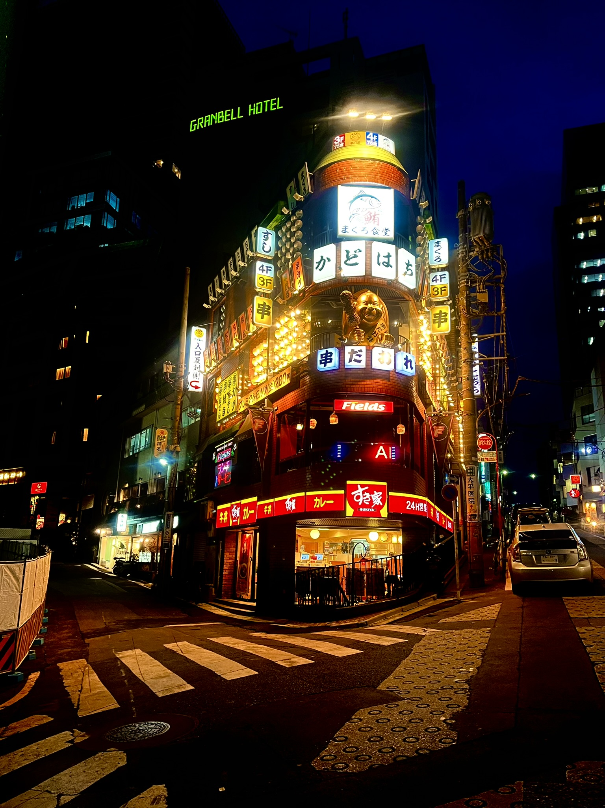
But also a creative person…

Slide 10


Thank you for your attention
My profile combines the rigor of cryogenic physics with the creativity of system architecture.
vincent.cauquil@cpe.fr/cea.fr
/in/vincent-cauquil-6048b3241
/?originalSubdomain=fr

