Slide 1
Event Page Prototype

Slide 2
What’s the point?
Design the information and its presentation

Slide 3
What are the steps?
Design an event (refer to Site Flow and Page Sketch)
Design an event area
Design an event page

Slide 4
To Do
Download the template file
Follow the instructions EXACTLY in gClass
Upload a filled in version of the template to your GitHub

Slide 5
Step 1: Design an event
What’s on Netflix
Section header
Movie/TV Show Title
Image stills
Show name, season info

Slide 6
Step 2: Design an event area
Use whatever tool you want
Show
Labels
Sample data
Layout

Slide 7
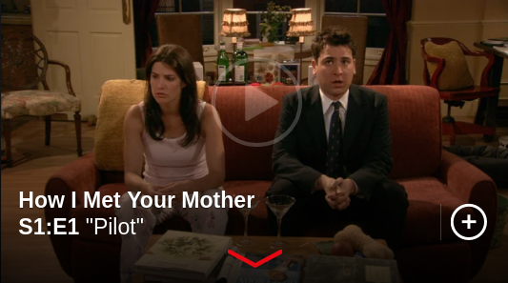
Step 2: Design an event area
Step 2: Design an event area
Attributes:
Play preview image
Show name
Season
Episode
Episode name
Sample data:
Show name: “How I Met Your Mother”
Season: “S1”
Episode: “E1”
Episode name: “Pilot”

Slide 8
Step 3: Design an event page
How does the event key into a larger page?
Navigation
Banners
Footers

Slide 9
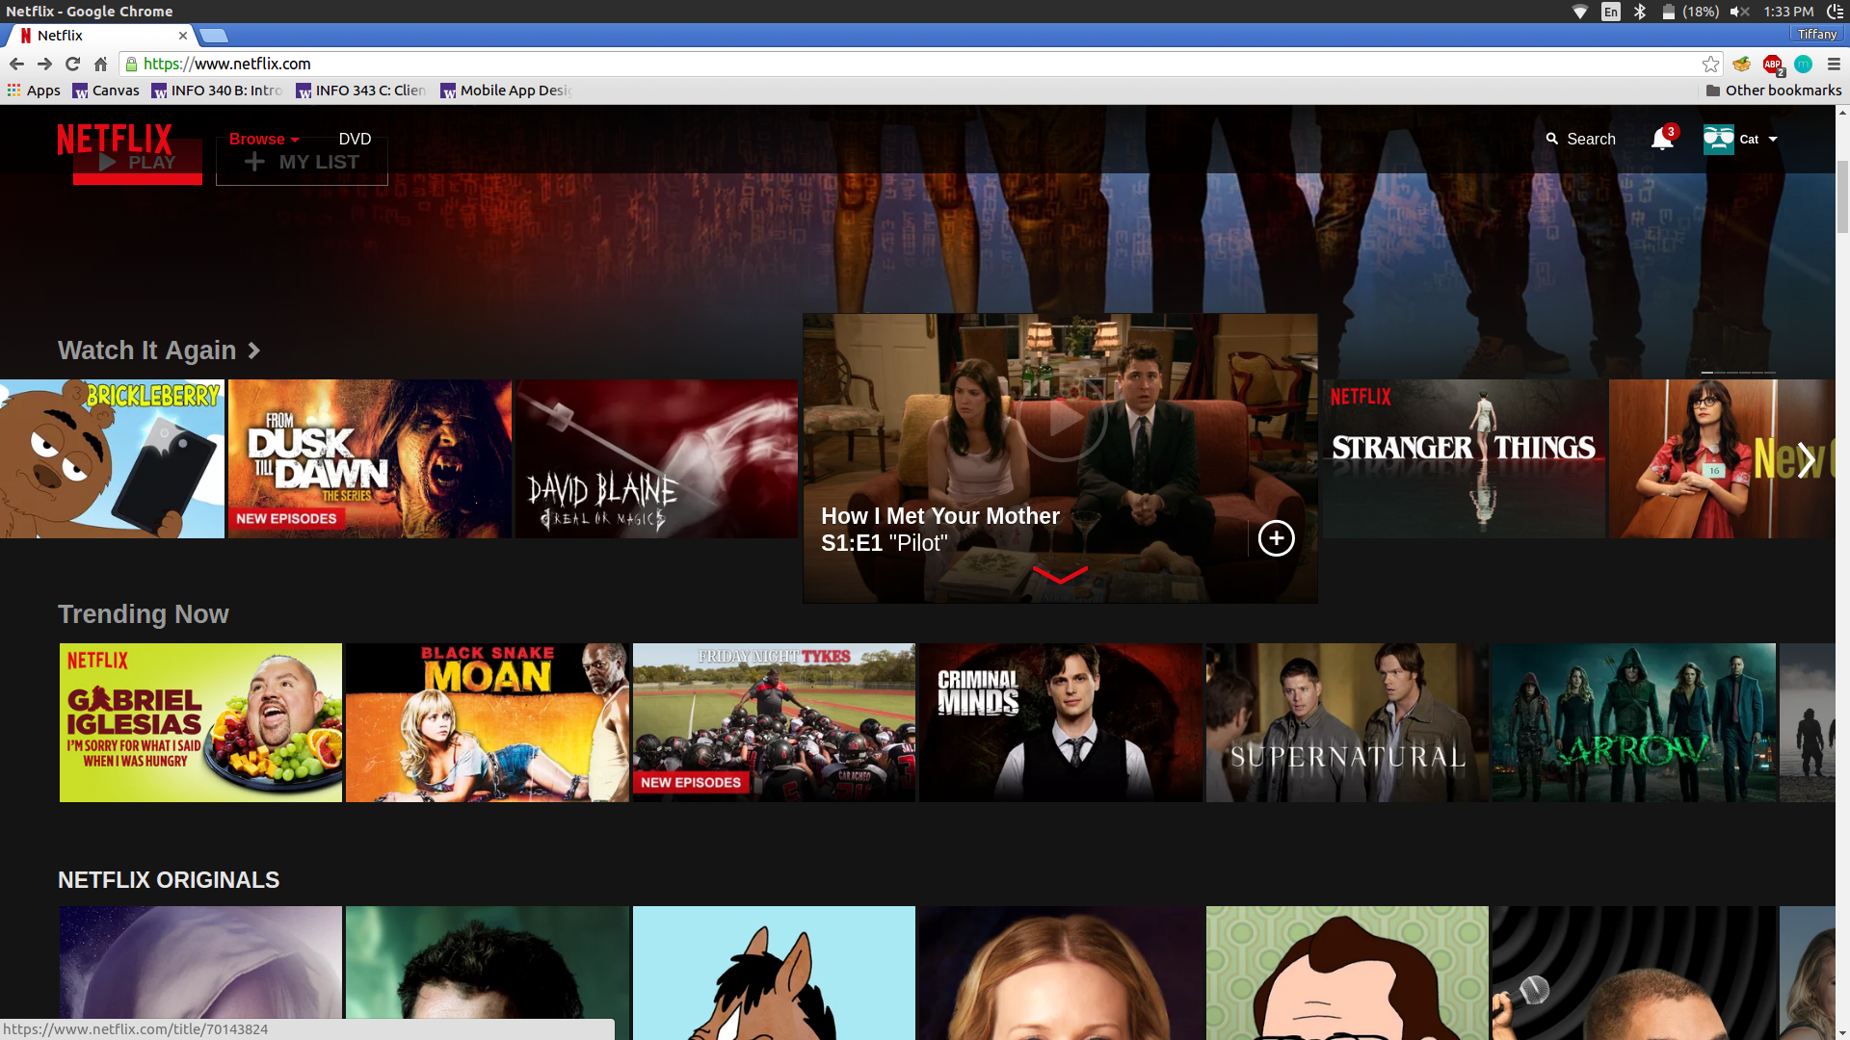
Step 3: Design an event page
Event Area

