Slide 1
Aircraft Risk Analysis & Business Recommendations
Presented by: [Vincent Barchok Ngochoch]
Email: [vngochoch@gmail.com]

Slide 2
Overview
Your company is expanding into aviation and needs to assess aircraft safety risks.
This presentation provides data-driven insights to help decide on aircraft purchases.

Slide 3
Business Understanding
- Identify the safest aircraft models
- Understand accident risks by flight purpose
- Analyze geographical accident trends
- Assess seasonal impact on aviation safety

Slide 4
Data Understanding
Data sources include aviation data with various variables as the columns from year 1948 to year 2022, safety reports, accident statistics, and FAA records.
Key variables analyzed:
- Aircraft make & model
- Flight purpose (business, personal, training)
- Geographic location
- Seasonal trends

Slide 5
Data Analysis
Analysis includes:
- Aircraft safety by model
- Accident risks by flight purpose
- Geographic trends
- Seasonal variations

Slide 6
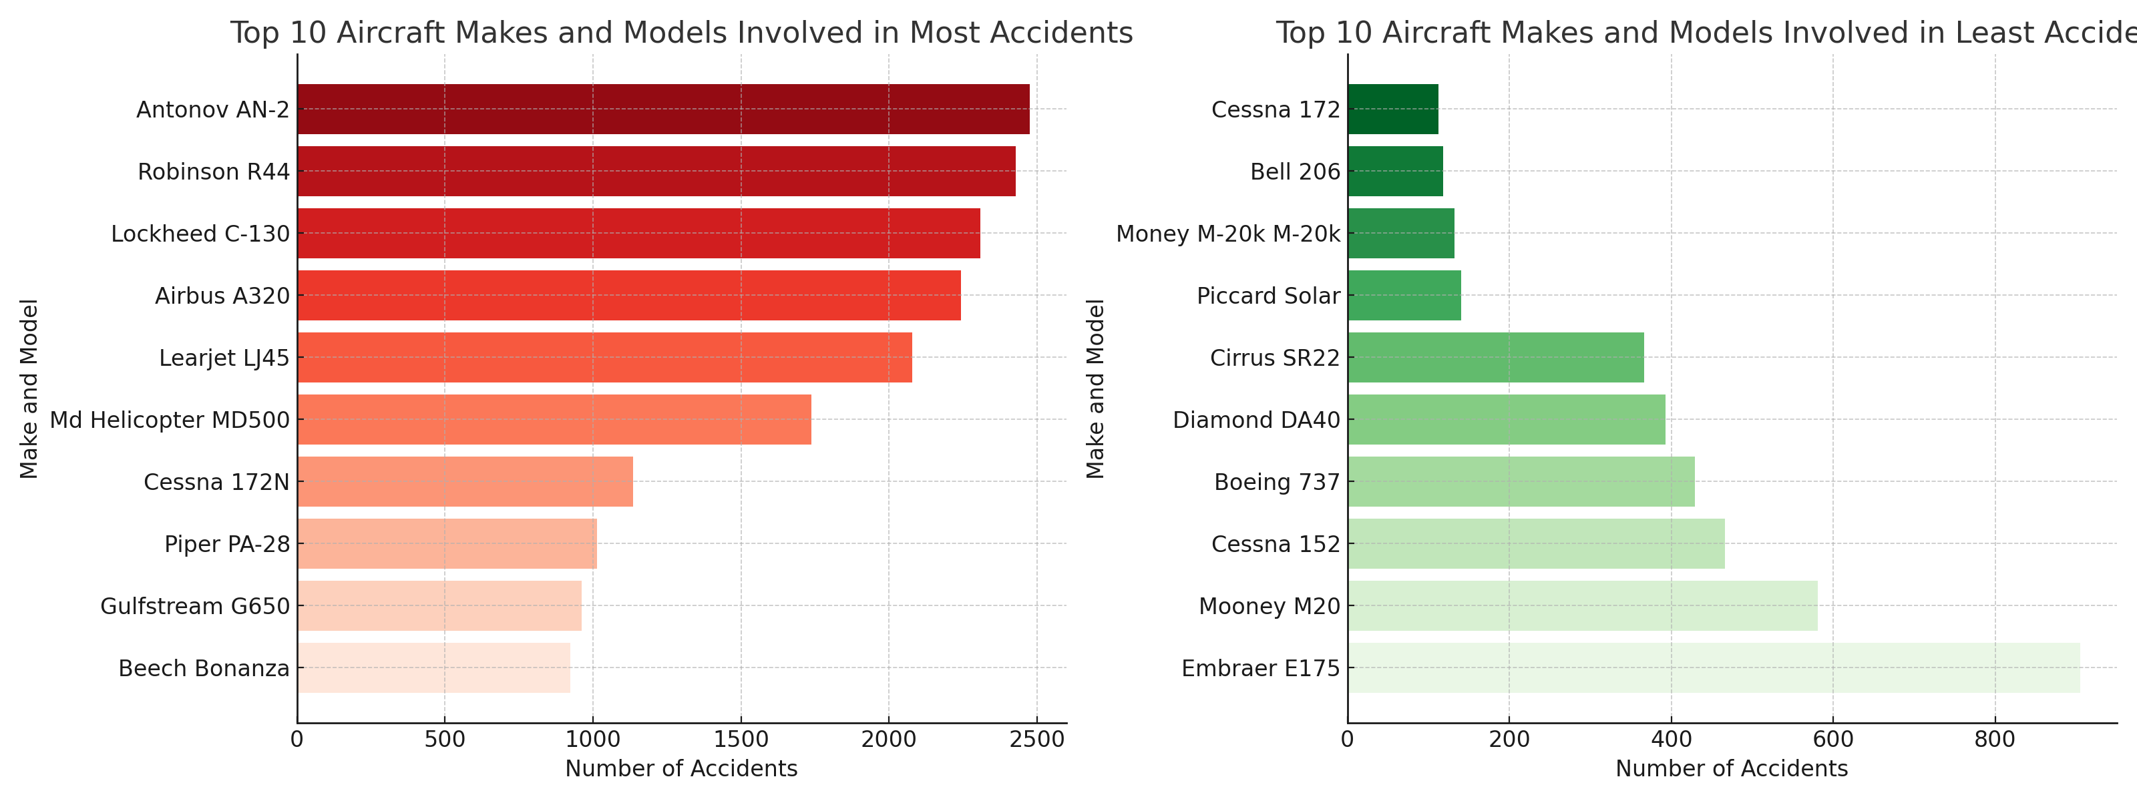
Visualizations: Evaluating Aircraft Safety Based on Make and Model

Slide 7
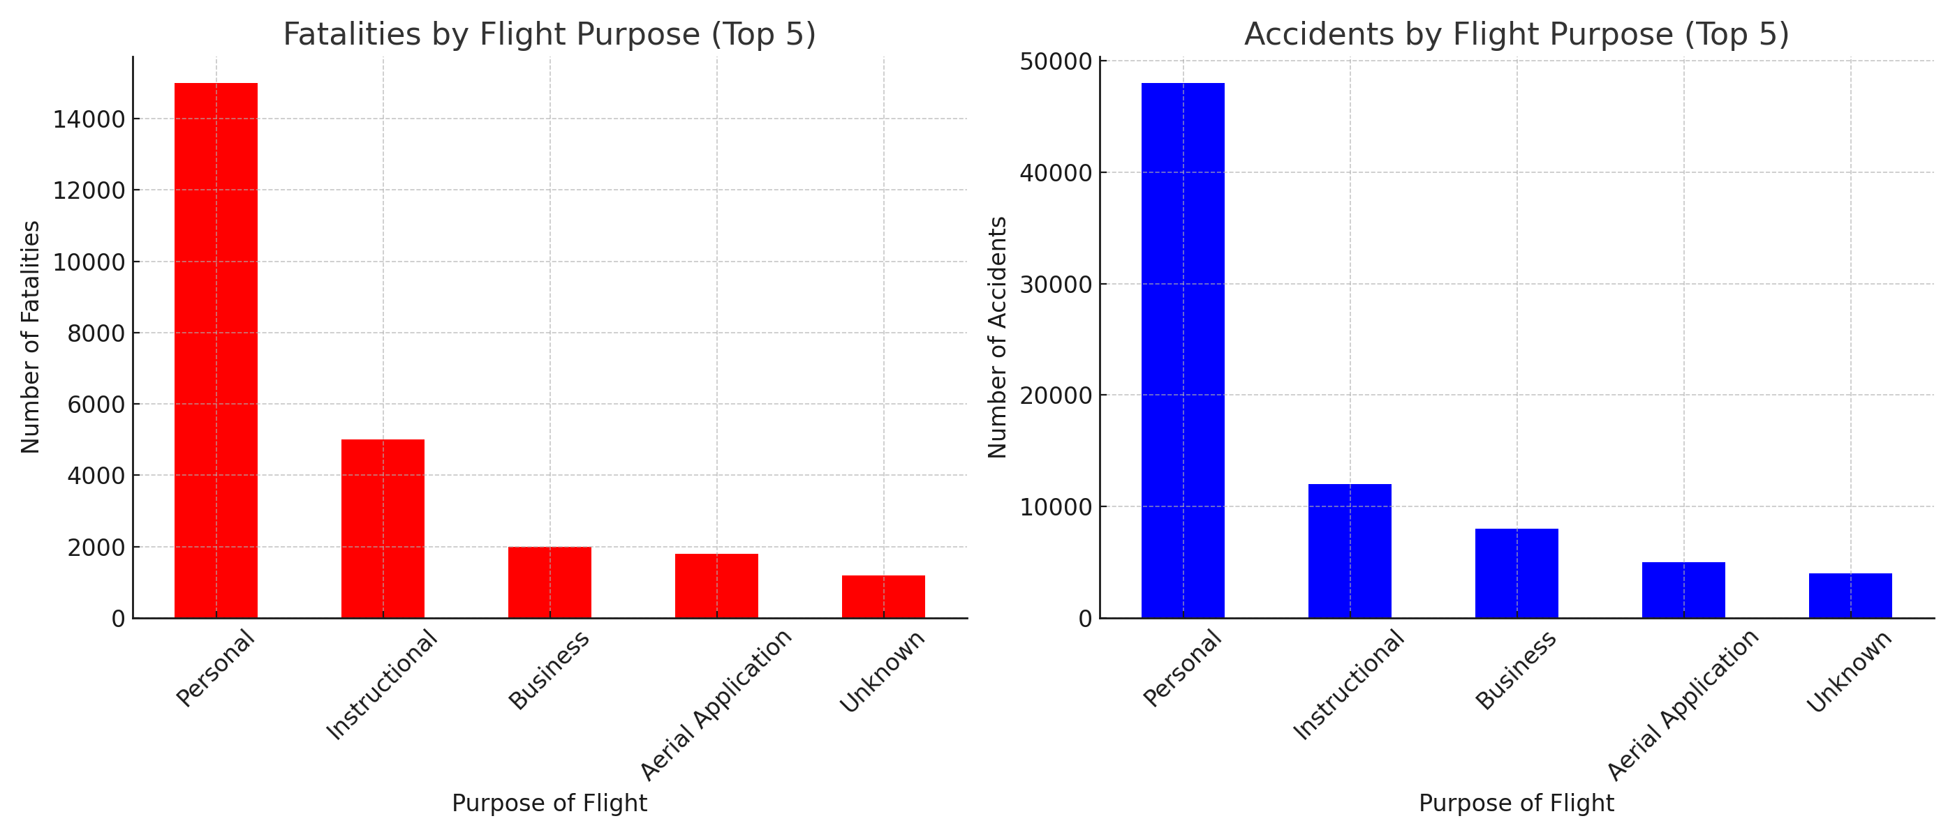
Assessing Accident Risk by Flight Purpose

Slide 8
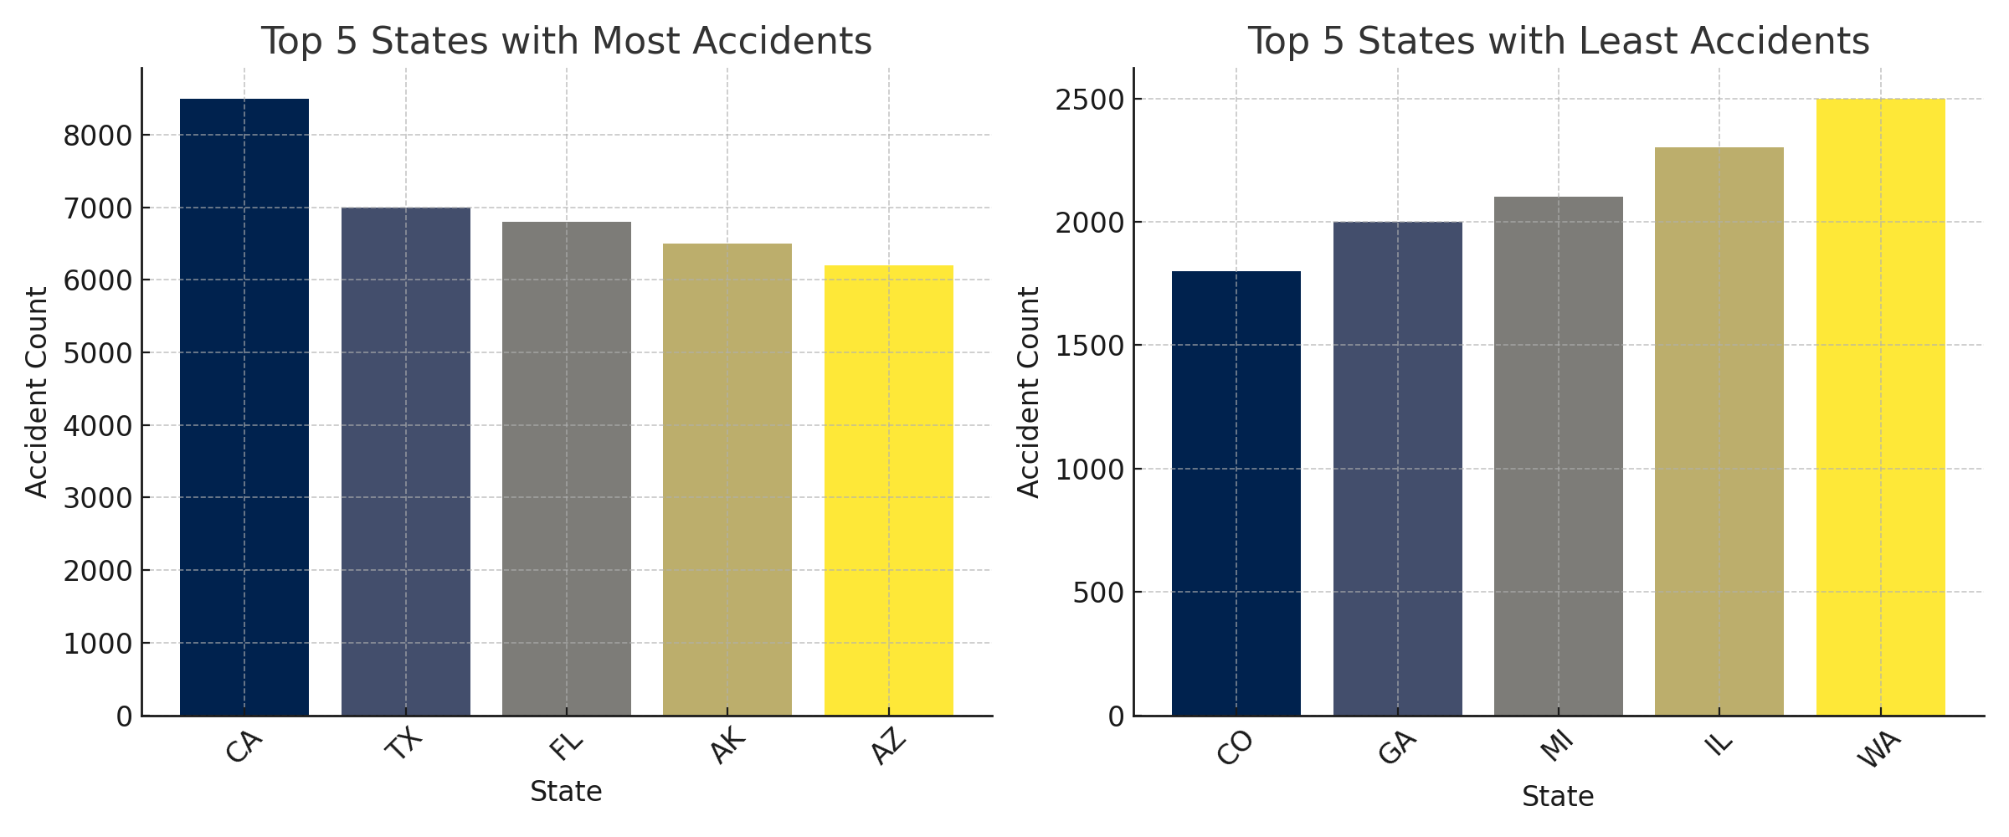
Geographical Analysis of Aviation Accidents in the U.S.A

Slide 9
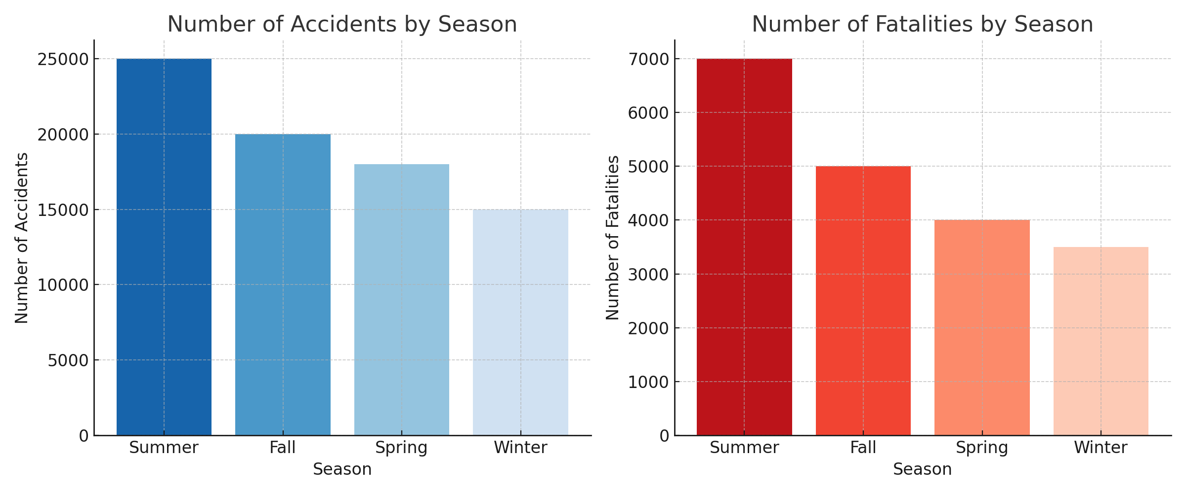
Seasonal Impact on Number of Aviation Accidents and Fatalities

Slide 10
Key Recommendations
1. Enhance pilot training for Cessna aircraft, these are the Aircrafts with most Accidents and Fatalities
2. Implement stricter safety regulations for personal flights as well as continuous training
3. Improve air traffic management in high-incident states
4. Conduct seasonal safety awareness campaigns to reduce risk associated with laxities especially in summer season.

Slide 11
Next Steps
- Conduct further research on emerging trends and safety technologies
- Implement targeted training programs
- Develop regulatory recommendations
- Monitor ongoing aviation safety trends

Slide 12
Thank You
Questions?
Contact: Vincent Barchok Ngochoch
LinkedIn:https://www.linkedin.com/in/vincent-ngochoch-94095b64/

