Slide 1
Loan Default Prediction Using Machine Learning
Presented by Vincent Barchok Ngochoch
Data Science & ML Consultant
Email: vbarchok@gmail.com | LinkedIn: vincent-ngochoch-94095b64

Slide 2
Problem Statement
Can we predict whether a customer will default on a loan based on historical data?
What are the most influential factors leading to default?
Which model performs better between Logistic Regression and Decision Tree?
Objective: Reduce NPLs, improve risk pricing, and support early intervention.

Slide 3
Data Overview
10,000 customer records with financial features.
Key Variables:
- Employed (1/0)
- Bank Balance (Numeric)
- Annual Salary (Numeric)
- Defaulted? (Target Variable)
• Binary classification: Predict 'Defaulted?'.

Slide 4
Exploratory Visualizations
Include key plots:
Default Rate by Employment Status
Distribution of Bank Balance
Correlation Heatmap
Default Probability by Salary Bracket
Brief annotations per plot to highlight key takeaways.

Slide 5
Key Drivers of Loan Default
Top contributing features:
- Bank Balance
- Annual Salary
- Employment Status
Interpretation:
Lower balances and unemployment significantly increase default risk.

Slide 6
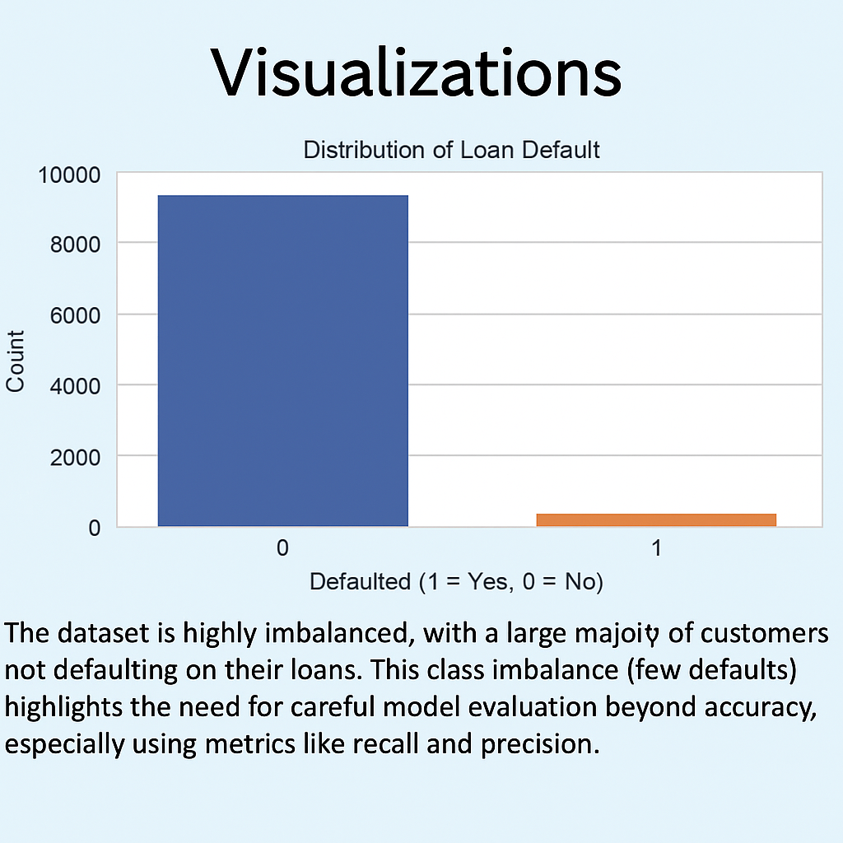

Slide 7
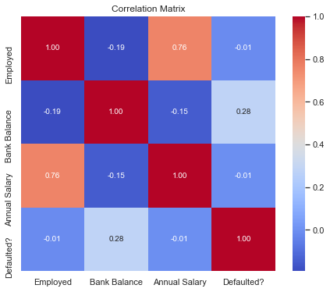
“Correlation Matrix: Annual Salary is strongly correlated with Employment Status (0.76), suggesting employed customers earn more. Bank Balance shows a mild positive correlation (0.28) with default, which is unexpected and warrants deeper analysis

Slide 8
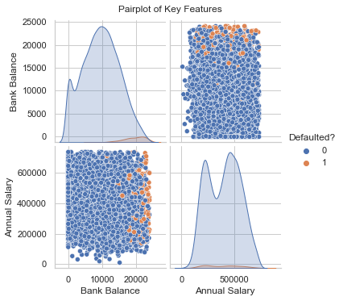
“Pairplot of Key Features: Most defaulters (orange) cluster around higher bank balances and lower-to-mid salary ranges. The plot reveals potential interaction effects between features and default behavior, supporting the use of non-linear models like decision trees.”

Slide 9
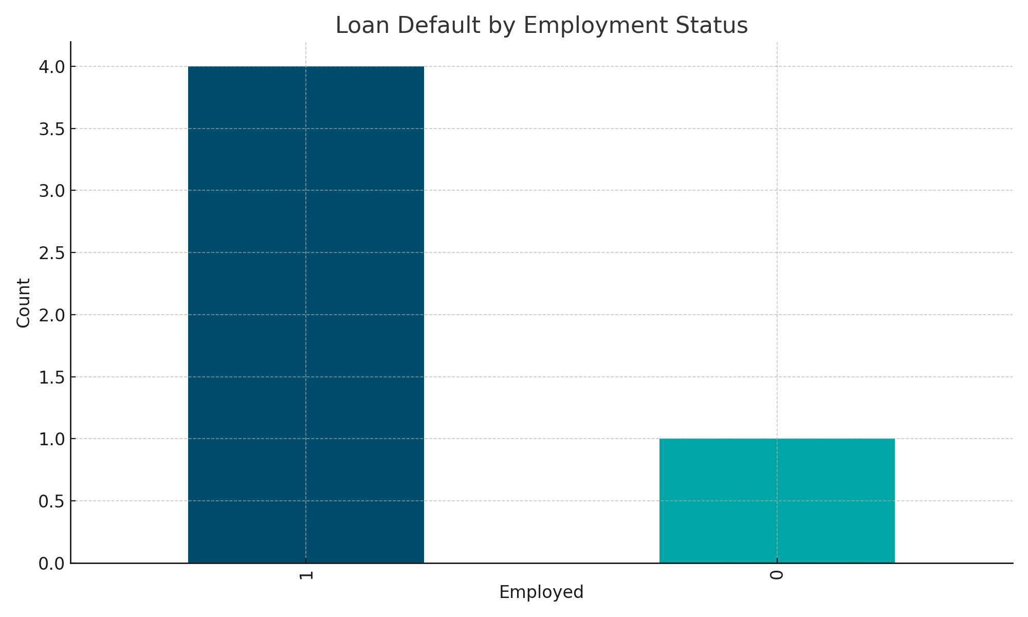
“Employed individuals (labelled '1') account for the majority of defaults, likely due to their higher representation in the dataset. However, the unemployed group (‘0’) shows a proportionally significant number of defaults relative to its size, highlighting employment status as a key factor in risk profiling.”

Slide 10
Model Performance Summary
Baseline: Logistic Regression
Final Model: Decision Tree Classifier
Evaluation Metrics:
- Accuracy, Precision, Recall, F1-Score, ROC AUC
Decision Tree showed higher recall and better business applicability.

Slide 11
Strategic Recommendations
Implement Decision Tree model in the credit scoring workflow.
Use insights to segment borrowers and adjust pricing models.
Conduct early outreach to high-risk profiles identified.
Periodically retrain model with updated data.
Goal: Smarter lending decisions, lower defaults, improved profitability.

Slide 12
Next Steps:
Integrate the Decision Tree model into the bank’s credit scoring system.
Monitor model performance regularly and assess its business impact.
Retrain the model periodically using updated customer data.
Consider testing more advanced models like Random Forest or XGBoost.
Work with credit and collections teams to act on high-risk segments.

Slide 13
Thank You – Questions?
Vincent Barchok Ngochoch
Email: vbarchok@gmail.com
LinkedIn: www.linkedin.com/in/vincent-ngochoch-94095b64
Happy to take any questions.

Slide 14
Thank You – Questions?
Vincent Barchok Ngochoch
Email: vbarchok@gmail.com
LinkedIn: www.linkedin.com/in/vincent-ngochoch-94095b64
Happy to take any questions.

