Slide 1
On supervised Feature Selection From High Dimensional Feature Spaces

Slide 2
Discriminant Feature Test (DFT)
For classification problems
DFT is used to measure the discriminant power of each feature dimension out of a P-dimensional feature space independently.
In our design, we use the weighted entropy of the left and right subsets as the DFT loss to measure the discriminant power of each dimension.
Because the weighted entropy considers the probability distribution of all classes.
Steps:
Training Sample Partitioning
DFT Loss Measured by Entropy
Feature Selection Based on Optimized Loss

Slide 3


Training Sample Partitioning
Find the optimal threshold to partition the samples into two subintervals

Slide 4


DFT Loss Measured by Weighted Entropy
Calculate weighted entropy of the left and right subintervals

Slide 5

Feature Selection Based on Optimized Loss
Partitions with the smallest entropy value represent better separation of the classes, that is , most discriminant features.

Slide 6
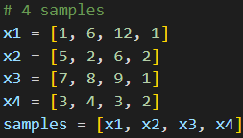
Example
Consider a sample space with 4 samples, and each sample contains 3 dimensions of features and 1 class label.

Slide 7
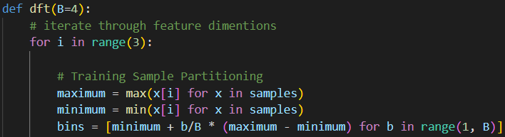
Example
Firstly, we iterate through all feature spaces. Then we partition the feature space into 4 subintervals, which yields 3 bin boundaries for partitioning.

Slide 8
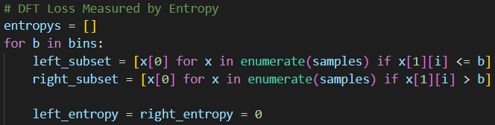
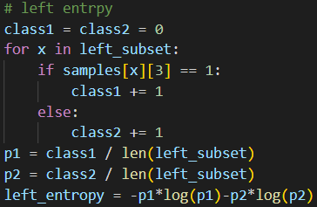
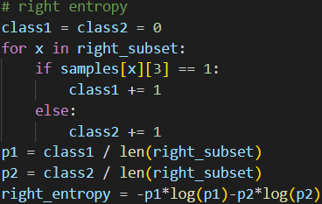
Example
We then iterate through every bins and calculate the entropy values of the left and right subintervals.

Slide 9

Example
Lastly, we calculate the weighted sum of the left and right subintervals’ entropy value. Then we choose the minimums of the entropy values we get from all bins for all features.
That says the second and the third features are the most discriminant features for they give us minimal entropy values.

Slide 10
Relevant Feature Test (RFT)
For regression problems
RFT is used to measure the discriminant power of each feature dimension out of a P-dimensional feature space independently.
In our design, we use the mean square error (MSE) of the left and right subsets as the RFT loss function to measure the discriminant power of each dimension.
Steps:
Training Sample Partitioning
Loss Measured by MSE
Feature Selection Based on Optimized Loss

Slide 11
Mean Square Error (MSE)
We use the mean of the samples as target value
Calculate the mean square error of the samples and the target value
This is equivalent to calculating their variance.

Slide 12
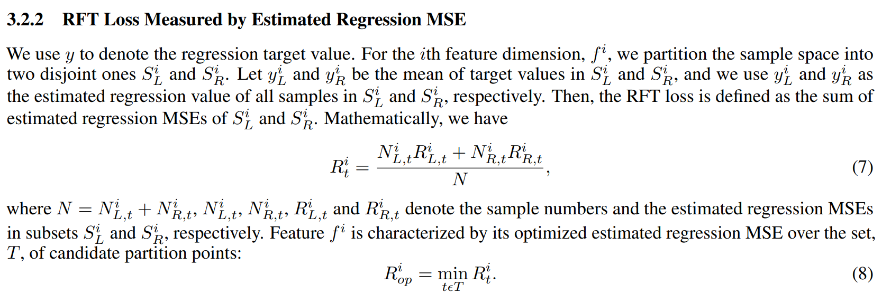
For each bin, we calculate the weighted variance of left and right subintervals it partitions .
The bin with the smallest weighted variance is the optimal threshold for that feature.
We select the features with the smallest optimal weighted variance.

