Slide 1
Arguments and Output

Slide 2
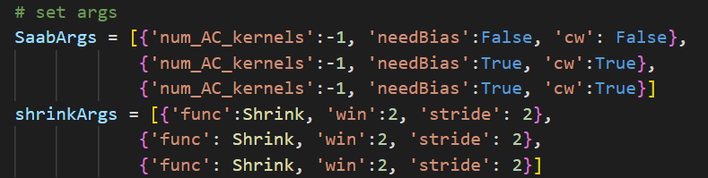
Arguments
num_AC_kernels:
Number of PCs that should be calculated by PCA. -1 means keeps all the features of the images. If it’s an 8x8 image, num_AC_kernels: -1 means PCA(number_of_PCs = 64).
need_Bias:
Whether this layer needs bias from the previous layers or not.
Cw:
Channel-wise or not
Func:
Function name of the Shrink function
Win, stride:
Window size and the stride of the window

Slide 3
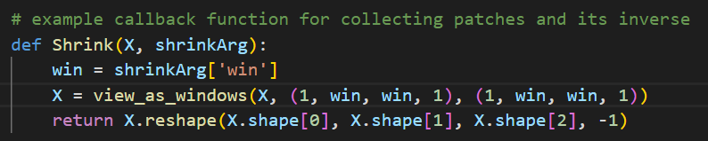
Shrink
Max-pooling and neighborhood construction
In this example call back we only implemented neighborhood construction to crop the images into non-overlapping patches, so we don’t need max-pooling to reduce spatial redundancy.

Slide 4
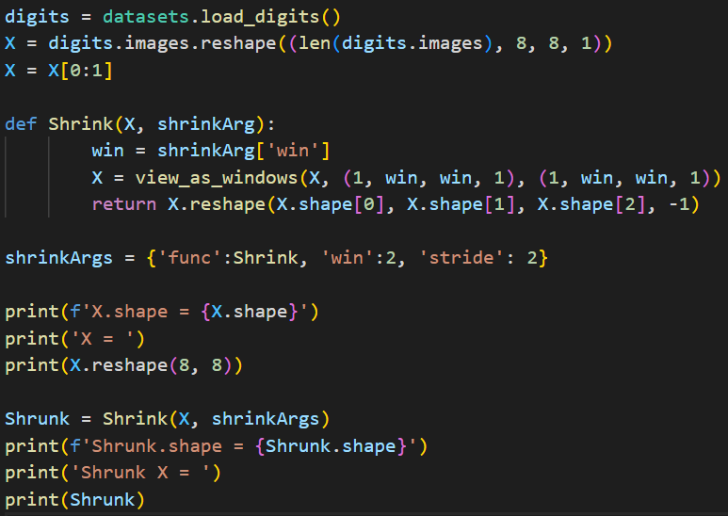
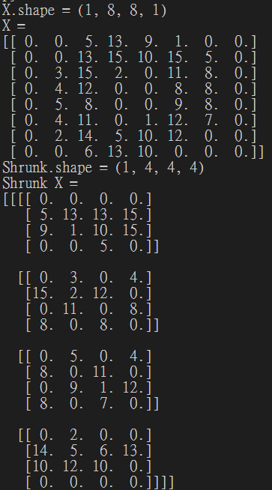

Slide 5
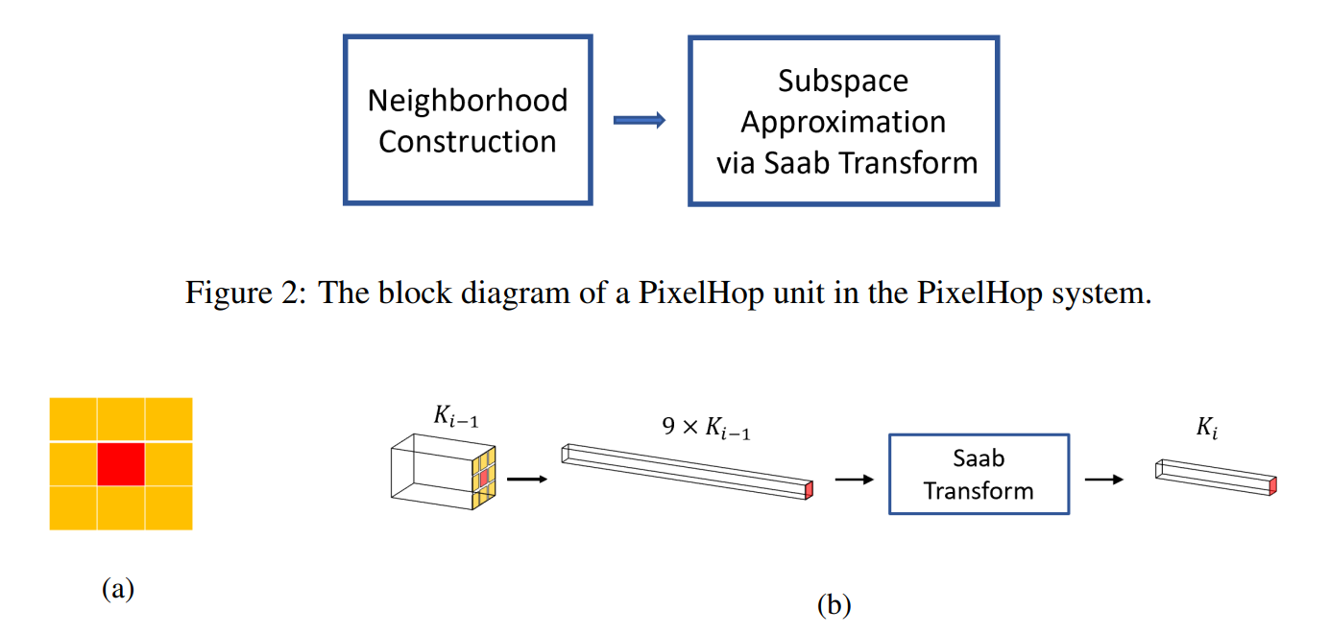
Neighborhood construction to saab

Slide 6
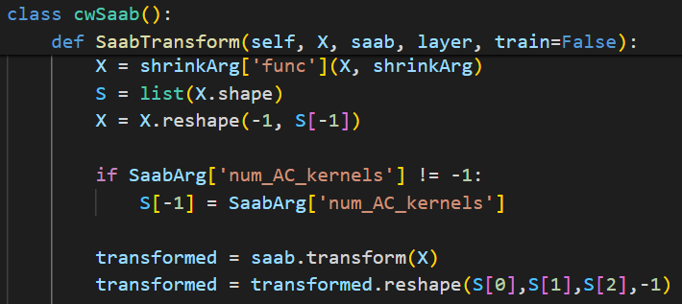
Saab transform
Shrink the image
Concatenate X together
transform
In this version of pixelhop implementation, the parameter ‘num_AC_kernels’ is never used. As we can see, in the code above we store ‘num_AC_kernels’ as the size of the shrunk X, but it was never used.

Slide 7
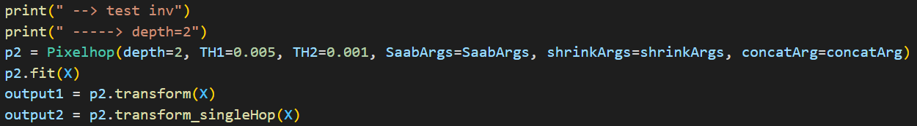
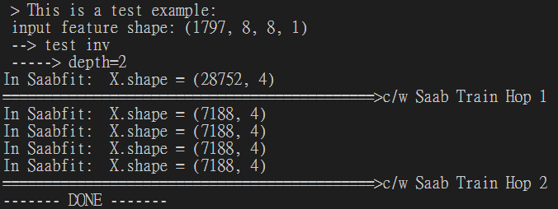
Transformed output
If we train a model with depth = 2, we will get an output with HOP1 and HOP2
So output1 = (HOP1, HOP2)
Each HOP contains our transformed features

Slide 8
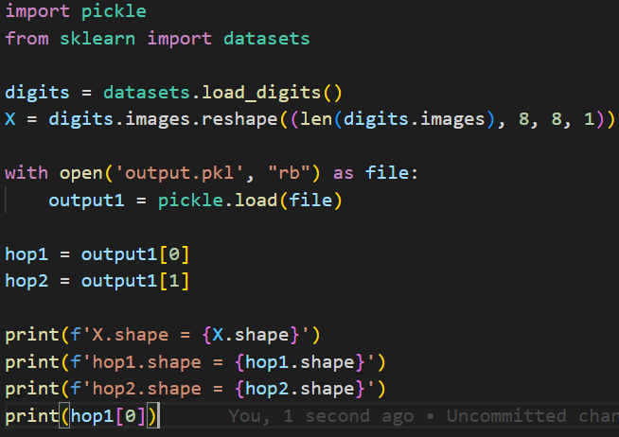
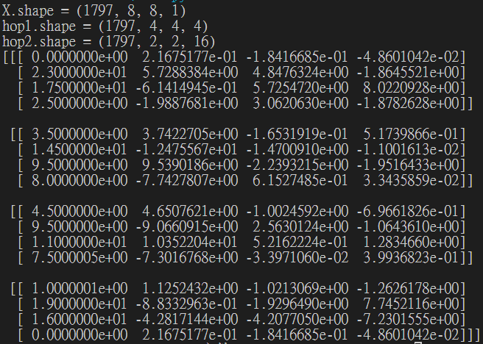
Shape of output
We can see that after each shrink(), the image just cropped into smaller patches, so it didn’t actually ‘shrank’.
That’s because we didn’t implement max-pooling in out Shrink() function and we didn’t specify the number of principal components we want to retain in the PCA.

Slide 9
conclusion
This version of PixelHop and its saab implementation is incomplete and can’t be actually used to reduce feature dimension as we desired without modification. In fact, there’s a main.py file with #TODOs in it left for our implementation, so this package may be the teaching material for their students.
I have found another repository called Project_Demo, which contains ‘FaceHop’, ‘Interpretable CNN’, ‘PixelHop++’, and ‘PixelHop’. I think the saab transform model implementation in those projects may be what we can actually use for our project.

