Slide 1
電腦視覺原理及應用簡介
Lab2
Enhancement

Slide 2
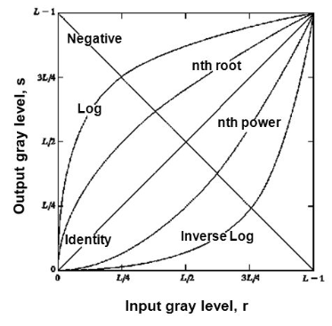
Point Processing: Gray-level transformation function
Linear
identity
negative
Logarithmic
log
inverse-log •
Power-law
nth power
nth root
s = (L - 1) - r
s = r
Notes:
S = L-1-r [影像反像]
S = c log(1+r) [對比調整 – 強化暗部]
S = r [輸入即輸出]
S為輸出之灰度值
R為輸入之灰度值
L為灰度最大值(常為256)
C為倍率

Slide 3
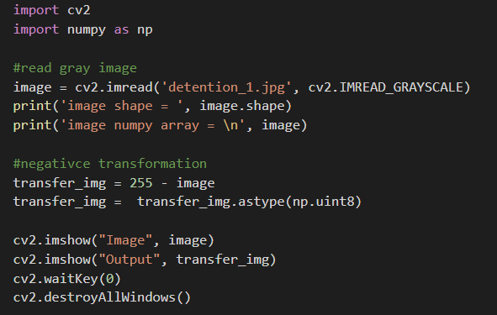
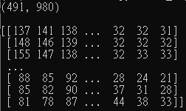
1.Negative transformation
S = (L - 1) - r
Shape (rows , cols)
Numpy array
Notes:
以 cv2.imread 讀進來的資料，會儲存成一個 NumPy 的陣列
灰度值範圍一般從0到255，白色為255，黑色為0

Slide 4
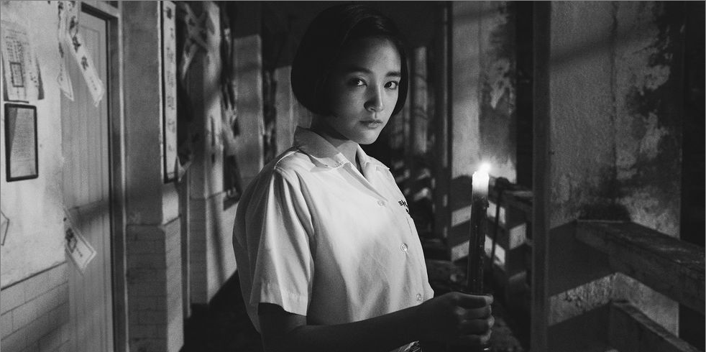
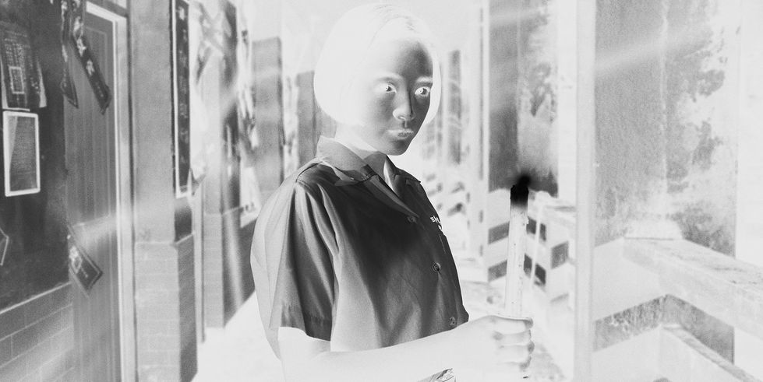
Negative transformation-Demo

Slide 5
2.Log transformation
S = c * log (1 + r)
r = input pixel value
c = scaling constant
S = output pixel value
The value of ‘c’ is chosen such that we get the maximum output value corresponding to the bit size used. So, the formula for calculating ‘c’ is :
c = 255 / (log (1 + max_input_pixel_value))
Notes:
變換用於擴展暗像素的值並壓縮亮像素的值。

Slide 6
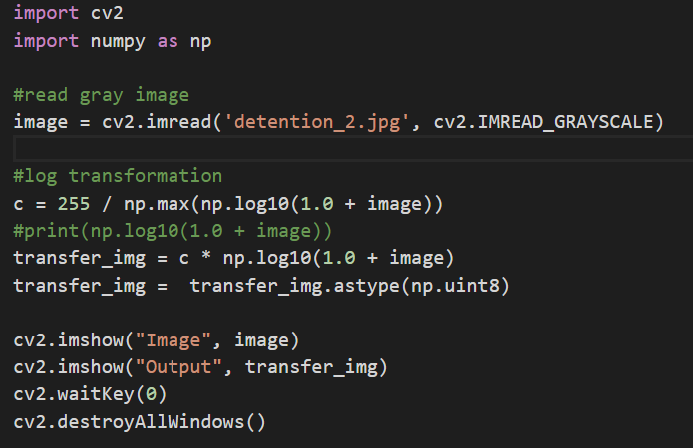
2.Log transformation
S = c * log (1 + r)

Slide 7
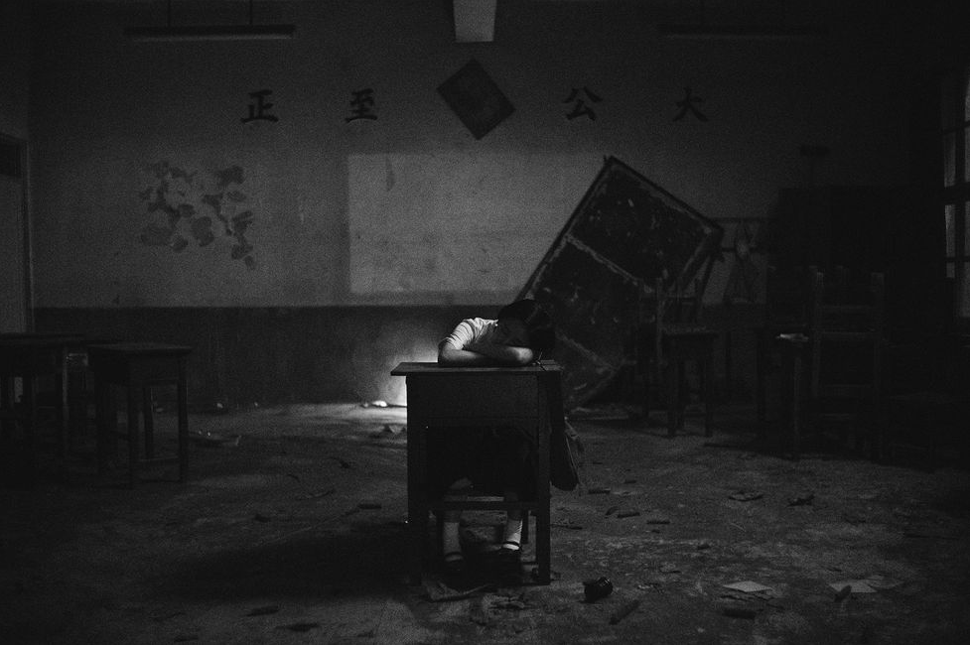
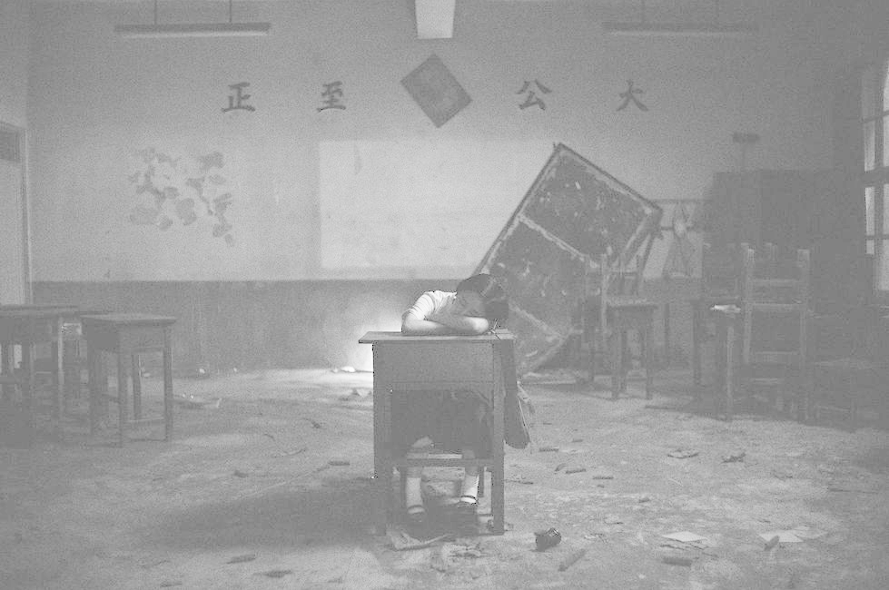
Log transformation-Demo

Slide 8
Assignment
將彩色圖片變灰階後分一半，一邊負片轉換，一邊Log轉換，並輸出轉換結果
完成請繳交程式碼與圖片，以學號命名壓縮檔
Convert the color image to grayscale and divide it into half, use negative transformation for half, and log transformation for half, and output the result.
Please submit the code and picture after completation, the compressed file is named with the student number.
Hint :
取出row跟column的值
對每個pixel做轉換

Slide 9
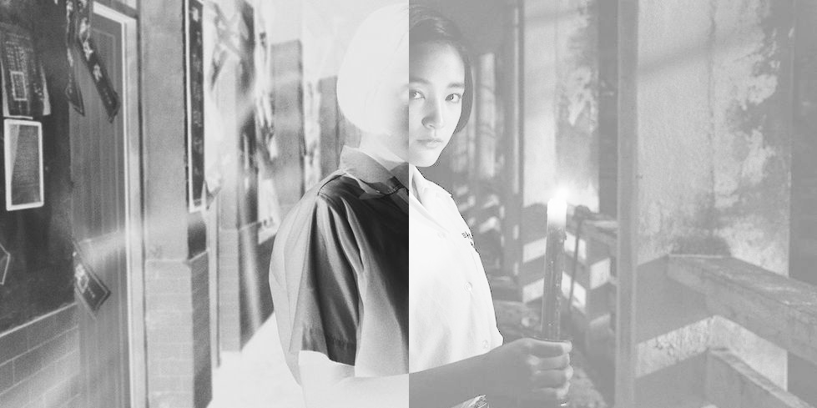
Demo

