Slide 1
計算機實習 04
2022.03.11

Slide 2
Outline
Basic concepts of class
Constructor
Copy Constructor
Assign Operator
Destructor & Garbage Collector
Inheritance
Override
Overloading
Polymorphism

Slide 3
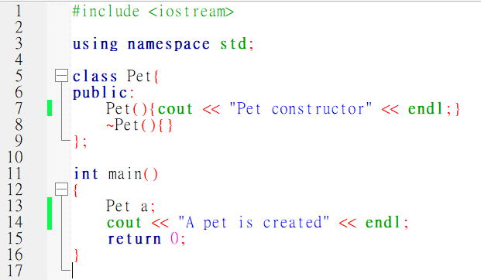
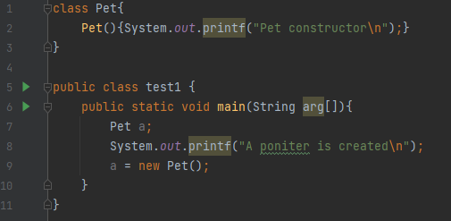
Class in C++ & Java
What is the difference of “Pet a;” in C++ and Java?
C++:
Java:
A pointer
An object

Slide 4
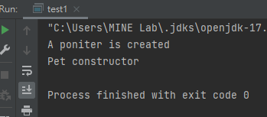
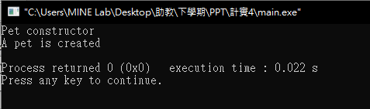
Class in C++ & Java
C++:
Java:
A pointer
An object

Slide 5
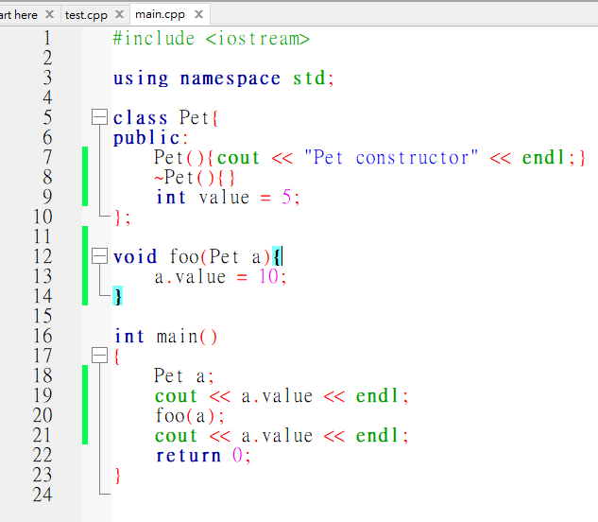
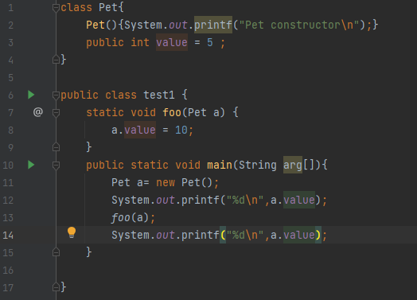
Does it matter?
C++:
Java:

Slide 6
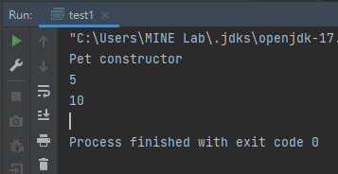
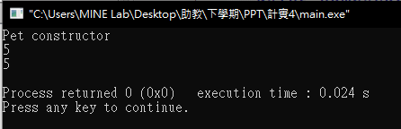
Does it matter?
C++:
Java:

Slide 7
Does it matter?
C++:
Java:
Pass-by-address
Pass-by-value

Slide 8
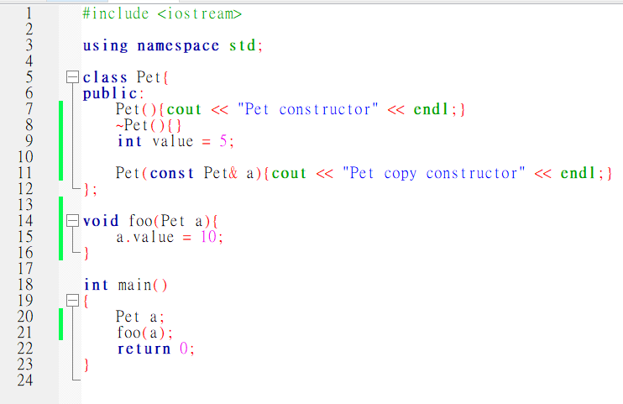
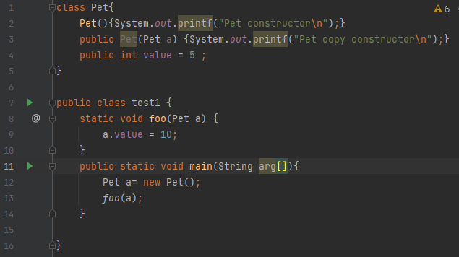
Copy Constructor
C++:
Java:

Slide 9
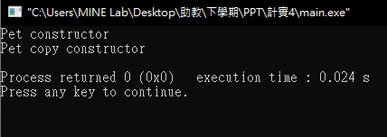
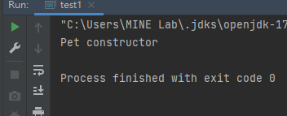
Copy Constructor
C++:
Java:

Slide 10
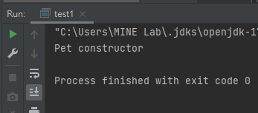
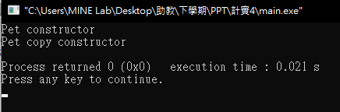
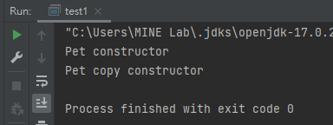
Copy Constructor
C++:
Java:
Pet a ;
Pet b = a;
Pet a = new Pet();
Pet b = a;
Pet a = new Pet();
Pet b = new Pet(a);

Slide 11
Assign operator
C++:
Java:
Pet a;
Pet b;
b.value = 10;
a = b;
cout << a.value << endl;
Pet a = new Pet();
Pet b = new Pet();
b.value = 10;
a = b;
System.out.printf(“%d\n”,a.value);

Slide 12
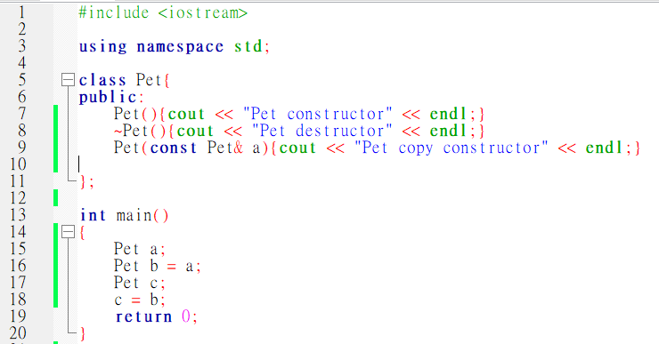
Destructor
C++:

Slide 13
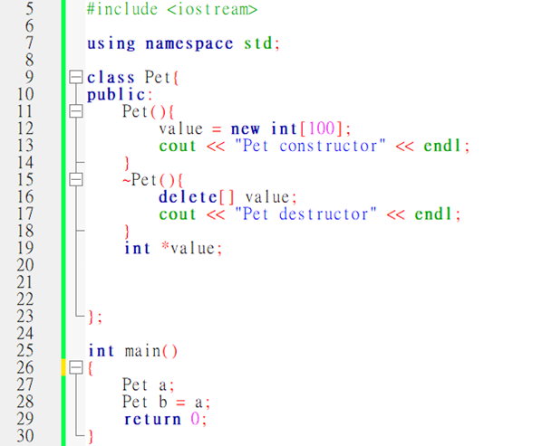
Is there anything wrong?

Slide 14
In java
There is no need to write a destructor.
Java always using Garbage Collector to free the objects that you are not going to use.

Slide 15
Inheritance
There is a class A and class B. I want class B inherit class A.
Rule: Is B an A?
Example:
There is a class called “Animal”, and there is a class called human.
We want human inherit Animal, then is human an animal?
If the answer is YES, then you use inheritance correctly.
If there is another class called monkey, and we want monkey inherit human.
Is monkey a human?

Slide 16
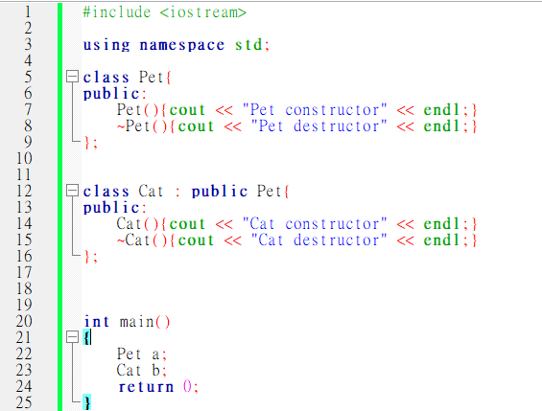
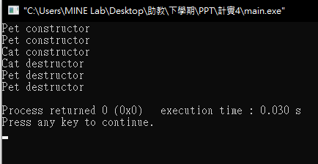
C++

Slide 17
Java
class Pet{
...
int value = 5;
}
class Cat extends Pet{
…
}
Cat a = new Cat();
System.out.printf(“%d”, a.value);

Slide 18
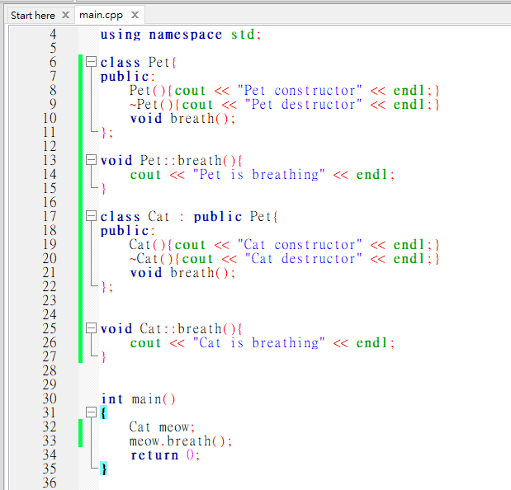
Override
Base class and subclass are using methods with same name.
In C++:

Slide 19
Java?
Try yourselves.

Slide 20
Practice 04 deadline:2022/03/12 23:55
There are five classes, Pet, Cat, Dog, newborn_Cat, and newborn_Dog.
Cat and Dog inherit Pet.
newborn_Cat and newborn_Dog inherit Cat and Dog respectively.
Please implement them and let them “speakable”.

Slide 21
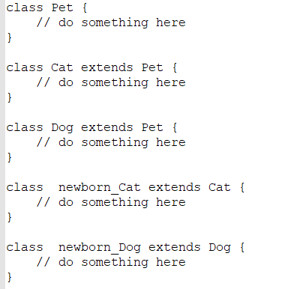
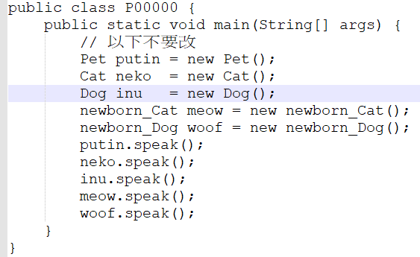
Don’t change main function.

Slide 22
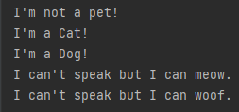
Output
Don’t just output these lines. You will get 0 points.

Slide 23
繳交規範

Slide 24
繳交內容：
內容包含:
.java檔(這次只交java檔就好，無需壓縮直接上傳)
※ 嚴禁抄襲，違者皆以零分計算

Slide 25
繳交格式
檔案名稱須為 AX_10XXXXXXX 或 PX_10XXXXXXX
Assignment: A, Practice: P
X為第X次練習or作業
10XXXXXXX為學號
若有兩題以上需加上對應題號，如AX_10XXXXXXX_1
※ 嚴禁抄襲，違者皆以零分計算

Slide 26
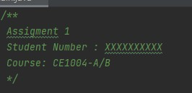
繳交格式
程式碼開頭要有以下文字
計算機概論II : 2022-CE1002
計算機實習IIA: 2022-CE1004-A
計算機實習IIB : 2022-CE1004-B
作業: Assignment
練習: Practice

