Slide 1
Operating System Concept
授課教授 周立德 教授
助教 任紀安
Notes:
‹#›

Slide 2
Ch 8 Deadlock
Def : The waiting processes will never again change state, because the resources they have requested are held by other waiting processes.
Deadlock四必要條件
Mutual exclusion ( 互斥)
Only one process at a time can use a resource.
Hold and wait (擁有和等待)
A process holding at least one resource is waiting to acquire additional resources held by other processes.
No preemption (不可奪取)
A resource can be released only voluntarily by the process holding it, after that process has completed its task.
Circular wait (循環等待)
There exists a set {P0, P1, …, P0} of waiting processes such that P0 is waiting for a resource that is held by P1, P1 is waiting for a resource that is held by P2, …, Pn–1 is waiting for a resource that is held by Pn, and P0 is waiting for a resource that is held by P0.
‹#›
Notes:
‹#›

Slide 3
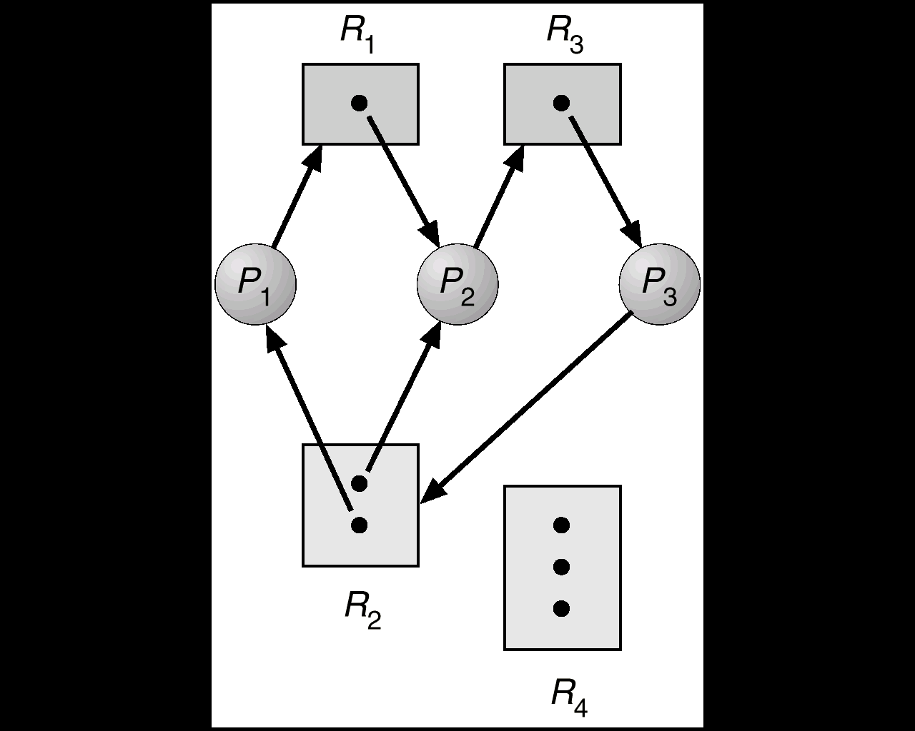
Resource Allocation Graph with deadlock
No cycle→No deadlock
有Cycle,不一定有deadlock(for multi-resource instance)
If all resources are single instance, then a cycle exists means that a deadlock exists
‹#›
Notes:
‹#›

Slide 4
Handling Deadlocks
Deadlock prevention
Deadlock avoidance
Pros
no deadlock
Cons
utilization lower and throughput lower
Deadlock detection and recovery
Pros
utilization和throughput相對較高
Cons
系統可能進入死結狀態
Cost高
‹#›
Notes:
‹#›

Slide 5
Handling Deadlocks
Deadlock prevention
Mutual Exclusion
Impossible（某些資源本身就具互斥性質 EX :CPU ）
Hold and wait
規定除非process可以一次取得完成工作所須知全部資源,才准許持有resource,否則不得持有任何資源
允許process先持有部份資源,但若要提出其他資源申請之前,需先釋放持有之所有資源才可申請.
No preemption
改成preemption即可,即高優先權process可搶奪其他process之資源來完成工作
對印表機、磁帶機、讀卡機…等專屬設備（Dedicated Device）而言，它們是不可奪取的資源（Non-preemptible Resource）
Circular waiting
賦予各資源編號,process需依資源編號順序提出申請
‹#›
Notes:
‹#›

Slide 6
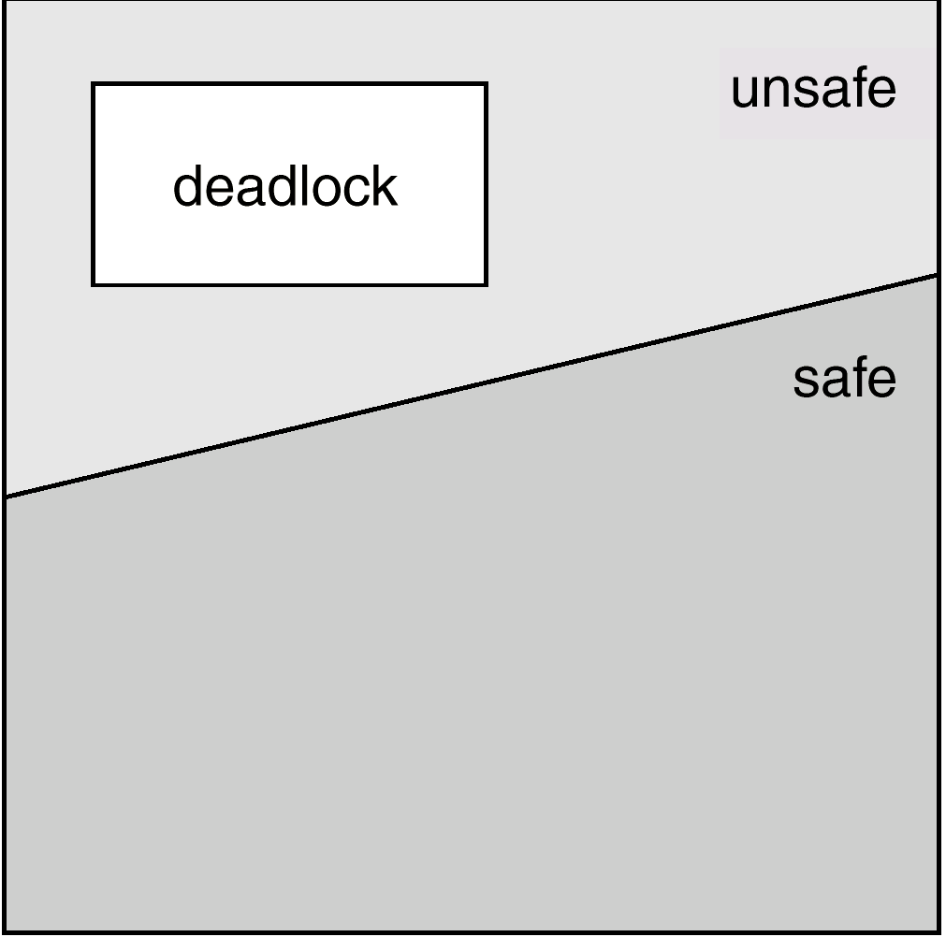
Handling Deadlocks
Deadlock Avoidance
When a process requests an available resource
How much resource is hold by each process currently
How much resource does each process need to complete jobs
Available resource in system
Execute Banker’s algo.(included safety algo.)
If system is in safety state ,then permit requests
Or reject this request and process must wait for next time to request
‹#›
Notes:
‹#›

Slide 7
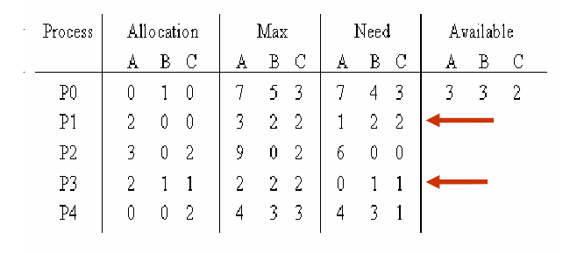
Banker’s Algorithm
‹#›

Slide 8
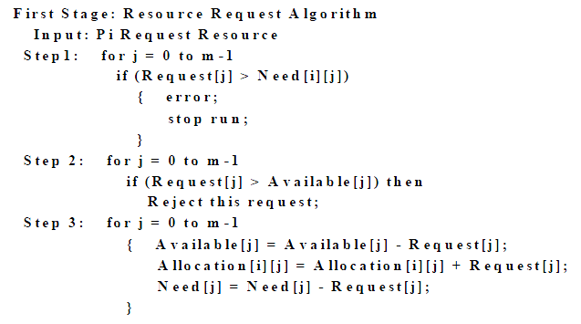
Data Structures for the Banker’s Algorithm
‹#›
Notes:
‹#›

Slide 9
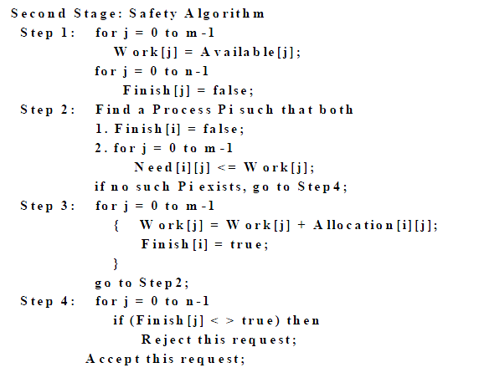
‹#›
Notes:
‹#›

Slide 10
Algo. Summary
Check request_{i} <= Need_{i}
Check request_{i} <= Available
Make a sheet
Run safety algo.
Goal of safety algo.
Find more than or equal to one safe sequence, OS follows this sequence allocate resources and make all processes complete their jobs
‹#›
Notes:
‹#›

Slide 11
Detection Algorithm
1. Let Work and Finish be vectors of length m and n, respectively Initialize:
(a) Work :- Available
(b) For i = 1,2, …, n, if Allocation_{i}  0, then Finish[i] := false;otherwise, Finish[i] := true.
2. Find an index i such that both:
(a) Finish[i] = false
(b) Request_{i}  Work
If no such i exists, go to step 4.
‹#›
Notes:
‹#›

Slide 12
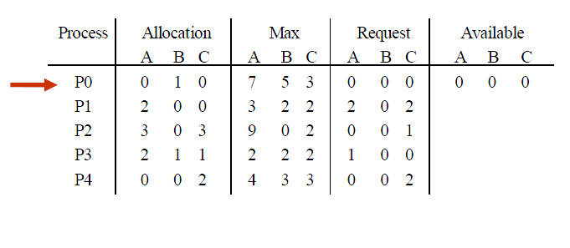
Detection Algorithm (Cont.)
‹#›
Notes:
‹#›

Slide 13
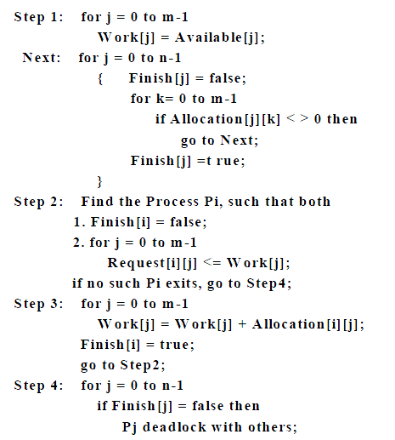
Detection Algorithm (Cont.)
‹#›

Slide 14
Recovery Algo.
Kill processes
Kill all processes
Kill the process one by one
Resource Preemption
Selecting a victim – minimize cost.
Rollback – return to some safe state, restart process from that state.
Starvation – same process may always be picked as victim, include number of rollback in cost factor.
‹#›
Notes:
‹#›

Slide 15
Combined Approach to Deadlock Handling
Combine the three basic approaches
prevention
avoidance
detection
allowing the use of the optimal approach for each of resources in the system.
Use most appropriate technique for handling deadlocks within each class.
‹#›
Notes:
‹#›

Slide 16
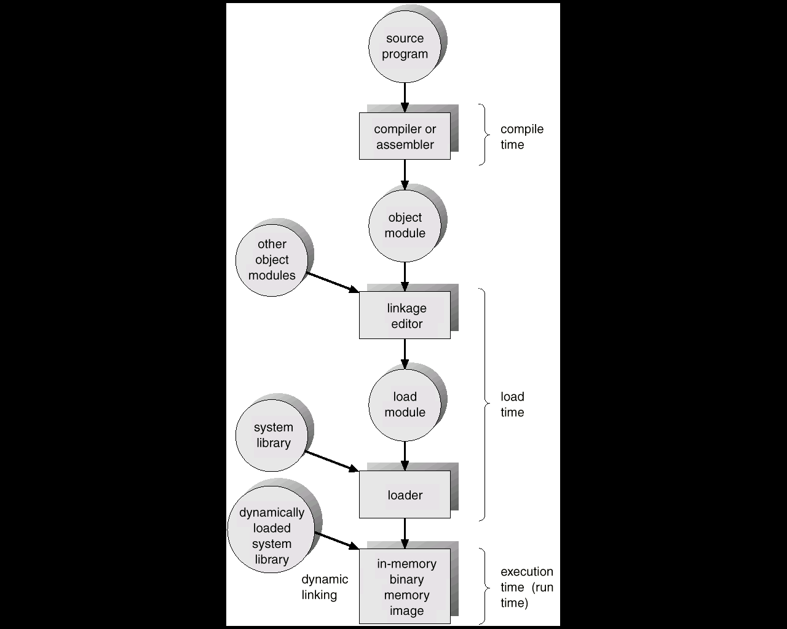
Ch9 Memory Management
Address binding of instructions and data to memory addresses can happen at three different stages
Compile time
Load time
Execution time
‹#›
Notes:
‹#›

Slide 17
Dynamic Loading
Routine is not loaded until it is called
Better memory-space utilization; unused routine is never loaded.
Useful when large amounts of code are needed to handle infrequently occurring cases.
No special support from the operating system is required implemented through program design.
‹#›
Notes:
‹#›

Slide 18
Dynamic Linking
Linking postponed until execution time.
Small piece of code, stub, used to locate the appropriate memory-resident library routine.
Stub replaces itself with the address of the routine, and executes the routine.
Operating system needed to check if routine is in processes’ memory address.
E.g Dynamic Linking library
‹#›
Notes:
‹#›

Slide 19
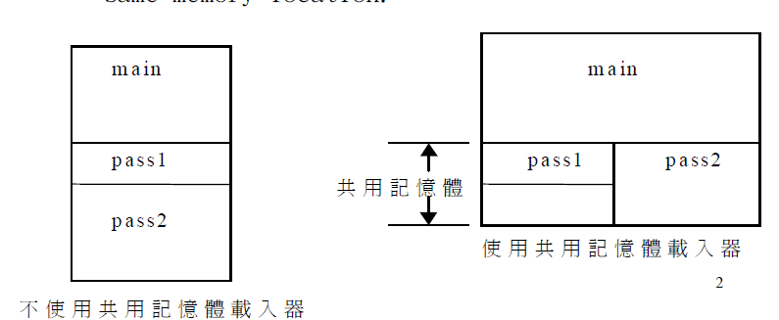
Overlays
Keep in memory only those instructions and data that are needed at any given time.
Needed when process is larger than amount of memory allocated to it.
Implemented by user, no special support needed from operating system, programming design of overlay structure is complex
‹#›

Slide 20
Logical vs. Physical Address Space
The concept of a logical address space that is bound to a separate physical address space is central to proper memory management.
Logical address – generated by the CPU; also referred to as virtual address.
Physical address – address seen by the memory unit.
Logical and physical addresses are the same in compile-time and load-time address-binding schemes; logical (virtual) and physical addresses differ in execution-time address-binding scheme.
‹#›
Notes:
‹#›

Slide 21
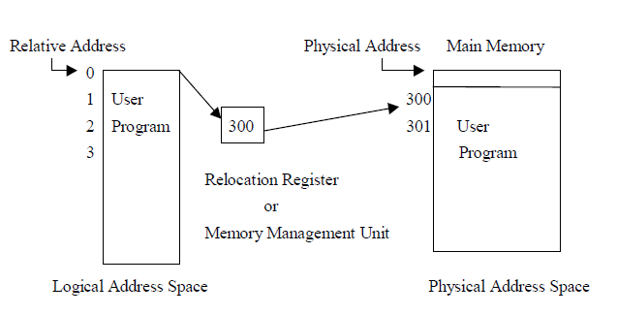
Logical vs. Physical Address Space
‹#›

Slide 22
Swapping
A process can be swapped temporarily out of memory to a backing store, and then brought back into memory for continued execution.
Backing store – fast disk large enough to accommodate copies of all memory images for all users; must provide direct access to these memory images.
Roll out, roll in – swapping variant used for priority-based scheduling algorithms; lower-priority process is swapped out so higher-priority process can be loaded and executed.
Major part of swap time is transfer time; total transfer time is directly proportional to the amount of memory swapped.
Modified versions of swapping are found on many systems, i.e., UNIX and Microsoft Windows.
‹#›
Notes:
‹#›

Slide 23
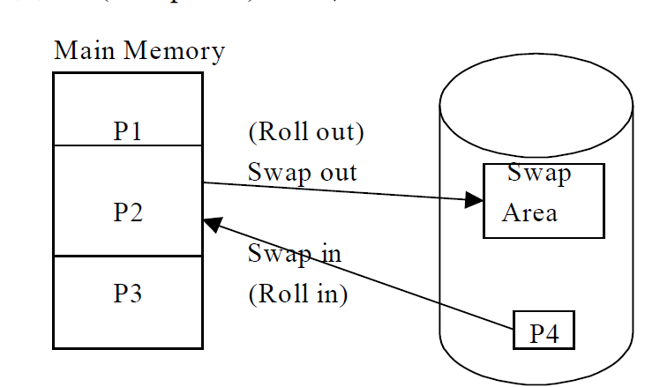
Swapping
‹#›

Slide 24
Memory Management Strategies
找尋策略（Fetch Strategies）去尋找那些程式必須佔有主記憶體
置放策略（Placement Strategies）
置換策略（Replacement Strategies）
‹#›

Slide 25
Memory allocation
First-fit: Allocate the first hole that is big enough.
Best-fit: Allocate the smallest hole that is big enough; must search entire list, unless ordered by size. Produces the smallest leftover hole.
Worst-fit: Allocate the largest hole; must also search entier list. Produces the largest leftover hole.
First-fit and best-fit better than worst-fit in terms of speed and storage utilization.
‹#›
Notes:
‹#›

Slide 26
記憶體配置（Storage Allocation）
連續記憶體配置（Contiguous Storage Allocation）
不連續記憶體配置（Non Contiguous Storage Allocation）
‹#›

Slide 27
Paging
Divide physical memory into fixed-sized blocks called frames
Divide logical memory into blocks of same size called pages.
Keep track of all free frames.
To run a program of size n pages, need to find n free frames and load program.
Set up a page table to translate logical to physical addresses.
Internal fragmentation.
‹#›
Notes:
‹#›

Slide 28
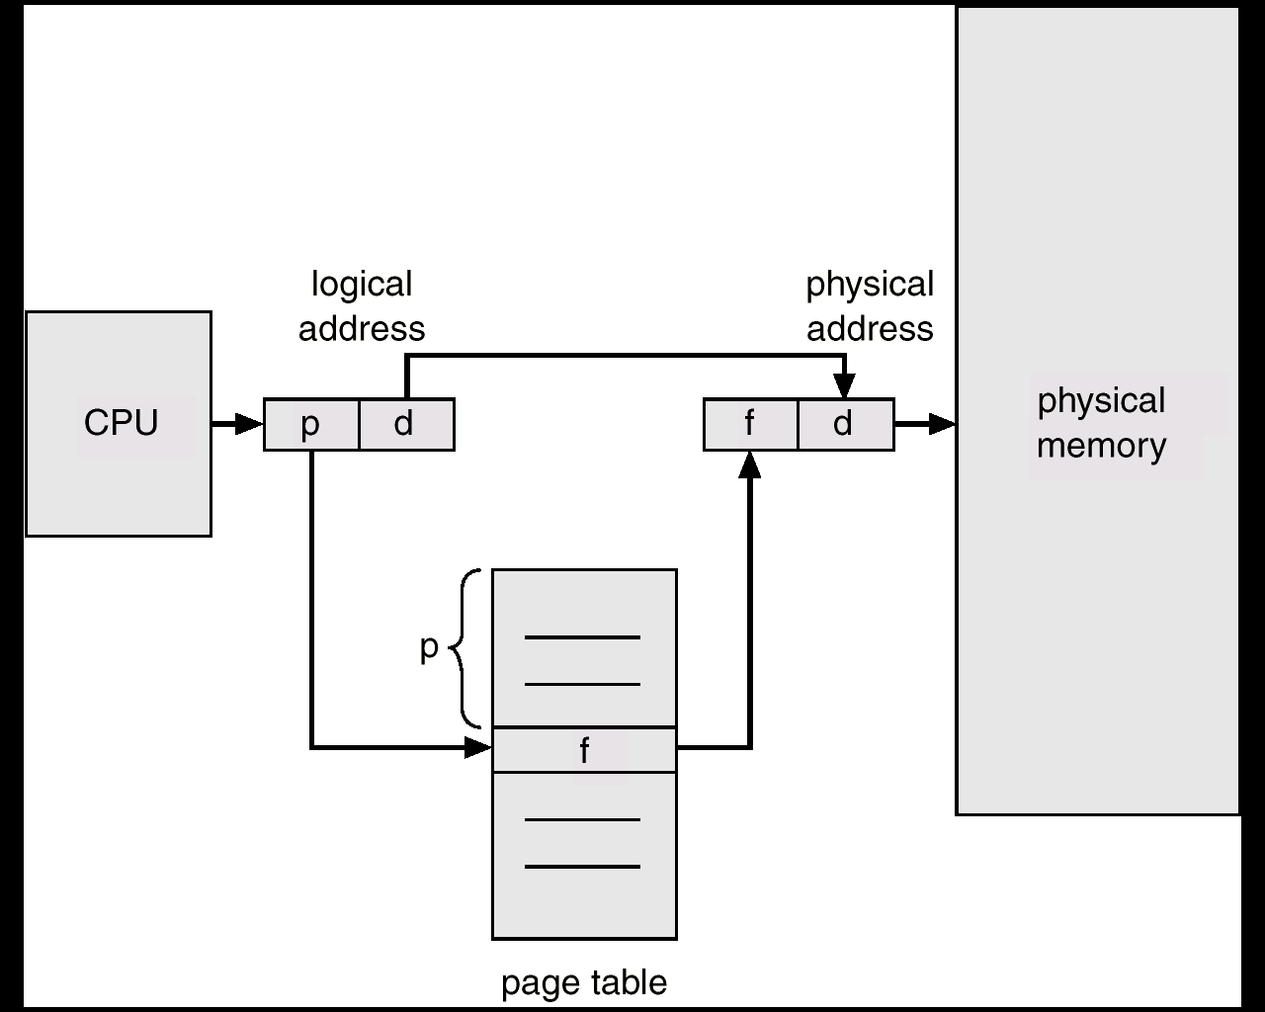
Paging(Cont.)
‹#›
Notes:
‹#›

Slide 29
Page Table
Register
Memory and PTBR(Page Table Base Register)
TLB(Translation Lookaside Buffer) register
Effective Memory Access Time
P*(TLB access time + memory access time)+(1-p)*(TLB access time +2*memory access time)
P:TLB hit ratio
‹#›
Notes:
‹#›

Slide 30
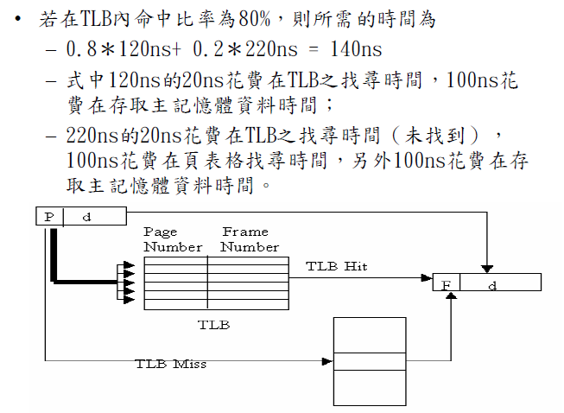
混合TLB及頁表格
‹#›

Slide 31
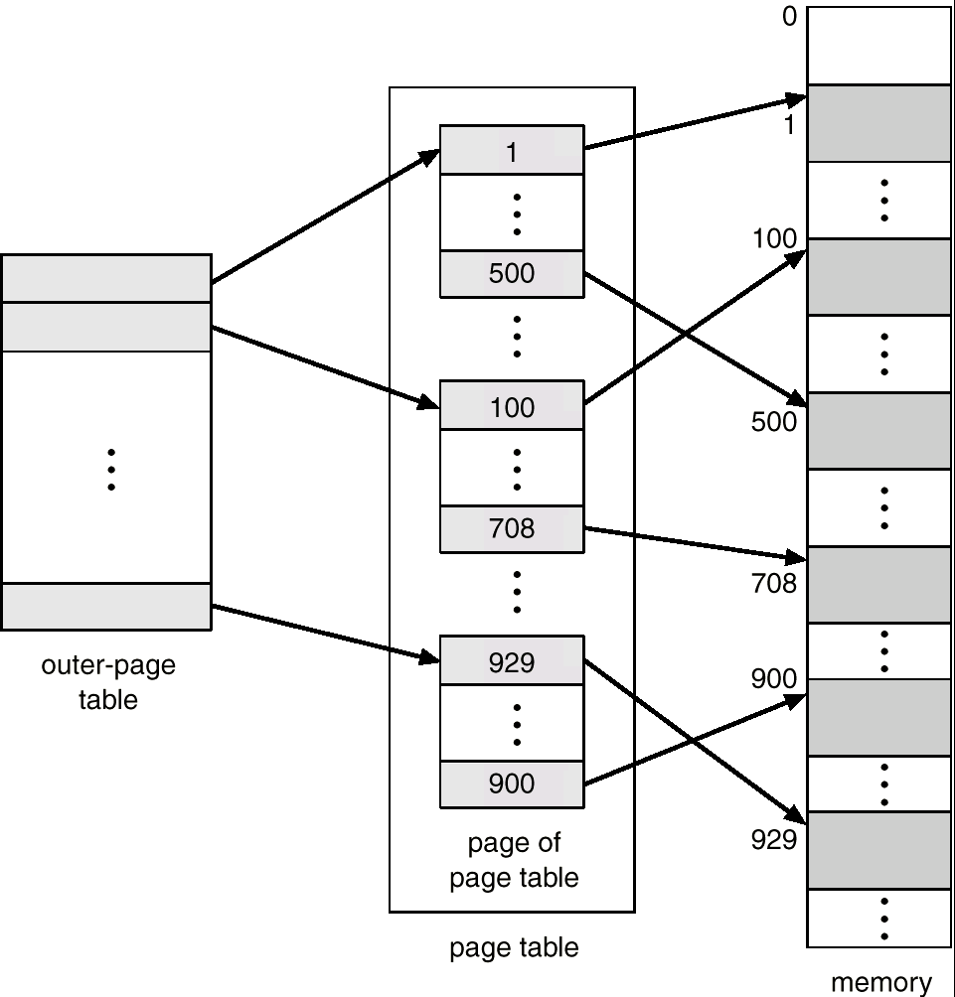
Multi-level paging
Def : paging the page table
By multi-paging, a large page table can be divided into more small piece one separately in memory
‹#›
Notes:
‹#›

Slide 32
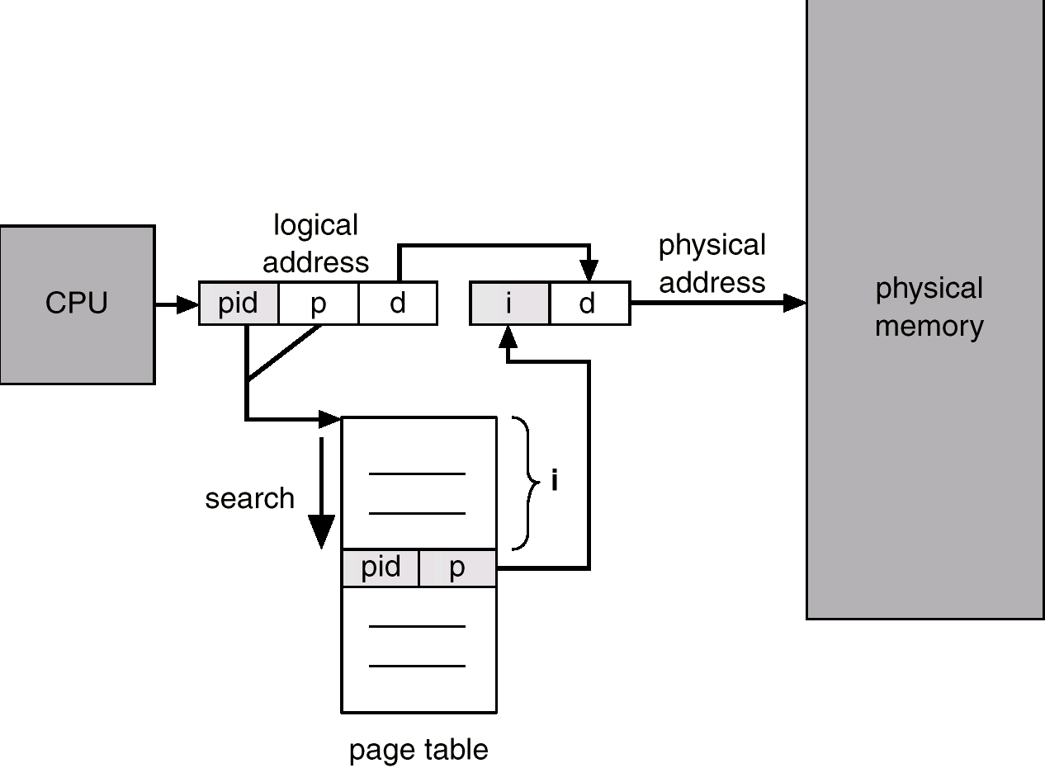
Inverted page table
以physical memory 之frame 為記錄對象,若有n個frames則inverted page table 就有n個entry,entry紀錄<process id, page no.>
‹#›
Notes:
‹#›

Slide 33
Segmentation
Memory-management scheme that supports user view of memory.
Physical memory
視為一個夠大的連續可用區塊
Logical memory
視為一組segment之集合，而各段大小不一定相等
‹#›
Notes:
‹#›

Slide 34
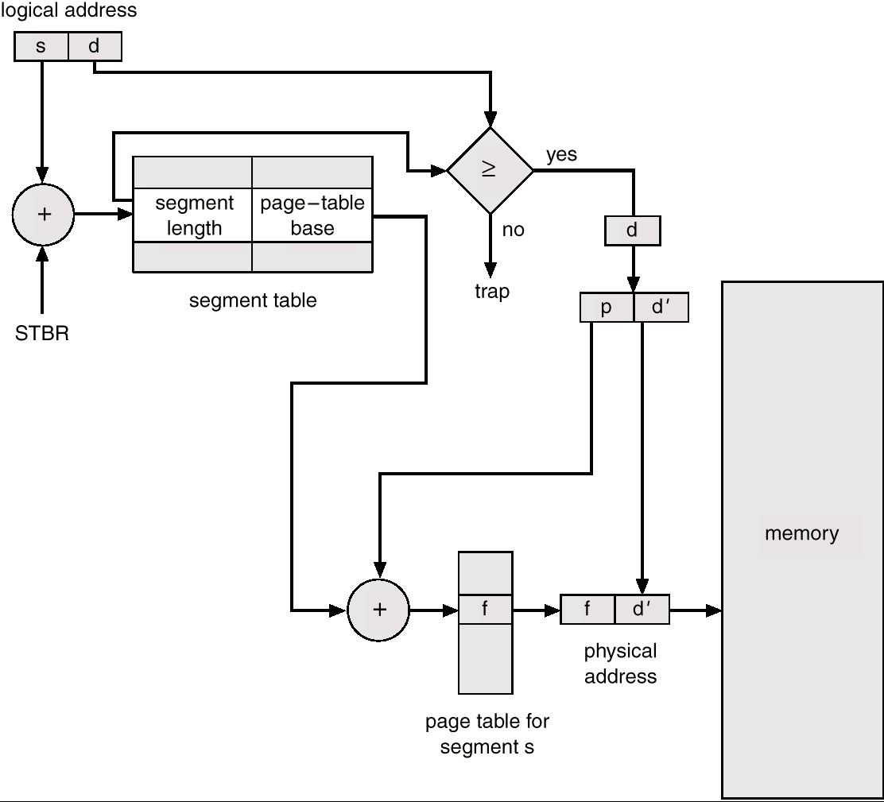
Paged segment memory management
‹#›
Notes:
‹#›

Slide 35
Fragmentation
External Fragmentation : 在連續性配置下,所有free blocks之size皆無法滿足process大小需求,但這些free blocks size加總大於等於process size,但由於不連續,依然不能配置,形成記憶體浪費
Internal Fragmentation : 配給process之空間超過process所需,其造成的差值空間,此process用不到且其他process亦無法使用
First-fit and Best-fit 無internal fragmentation ,but external fragmentation
‹#›
Notes:
‹#›

Slide 36
Page v.s. segment
Page | Segment
各page size相同 | 各segment大小不同
無 | 有外部斷裂
有內部斷裂 | 無
Memory protection share較困難 | 較易實現
與user對memory看法不一致 | 一致
Logical address為單一量 | 兩個量(s,d)
無須check page offset<page size | 須check segment offset<segment limit
Page table只記錄frame No. | Segment table記segment之大小即起始位置

Slide 37
Ch10 Virtual Memory
Virtual memory – separation of user logical memory from physical memory.
Only part of the program needs to be in memory for execution.
Logical address space can therefore be much larger than physical address space.
Need to allow pages to be swapped in and out.
Virtual memory can be implemented via:
Demand paging
Demand segmentation
‹#›
Notes:
‹#›

Slide 38
Demand paging
以paging memory management為基礎,採lazy swapper,程序執行不需全部載入pages,而是載入所需.若試著存取不在memory的pages則page fault.需載入lost pages 使process繼續執行
‹#›
Notes:
‹#›

Slide 39
Valid-Invalid Bit
With each page table entry a valid–invalid bit is associated (1  in-memory, 0  not-in-memory)
Initially valid–invalid but is set to 0 on all entries.
Example of a page table snapshot.
During address translation, if valid–invalid bit in page table entry is 0  page fault.
Frame #
valid-invalid bit
1
1
1
1
0

0
0
page table
‹#›
Notes:
‹#›

Slide 40
Page Fault
If there is ever a reference to a page, first reference will trap to OS  page fault
OS looks at another table to decide:
Invalid reference  abort.
Just not in memory.
Get empty frame.
Swap page into frame.
Reset tables, validation bit = 1.
Restart instruction: Least Recently Used
block move auto increment/decrement location
‹#›
Notes:
‹#›

Slide 41
What happens if there is no free frame?
Page replacement – find some page in memory, but not really in use, swap it out.
algorithm
performance – want an algorithm which will result in minimum number of page faults.
Same page may be brought into memory several times.
‹#›
Notes:
‹#›

Slide 42
Page Replacement Algo.
FIFO
Belady anomaly
Page越多反而錯誤率越高？
1, 2, 3, 4, 1, 2, 5, 1, 2, 3, 4, 5
OPT
難以實做
LRU-最少被用的swap out
LRU Approximation
Reference bit
Second chance
LFU/MFU
被用到最少/多次的swap out
‹#›
Notes:
‹#›

Slide 43
Thrashing
在demanding paging, multiprogramming, global replacement policy,若process分配到的frames不足,則process會經常page fault且需page replacement,則此process可能會搶奪其他process的frames,造成其他process也page fault,同時再繼續搶其他process的frames,如此之下,所有process 都page fault及等待swap in/out.此時cpu utilization下降,multiprogramming機制試圖引入更多process但原本frames就不足,造成更多page fault.如此造成cpu utilization急速下降,paging I/O異常忙碌,花在io上比花在執行code的時間更多.
‹#›
Notes:
‹#›

Slide 44
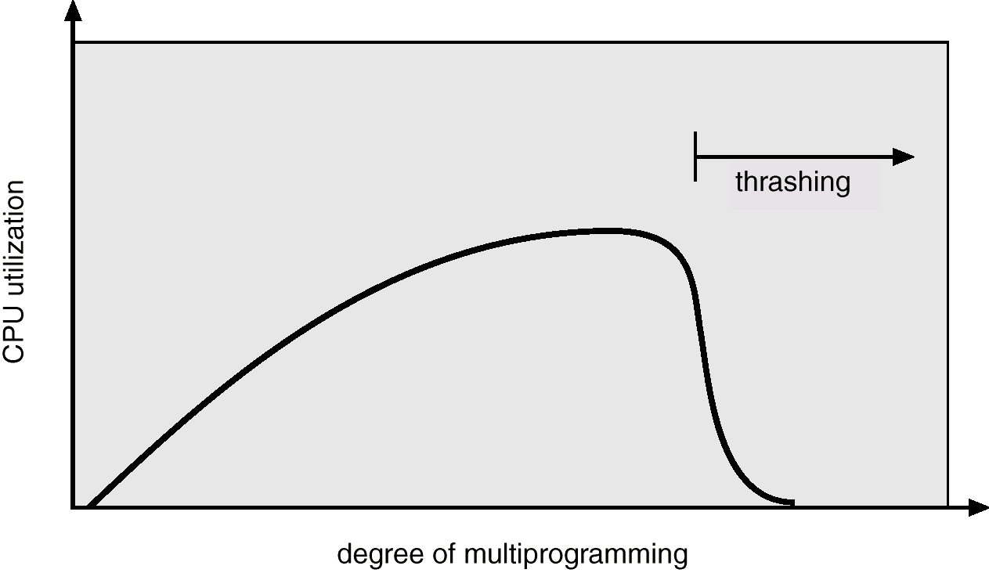
Thrashing
Solutions
Decrease multiprogramming degree
Page fault frequency bound
Working set
More practices are required
‹#›
Notes:
‹#›

Slide 45
Ch11File System
各種file operation
create
write
read
reposition within file – file seek
delete
truncate
open(F_{i}) – search the directory structure on disk for entry F_{i}, and move the content of entry to memory.
close (F_{i}) – move the content of entry F_{i} in memory to directory structure on disk.
‹#›
Notes:
‹#›

Slide 46
File Organization Method
Sequential Access File
Direct Access
Index Access File
Index Sequential Access Method
‹#›
Notes:
‹#›

Slide 47
Directory Structure
Single-Level Directory
A single directory for all users.
Two-Level Directory
Separate directory for each user
Tree-Structured Directories
Efficient searching
Acyclic-Graph Directories刪檔案問題
檔案指標變懸置
沒被參考才可刪除

Slide 48
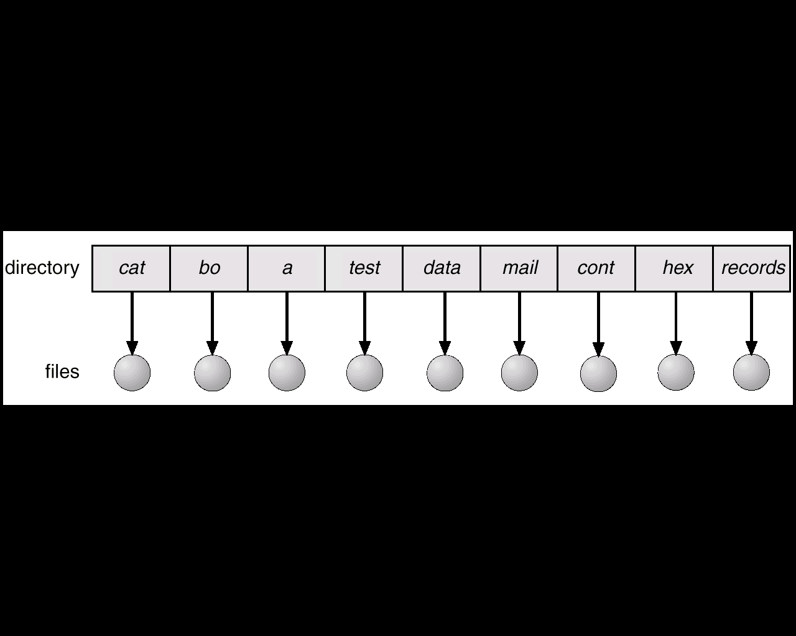
Single-Level Directory
‹#›

Slide 49
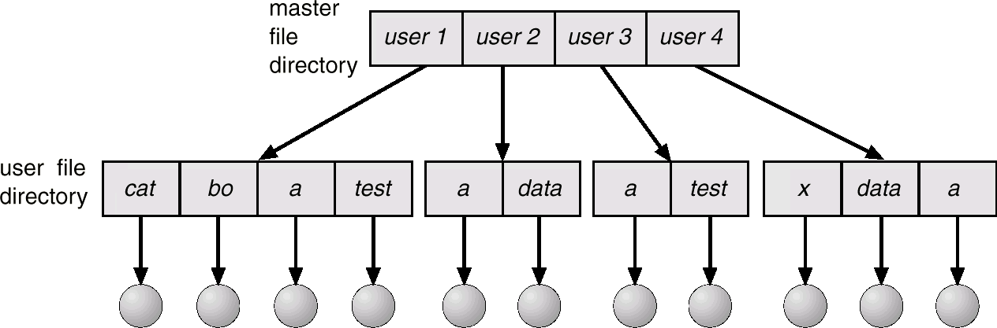
Two-Level Directory
‹#›

Slide 50
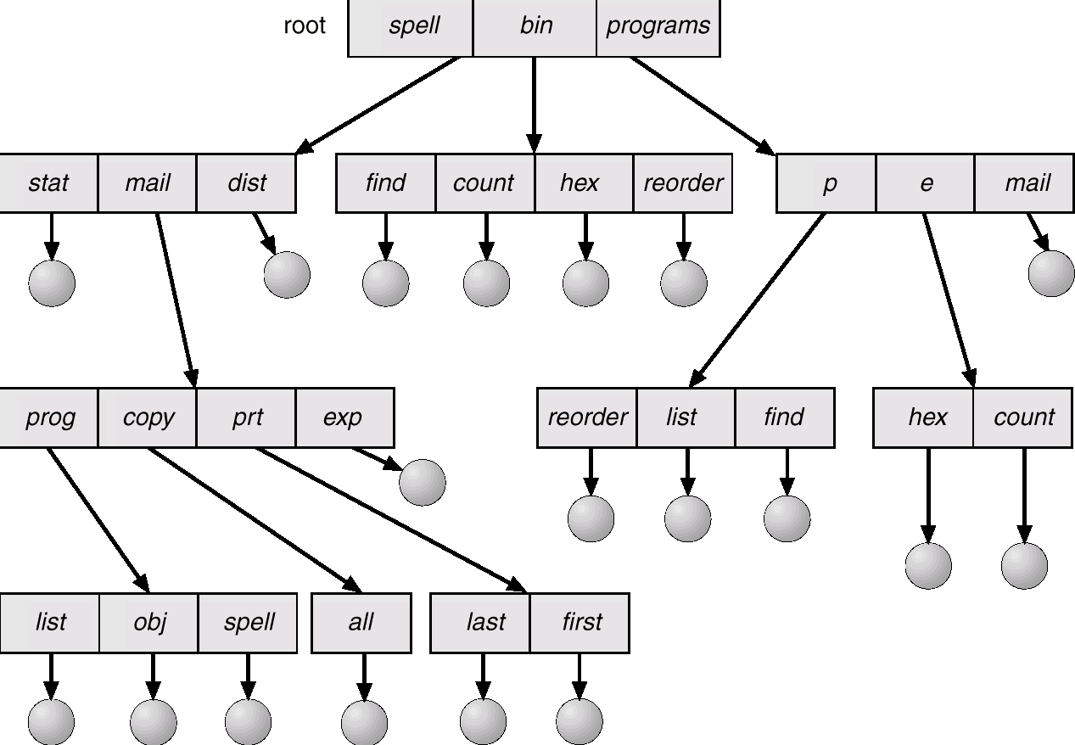
Tree-Structured Directories
‹#›

Slide 51
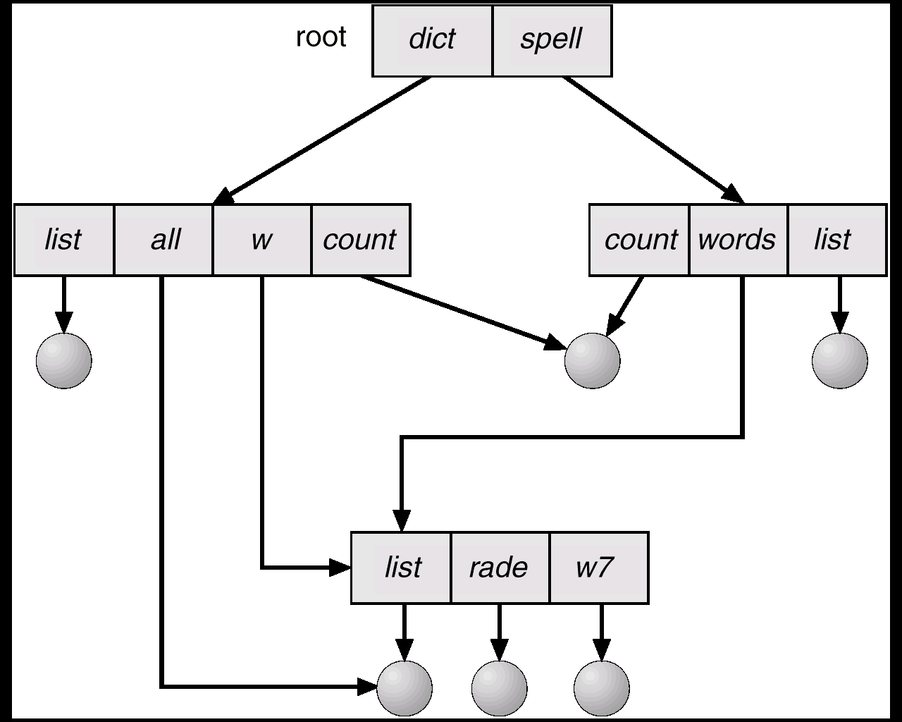
Acyclic-Graph Directories
‹#›

Slide 52
File-System Structure
Contiguous Allocation
優點：avg seek time較短、支援random access以及sequential access
缺點：浪費空間、檔案大小無法擴充
Linked Allocation
優點：省空間、檔案大小可擴充
缺點： avg seek time較長，不支援random access
Indexed Allocation (NTFS)
優點：不浪費空間、檔案大小可擴充，支援random access
缺點：需額外 index table，檔案太大時單一index能無法容納所有block

Slide 53
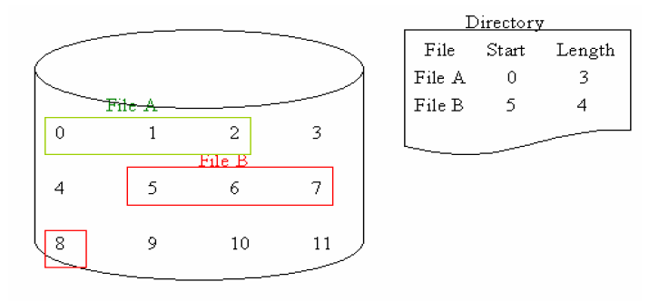
Contiguous Allocation
‹#›

Slide 54
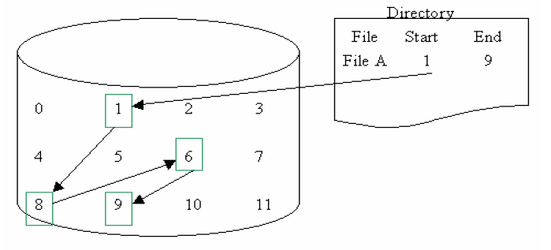
Linked Allocation
‹#›

Slide 55
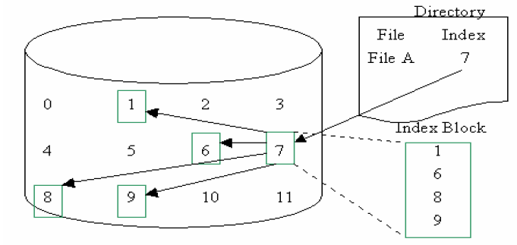
Indexed Allocation
‹#›

Slide 56
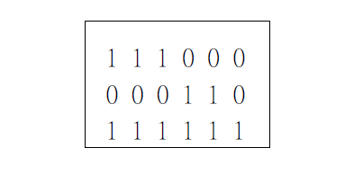
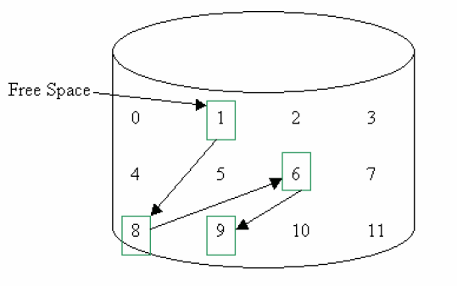
Free-Space Management
Bit vector
優點：易實做、容易找到可用區塊
缺點：不適用於大型disk system
Linked list
優點：不浪費空間
缺點：不容易找到可用區塊
Grouping
Counting

Slide 57
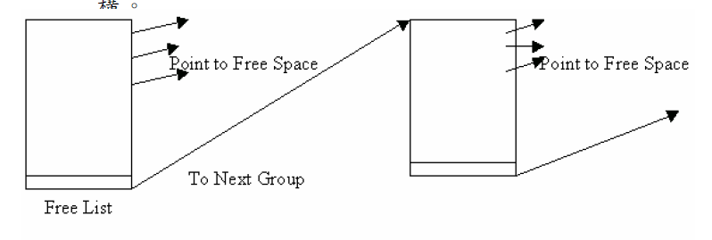
Grouping
‹#›

Slide 58
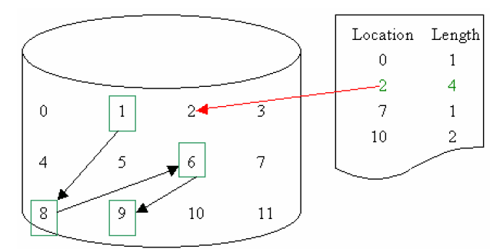
Counting
‹#›

Slide 59
Ch12 I/O
Polling
Busy-wait cycle to wait for I/O from device
Interrupts
CPU Interrupt request line triggered by I/O device
Interrupt handler receives interrupts
Direct Memory Access
‹#›
Notes:
‹#›

Slide 60
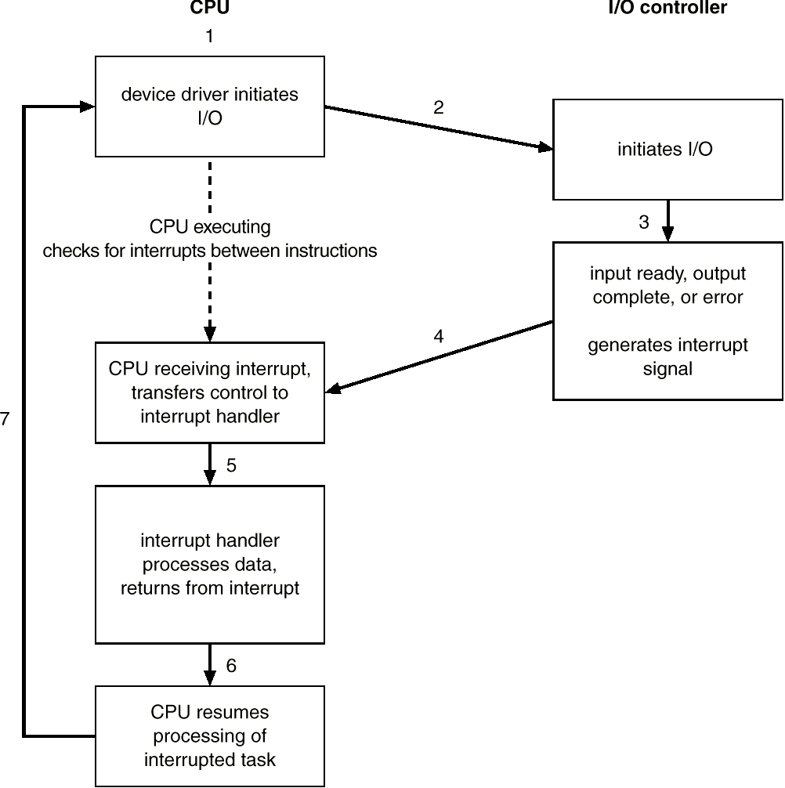
Interrupt
‹#›
Notes:
‹#›

Slide 61
Kernel I/O Subsystem
Buffering
store data in memory while transferring between devices
Spooling
利用disk作為急大的緩衝區在使用，CPU將output以file形式送往disk spooling area後，即認為工作結束。而output device此時或稍後可自spooling area取出file進行I/O operation，如printer

Slide 62
Ch13 Disk management
Disk access time
Seek time (bottle neck)
將磁頭移到指定的track上方所花的時間
Latency
將sector轉到磁頭下方所花的時間
Transfer time
Data在disk與memory之間的傳輸時間
Swap-space
Virtual memory uses disk space as an extension of main memory.
‹#›
Notes:
‹#›

Slide 63
Disk scheduling Algo.
FCFS
越早到達的track request優先服務
SSTF
距離目前讀寫頭位置最近的track request優先服務

Slide 64
Disk scheduling Algo.(cont.)
SCAN
讀寫頭來回不斷掃描，遇有請求即刻服務。而當磁頭遇track盡頭或開頭才折返
C-SCAN
與SCAN類似，差別在於只提供單方向的服務，回程不做任何服務
Look
類似SCAN，差別在於服務完後該方向之最後一個track請求後，即刻折返提供服務，無須到盡頭/開端才折返
C-Look
與Look類似，差別在於只提供單方向的服務，回程不做任何服務

Slide 65
名詞解釋
Deadlock
The waiting processes will never again change state, because the resources they have requested are held by other waiting processes.
Rollback
An aborted transaction must restored to what it was just before the transaction started execution.
‹#›

Slide 66
名詞解釋
Fragmentation Problem
Total free memory is fragmented into small pieces, but it is not contiguous to satisfy a memory request.
External Fragmentation
When enough total memory space exists to satisfy a request, but it is not contiguous, storage is fragmented into a large number of small holes
Internal Fragmentation
Memory that is internal to a partition, but is not being used
Virtual Memory
Virtual memory is a technique that allow the execution of processes that may not be completely in memory. Program can be larger than main memory
‹#›

Slide 67
名詞解釋
Page Fault
There is a page reference for which the page needed is not in main memory.
Page Replacement
當主記憶體內所有頁框均有程式或資料使用時，若有某一頁需載入主記憶體頁框內，此時必須在主記憶體內找 到一個犧牲者，將此被犧牲的頁由頁框內作頁置換出 （Page Out），然後將欲載入主記憶體的頁，作頁置換 入（Page In），以便佔有這個頁框。這就是頁置換 （Page Replacement）。
Belady's Anomaly
增加頁框數，反而造成更多的頁錯誤及頁置換。
畢雷笛反例僅是少數特例。
使用先進先出頁置換法並不是增加頁框數目，就一定能減少頁錯誤發生。
‹#›

Slide 68
名詞解釋
Thrashing
Replace a page that will be needed again right away. Consequently, it very quickly faults again, and again, and again, this very high paging activity is called thrashing
Working Set
A Collection of pages a process is actively referencing.
Spooling
利用disk作為急大的緩衝區在使用，CPU將output以file形式送往disk spooling area後，即認為工作結束。而output device此時或稍後可自spooling area取出file進行I/O operation，如printer
‹#›

