Slide 1
Examples of GL

Slide 2
Deepfake detection
DeepfakeHop++ V.S. CNNs (on 2nd Gen.)
DeepfakeHop++ V.S. MobileNet v3 (on 3rd Gen.)
Blind image/video quality assessment (NR data)
GreenBIQA wins conventional BIQA in all 4 datasets
Wins 2DL methods without pre-training in authentic-distortion datasets
Has performance gap between pre-trained models.
Point clouds registration
R-PointHop
Learns representations in an unsupervised manner for point correspondence
Uses the correspondences to find 3d transformations for registration.
Performance: bigger size -> better performance

Slide 3
Graph node classification
Semi-supervised learning (graph learning problems)
Challenges for Graph Convolutional Networks (GCN):
Needs sufficient number of labeled samples
2. Consist of 2 convolutional layers -> neighboring nodes being exploit, ignoring correlations from nodes of longer distance.
GraphHop++ outperformed GCN-based methods
At extremely low label rates in particular
Knowledge graph completion
To discover missing relationships between entities in knowledge graph
Modules of GreenKGC: (1) representation learning, (2) feature pruning, and (3) decision learning.
GreenKGC can achieve comparable or even better performance with around 4 times smaller model size.

Slide 4
Future Outlook of GL

Slide 5
Robustness
To attack a GL system, one needs to modify its representation, the feature learner (i.e., DFT) or the classifier.
For adversarial attack: GL systems adopt signal transforms to reduce representation’s dimension; small perturbations to the input obtained by adversarial attacks to DL systems are filtered out.
Furthermore, the ensemble learning technique can be leveraged by GL to enhance its accuracy since each individual GL decision is lightweight.
The latter two are related to statistics of training data. They cannot be controlled by a single input.
Trust and risk assessment
Since GL is rooted in both statistics and optimization, it offers probabilistic models with performance guarantees, which also enable risk assessment.
The risks of GL: (1) sampling bias and fairness (2) labeling errors (3) analysis errors.

Slide 6
Conclusion

Slide 7
Modularized, efficiency, logical transparency
FF-CNN: derives network parameters of the current layer based on data statistics from the output of the previous layer in a one-pass feedforward manner.
Filter weights in the convolutional layers are conveniently computed through the Saab and c/w Saab transforms without any labels.
Filter weights in the FC layers are calculated with labels or pseudo-labels based on linear least squared regression.
Ensemble learning is incorporated in the FF design to reduce the performance gap between FF-CNN and the classical BP-CNN.
Discriminant and relevant feature selection tools, new classifiers/regressors that leverage both feature and decision fusions

Slide 8
On Supervised Feature Selection From High Dimentional Feature Spaces

Slide 9
Discriminant feature test (DFT)
For classification problems
DFT is used to measure the discriminant power of each feature dimension out of a P-dimensional feature space independently.
In our design, we use the weighted entropy of the left and right subsets as the DFT loss to measure the discriminant power of each dimension.
Because the weighted entropy considers the probability distribution of all classes.
Steps:
Training Sample Partitioning
DFT Loss Measured by Entropy
Feature Selection Based on Optimized Loss

Slide 10


Training Sample Partitioning
Find the optimal threshold to partition the samples into two intervals

Slide 11


DFT Loss Measured by Weighted Entropy
Calculate weighted entropy of the left and right subintervals

Slide 12

Feature Selection Based on Optimized Loss
Partitions with the smallest entropy value represent better separation of the classes, that is , most discriminant features.

Slide 13
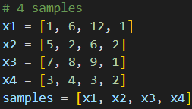
Example
Consider sample space with 4 samples, each sample contains 3 dimensions of features and 1 class labels.

Slide 14
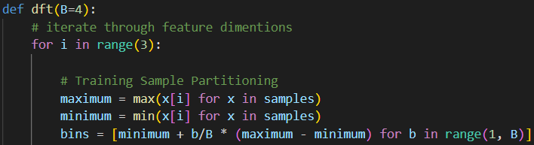
Example
Firstly, we iterate through all feature spaces. Then we partition the feature space into 4 subintervals, which yields 3 bin boundaries for partitioning.

Slide 15
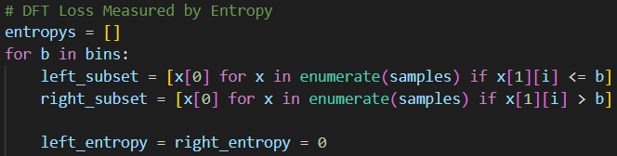
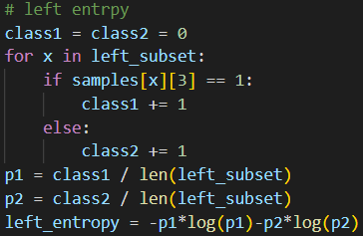
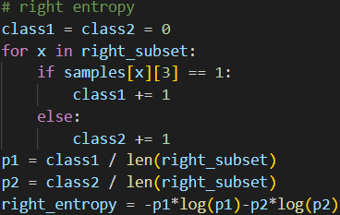
Example
We then iterate through every bins and calculate the entropy values of the left and right subintervals.

Slide 16

Example
Lastly, we calculate the weighted sum of the left and right subintervals’ entropy value. Then we choose the minimums of the entropy values we get from all bins for all features.
That says the second and the third features are the most discriminant features for they give us minimal entropy values.

