Slide 1
PixelHop
An object classification model

Slide 2
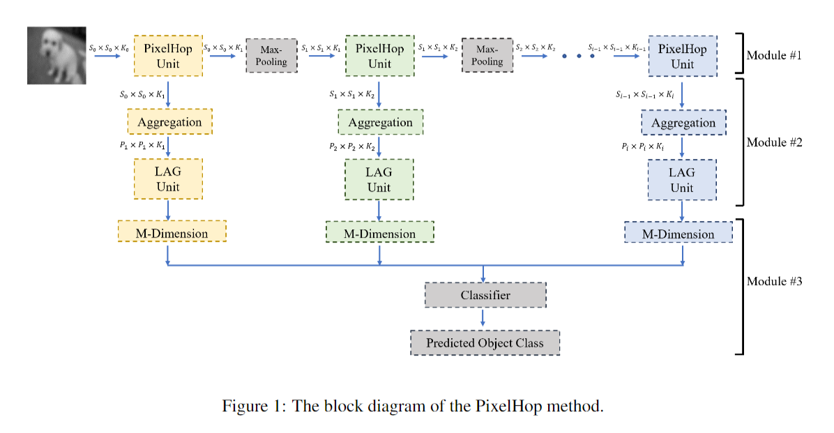
Overview
i is usually set to 8

Slide 3
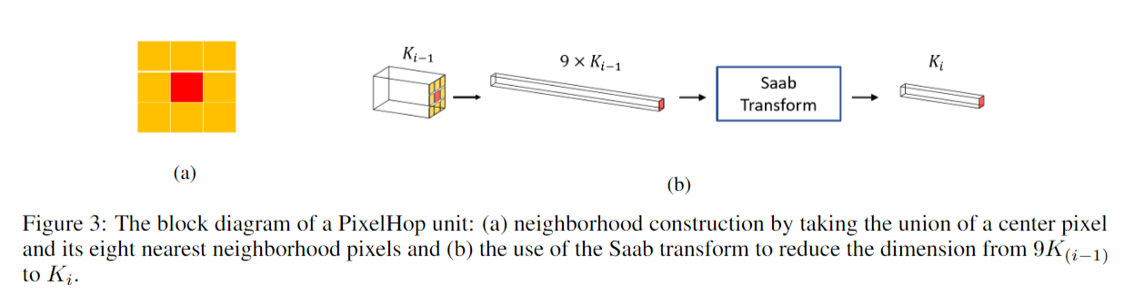
PixelHop unit
Concatenate attributes of the neighborhoods
Apply saab transform
Maximum pooling

Slide 4
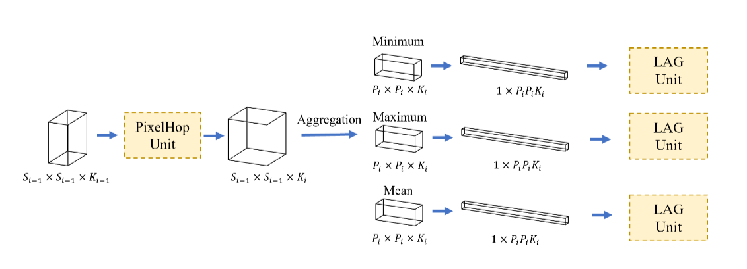
Aggregation and LAG
Take maximum, minimum, and mean
Apply Label-Assisted Regression (LAG)
The size of aggregation Pi is a hyper-parameter

Slide 5
Classification using SVM
Get M features from I pixelhop units
Use Support Vector Machine classifier
The kernel is radial basis function (RBF)

