Slide 1
Assembly Language and System Programming – Lab8(Week10)
2022/11/14

Slide 2
Target
Target：Find the largest number in the array.
Task：Add a Procedure(FindLargest) to your program, pass two parameters after calling FindLargest.：
1. aPtr -> Points to the incoming Array
2. arraySize -> The size of the array
Find the largest number in the array and save the result to register eax.

Slide 3
Program Architecture
.stack 4096
_______ PROTO _____ , _______ ; Declare the prototype of FindLargest
.data Ex1Array sdword 105522063 , ___________ , ___________
;The array initialized with 105522063, Student ID-1, Student ID-2
Ex2Array sdword -105522063 , ___________ , ____________
; The array initialized with -105522063, Negative Student ID-1, Negative Student ID-2
.code
main proc
_____ FindLargest, _____ Ex1Array, _________ Ex1Array
_____ FindLargest, _____ Ex2Array, _________ Ex2Array
call WaitMsg
invoke ExitProcess,0
main endp
end main

Slide 4
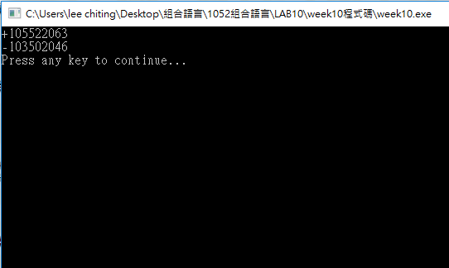
Result

Slide 5
Report
Deadline : 2022/11/15(Tue.)Before 12:00 P.M. (EEClass)
Each group only needs to submit one report
Pack the following files and compress into .zip file.
Code (lab8_groupX.asm)
Report (lab8_groupX.doc or lab8_ groupX.pdf)
Title
Group、StudentID、Name
Screenshots of Result and Code + Explanation
The report has to clearly explain how the program works.
Thoughts about the lab.
Please must be aware of the file name.

Slide 6
Contact Info：
Jeffrey’s Email: jeffrey890705@gmail.com
Jim’s Email: kg128888@gmail.com

