Slide 1
Lex

Slide 2
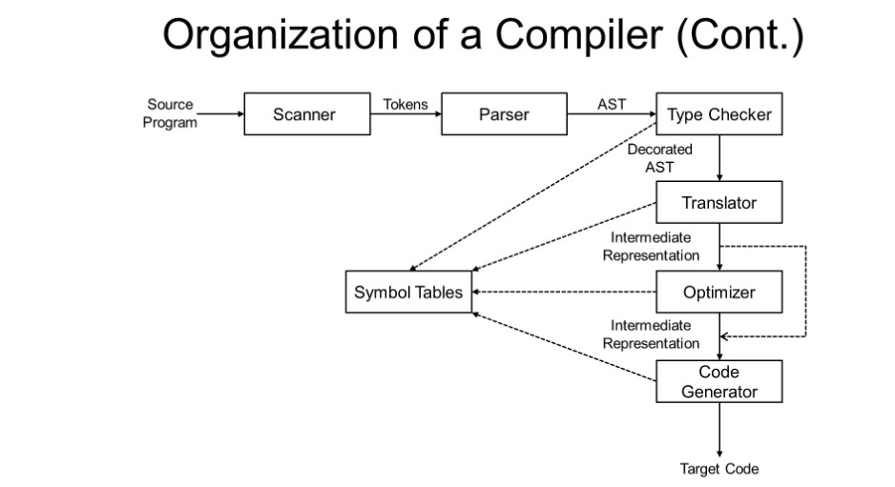
What is Lex
可理解為Compile中的Scanner

Slide 3
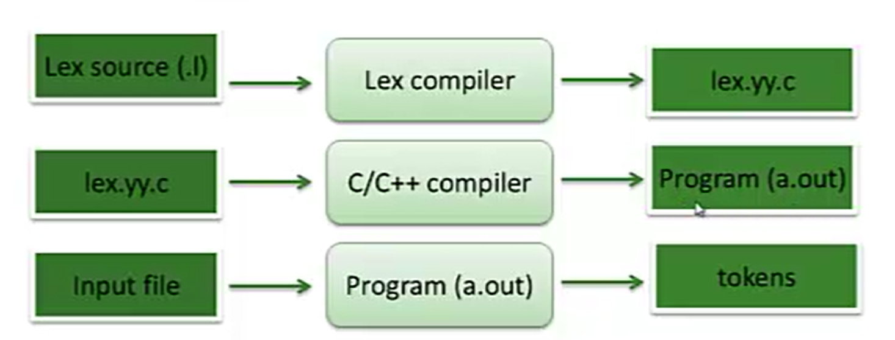
What is Lex
A lexical analyzer generator
  Read characters and translate to token
  Read rules from a specification file (*.l file)
  Generate the lexical analyzer in C language

Slide 4
How to Write
The structure of a lex program – three sections
  Definition section: any initial C/C++ codes or lex definitions
  Rules section: pattern + action, separated by whitespaces
  Subroutine section: any legal C or C++ codes
Two sections are separated by a “%%” line
… Definition Section …
%%
… Rules Section …
%%
… Subroutine Section …

Slide 5
Example Lex Code
/***定義區塊***/
digit [0-9]
%option noyywrap /*告訴flex指讀取輸入檔案*/
%%
/***規則區塊***/
{digit} { ECHO; printf(“ is digit.\n”); } /*ECHO為符合字串本身*/
%%
/***c程式碼區塊***/
int main(int argc, char *argv[]) {
yylex(); /*呼叫lexer，也就是rule區塊，結束回傳token*/
return(0);
}

Slide 6
The Definition Section
Define C/C++ codes and Abbreviations
Initial C or C++ codes enclosed with %{ and %}
%{
unsigned int charCount=0, wordCount=0, lineCount=0;
%}
digit [0-9]+
word [^ \t\n]+
eol \n
%%
…
%%
…
}
Lex definitions :
Token name and corresponding REs that separated by whitespaces

Slide 7
The Rules Section
The rules used by yylex() function
Action:
C/C++ statement or lex macro
Separated by whitespaces
…
%%
{word} { wordCount++; charCount += yyleng; }
{eol} { charCount++; lineCount++; }
. charCount++;
%%
…
Pattern:
Can be a token or RE
Predefine token enclosed with { and }

Slide 8
The Rule Section (Cont’d)
If C/C++ codes are more than one statements or span multiple lines, it can be enclosed in braces { }.
  .|\n printf(“rule1”); char_count++;
  .|\n { printf(“rule1”); char_count++; }
If a pattern matches, the associated actions are executed
Same

Slide 9

How to Compile
Compile and Run the Program
How to compile?
Run the program

Slide 10
Lex Matching Pattern – REs
RE | Purpose
. | Matches any single character except \n.
* | Matches zero or more occurrence of the preceding RE. Bo* -> B, Bo
+ | Matches one or more occurrence of the preceding RE Bo+ -> Bo, Boo, Booo
? | Matches zero or one occurrence of the preceding RE Bo? -> B, Bo
[] | Matches a character listed in brackets. If the first character is a circumflex (^), it inverses the meaning to match a not listed character. This is also called a character class. [abc] -> a, b, c [_a-z] -> a, b, …, z [^abc] -> 非a, b, c
^ | Matches the beginning of a line
$ | Matches the end of a line

Slide 11
Lex Matching Pattern – REs (Cont’d)
RE | Purpose
| | Matches either the preceding RE or the following RE a|b -> a, b (a|b is equal to [ab])
\ | The escape character. \. -> .
{} | Indicate how many times the preceding pattern is allowed to match. {times-lower-bound[,times-upper-bound]} ok{2} -> okok ok{2,} -> okokok ok{2,3} -> okokok
“…” | Interprets everything within the quotation marks literally “int” -> int
() | Group a series of REs together into a new RE (abc|ABC) -> abc, ABC (abc|ABC) + -> abcABCabc

Slide 12
作業HINT
digits [0-9]+ , {digit}+
integer [+-]?{digits}
letter [a-zA-Z_]
date [0-9]{4} \/[01][0-9]\/[0-3][0-9]

Slide 13
Common Lex Macros
ECHO
  It is equivalent to printf(“%s”, yytext)
  An example: ECHO;

Slide 14
命令列參數
http://gitqwerty777.github.io/gcc-usage/

