Slide 1
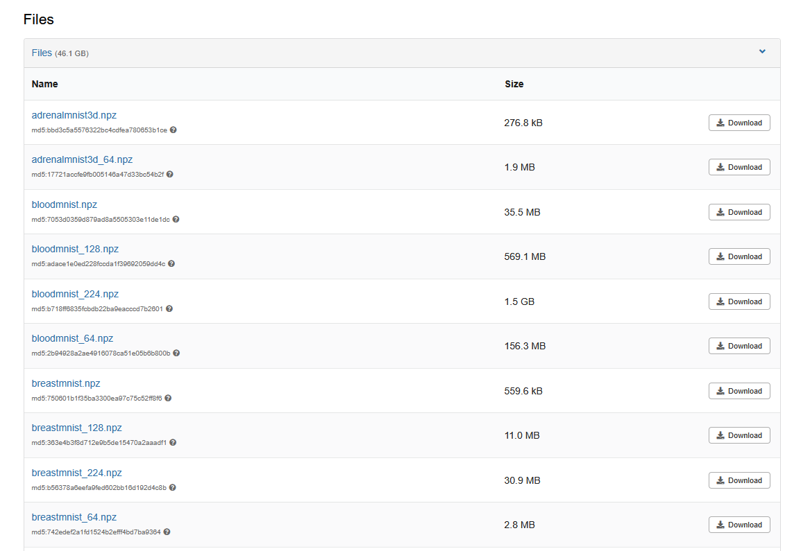
Homework -1
Create a NN for the Blood MNIST.
https://zenodo.org/records/10519652

Slide 2
Homework -1
Requirement: model size must smaller than 2MB. (.pth)
Due date: 9/30 (23:59:59)
Submit four files:
  1. weight.pth the trained parameters only
  2. model.py the network definition (name the class “Model”), plus MEAN / STD if you trained with normalization
  3. confusion_matrix.png, loss_graph.png
Upload to the Moodle system.
Don’t be late.

Slide 3
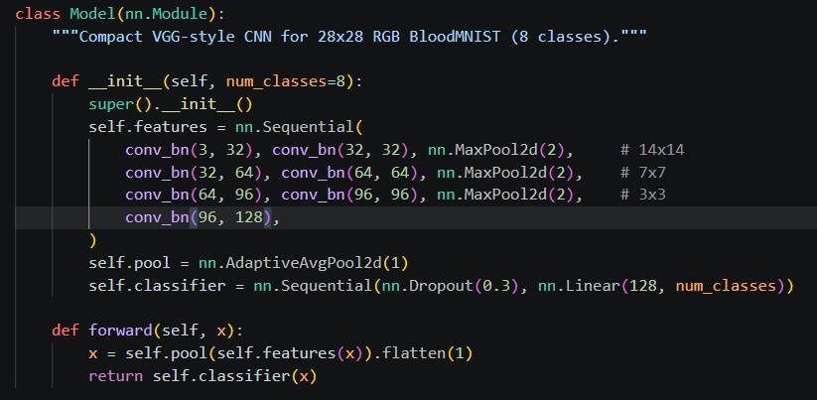
Homework -1

Slide 4
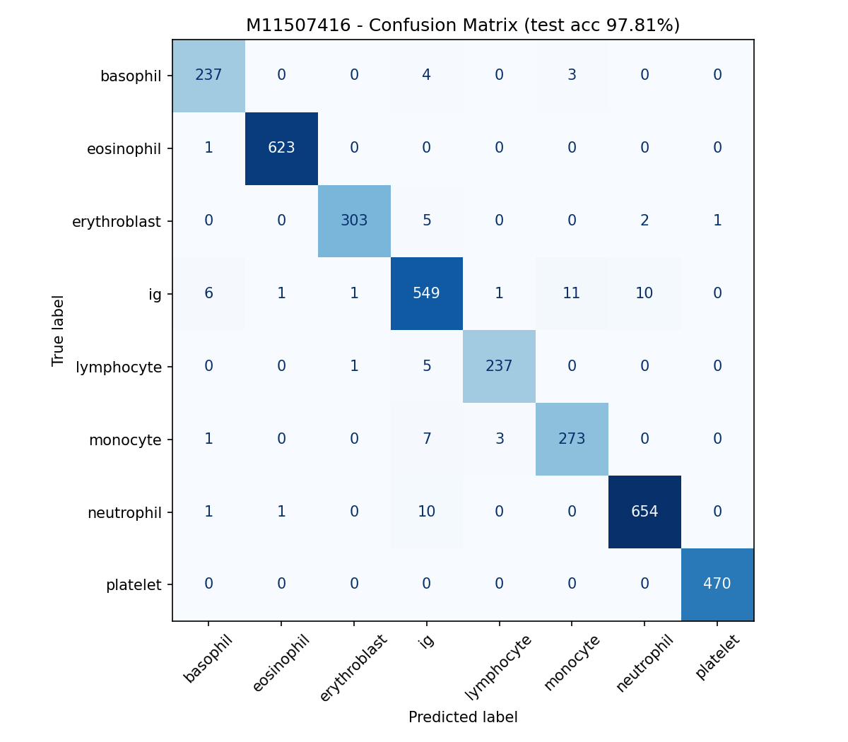
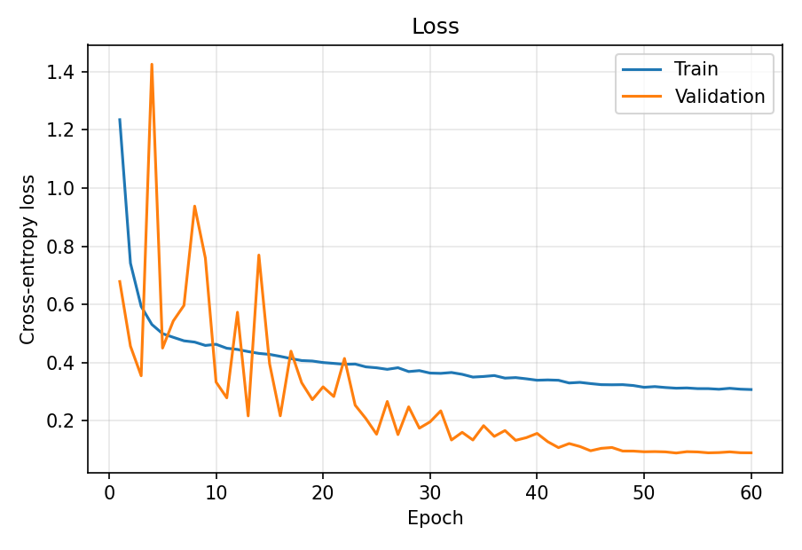
Homework -1

Slide 5
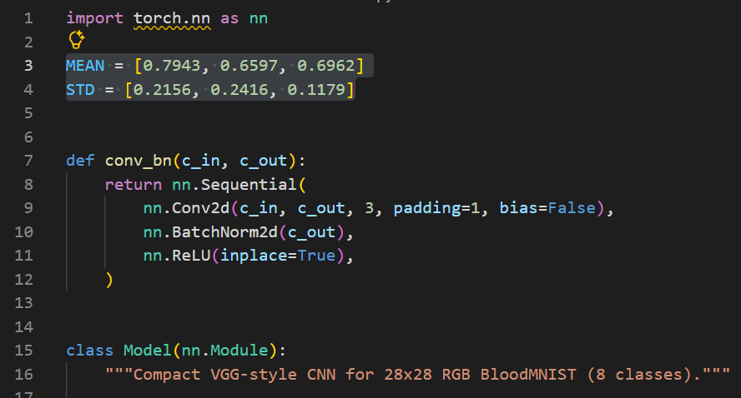
Homework -1
The test patterns may be flipped or rotate.
The model must be able to run in test.py.
If the model was trained with normalization, model.py must define the MEAN and STD constants at module level, as shown below. Otherwise, test.py falls back to the default MEAN = [0, 0, 0] and STD = [1, 1, 1], which means the input images are only scaled to [0, 1] (divided by 255) without further normalization.

Slide 6
Homework -1 - Grading
The submission must contain a confusion matrix and a loss graph.
More than 2MB will be minus 30 points for this HW.
Incorrect submission formats will be minus 30 points for this HW1.
Grade = (Accuracy × 0.9) + (Pictures × 0.1).

Slide 7
Homework -1 – Submit format
Example:
M11XXXXXX.zip
├── weight.pth
├── model.py
├── confusion_matrix.png
└── loss_graph.png

