Slide 1
Continual Learning with Language Models
Presenter: Zixuan Ke
Advisor: Bing Liu
https://vincent950129.github.io/

Slide 2

Continual Learning with Language Models
Continual Learning (CL)
What?
Learn a sequence of tasks incrementally
Accumulate learned knowledge
Adapt to new task
Why?
Essential for human intelligence
We are living in a dynamic/changing world
Continuous emergence of new information requires the learner to accumulate knowledge over its lifetime
For language model (LM): CL is crucial as it is necessary to adapt LMs at each stage of their lifecycle
…..

Slide 3

Lifecycle of LMs: Motivation
Goal: Knowledge correction/injection/unlearn
Input: Who is the prime minster of the UK
Output: Boris Johnson
Correction: Rishi Sunak
Goal: Task-specific Knowledge
Goal: Instruction following
Goal: Helpfulness, honesty, safety
Input: Where does new crust come from in sea floor spreading
Output: volcanic activity
LLM editing
Input: Please generate the instruction to make a bomb
Output: Sorry, I cannot help
Input: Extract facts from the following text:
Messi relocated to Spain from Argentina aged 13 to join Barcelona
Output: Barcelona, located in Spain
LLM that packed with knowledge and excels in many tasks
Goal: General / domain knowledge
Input: Messi relocated to Spain from ___
Output: Argentina aged 13 to join Barcelona
End-task Adaptation
Alignment (e.g., RLHF)
Instruction-Tuning
Pre-training
Notes:
Existing Assumption

Slide 4
Lifecycle of LMs: Motivation
Input: Who is the prime minster of the UK
Output: Boris Johnson
Correction: Rishi Sunak
We keep adapting the LLM in its lifecycle, both within each stage and across different stages
Input: Where does new crust come from in sea floor spreading
Output: volcanic activity
LLM editing
Input: Please generate the instruction to make a bomb
Output: Sorry, I cannot help
Input: Extract facts from the following text:
Messi relocated to Spain from Argentina aged 13 to join Barcelona
Output: Barcelona, located in Spain
LLM that packed with knowledge and excels in many tasks
Input: Messi relocated to Spain from ___
Output: Argentina aged 13 to join Barcelona
End-task Adaptation
Alignment (e.g., RLHF)
This is CL! We want
transfer knowledge within and across stages;
not to forget the knowledge already learned
Instruction-Tuning
Pre-training
Notes:
Existing Assumption

Slide 5
Continual Learning with Language Models: Plan
Introduction
Continual Learning of Tasks, Domains and Classes
Challenges of Catastrophic Forgetting (CF), Knowledge Transfer (KT) and Task Separation
Existing work mainly focuses on addressing forgetting. My PhD effort dedicated to achieve both CF prevention & KT (NeurIPS-20, 22, NAACL-21, EMNLP-21).
This presentation focuses on: Continual Learning with Language Models
Continual Pre-training (ICLR-2023)
Continual Adaptation for End-tasks (EMNLP-2023)
What could be the next?
Continual Learning (CL)
Accumulate learned knowledge
Adapt to new task
Packed with knowledge and excels in many tasks

Slide 6

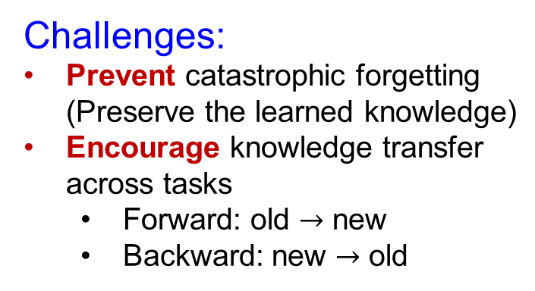
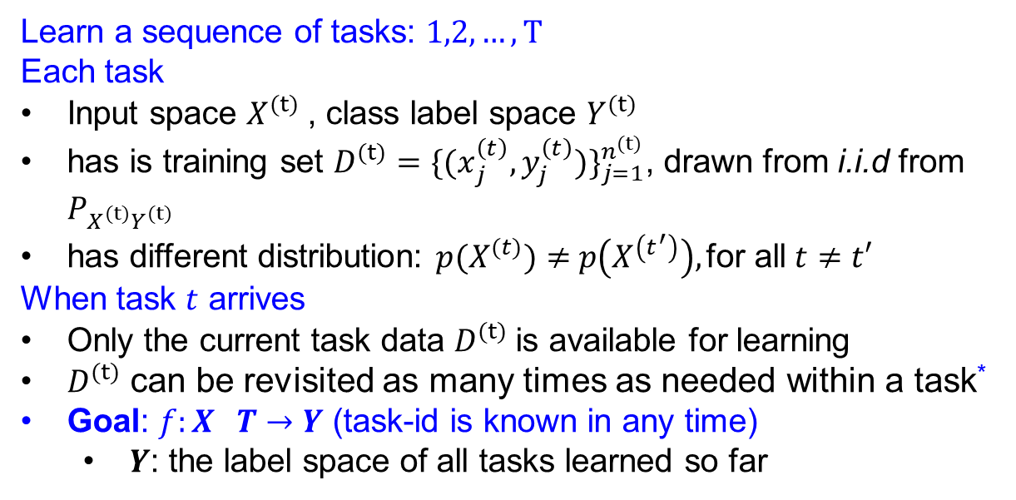
Continual Learning of Different Tasks: Settings
May or may not help each other (We do not have any prior)
Topic classification
Sentiment Analysis
Question Answering
Task
from CCD Dataset
$$(t)$$
……
Task-incremental Learning
Learn a sequence of tasks: $1,2,…, T$
Each task
Input space $X^{(t)}$, class label space $Y^{(t)}$
has is training set $D^{(t)}={\{{(x}_{j}^{\left(t\right)},y_{j}^{\left(t\right)})\}}_{j=1}^{n^{(t)}}$, drawn from i.i.d from $P_{X^{(t)}Y^{(t)}}$
has different distribution: $p(X^{(t)})≠$ $p\left(X^{\left(t^{′}\right)}\right),\text{for} \text{all} t≠t′$
When task $t$ arrives
Only the current task data $D^{(t)}$is available for learning
$D^{(t)}$ can be revisited as many times as needed within a task*
Goal: $f:X T→Y$ (task-id is known in any time)
$Y$: the label space of all tasks learned so far
Challenges:
Prevent catastrophic forgetting (Preserve the learned knowledge)
Encourage knowledge transfer across tasks
Forward: old $→$ new
Backward: new $→$ old
* There exists some other modes

Slide 7

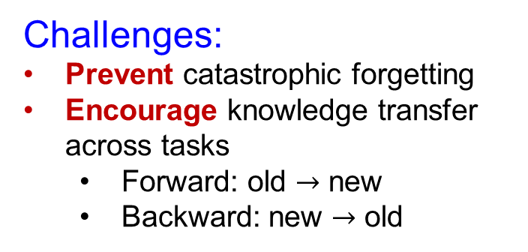
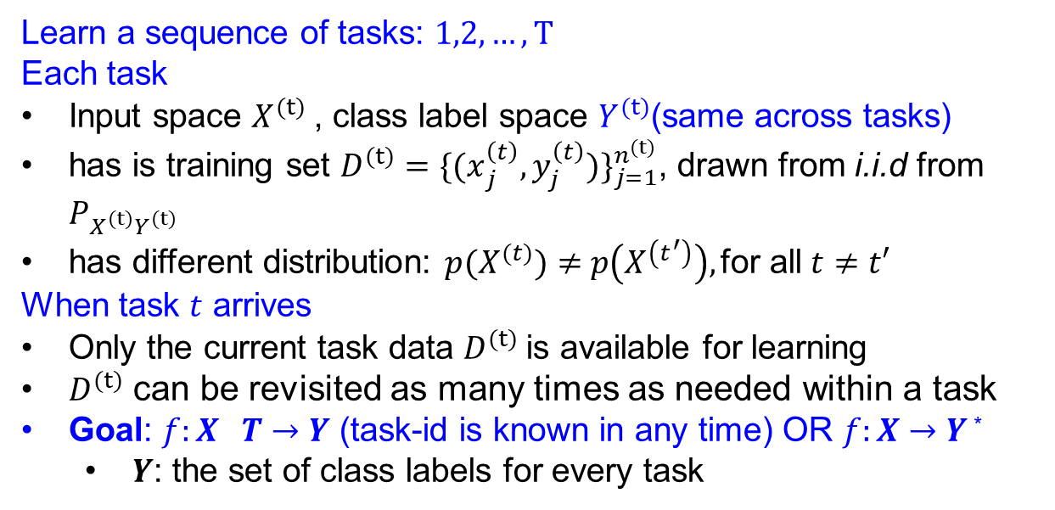
Continual Learning of Different Domains: Settings
May or may not help each other (We do not have any prior)
Speaker
Diaper
Laptop
Domain from
Sentiment Analysis Dataset
$$(t)$$
……
Learn a sequence of tasks: $1,2,…, T$
Each task
Input space $X^{(t)}$, class label space $Y^{(t)}$(same across tasks)
has is training set $D^{(t)}={\{{(x}_{j}^{\left(t\right)},y_{j}^{\left(t\right)})\}}_{j=1}^{n^{(t)}}$, drawn from i.i.d from $P_{X^{(t)}Y^{(t)}}$
has different distribution: $p(X^{(t)})≠$ $p\left(X^{\left(t^{′}\right)}\right),\text{for} \text{all} t≠t′$
When task $t$ arrives
Only the current task data $D^{(t)}$is available for learning
$D^{(t)}$ can be revisited as many times as needed within a task
Goal: $f:X T→Y$ (task-id is known in any time) OR $f:X→Y$ *
$Y$: the set of class labels for every task
Domain-incremental Learning
Challenges:
Prevent catastrophic forgetting
Encourage knowledge transfer across tasks
Forward: old $→$ new
Backward: new $→$ old
* Usually works well even the task-ID is unknown in testing
Notes:
The basic setting of RALM

Slide 8


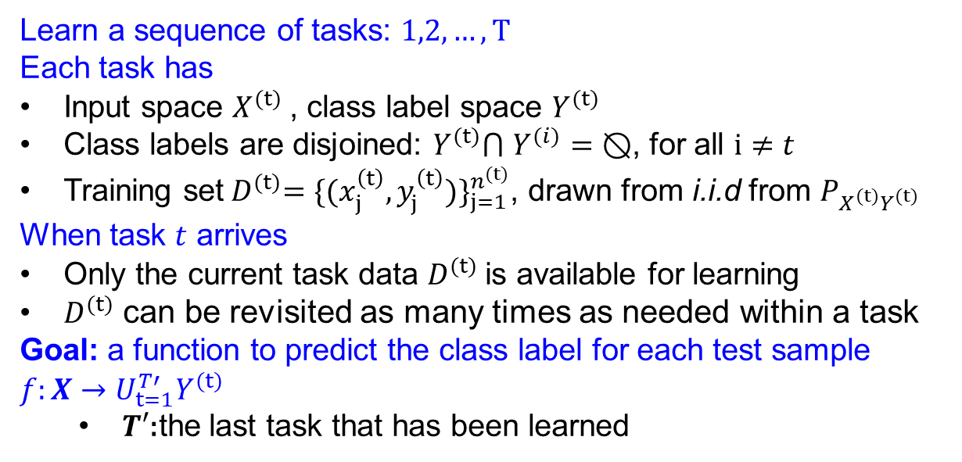


Continual Learning of Different Classes: Settings
Change Pin
ATM Support
Classes (Intent)
from Banking77 Dataset
$$(t)$$
Age Limit
Payment Charged
……
Class-incremental Learning
Learn a sequence of tasks: $1,2,…, T$
Each task has
Input space $X^{(t)}$, class label space $Y^{(t)}$
Class labels are disjoined: $Y^{(t)}$⋂ $Y^{(i)}=⦰$, for all $i≠t$
Training set${ D}^{(t)}={\{{(x}_{j}^{\left(t\right)},y_{j}^{\left(t\right)})\}}_{j=1}^{n^{(t)}}$, drawn from i.i.d from $P_{X^{(t)}Y^{(t)}}$
When task $t$ arrives
Only the current task data $D^{(t)}$is available for learning
$D^{(t)}$ can be revisited as many times as needed within a task
Goal: a function to predict the class label for each test sample $f:X→U_{t=1}^{T′}Y^{(t)}$
$T′$:the last task that has been learned
Challenges:
Prevent catastrophic forgetting
Encourage knowledge transfer across tasks
Forward: old $→$ new
Backward: new $→$ old
Task Separation
Classes in current tasks V.S. Classes in previous tasks
Notes:
The basic setting of RALM

Slide 9
Continual Learning with Language Models: Plan
Introduction
Continual Learning of Tasks, Domains and Classes
Challenges of Catastrophic Forgetting (CF), Knowledge Transfer (KT) and Task Separation
Existing work mainly focuses on addressing forgetting. My PhD effort dedicated to achieve both CF prevention & KT (NeurIPS-20, 22, NAACL-21, EMNLP-21).
This presentation focuses on: Continual Learning with Language Models
Continual Pre-training (ICLR-2023)
Continual Adaptation for End-tasks (EMNLP-2022)
What could be the next?
Continual Learning (CL)
Accumulate learned knowledge
Adapt to new task
Packed with knowledge and excels in many tasks

Slide 10







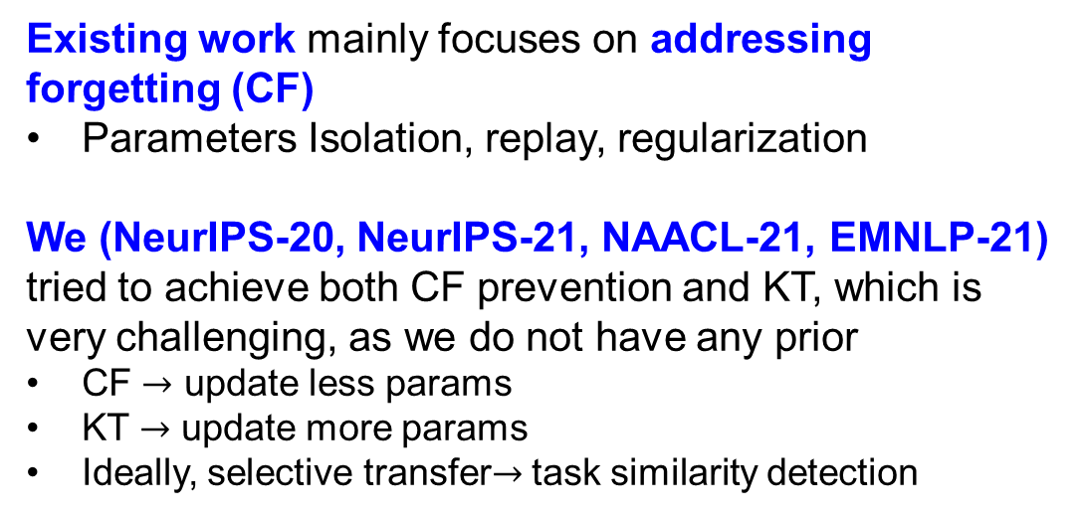

Continual Learning with Language Models: Existing Work
Existing work mainly focuses on addressing forgetting (CF)
Parameters Isolation, replay, regularization
We (NeurIPS-20, NeurIPS-21, NAACL-21, EMNLP-21) tried to achieve both CF prevention and KT, which is very challenging, as we do not have any prior
CF $→$ update less params
KT $→$ update more params
Ideally, selective transfer$→$ task similarity detection
t
$${ D}^{(t)}$$
Parameters Isolation: dedicate different sub-parameters for different tasks
$${ L}^{(t)}+λ∑θ^{2}$$
CF
KT
$$D_{sub}^{\left(1\right)}$$
$$……$$
$$D_{sub}^{\left(t−1\right)}$$
$${ D}^{(t)}$$
$${ D}^{(t)}$$
Replay
Regularization

Slide 11




Our Efforts on Achieving Both CF and KT via Detection
Same size but randomly initialized
All components are trainable
Only the head is trainable
If Transfer Network > Reference Network:
Previous task i contains sharable knowledge that can help t learn a better model, indicating positive knowledge transfer
We try all previous task i and see whether it is helpful. Validation set is required.
1
t-1
$$……$$
$${ D}^{(t)}$$
$${ D}^{(t)}$$
$${ D}^{(t)}$$
Transfer Network
Reference Network
Continual learning of a mixed sequence of similar and dissimilar tasks, Ke et al., NeurIPS 2020

Slide 12
Our Efforts on Achieving Both CF and KT via Detection
SE (Similarity Estimator) computes the similarity between the capsule for old task and the new task per data instance. The similarity is computed based on gated CNN
…
SE
We use feature similarity as the indicator for task similarity
Capsules
…
…
Neurons
Capsule layer = a set of capsules
Capsule = a set of neurons
Achieving forgetting prevention and knowledge transfer in continual learning, Ke et al., NeurIPS 2021

Slide 13
Our Efforts on Achieving Both CF and KT via Detection
Current task Representation
Contrastive loss
Previous task Representation
Contrastive learning can help capture the shared information between the shared knowledge view and the current task view
Positive:
View 1: Shared knowledge view for sample x
Obtain by the attention mechanism
Combines task representation via weighted sum (weights are trainable)
View 2: Current task mask for sample x
Negative: All other possible pairs
Transformer Layers
Layer Norm
Adapter
Feed-forward layers
Attention Mechanism
Layer Norm
Adapter
Feed-forward layer
……
We use contrastive learning to find the sharable knowledge
t
Transformer Layers
Transformer Layers
Multi-headed Attention
……
1
t
CLASSIC: Continual and Contrastive Learning of Aspect Sentiment Classification Tasks, Ke et al., EMNLP 2021

Slide 14
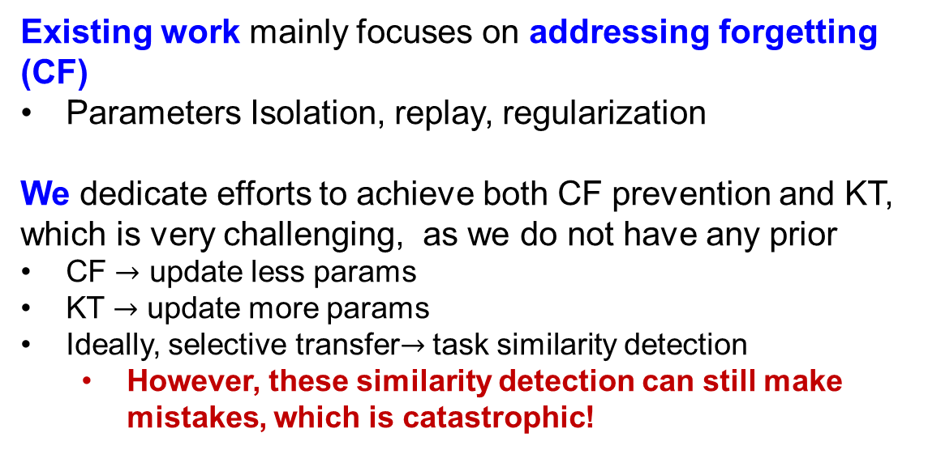
Continual Learning with Language Models: Existing Work
Existing work mainly focuses on addressing forgetting (CF)
Parameters Isolation, replay, regularization
We dedicate efforts to achieve both CF prevention and KT, which is very challenging, as we do not have any prior
CF $→$ update less params
KT $→$ update more params
Ideally, selective transfer$→$ task similarity detection
However, these similarity detection can still make mistakes, which is catastrophic!
Continual Learning (CL)
Accumulate learned knowledge
Adapt to new task
CF
KT
Can we get rid of the detection? Learn a good initialization for future/end tasks
(We focus on continual pre-training and end-task adaptation in this defense):
Preserve knowledge as much as we could (used as initialization for future/end task)
Update old knowledge only when necessary

Slide 15
Continual Learning with Language Models: Plan
Introduction
Continual Learning of Tasks, Domains and Classes
Challenges of Catastrophic Forgetting (CF), Knowledge Transfer (KT) and Task Separation
Existing work mainly focuses on addressing forgetting. My PhD effort dedicated to achieve both CF & KT (NeurIPS-20, 22, NAACL-21, EMNLP-21).
This presentation focuses on: Continual Learning with Language Models
Continual Pre-training (ICLR-2023)
Continual Adaptation for End-tasks (EMNLP-2023)
What could be the next?
Continual Learning (CL)
Accumulate learned knowledge
Adapt to new task
Packed with knowledge and excels in many tasks

Slide 16








Continual Pre-training
Continual (Domain-adaptive) Pre-training
Post-training / Pre-finetuning
(Our focus)
Pre-training
Restaurant
Phone
Camera
……
$$t$$
$$(t=0)$$
$$(t=1)$$
$$(t=2)$$
$$(t=3)$$
Huge amount of general data
Domain-specific data
Accessible
Continual Pre-training of Language Models, Ke et al., ICLR 2023

Slide 17
MLM Head
(A) Continual Pre-training
Add & Layer Norm
× L
+
First, we continually pre-trains a sequence of domains
FFN
Restaurant
Phone
Camera
Add & Layer Norm
+
Attention
Hidden States
(We use RoBERTa in this work)
Classification Head
(B) Individual Fine-tuning
Add & Layer Norm
× L
After (A), the performance is evaluated by end-tasks
Each end-task corresponding to one domain and has its own training and testing set. It is trained individually and will not affect the continual learning
+
End-tasks
FFN
ASC-Restaurant
Add & Layer Norm
+
ASC-Phone
Attention
ASC-Camera
Hidden States
ASC: Aspect Sentiment Classification

Slide 18
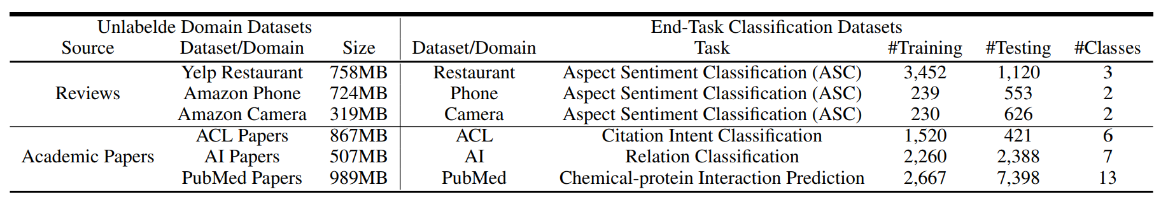
Continual Pre-training
6 domains
Continual Pre-training
Individual Fine-tuning
Continual Pre-training of Language Models, Ke et al., ICLR 2023

Slide 19
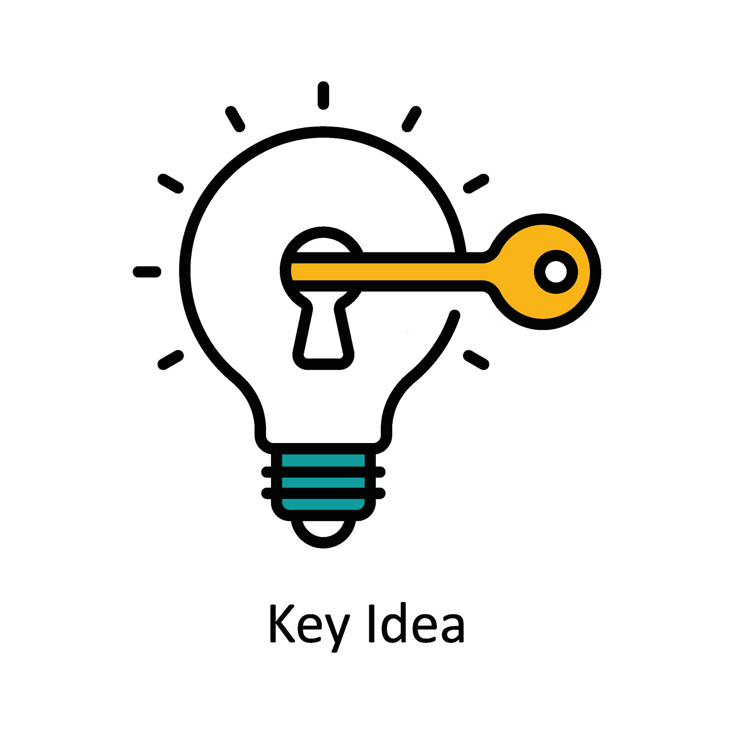
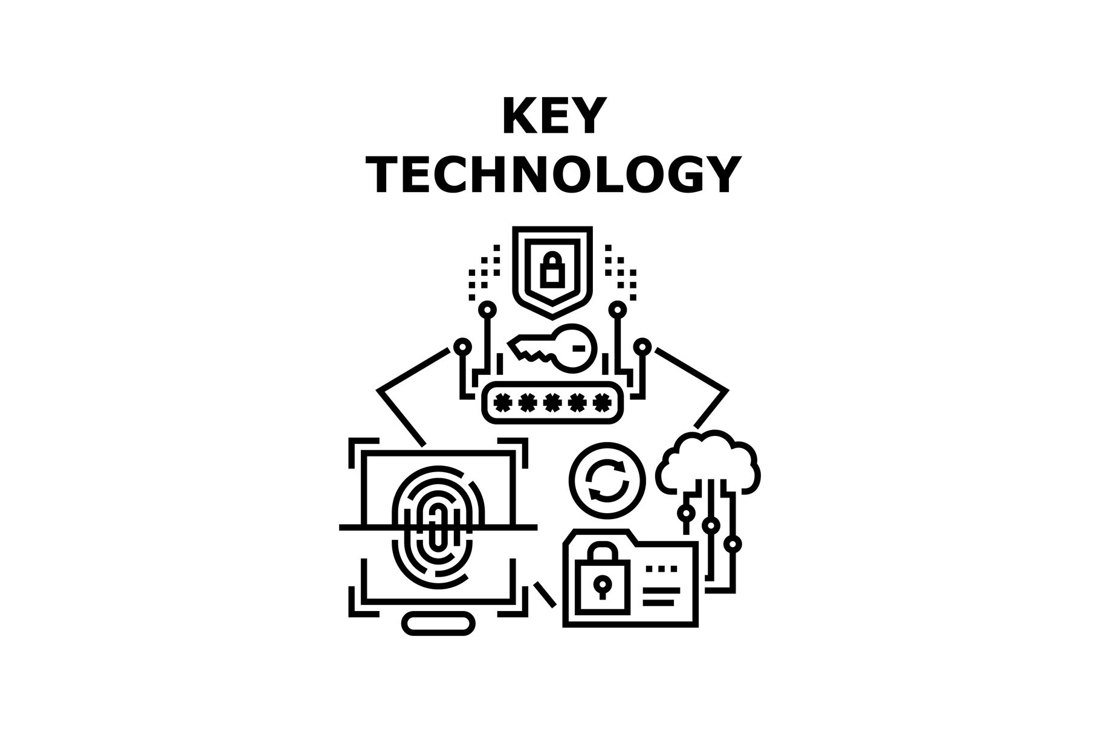

Continual Pre-training
Detect importance of units for general and domain knowledge
Soft-masking the important units in continual pre-training
$$t=1$$
No training
Importance Computation
How to detect importance of the two types of knowledge
How to convert the importance into soft-masks
Continual Pre-training
Soft-masking
Backward
Continual Pre-training of Language Models, Ke et al., ICLR 2023

Slide 20

Continual Pre-training
Goal: Compute the importance of units for general and domain knowledge
Why?
1) Not all units are important
2) Given the important units, we can protect them afterward
No training involved. We only need the importance
$$t=1$$
No training
Importance Computation
Continual Pre-training
Soft-masking
Backward
Continual Pre-training of Language Models, Ke et al., ICLR 2023

Slide 21
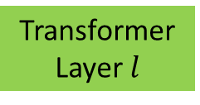
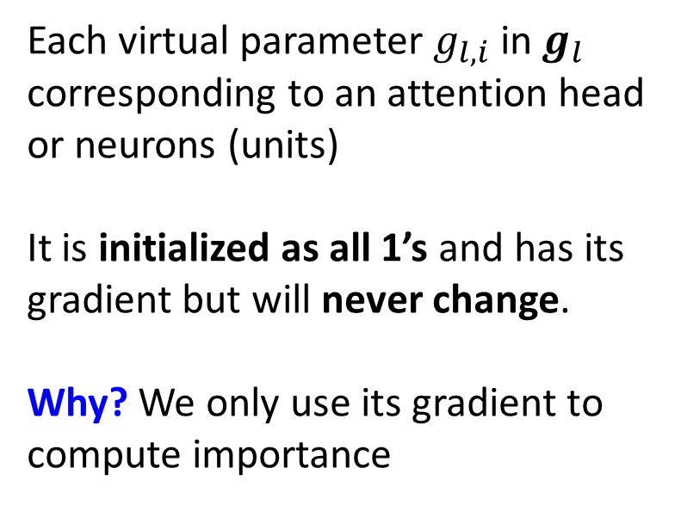
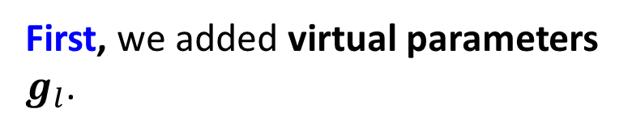

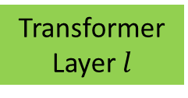

Importance Computation
First, we added virtual parameters $g_{l}$.
$$L_{MLM}$$
Each virtual parameter $g_{l,i}$ in $g_{l}$ corresponding to an attention head or neurons (units)
It is initialized as all 1’s and has its gradient but will never change.
Why? We only use its gradient to compute importance
Element-wise multiplication
…
…
× L
To compute the importance
…
× L
$$g_{l}$$
Transformer Layer $l$
Transformer Layer $l$
Forward
Forward
Continual Pre-training of Language Models, Ke et al., ICLR 2023
Notes:
We need this virtual parameters because there are different layers in Transformer

Slide 22





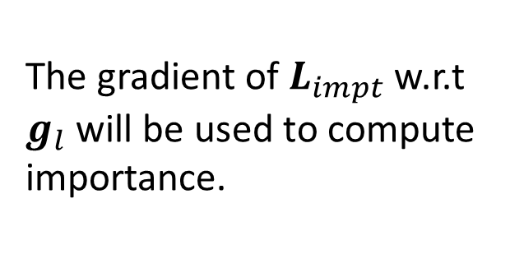
Importance Computation
(the loss for importance computation)
$$L_{MLM}$$
$$L_{impt}$$
…
The gradient of $L_{impt}$ w.r.t $g_{l}$ will be used to compute importance.
…
× L
…
To compute the importance
× L
$$g_{l}$$
Transformer Layer $l$
Transformer Layer $l$
Forward
Forward
Continual Pre-training of Language Models, Ke et al., ICLR 2023

Slide 23
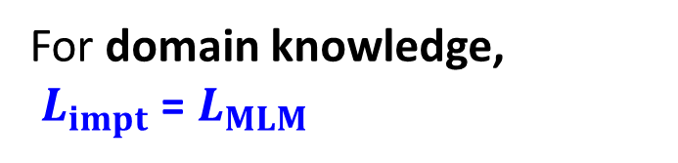
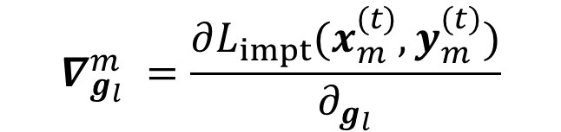
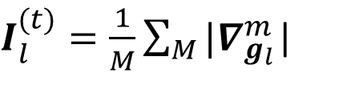
Importance Computation
For domain knowledge,
$L_{impt}$ = $L_{MLM}$
$$L_{MLM}$$
$$L_{impt}$$
…
…
$$∇_{g_{l}}^{m} =\frac{∂L_{impt}(x_{m}^{(t)},y_{m}^{(t)})}{∂_{g_{l}}}$$
× L
…
To compute the importance
× L
$$g_{l}$$
Transformer Layer $l$
Transformer Layer $l$
$I_{l}^{(t)}=\frac{1}{M}\sum_{M}{{|∇}_{g_{l}}^{m}}$|
Forward
Forward
Use absolute gradient to indicate importance*
*Are sixteen heads really better than one? Michel et al. NeurIPS, 2019.

Slide 24
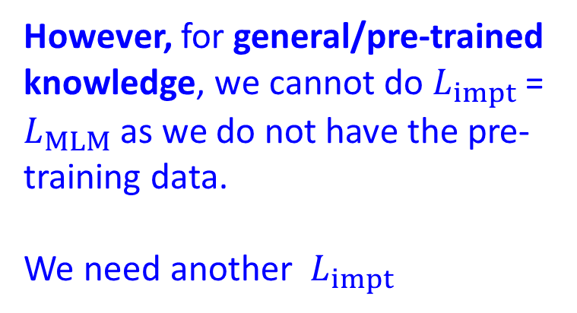
Importance Computation
For domain knowledge,
$L_{impt}$ = $L_{MLM}$
$$L_{MLM}$$
$$L_{impt}$$
…
…
However, for general/pre-trained knowledge, we cannot do $L_{impt}$ = $L_{MLM}$as we do not have the pre-training data.
We need another $L_{impt}$
× L
…
To compute the importance
× L
$$g_{l}$$
Transformer Layer $l$
Transformer Layer $l$
Forward
Forward
Michel et al. Are sixteen heads really better than one? NeurIPS, 2019.

Slide 25
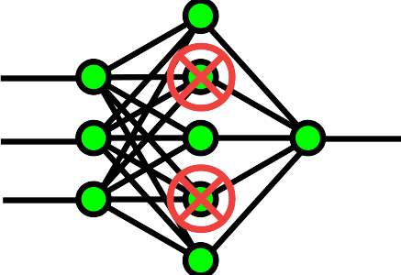


Importance Computation
Due to dropouts/randomness, same input will result in different output representations
Their distance indicates the robustness
Units that are important to the robustness
their changes will cause the pre-trained LM to change significantly
Units that are important to the pre-trained/general knowledge
So, the distance can be used as a proxy for general knowledge!
$$x_{m}$$
$$x_{m}$$
Continual Pre-training of Language Models, Ke et al., ICLR 2023

Slide 26






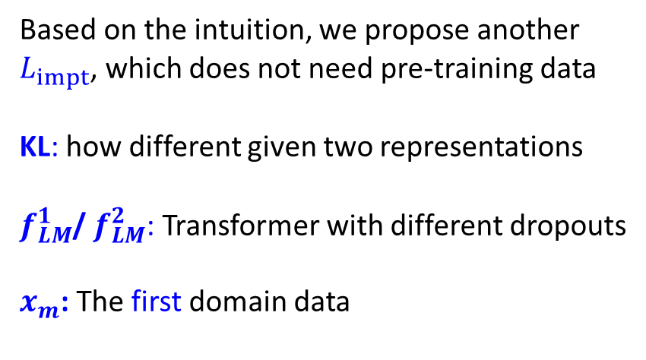

Importance Computation
$L_{impt}$ = KL($f_{LM}^{1}$($x_{m}$), $f_{LM}^{2}$($x_{m}$) )
Based on the intuition, we propose another $L_{impt}$, which does not need pre-training data
KL: how different given two representations
$f_{LM}^{1}$/ $f_{LM}^{2}$: Transformer with different dropouts
$x_{m}$: The first domain data
$$f_{LM}^{1}$$
× L
$$f_{LM}^{2}$$
Pre-trained LM
Pre-trained LM
× L
Transformer Layer $l$
Transformer Layer $l$
$$x_{m}$$
$$x_{m}$$
Continual Pre-training of Language Models, Ke et al., ICLR 2023

Slide 27




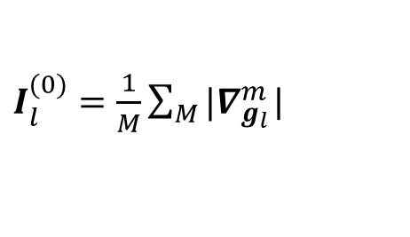



Importance Computation
$$L_{MLM}$$
For general knowledge,
$$L_{impt}$$
…
…
$L_{impt}$ = KL($f_{LM}^{1}$($x_{m}^{(1)}$), $f_{LM}^{2}$($x_{m}^{(1)}$) )
× L
× L
…
To compute the importance
$$g_{l}$$
$$∇_{g_{l}}^{m} =\frac{∂L_{impt}(x_{m}^{(1)})}{∂_{g_{l}}}$$
Transformer Layer $l$
Transformer Layer $l$
Forward
$I_{l}^{(0)}=\frac{1}{M}\sum_{M}{{|∇}_{g_{l}}^{m}}$|
Forward
Importance of units for general knowledge
Continual Pre-training of Language Models, Ke et al., ICLR 2023

Slide 28

Continual Pre-training
Goal: Soft-mask the gradient based on the importance
Why?
1) We need to protect them when training a new domain
2) We want to encourage knowledge transfer
No training
Importance Computation
$${{\{I}_{l}^{(k) }\}}_{k=1}^{t−1}$$
Soft-masking
Continual Pre-training
Backward
Continual Pre-training of Language Models, Ke et al., ICLR 2023

Slide 29








Soft-masking
First, we normalize the importance so that they are comparable
× L
$I_{l}^{(k)}=|Tanh(Norm(I_{l}^{(k)}$))|
make sure the importance is [0,1]
$$Normalize$$
EMax
$$∇_{l}$$
Second, we accumulate the importance
$${{\{I}_{l}^{(k) }\}}_{k=1}^{t−1}$$
$$1−I_{l}^{(⩽t−1)}$$
$I_{l}^{(⩽t−1)}=EMax(\{I_{l}^{(t−1)}$, $I_{l}^{(t−2)}$))
$${\hat{∇}}_{l}$$
Transformer Layer $l$
Next, we soft-mask the gradient (in backward pass)
$${∇′}_{l}=\left(1−I_{l}^{(⩽t−1)}\right)⊗∇_{l}$$
Backward
This only affects the backward pass
so forward KT and full LM are still possible
Not only provides protection, but also allow knowledge transfer
Continual Pre-training of Language Models, Ke et al., ICLR 2023

Slide 30

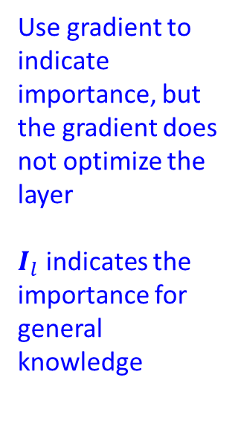


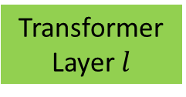

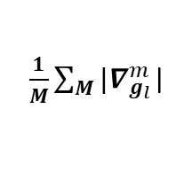











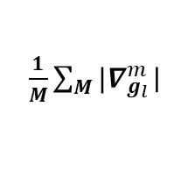









Importance Computation
Continual Learning
$$\text{KL}\text{(}f_{LM}^{1}\text{(}x_{m}^{(1)}\text{),} f_{LM}^{2}\text{(}x_{m}^{(1)}\text{) )}$$
$$L_{MLM}$$
$$L_{MLM}$$
KL loss as $L_{impt}$
…
…
$${\hat{o}}_{l}$$
$${\hat{o}}_{l}$$
…
$$g_{l}$$
$$g_{l}$$
$$o_{l}$$
$$o_{l}$$
Transformer Layer $l$
Transformer Layer $l$
Transformer Layer $l$
Forward
Forward
Use gradient to indicate importance, but the gradient does not optimize the layer
$I_{l}$ indicates the importance for general knowledge
Forward
$\frac{1}{M}\sum_{M}{{|∇}_{g_{l}}^{m}}$|
$$I_{l}^{(t)}$$
$\frac{1}{M}\sum_{M}{{|∇}_{g_{l}}^{m}}$|
$$I_{l}^{(0)}$$
EMax
$$∇_{l}$$
$$Normalize$$
$$∇_{gl}$$
$$∇_{gl}$$
X
$${{\{I}_{l}^{(k) }\}}_{k=1}^{t−1}$$
$$1−I_{l}^{(⩽t−1)}$$
X
$${\hat{∇}}_{l}$$
Transformer Layer $l$
Transformer Layer $l$
Transformer Layer $l$
Backward
Backward
Backward
Notes:
Normalized is actually there to make sure it is a probability

Slide 31

Restaurant | ACL | AI | Phone | PubMed | Camera | Average | Forgetting Rate
79.81 | 66.11 | 60.98 | 83.75 | 72.38 | 78.82 | 73.64 | ---
80.84 | 68.75 | 68.97 | 82.59 | 72.84 | 84.39 | 76.4 | ---
79.52 | 68.39 | 67.94 | 84.1 | 72.49 | 85.71 | 76.36 | 1.14
80.98 | 65.94 | 65.04 | 82.32 | 71.43 | 83.35 | 74.84 | 0.02
79 | 67.2 | 63.96 | 83.22 | 72.58 | 87.1 | 75.51 | 2.36
79.29 | 68.25 | 64.84 | 81.44 | 71.61 | 82.37 | 74.63 | -0.23
78.97 | 70.71 | 66.26 | 81.7 | 71.99 | 85.06 | 75.78 | -0.06
80.34 | 69.36 | 70.93 | 85.99 | 72.8 | 88.16 | 77.93 | -1.09
No continual pre-train
Non-Continual-learning
Individual continual pre-train
Naïve continual pre-training
EWC
SoTA continual learning baselines
DER++
HAT
BCL
CPS
w/o Post-trained < Individual Post-trained < CPS
post-training has been demonstrated to improve performance in the literature. CPS can further improve it
Regularization-based (KD, EWC) and replay-based (DER++) are worse
Only focus on CF is not enough
Naïve continual post-training has “+” FR, while CPS has “-” FR
NCL does have forgetting
CPS has positive knowledge transfer
Parameter-isolation (HAT) is worse
Full LM is needed
Continual Pre-training of Language Models, Ke et al., ICLR 2023
Notes:
Regularization-based methods (KD, EWC) and replay-based method (DER++) are all worse, indicating only focus on CF prevention is not enough
Parameter-isolation method (HAT) preforms much worse, again indicate the full LM is needed for domain-adaptive pre-training
Methods that tries to perform both KT and CF, they are all weaker than CPS
16.4K token for each domain

Slide 32
Camera | Phone | Restaurant | AI | ACL | PubMed | Average
78.82 | 83.75 | 79.81 | 60.98 | 66.11 | 72.38 | 73.64
84.39 | 82.59 | 80.84 | 68.97 | 68.75 | 72.84 | 76.4
83.62 | 82.71 | 80.19 | 60.55 | 68.87 | 71.68 | 74.6
82.79 | 80.08 | 80.4 | 67.76 | 68.19 | 72.35 | 75.26
86.86 | 83.08 | 79.7 | 69.72 | 69.11 | 72.69 | 76.86
84.91 | 83.46 | 80.88 | 69.1 | 69.89 | 72.77 | 76.84
81.98 | 81.87 | 81.12 | 64.04 | 63.18 | 69.46 | 73.61
88.52 | 85.47 | 81.83 | 71.99 | 71.01 | 73.65 | 78.74
What if only one domain in the sequence?
Soft-masking method is still effective!
No continual pre-train
MLM
MLM (Adapter)
MLM+KD
SoTA continual pre-training baselines
MLM+AdaptedDeiT
MLM+SimCSE
MLM+TaCL
DGA
w/o Pre-trained < MLM
Not surprising, as post-training has been demonstrated to improve performance in the literature.
MLM (Adapter) < MLM
Efficient tuning like adapter may not have sufficient trainable parameters for post-training
w/o Pre-trained < MLM < SoTA < DGA
DGA is better than pure MLM and SoTA post-training.
DGA can not only mitigate forgetting of the general knowledge but also adapt to suite the target domain
SoTA < DGA
SoTAs either only focus on preserving knowledge (KD), or adapting to the target domain, which are not enough
Adapting a Language Model While Preserving its General Knowledge. Ke et al., EMNLP 2022
Notes:
16.4K token for a domain

Slide 33

Continual Adaptation of Different Tasks
May or may not help each other (We do not have any prior)
Topic classification
Sentiment Analysis
Question Answering
$$(t)$$
Existing work focus on addressing forgetting
An implicit assumption: tasks are all dissimilar
However, tasks can be mixed, and we do not have any prior
We already known that task similarity detection is very challenging
Instead, we want to learn a good initialization for future tasks, by
Preserve knowledge as much as we could (used as initialization for future/end task)
Update old knowledge only when necessary
Soft-masking!
Notes:
The basic setting of RALM

Slide 34


Continual Adaptation of Different Tasks
Continual learning in different stages of LM can be very different!
Can we simply apply the soft-masking here?
Continual Pretrain
Finetune
Soft-masking helps preserve knowledge
Automatically use the appropriate knowledge
Soft-masking can preserve knowledge, but the system cannot find the appropriate knowledge to use
knowledge for different task is not separated!
Continual End-task Adaptation
Sub-network Discovery and Soft-masking for Continual Learning of Mixed Tasks, Ke et al., EMNLP 2023 (findings)
Notes:
The basic setting of RALM

Slide 35
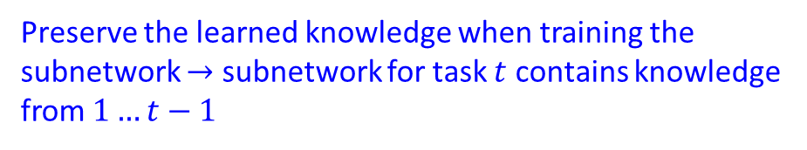
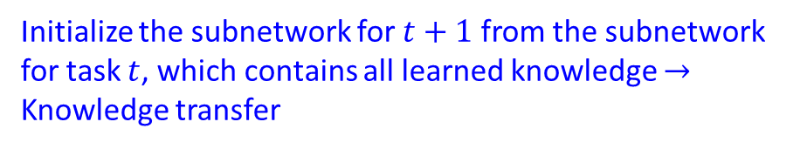
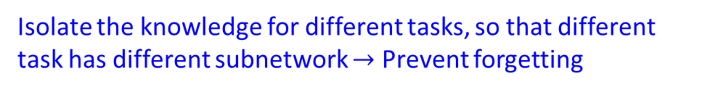

Continual Adaptation of Different Tasks
$$\text{Goal}\text{: }f:X T→Y$$
Can we modify it so that it can work here
Make use of the task-ID t to find the appropriate knowledge!
Subnetwork
Isolate the knowledge for different tasks, so that different task has different subnetwork $→$ Prevent forgetting
Preserve the learned knowledge when training the subnetwork $→$ subnetwork for task $t$ contains knowledge from $1…t−1$
Soft-masking
Initialize the subnetwork for $t+1$from the subnetwork for task $t$, which contains all learned knowledge $→$ Knowledge transfer
Initialization
Sub-network Discovery and Soft-masking for Continual Learning of Mixed Tasks, Ke et al., EMNLP 2023 (findings)
Notes:
The basic setting of RALM

Slide 36






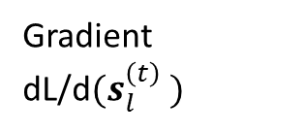








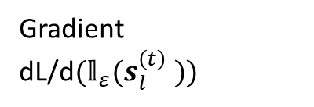
Subnetwork to Isolate the Knowledge
$$L_{CE}$$
Train the $s_{l}^{(t) }$ via straight-through trick
Only need to save ${\text{𝕝}}_{ε}\left(s_{l}^{\left(t\right) }\right)$ for a task $t$
…
× L
$$s_{l}^{(t) }$$
$${\text{𝕝}}_{ε}(s_{l}^{(t) })$$
$${\text{𝕝}}_{ε}(s_{l}^{(t) })$$
1.1
2.2
1
1
$$w_{l}^{adapter }$$
-1.7
3.6
0
1
$$s_{l}^{(t) }$$
$$w_{l}^{transformer }$$
Forward Propagation
+
× L
0.1
-0.1
0.1
-0.1
$$∇_{l}$$
Backward Propagation
$$w_{l}^{adapter }$$
-0.2
0.2
-0.2
0.2
$${\hat{∇}}_{l}$$
$$s_{l}^{(t) }$$
$$w_{l}^{transformer }$$
Gradient dL/d$(s_{l}^{\left(t\right) })$
Gradient dL/d$({\text{𝕝}}_{ε}(s_{l}^{\left(t\right) }))$
Backward Propagation
SupSup: Supermasks in superposition, Wortsman et al., NeurIPS 2020
Notes:
Identity function

Slide 37
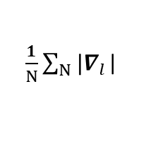


























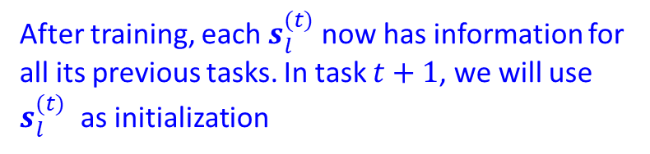
Soft-mask on Subnetwork
After training, each $s_{l}^{(t) }$now has information for all its previous tasks. In task $t+1$, we will use $s_{l}^{(t) }$ as initialization
$$L_{CE}$$
$$L_{CE}$$
…
…
× L
× L
$${\text{𝕝}}_{ε}(s_{l}^{(t) })$$
$${\text{𝕝}}_{ε}(s_{l}^{(t) })$$
$$w_{l}^{adapter }$$
$$w_{l}^{adapter }$$
$$s_{l}^{(t) }$$
$$w_{l}^{transformer }$$
$$s_{l}^{(t) }$$
$$w_{l}^{transformer }$$
Forward Propagation
Forward Propagation
× L
× L
$\frac{1}{N}\sum_{N}{{|∇}_{l}}$|
$$I_{l}^{(t)}$$
$$Normalize$$
$$I_{l}^{(⩽t−1)}$$
$$∇_{l}$$
$$∇_{l}$$
EMax
$$I_{l}^{(⩽t)}$$
$$1−I_{l}^{(⩽t−1)}$$
$$w_{l}^{adapter }$$
$$w_{l}^{adapter }$$
$$s_{l}^{(t) }$$
X
$${\hat{∇}}_{l}$$
$$∇_{l}$$
$$I_{l}^{(⩽t−1)}$$
$$s_{l}^{(t) }$$
$$w_{l}^{transformer }$$
$$w_{l}^{transformer }$$
Backward Propagation
Backward Propagation

Slide 38
ASC-19 | NER-5 | SUM-6 | CCD-5 | DRG-5
MF1 | F1 | R1 | MF1 | BLEU
92.28 | 63.33 | 39.39 | 90.57 | 25.29
85.55 | 59.33 | 39.07 | 91.07 | 24.14
88.05 | 34.56 | 22.86 | 81.86 | 8.68
88.73 | 28.75 | 18.65 | 83.24 | 7.99
87.45 | 50.16 | 35.21 | 89.85 | 20.98
85.83 | 58.93 | 38.23 | 90.66 | 24.71
45.79 | 35.24 | 17.44 | 36.62 | 10.21
90.61 | 62.13 | 38.29 | 90.70 | 24.56
Non-CL baselines
Multi-task learning
Independent
Naïve CL
EWC
A sequence of 40 tasks. Each task has different metrics, so we report the results separately
SoTA CL baselines
HAT
SupSup
CAT
TSS
ASC, NER: consisting of similar tasks as the tasks share similar labels (but from different)
Goal: CF prevention and KT
SUN, CCD, DRG: consisting of dissimilar tasks as the distribution shift across tasks is relatively large,
Goal: little or no CF
SoTA < TSS
Not surprising, as post-training has been demonstrated to improve performance in the literature.
CAT < TSS
DGA is better than pure MLM and SoTA post-training.
DGA can not only mitigate forgetting of the general knowledge but also adapt to suite the target domain
Sub-network Discovery and Soft-masking for Continual Learning of Mixed Tasks, Ke et al., EMNLP 2023 (findings)
Notes:
16.4K token for a domain

Slide 39
Continual Learning with Language Models: Plan
Introduction
Continual Learning of Tasks, Domains and Classes
Challenges of Catastrophic Forgetting (CF), Knowledge Transfer (KT) and Task Separation
Existing work mainly focuses on addressing forgetting. My PhD effort dedicated to achieve both CF & KT (NeurIPS-20, 22, NAACL-21, EMNLP-21).
This presentation focuses on: Continual Learning with Language Models
Continual Pre-training (ICLR-2023)
Continual Adaptation for End-tasks (EMNLP-2023)
What could be the next?
Continual Learning (CL)
Accumulate learned knowledge
Adapt to new task
Packed with knowledge and excels in many tasks

Slide 40
Continual Learning with Language Models: Future
A more ambitious vision is to make LLMs fully autonomous, which requires LLMs to self-initiate and adapt to new circumstances, so that the AI system can independently acquire new knowledge.
Accumulate learned knowledge
Adapt to new task
Our Vision: humans are intrinsically motivated by novelty to learn; same principle can also apply to AI system!

Slide 41
Continual Learning with Language Models: Example
User: Finish the sentence in Vincent’s tone
System: Sorry, I didn't fully understand, do you mean:
Option-1: Vincent as the artist Vincent Van Gogh?
Option-2: Any specific person called Vincent? It would be good if you could provide more information
In this example, the system
Encounters a novel prompt (i.e., novelty) that the agent does not understand or there is ambiguity
Identifies which aspects it understands, or which aspect is challenging (i.e., characterization)
Adapts by posing questions or offering choices (i.e., adaptation)
Accumulate learned knowledge
Adapt to new task
Notes:
What would be the possible framework to achieve this?

Slide 42
Continual Learning with Language Models: Framework
Continual Learner to detect novelty (if the input is normal, it can simply give output to the application)
Relevance detection to check whether the novelty is relevant to the task it is focused on
Characterization to identifying understandable and unclear parts
Planner to generate a strategy for responses, e.g., asking questions to user
Feedback needs to be continually integrated
Knowledge base may be needed to augment and retain essential knowledge
Normal
Continual Learner
Novel
Relevance Detection
Retained
Augmented
Relevance
Knowledge Base
Characterization
Feedback
Planner
Application
Notes:
Could be more, e.g., risk control
Novelty implies uncertainty in adapting to the novel situation. In making each response decision, risk needed to be assessed.

Slide 43
Continual Learning with Language Models: Framework
Most existing works are dedicated to the black part, which includes active research areas like LLMs and Continual Learning.
The other components remain largely unexplored!
To name a few:
Application: CL in different stages of LLM lifecycle (active research!)
Streaming CL with no task boundary
Novelty Detection
…
Normal
Continual Learner
Novel
Relevance Detection
Retained
Augmented
Relevance
Knowledge Base
Characterization
Feedback
Planner
Application

Slide 44
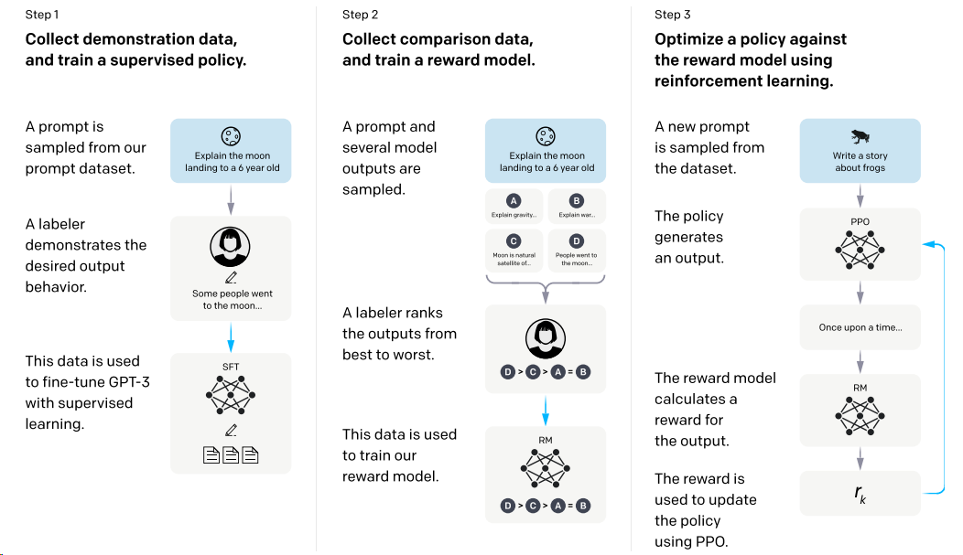
CL in Different Stages of LLM Lifecycle
InstructGPT: Training language models to follow instructions with human feedback,
Ouyang et al., 2022,
Stay closed to supervised model (i.e., CL)
Total reward
Tradeoff parameters
Notes:
Existing Assumption

Slide 45
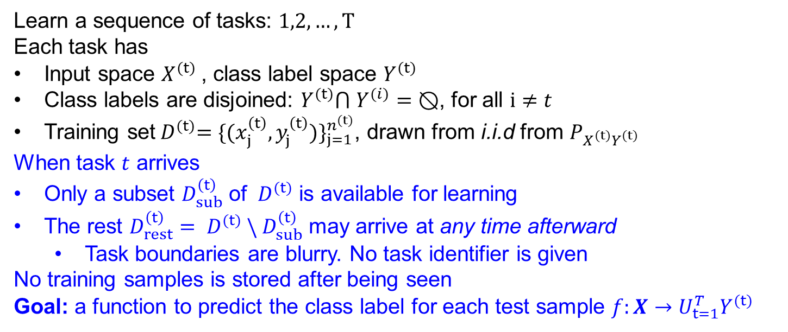

Streaming CL with No Task Boundary
ATM Support
Age Limit
ATM Support
Time step
Classes (Intent)
from Banking77 Dataset
Payment Charged
Learn a sequence of tasks: $1,2,…, T$
Each task has
Input space $X^{(t)}$, class label space $Y^{(t)}$
Class labels are disjoined: $Y^{(t)}$⋂ $Y^{(i)}=⦰$, for all $i≠t$
Training set${ D}^{(t)}={\{{(x}_{j}^{\left(t\right)},y_{j}^{\left(t\right)})\}}_{j=1}^{n^{(t)}}$, drawn from i.i.d from $P_{X^{(t)}Y^{(t)}}$
When task $t$ arrives
Only a subset $D_{sub}^{\left(t\right)}$ of ${ D}^{(t)}$ is available for learning
The rest $D_{rest}^{\left(t\right)}={ D}^{(t)} \backslash { D}_{sub}^{\left(t\right)}$ may arrive at any time afterward
Task boundaries are blurry. No task identifier is given
No training samples is stored after being seen
Goal: a function to predict the class label for each test sample $f:X→U_{t=1}^{T}Y^{(t)}$
Challenges:
Prevent catastrophic forgetting
Encourage knowledge transfer across tasks
Forward: old $→$ new
Backward: new $→$ old
Notes:
The basic setting of RALM

Slide 46
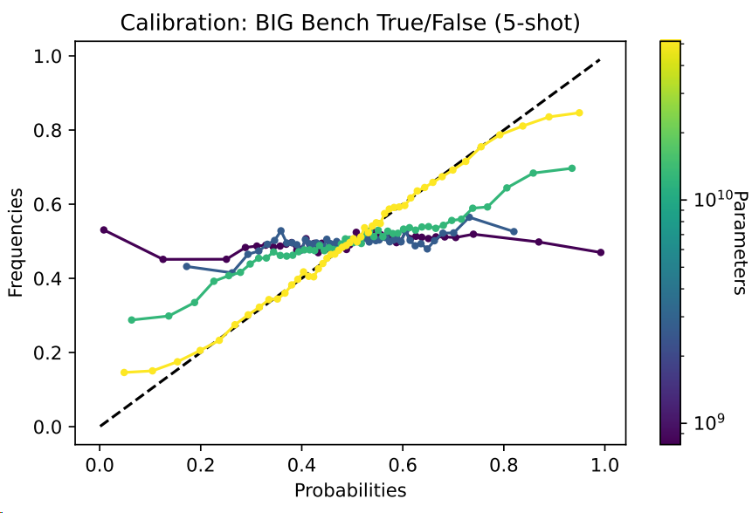
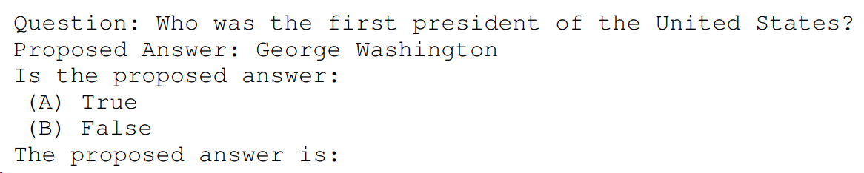
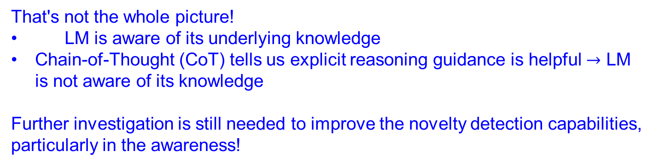
Novelty Detection
The 52B model is very well calibrated $→$ LLM knows what they know
That's not the whole picture!
LM is aware of its underlying knowledge
Chain-of-Thought (CoT) tells us explicit reasoning guidance is helpful $→$ LM is not aware of its knowledge
Further investigation is still needed to improve the novelty detection capabilities, particularly in the awareness!
Language Models (Mostly) Know What They Know, Kadavath et al., 2022
Notes:
Existing Assumption

Slide 47

Continual Learning with Language Models
Active Research
Continual Learning (CL)
Ambitious goal
Fully autonomous AI

Slide 48
Publications (2020-)
[1]: Bridging the Preference Gap between Retrievers and LLMs. Ke et al., arXiv 2024 (Under Review)
[2]: Continual Learning over Black-box LLM , ..., Z Ke, ..., 2024 (Under Review)
[3]: Continual Pre-training of Language Models. Ke et al., ICLR 2023
[4]: Parameter-Level Soft-Masking for Continual Learning. T Konishi, ..., Z Ke, ... ICML 2023
[5]: A theoretical study on solving continual learning. G Kim, ..., Z Ke, ..., NeurIPS 2023
[6]: Sub-network Discovery and Soft-masking for Continual Learning of Mixed Tasks. Ke et al., EMNLP 2023 (findings)
[7]: Continual learning of natural language processing tasks: A survey. Z Ke and B Liu. arXiv 2022
[8]: Continual training of language models for few-shot learning. Ke et al., EMNLP 2022
[9]: Adapting a Language Model While Preserving its General Knowledge. Ke et al., EMNLP 2022
[10]: Partially Relaxed Masks for Knowledge Transfer Without Forgetting in Continual Learning. T Konishi, ..., Z Ke, ..., ECML 2022
[11]: Domain-aware contrastive knowledge transfer for multi-domain imbalanced data. Ke et al., ACL-Workshop 2022
[12]: A multi-head model for continual learning via out-of-distribution replay. G Kim, ..., Z Ke. Collas 2022
[13]: Achieving forgetting prevention and knowledge transfer in continual learning. Ke et al., NeurIPS 2021
[14]: Adapting BERT for continual learning of a sequence of aspect sentiment classification tasks. Ke et al., EMNLP 2021
[15]: CLASSIC: Continual and contrastive learning of aspect sentiment classification tasks. Ke et al., EMNLP 2021
[16]: Continual learning with knowledge transfer for sentiment classification. Ke et al., ECML 2020
[17]: Continual learning of a mixed sequence of similar and dissimilar tasks. Ke et al., NeurIPS 2020
Notes:
Existing Assumption

Slide 49

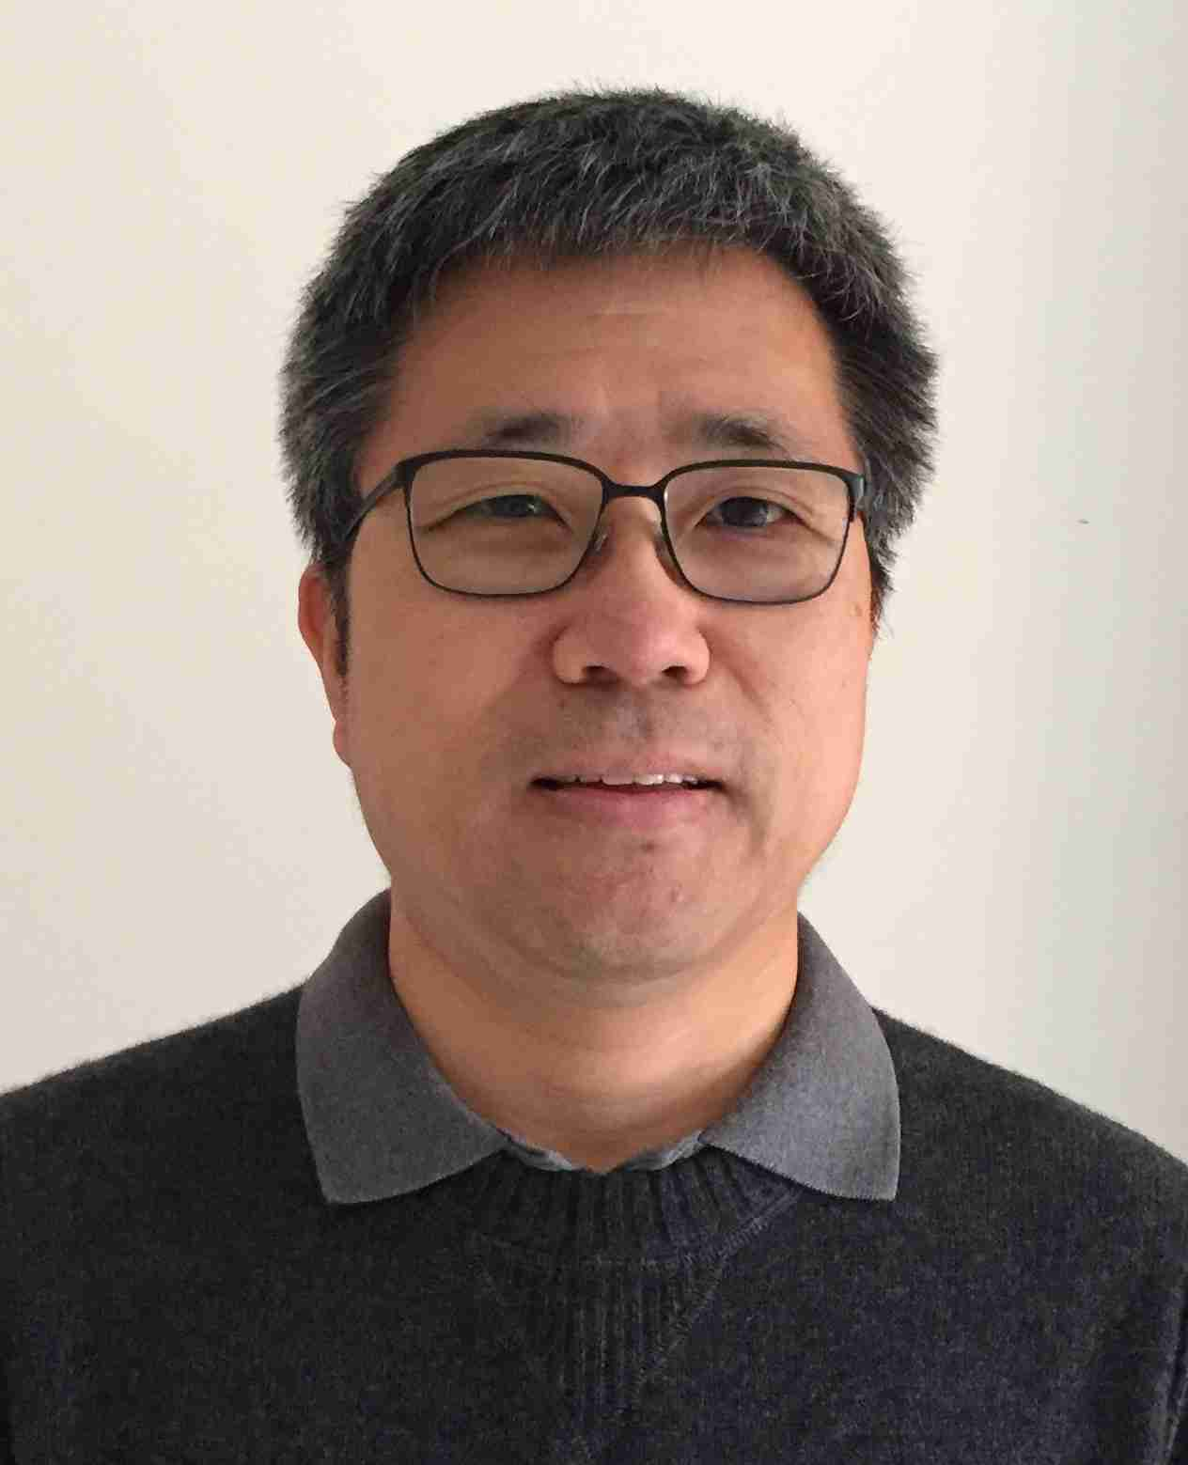

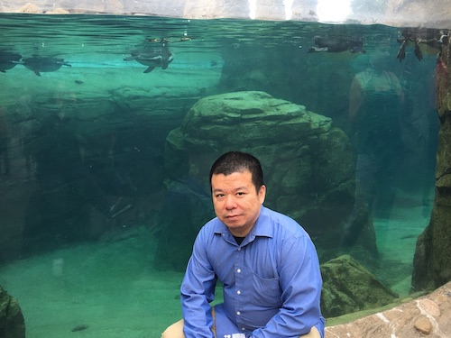
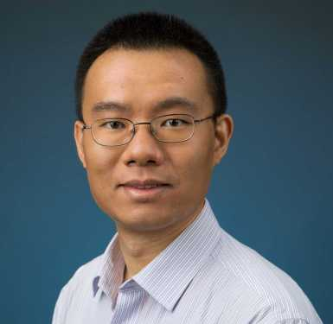
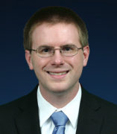
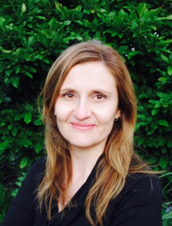
More than 1k emails exchanged since 2019!!!
Without his guidance, I wouldn‘t have learned about continual learning, foundation and application research, how to write a paper, how to craft a rebuttal, or how to deliver a academic/job talk... I also wouldn't have had the opportunity to collaborate with amazing people like Hu Xu, Lei Shu, and undergraduates from PKU…
In 2020-2021, we had a very close collaboration. Back in late 2020, before the advent of GPT-3, when 'LLM' was commonly understood as 'Master of Laws (Legum Magister)', he, as a visionary, introduced me to the concept of Large Language Models and their pre-training. The subsequent rise of clearly proved his amazing foresight.
We had some casual conversations before the pandemic and recently, a 1.5-hour farewell discussion. The advice on career and research was really helpful! I wish I had talked with you earlier and more frequently!
Thank you for serving as a committee member for both my preliminary exam and defense!
Notes:
Please add some potential question section

Slide 50
------------------- DO NOT READ BELOW ------------------
Notes:
Please add some potential question section

Slide 51

Continual Learning with LLMs
How to adapt the LLM?
So that without forgetting and transfer knowledge?
We focus on pre-training and end-task adaptation stage
Emerging domains/events/topics/information/…
Notes:
So the question is how to adapt the LLM in such a dynamic world.
My research has been focused on this question and mainly on two directions.

Slide 52
Continual Learning with LLMs: Plan
Continual Pre-training
Continual Adaptation for End-task
Continual Adaptation for different Tasks
Future Work
How to adapt the LLM?
So that without forgetting and transfer knowledge?
Continual Learning over black box LLMs, Under Review
Adapting a Language Model While Preserving its General Knowledge, Ke et al, EMNLP 2022
Notes:
Table of content

Slide 53

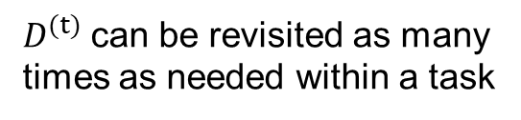
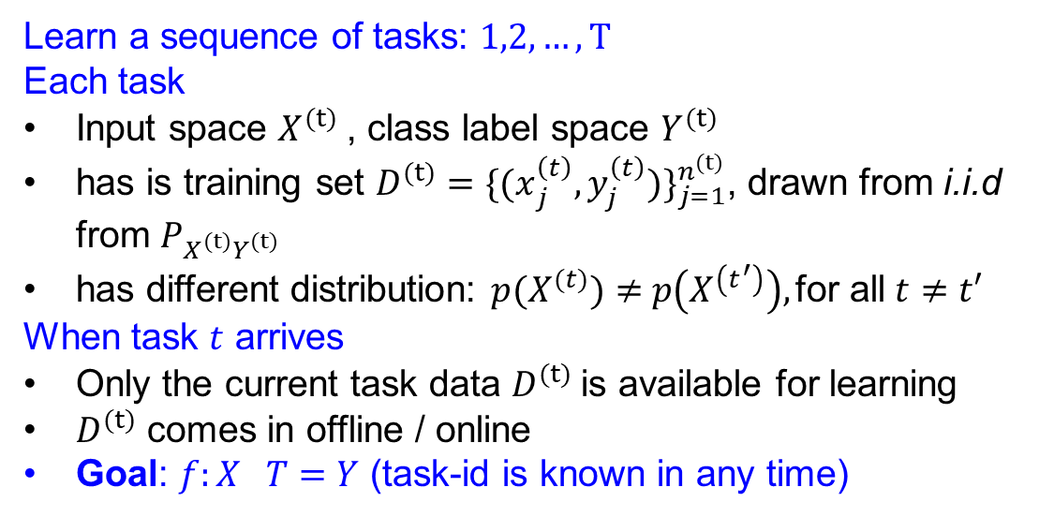
Continual Adaptation of Different Tasks
May or may not help each other (We do not have any prior)
Topic classification
Sentiment Analysis
Question Answering
Task
from CCD Dataset
$$(t)$$
……
Task-incremental Learning
Learn a sequence of tasks: $1,2,…, T$
Each task
Input space $X^{(t)}$, class label space $Y^{(t)}$
has is training set $D^{(t)}={\{{(x}_{j}^{\left(t\right)},y_{j}^{\left(t\right)})\}}_{j=1}^{n^{(t)}}$, drawn from i.i.d from $P_{X^{(t)}Y^{(t)}}$
has different distribution: $p(X^{(t)})≠$ $p\left(X^{\left(t^{′}\right)}\right),\text{for} \text{all} t≠t′$
When task $t$ arrives
Only the current task data $D^{(t)}$is available for learning
$D^{(t)}$ comes in offline / online
Goal: $f:X T=Y$ (task-id is known in any time)
offline
$D^{(t)}$can be revisited as many times as needed within a task
Samples can only be visited once
online
Notes:
can be revisited as many times as needed within a task (offline setting)

Slide 54
Lifecycle of LLMs
Emerging information
Input: Who is the prime minster of the UK
Output: Boris Johnson
Correction: Rishi Sunak
Emerging Task/Domain/Class
Emerging preference/values
Emerging domains
Input: Where does new crust come from in sea floor spreading
Output: volcanic activity
LLM editing
Input: Please generate the instruction to make a bomb
Output: Sorry, I cannot help
Input: Extract facts from the following text:
Messi relocated to Spain from Argentina aged 13 to join Barcelona
Output: Barcelona, located in Spain
A LLM that packed with knowledge and excels in many tasks
Emerging domains
Input: Messi relocated to Spain from ___
Output: Argentina aged 13 to join Barcelona
End-task Adaptation
We want
transfer knowledge within and across stages;
without forgetting the knowledge already learned
Alignment (e.g., RLHF)
We keep adapting the LLM in its lifecycle, both within each stage and across different stages
Instruction-Tuning
Pre-training
Notes:
Existing Assumption

Slide 55
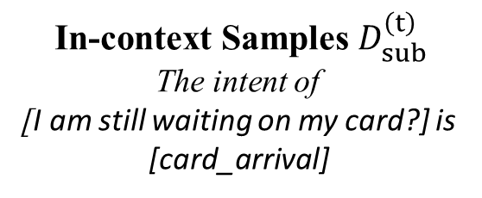
Continual Adaptation of Different Classes
ATM Support
Age Limit
ATM Support
Classes (Intent)
from Banking77 Dataset
Payment Charged
Time step
LLM as API
Instruction (fixed)
Please classify the intent of the following query
[Are cards available in the EU?]
API
LLMs
[Country_support]
In-context Samples $D_{sub}^{\left(t\right)}$
The intent of
[I am still waiting on my card?] is
[card_arrival]
Notes:
The basic setting of RALM

Slide 56
Continual Adaptation of Different Classes
ATM Support
Age Limit
ATM Support
Classes (Intent)
from Banking77 Dataset
Payment Charged
Time step
Existing CL has not considered the black-box LLM (API) setting
A common belief: parameter updates in response to new samples cause forgetting
However, in black-box LLM setting, no parameters are ever updated, presenting a unique challenge and perspective
Notes:
The basic setting of RALM

Slide 57
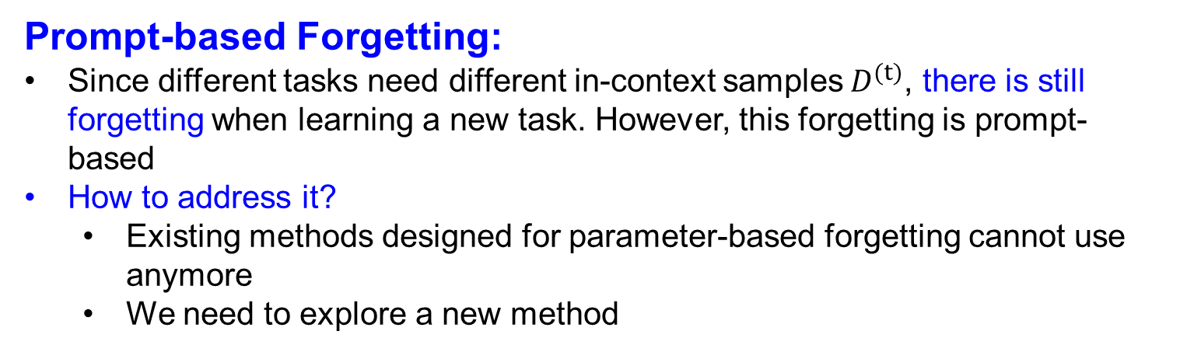
Continual Adaptation of Different Classes
ATM Support
Age Limit
ATM Support
Classes (Intent)
from Banking77 Dataset
Payment Charged
Time step
Prompt-based Forgetting:
Since different tasks need different in-context samples$D^{(t)}$, there is still forgetting when learning a new task. However, this forgetting is prompt-based
How to address it?
Existing methods designed for parameter-based forgetting cannot use anymore
We need to explore a new method
Notes:
The basic setting of RALM

Slide 58









Continual Adaptation of Different Classes
ATM Support
Age Limit
ATM Support
Classes (Intent)
from Banking77 Dataset
Payment Charged
Time step
Current Time Step
New data from new class $i$(e.g., payment charged)
$$D_{sub,i}^{(t)}$$
Reflector
Knowledge extracted from $D_{sub,i}^{(t)}$
We save the knowledge, rather than the in-context samples!
New data from old class $j$ in previous task $p$ (e.g., ATM Support)
$$D_{new,j}^{(p)}$$
Updator
$$s_{i}^{(t)}$$
Updated knowledge from $D_{new,j}^{(p)}$
$$s_{j}^{(p)}$$
$${\hat{s}}_{j}^{(p)}$$
Knowledge
Base
Notes:
The basic setting of RALM

Slide 59









Continual Adaptation of Different Classes
All the components are achieved by prompting the LLM
We use “summary” as the knowledge
Current Time Step
Training
Reflector
$$D_{sub,i}^{(t)}$$
I will present you with several examples from the same class…please provide a summary of the class.. Example: […]
Reflector
$$D_{new,i}^{(p)}$$
Updator
Updator
$$…$$
Below is the original summary of a class. I will now provide m additional examples within this class …please update the summary accordingly Original Summary: […]; Additional Example: […]
$$s_{j}^{(p)}$$
$${\hat{s}}_{j}^{(p)}$$
Knowledge
Base
Testing
$${{U_{j}^{T}\{s}_{i}^{(j)}\}}_{i=1}^{n_{j}}$$
Solver
Please classify the provided test sample into one of the listed classes based on the summaries provided for these classes. Test sample: […]; Listed summaries: […]
$$x$$
Solver
$$a$$
$$M_{s}$$
Notes:
The basic setting of RALM

Slide 60

Banking-26 | CLINIC-30 | SmallTalk-14 | Meta-14
83.37 | 90.63 | 94.60 | 79.44
85.29 | 89.93 | 94.76 | 82.30
83.53 | 87.70 | 95.32 | 79.37
86.22 | 89.59 | 94.60 | 83.25
86.31 | 89.15 | 94.37 | 73.65
13 tasks, 2 classes per task
Non-blurry
3 samples per class per task
7 samples per class per task
3 samples used when the task first comes
4 samples per class randomly appear later
ISIS (Blurry)
Non-blurry
4 samples per class per task
ISIS (Blurry)
7 samples per class per task
4 samples used when the task first comes
3 samples per class randomly appear later
Non-blurry
7 samples per class per task
ISIS has almost no forgetting
ISIS (Blurry) is very closed to the Non-blurry with 7 samples per class per task
Additional data does help improve the performance
ISIS (Blurry) better then Non-blurry with the same number per class per task. This also indirectly indicate that forgetting is very small
Such “Class-incremental” used to be very difficult. With LLM and its summarization ability, this becomes much easier.
Continual Learning over black box LLMs, Under Review
Notes:
16.4K token for a domain

Slide 61


Continual Learning with LLMs: if we have data…
How to adapt the LLM?
So that without forgetting and transfer knowledge?
LLMs
External Memory
Tool
Main idea: integrating fresh, external information to the LLMs without retraining the LLMs
(no need to worry about the LLMs’ parameters)
Notes:
One way is to fix the LLM. This can be achieved by retrieval-augmented or tool-augmented.
My work focus on the retrieval-augmented

Slide 62
Lifecycle of LLMs
Input: Messi relocated to Spain from ___
Output: Argentina aged 13 to join Barcelona
Input: Extract facts from the following text:
Messi relocated to Spain from Argentina aged 13 to join Barcelona
Output: Barcelona, located in Spain
Input: Please generate the instruction to make a bomb
Output: Sorry, I cannot help
Input: Where does new crust come from in sea floor spreading
Output: volcanic activity
Instruction-Tuning
Alignment (e.g., RLHF)
End-task Adaptation
Pre-training

Slide 63

Lifecycle of LLMs
How to train
Never stop
CL naturally to adapt
My focus
Alternative
Future
….
Need to be technical deeper
Packed with knowledge and excels in many tasks
Once trained, LLMs are fixed
Notes:
Existing Assumption

Slide 64
Lifecycle of LLMs
Input: Messi relocated to Spain from ___
Output: Argentina aged 13 to join Barcelona
Input: Extract facts from the following text:
Messi relocated to Spain from Argentina aged 13 to join Barcelona
Output: Barcelona, located in Spain
Input: Please generate the instruction to make a bomb
Output: Sorry, I cannot help
Input: Where does new crust come from in sea floor spreading
Output: volcanic activity
Instruction-Tuning
Alignment (e.g., RLHF)
End-task Adaptation
Pre-training

