Slide 1
DEVOPS
General concepts

Slide 2
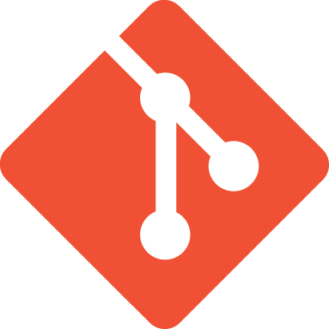
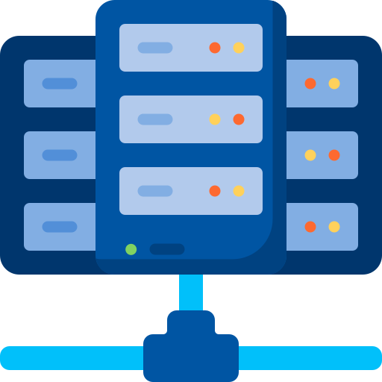
« traditional » software teams organisation
Development
Operations
Source code
Data center
Releases
Bugs tickets
Produce code and software releases
Master backend / frontend languages
Work on regular hours
Know their repositories in depth
Run and monitor the company software
Scripting for automation & tooling
24/7 incident response
Know all the company functionalities

Slide 3
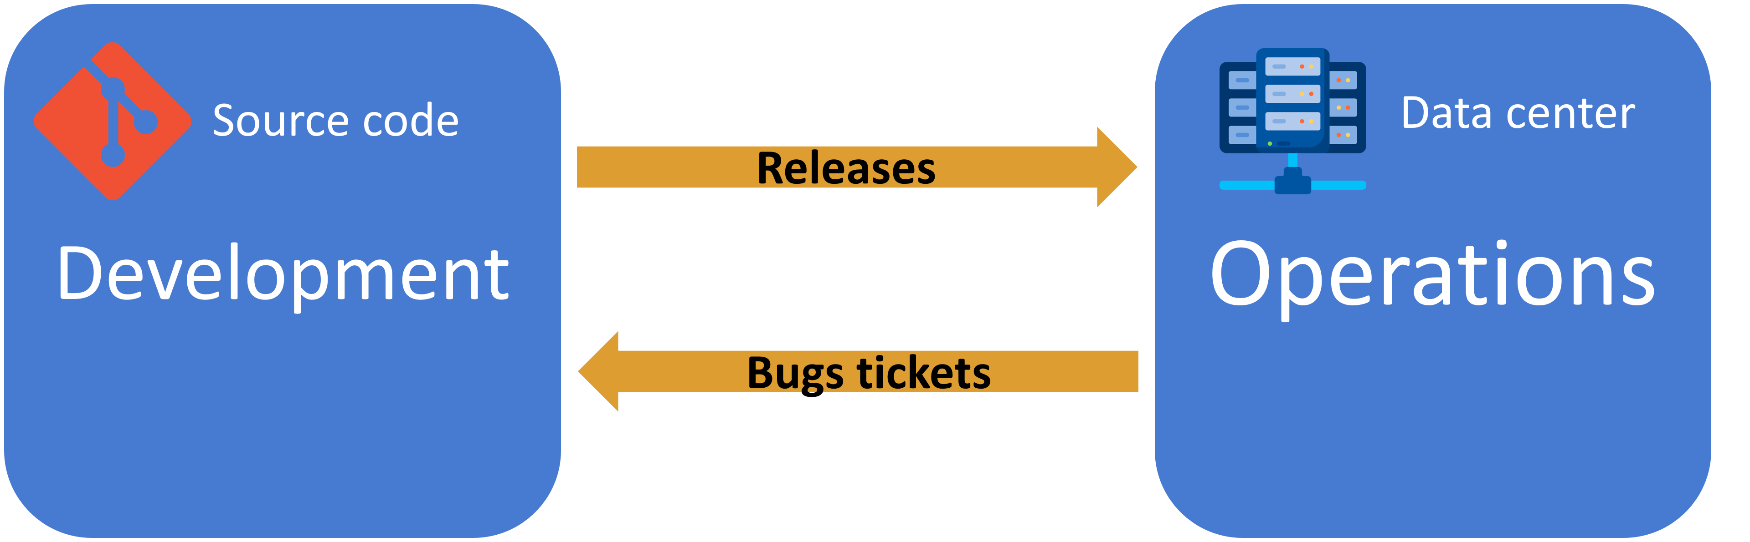
Critique
Highly specialized teams
Hard communication
  Different team culture (not the same daily job)
  Different location (they never see each other)
Not empowering the teams
  teams are not accountable for the whole solution success (Not my fault!)
Lack of transparency from each side
  Ops don’t exactly know what code they operate, Devs don’t exactly know how the software behaves in prod
  Leads to a weak solution quality

Slide 4

DEVOPS teams organisation
You run what you build
One devops team per functionality domain:
  Ex: payment, catalog, …
Ops outcome is relevant to improve the app
  Ex: performance metrics and logs are accessible by the developers
Dev outcome with ease of operations in mind
  Ex: security logs implemented

Slide 5
Critique
Larger scope / shallower knowledge
  Coding, testing, CI/CD, docker, Kubernetes, …
  Tend to rely on Open Source software and tools
  Encourage automation
The team must be UP 24/7
  At least 1 person at a time
Enhanced solution quality & security
  Short feedback to the dev team
  Fast release cycle
  The bugfix can come in prod before the customer sees the bug! 🪲

Slide 6
Everything as code
GIT is the de-facto tool for organizing the devops teams activity:
Traceability
History
Code reviews
Possible revert
Any text file could be managed with GIT
Source code & dependencies
Documentation (README.md, markdown format)
API specification (YAML or JSON format)
Cloud resources description (Infrastructure as code) (Using Terraform tool)
Git, at the center of Devops process

Slide 7



devops typical products
Media streaming
Cloud provider
E-commerce

Slide 8
devops tech stack
Modern (2024) programming language (do more in less time) ➡️ Golang & Javascript
Web Frameworks ➡️ React, VueJS, SolidJS, HTMX
Packaging the app ➡️ Docker
Managing the app ➡️ Kubernetes
Automation for CI/CD ➡️ GitHub Actions

Slide 9
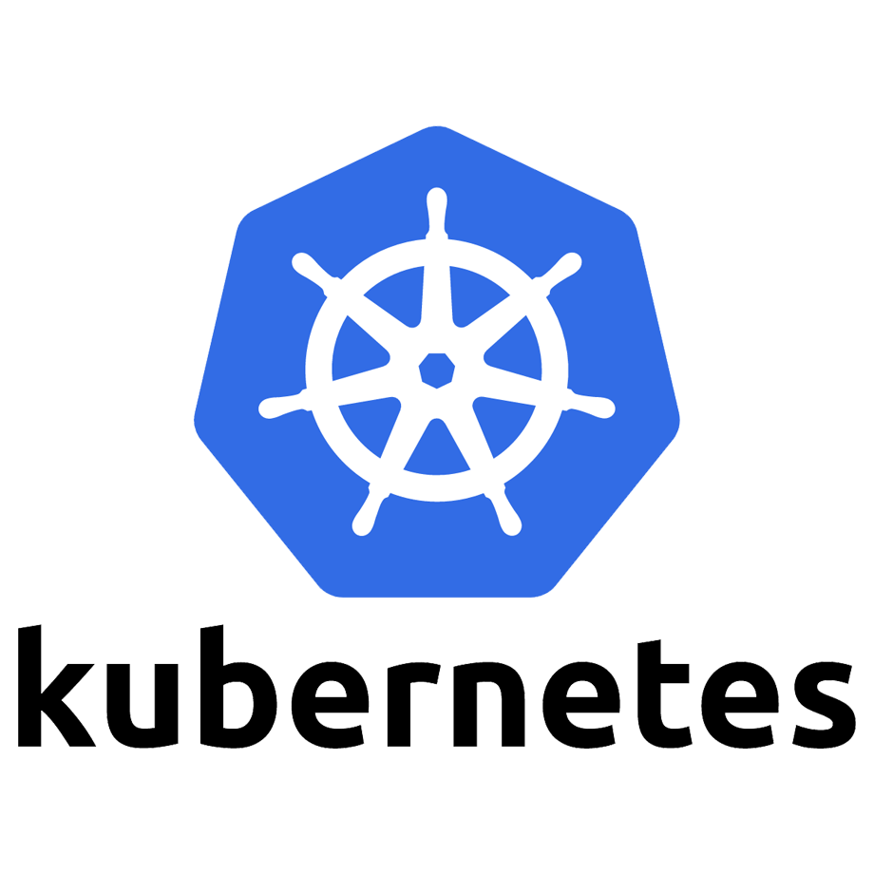





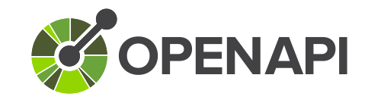
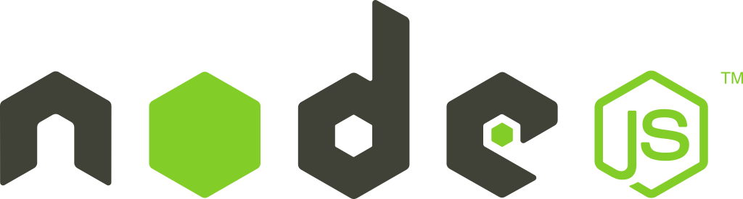




devops tech stack

Slide 10
Our journey into devops
Work on a basic Golang web server (language, build, run, test)
REST API specification with OpenAPI v3 and its UI
Learning Docker to package, distribute and run the app
Leverage GitHub Actions to automate all into a CI/CD pipeline

